Slide 1
The Capital Asset Pricing Model
P.V. Viswanath
For a First Course in INvestments

Slide 2
Learning Goals
What are the assumptions of the CAPM?
What are the implications of the CAPM?
What happens if we relax the assumptions of the CAPM?
Is the CAPM testable in principle?
What are some of the extensions of the CAPM?

Slide 3
Risk and Return
Earlier, we considered how to construct portfolios of risky assets, given their expected returns and their variance-covariance structure.
However, the expected returns of assets and their variance-covariance structure are not independent characteristics.
In equilibrium, the two are related.
It is important to know how these are related in order to identify mispriced assets and in order to evaluate portfolios.
The Capital Asset Pricing Model is one model that explains the connection between expected asset returns and their second moments.

Slide 4
Assumptions
There are many small investors in the economy
All investors have a single period horizon
Investors can only invest in a universe of publicly traded financial assets, including risk-free borrowing and lending – there is no possibility of investing in human capital, private enterprises etc.
There are no taxes or transactions costs.
All investors are mean-variance investors.
All investors have the same information and they analyze investments in the same way.

Slide 5
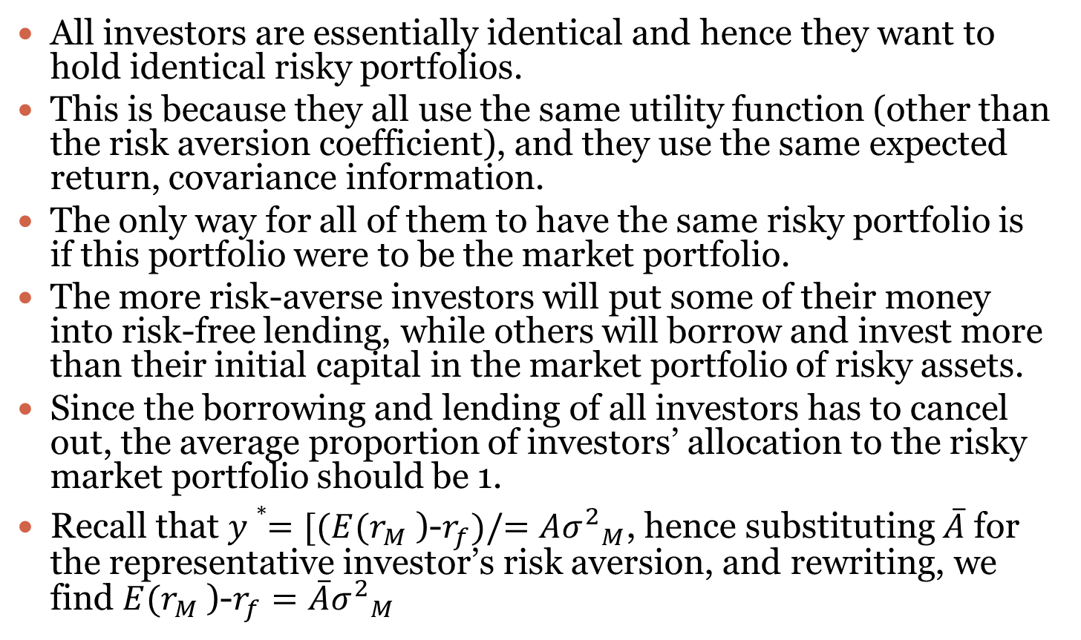
How do we get the CAPM from the assumptions
All investors are essentially identical and hence they want to hold identical risky portfolios.
This is because they all use the same utility function (other than the risk aversion coefficient), and they use the same expected return, covariance information.
The only way for all of them to have the same risky portfolio is if this portfolio were to be the market portfolio.
The more risk-averse investors will put some of their money into risk-free lending, while others will borrow and invest more than their initial capital in the market portfolio of risky assets.
Since the borrowing and lending of all investors has to cancel out, the average proportion of investors’ allocation to the risky market portfolio should be 1.
Recall that $y∗=[(E(r_{M }\text{)−}r_{f})/=A{σ^{2}}_{M}$, hence substituting $\overline{A}$for the representative investor’s risk aversion, and rewriting, we find $E(r_{M }$)-$r_{f}=\overline{A}{σ^{2}}_{M}$

Slide 6
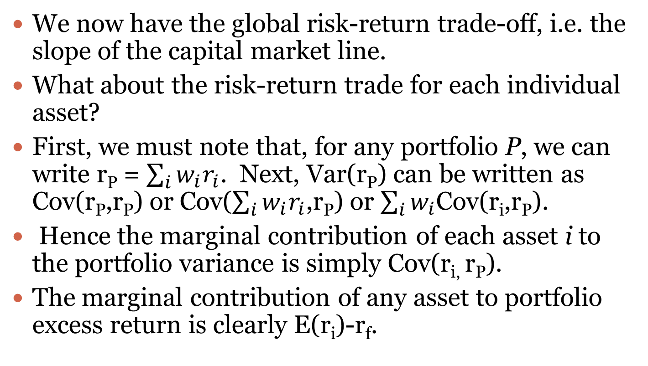
How do we get the CAPM from the assumptions?
We now have the global risk-return trade-off, i.e. the slope of the capital market line.
What about the risk-return trade for each individual asset?
First, we must note that, for any portfolio P, we can write r_{P} = $\sum_{i}{w_{i}r_{i}}$. Next, Var(r_{P}) can be written as Cov(r_{P},r_{P}) or Cov($\sum_{i}{w_{i}r_{i}}$,r_{P}) or $\sum_{i}{w_{i}\text{Cov}\text{(}\text{ri}\text{,}\text{rP}\text{)}}$.
Hence the marginal contribution of each asset i to the portfolio variance is simply Cov(r_{i,} r_{P}).
The marginal contribution of any asset to portfolio excess return is clearly E(r_{i})-r_{f}.

Slide 7
How do we get the CAPM from the assumptions?
Now, if we look at any portfolio on the efficient frontier, we can think of it as being the result of maximizing the expected excess return on the portfolio subject to the variance being equal to a certain value.
This is equivalent to ensuring that the ratio of the marginal contributions by each asset to portfolio expected excess return to the marginal contributions of each asset to portfolio variance.
Hence it must be true for each asset that [E(r_{i})-r_{f}]/Cov(r_{i,} r_{P}) is the same.
We have already established that the market portfolio is on the efficient frontier. Hence this relationship is true of the market portfolio. That is, [E(r_{i})-r_{f}]/Cov(r_{i,} r_{m}) is the same for all assets/portfolios in the market portfolio. But the market portfolio is also one of these portfolios. Hence [E(r_{i})-r_{f}]/Cov(r_{i,} r_{m}) = [E(r_{m})-r_{f}]/Cov(r_{m,} r_{m}) = [E(r_{i})-r_{f}]/Var(r_{m}).
If we define $β_{i}=\frac{Cov(r_{i},r_{M})}{{σ^{2}}_{M}}$, it follows that E($r_{i}$)-$r_{f}$=$β_{i}$[$E(r_{M }$)-$r_{f}$]

Slide 8
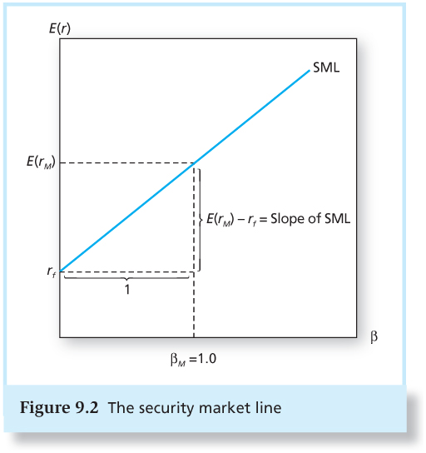
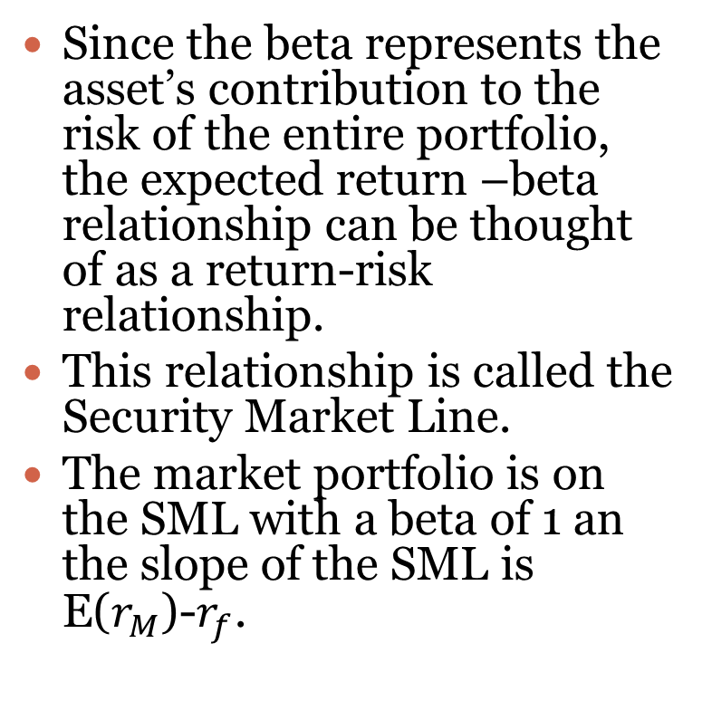
The Security Market Line
Since the beta represents the asset’s contribution to the risk of the entire portfolio, the expected return –beta relationship can be thought of as a return-risk relationship.
This relationship is called the Security Market Line.
The market portfolio is on the SML with a beta of 1 an the slope of the SML is E($r_{M}$)-$r_{f}$.

Slide 9
Summary of implications of the CAPM
All investors will choose to hold a portfolio of risky assets in proportions that duplicate the market portfolio.
The market portfolio is the portfolio of all traded assets; the proportion of each asset in the market portfolio equals the market value of the asset divided by the total market value of all assets.
The market portfolio will be tangency portfolio to the optimal capital allocation line derived by each investor.
Hence the capital market line (CML), the line from the risk-free rate through the market portfolio is also the best attainable capital allocation line.

Slide 10
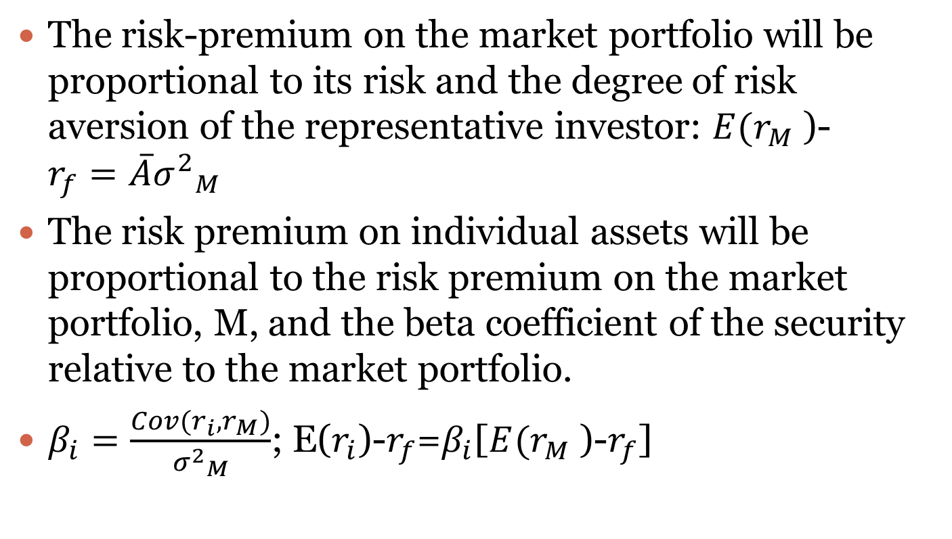
Summary of implications of the CAPM
The risk-premium on the market portfolio will be proportional to its risk and the degree of risk aversion of the representative investor: $E(r_{M }$)-$r_{f}=\overline{A}{σ^{2}}_{M}$
The risk premium on individual assets will be proportional to the risk premium on the market portfolio, M, and the beta coefficient of the security relative to the market portfolio.
$β_{i}=\frac{Cov(r_{i},r_{M})}{{σ^{2}}_{M}}$; E($r_{i}$)-$r_{f}$=$β_{i}$[$E(r_{M }$)-$r_{f}$]

Slide 11
Is the CAPM testable?
A model consists of i) assumptions and ii) implications of the assumptions.
By definition, a model is a simplification of reality. Hence the assumptions are certainly false.
However, we would prefer the assumptions are such that the implications of the model are not highly sensitive to violations of the assumptions. This is called model robustness.
The only meaningful interpretation of testability of a model is whether the positive implications of the model are valid empirically, i.e. whether the model is robust empirically with respect to the assumptions
As we discussed before, the two implications of the CAPM are that the market is mean-variance efficient, and therefore that the expected-return beta relationship holds for the market portfolio.

Slide 12
Is the CAPM testable?
Roll pointed out that a) the true market portfolio is not identifiable (because it includes all risky assets) and b) the linear E(R)-b relation holds for all efficient portfolio. Tests of the CAPM test for ex-post mean-variance efficiency. Hence even if we accept the validity of the linear risk-return relationship, we may not have identified a true efficient portfolio that can be used for expected return computations.
Practically, though, we make do with what we have; empirical tests of the CAPM use diversified portfolios of stocks as proxies for the market portfolio.
Empirically, we find that if excess returns on stocks are regressed on the excess market return, the intercept is significantly higher than zero. The alpha or the beta-adjusted excess return is positive for low-beta securities and negative for high-beta securities.
So if the linear expected return-beta relationship does not hold up, is it still true that the observed market portfolio is mean-variance efficient?
Since most active mutual funds are not able to outperform the observed market portfolio, we can argue that the observed market portfolio is efficient and use the expected return-beta relationship with respect to the observed market portfolio.

Slide 13
Econometrics and the E(r)-β relationship
The testing procedure involves first estimating stock betas using time-series data and then testing the E(r)-β relationship on a cross-section.
Since the betas used in tests of the CAPM are estimated with error, the estimates of the CAPM equation coefficients are biased. This is mitigated by testing the CAPM on portfolios rather than on single stocks.
The coefficients in the E(r)-β regression are not efficiently estimated in the OLS procedure because residuals are not uncorrelated across observations; for example, for different firms, the random deviation of the beta-adjusted average stock return from the expected value of zero will be correlated across firms in the same industry.
Hence it is necessary to use GLS estimates rather than OLS estimates.
The CAPM theory allows for time-varying risk-free rates and time-varying betas.
Correcting for such econometric problems improves the empirical fit of the CAPM.

Slide 14
Relaxing the CAPM assumptions
Few investors actually hold the market portfolio; does this invalidate the CAPM?
Most investors hold well-diversified portfolios in order to shed individual firm risk. Hence their portfolios are likely to be highly correlated with the CAPM.
Brennan showed that even if investors had different personal tax rates, a modified version of the CAPM held.
Mayers showed that another modified version of the CAPM held when investors were allowed to trade in non-traded assets such as human capital. He derived a CAPM, where high-beta securities could have higher than expected risk premiums and low-beta securities lower than expected risk premiums.

Slide 15
Relaxing the CAPM assumptions
Fischer Black showed that even if there is no risk-free asset, one can derive a zero-beta version of the CAPM, where the intercept could be higher than expected under the traditional CAPM.
The Consumption-based CAPM allows for the fact that investors’ horizons are longer than one period and hence when they choose portfolios they are also thinking of how the current portfolio will hedge risks in future periods. Hence the CAPM might not hold exactly.
The implication is that expected returns may be correlated with another factor that measures risk with respect to future wealth. This suggests a multi-factor CAPM.

Slide 16
Liquidity and the CAPM
Liquidity is the ease and speed with which an asset can be sold at fair market value.
Some stocks are illiquid because of insufficient trading interest. Hence if a seller wishes a quick sale, s/he must accept a discount from fair market value. This is called the Illiquidity Premium.
This illiquidity premium is measured partly by the bid-ask spread. Market impact costs are also part of this premium.
It is reasonable to believe that expected returns would incorporate this premium.
There are extensions of the CAPM where, in addition to the stock beta, other variables such as return volatility are also included in the pricing equation.

Slide 17
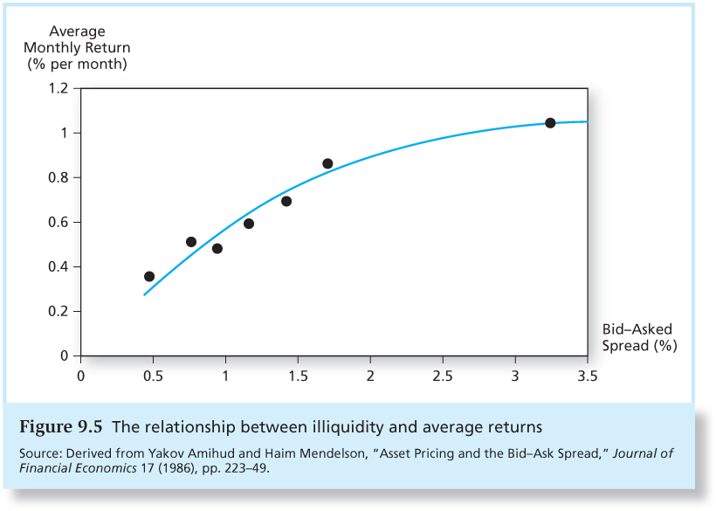
The empirical relationship between Illiquidity and Average Returns

Slide 18
Liquidity risk and liquidity betas
In a financial crisis, liquidity can unexpectedly dry up.
When liquidity in one stock decreases, it tends to decrease in other stocks at the same time.
For some stocks, such illiquidity will occur at the same time as it occurs in the broader marketplace.
Since illiquidity at such times is costlier for the investor, stocks whose illiquidity is correlated with market illiquidity, i.e. those that have higher liquidity betas will have to pay higher returns.

Slide 19
Why do I need to know the math?
Would you restrict yourself to knowing only simple words when you speak a language?
Sometimes learning new words – even if they can be defined in terms of existing words – ends up with the definition of new concepts.
We can talk much more concisely about things if we can describe things in a short-hand.

Slide 20
Why do I need to know the CAPM (or any other model)?
Can we understand complex phenomena by being untidy in our thoughts?
Does structuring our ideas force us to think through our decisions more carefully?
How do I evaluate my performance?

