Slide 1
Shadow banking in china
The Chinese financial system, spring 2014
PV Viswanath
Lubin school of business

Slide 2
Learning objectives
What is intermediation?
What is shadow banking?
How does shadow banking operate in the United States?
How does shadow banking work in China?
What are wealth management products?
What are trusts and TICs?
Is shadow banking a matter of concern in China?
What is the regulatory response to shadow banking in China?

Slide 3
Intermediation
The activity that banks engage in is called intermediation. This involves credit, maturity and liquidity transformation.
Credit transformation refers to the enhancement of the credit quality of debt issued by the intermediary through the use of priority of claims. Credit enhancement starts with an asset or portfolio of assets with a defined stream of cashflows. Two or more classes of securities are created with a claim on this stream. By making one or more of these classes junior in terms of claim priority, the quality of the other senior claim(s) is improved. Credit intermediation is frequently enhanced through the use of third-party liquidity and credit guarantees. Such guarantees can be made by the government (such as through the FDIC) or by private parties (e.g. MBIA in the US).
Maturity transformation refers to the use of short-term deposits to fund long-term loans, which creates liquidity for the saver but exposes the intermediary to rollover and duration risks.
Liquidity transformation refers to the use of liquid instruments to fund illiquid assets (essentially the process of securitization). For example, a pool of illiquid loans might trade at a lower price than a liquid rated security secured by the same loan pool, as certification by a credible rating agency would reduce information asymmetries between borrowers and savers. The rating agency is a kind of auditing agency, that assures the investor that the loan pool has high creditworthiness.

Slide 4
intermediation
Banks have the advantage of public sector credit guarantees such as deposit insurance. Bank regulations also require banks to maintain reserves, which function as liquidity backups. In addition, banks have access to central bank liquidity, in the form of the discount window.
Shadow banks are financial intermediaries that conduct maturity, credit, and liquidity transformation without explicit access to central bank liquidity or public sector credit guarantees.
As a result, when access to short-term market funds dries up, these shadow banks are no longer able to keep up their promised payments, which leads to their collapse. To the extent that one failing bank owes money to another, the failure of the first can also lead to the failure of the second and so on, leading to a financial crisis.
In China, the PBOC has often propped up these private sector shadow banks, thus preventing the collapse of the financial system. However, this creates moral hazard and increases the inefficiency of resource allocation.

Slide 5
The US shadow banking system
The shadow banking sector in the US takes several forms. One, there is the The Government-Sponsored Shadow Banking Sub-System, consisting of the FHLB system (1932), Fannie Mae (1938) and Freddie Mac (1970).
The FHLB System consists of U.S. government-sponsored banks that provide stable, on-demand, low-cost funding to American financial institutions for home mortgage loans, small business, rural, agricultural, and economic development lending.
Fannie Mae and Freddie Mac buy mortgage loans originated by banks and package them and resell them.
The “Internal” Shadow Banking Sub-System consists of financial bank holding companies that consist of a bank and other non-banking subsidiaries that provide intermediation services. Only the bank subsidiary has access to central bank backstops (such as the FBI discount window), but it is cheaper to obtain financing for non-bank subsidiaries because there are fewer regulations, such as the requirement to hold reserves. This subsystem, thus, is a product of regulatory arbitrage.
The “External” Shadow Banking Sub-System is a system of vertically integrated and specialized that originate, fund and securitize loans and further engage in maturity and credit transformation. This subsystem is a result of specialization, primarily. Examples are groups that specialize in auto or equipment leasing or captive finance companies. These institutions are supported by private risk depositories, such as mortgage insurers, monoline insurers, credit hedge funds and credit derivative product companies.

Slide 6
The Chinese shadow banking system
Market participants in China usually refer to nonbank financial institutions, such as trust companies, brokerage firms, small lenders and financial guarantors, as shadow banks. Certain off-balance sheet and informal bank lending is also often viewed as shadow banking. The reason for including such bank lending is that these loans are usually made with a view to avoiding regulation, and as such have the potential to increase systemic risks.
According to Standard & Poor’s (March 27, 2013), China’s shadow banking credit has been growing at an annualized rate of 34 percent since year-end 2010.
According to the FRB of SF, shadow banking assets amount to RMB 30 trillion (USD 4.8 trillion) (upper bound) as of 2012. This amounts to 57 percent of GDP, or 31 percent of bank assets. Putting these numbers in perspective, the FSB estimated that shadow banking assets around the world reached USD 67 trillion in 2011, which is roughly equivalent to 111 percent of global GDP or half the size of banking system assets.
Shadow banking assets were 152 percent of GDP in the United States, 168 percent in Euro area, and 370 percent in the United Kingdom in 2011. Therefore, the relative size of China’s shadow banking system is still small as compared to advanced economies.
Much of the discussion regarding China comes from “Shadow Banking in China: Expanding Scale, Evolving Structure, Fed Res Bank of SF, April 2013

Slide 7
Shadow banking products: WMPs
The restriction on bank deposit rates has led to a search for higher rates of return on the part of investors. Banks and other financial institutions, in turn, have created various investment products that are not subject to deposit rate restrictions. These are often called WMPs or wealth management products.
These WMPs are usually short-maturity deposits with sometimes specified “guaranteed” rates of return. In 2012, 63% of WMPs were not guaranteed either with regard to principal or return.
Banks issue most of these products. According to the CBRC, total outstanding WMPs issued by banking institutions reached RMB 7.1 trillion (USD 1.1 trillion) at year-end 2012, a 55 percent increase from 2011.
Trust companies, insurance companies, brokerage firms and private equity funds are also issuers. Issuers often pool the proceeds from various WMPs to be invested in a wide range of assets. The underlying assets include liquid, relatively safe investments, such as money market and bond funds, but can also include illiquid, risky credit-related assets, including SME loans, real estate loans, and local government financing vehicle (LGFV) loans (cf. the discussion about local government borrowing in the Fiscal System slides.).

Slide 8
Wealth management products
Asset-backed WMPs closely resemble collateralized debt obligations (CDOs) in structure, and can be viewed as informal securitization. Investors are usually not able to identify assets underlying each individual asset-backed WMP. Moreover, consistent credit ratings for WMPs issued by different banks or invested in different types of assets do not exist. A secondary market for these products does not exist, either. Hence they are different from CDOs, as well, in that CDOs are securitized.
Since WMPs are short-maturity, banks have the flexibility to move assets and liabilities on- and off-balance-sheet by choosing the start and end-dates of WMPs, since balance-sheets are only prepared as of specific dates. Hence any deposits made between quarter-ends or year-ends will not show up on bank balance sheets. Bank financial ratios, therefore, will not be negatively affected.
Furthermore, banks are able to comply with regulatory requirements on loan-to-deposit ratios, since most funds invested in WMPs are automatically transferred to time deposit accounts by the end of each month or quarter. In this way, banks maintain a low average deposit balance so as to avoid high reserve requirements. (Time deposits are not subject to reserve requirements or restrictions on loan-to-deposit ratios.)
External credit enhancements to WMPs usually take the form of principal guarantee. Typically, Chinese guarantors are private, small in size, and only have limited capital to cover potential losses. It is unclear whether existing guarantees could effectively reduce credit risks for investors. However, since many WMPs are sold through banks, customers believe that these products are guaranteed by the government.

Slide 9
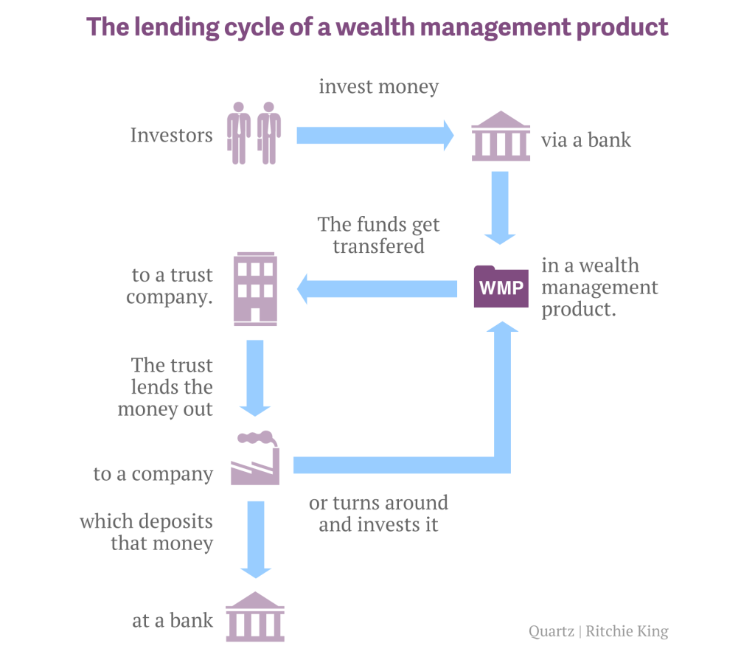

Slide 10
Trust companies
Shadow banking credit in China is often extended through trust companies, the largest group of nonbank institutions in China as measured by total assets. Trust companies engage in a wide range of businesses including lending, asset management, real estate investment, and private equity investment.
Before 2007, trust companies were known as trust investment companies (TICs) and specialized in credit extension to private enterprises. Local governments also used lightly regulated TICs to finance long-term, risky real estate and infrastructure projects, which led to a rapid deterioration of TICs’ asset quality in the early 1990s when the economy experienced a downturn.
In 2007, the entire sector underwent restructuring and consolidation, with only 54 trust companies remaining in business, down from more than 2,000 at their peak in the early 1990s. Assets under management (AUM) have grown six-fold between 2007 and 2012, reaching RMB 7.5 trillion (USD 1.2 trillion) by year-end 2012.
Trust companies and banks are interconnected through ownership and business operations. It is common practice for banks to own controlling shares in trust companies. Furthermore, in the so-called “bank-trust cooperation model,” banks channel funds to trusts via entrusted loans; trusts make high-yield loans to risky or small borrowers that have difficulty directly obtaining bank credit. By engaging in this type of cooperation, banks are able to “outsource” part of their lending business to trust companies and move these loans off their balance sheets.

Slide 11
Trust companies
WMPs have become a fast growing source of funding for the trust sector after 2010. Banks issue WMPs, and invest a large share of the proceeds in trust projects. Trust companies also issue WMPs independently, often using banks as sales outlets. A large portion of trust assets are mid to long-term investments in the real sector. Loans represented the largest share of trusts’ AUM at 43 percent as of year-end 2012. Securities held-to-maturity and long-term equity interests together accounted for another 28 percent. In terms of industry segment, industrial and commercial loans (mostly to SMEs), basic industries (mostly infrastructure projects), and real estate accounted for roughly 60 percent of trust assets.
LGFVs are now borrowing from trusts as bank lending further tightens. The opacity in the nature of these trust loans has raised questions about credit quality. There is also a certain Ponzi fund quality to some of these trusts, which might be using newly raised funds to pay off existing investors. Trust failures have increased in recent years.

Slide 12
Why shadow banking was toxic in the US
The reasons why economists are worried about the shadow banking system in China is similar to their worries regarding shadow banking in the US; it could be argued that it was shadow banking primarily that caused the financial collapse in the US in 2008. In the US, the arguments for the riskiness of the shadow banking system are:
A lot of loans and other liabilities are generated through opaque structures such as CDSs (credit default swaps) and CMOs (collateralized mortgage obligations) in such a way that their true riskiness is not known.
These liabilities are often off-balance sheet (such as CDSs) and the aggregate size of these liabilities is not always known.
These liabilities are sometimes not securitized and their risks are, thus, not priced by the market; this contributes to the underestimation of risk.
There is a network of institutions that holds a chain of such liabilities in a way that failure of one of them threatens the failure of another.
Many institutions in the shadow banking system are non-regulated non-bank entities; as such, there are no reliable backstops to prevent their failure. For example, there is no deposit insurance and these institutions do not have access to the discount window of the Fed.

Slide 13
why Chinese shadow banking may not be toxic
It could be argued that shadow banking in China is not only not harmful, but actually beneficial to the Chinese economy. Here are some arguments.
In China, private businesses often have difficulty accessing credit directly. Shadow banking through trusts and inter-corporate lending often functions as a device to allow such businesses access to credit. This is why some economists, such as Franklin Allen have argued that shadow banking (informal banking) is a strength of the Chinese financial system.
Many investment products in China are marketed through the banks; sometimes the banks themselves have equity interests in trusts that originate such investment products. Thus, even if the banks do not have direct liability, the government often accepts liability. As such, financial system failure is unlikely and as a result, the system is more stable than it would be without such implicit government backing. The flip side of this, of course, is moral hazard; financial institutions continue to make loans without sufficient regard to the financial viability of these investments. The consequences of loose lending in the 1990s is still being felt in the Chinese banking system and the loans have still not been fully written off.
Chinese shadow banking activities generally involve direct lending to the real sector and hence do not exhibit the structural opacity of similar activities in economies like that of the US.
Financial repression in China ensures that savers are paid below-equilibrium rates of return for their savings. This leads to excess saving (as savers try to ensure a sufficient rate of savings asset growth) and inefficient investments (due to overly-low borrowing rates for SOEs and other preferred borrowers). Shadow banking ensures an escape valve by allowing savers to obtain higher rates of return for their savings and channels SOE and SOBC funds to more productive investments.

Slide 14
why Chinese shadow banking could be toxic
On the other hand, a counter-argument could be made, as well.
Chinese investment products are quite opaque even if they are not as opaque as some of the financial engineering products in the US. This is because it is not always clear what the underlying assets of the institution are, in which the investor is buying a share or lending money to; sometimes this money is lent forward to other financial institutions who lend to yet others, who may be doing the final investment. The situation is worsened since the primary investors are wealthy individuals who may have less sophistication than the financial institutions that are the primary investors in the US shadow banking system.
Many investment products are short-term in nature with a maturity of three months, while the assets that these funds are invested in may be of much longer duration, such as real estate and may be quite illiquid – even more than in the US.
In China, direct lending between nonfinancial companies is prohibited. However, some of the largest state-owned enterprises in China, including China Mobile and PetroChina, are reportedly issuing loans through their financial arms, charging hefty interest rates. An important element of shadow banking, then, is direct company-to-company lending, where large, SOEs obtain bank loans at low interest rates then lend the funds to small and medium-sized private enterprises (SMEs) that are in need of credit. Consequently, the quality of bank loans can deteriorate if state-owned enterprises suffer losses due to SME defaults.

Slide 15
why Chinese shadow banking could be toxic
In addition to ordinary inter-corporate lending, some of the lending in China is informal, even though the money originates with banks.
Lenders usually charge hefty interest rates on these investments. According to the PBOC, the cost of borrowing in the Wenzhou underground lending market ranged between 21-25 percent from mid-2011 to mid-2012. Other surveys indicate that borrowers in urgent need of liquidity sometimes face annualized interest rates approaching 100 percent. The high rates charged on these short-term (usually emergency) loans are a signal of the speculative nature of these activities.
Sometimes, bank funds end up in the underground lending market, through channels such as letters of credit for commodities imports, short-term loans for domestic traders, discounted bills, group guarantee and residential mortgages. In particular, some state-owned enterprises take advantage of their easy access to low-cost bank loans to lend the funds to private businesses in need of liquidity. Sometimes, credit quality problems with informal loans can spill over to the banking sector even when banks are not directly involved; for example, when the underground lending market in Wenzhou suffered from massive SME defaults in 2011, state-owned banks stepped in to provide credit as part of the government’s efforts to bailout SMEs.
A widely cited report by CITIC Securities estimates the size of the market at RMB 4 trillion (USD 635 billion) in 2011.

Slide 16
Shadow banking defaults
There is some evidence that the Chinese government may be willing to allow shadow banking institutions to default on their products. While this will bring a certain amount of market discipline to the industry, on the other hand, it is likely to increase systemic risk. Here are some examples.
Shanghai-based Chaori Solar Energy Science and Technology Co Ltd reported China's first corporate bond default in early March 2014. The company paid 4 million yuan of an 89.8 million yuan coupon payment, due March 7. http://www.bloomberg.com/news/2014-03-12/chaori-solar-warns-bonds-may-be-delisted-after-third-net-loss.html
In January 2014, a trust fund, the China Credit Trust, whose products were marketed by the ICBC came close to bankruptcy. At the last moment, ICBC told investors that they could sell the rights in the RMB 3 billion product issued by China Credit Trust Co. to an unidentified buyer at a price equal to the value of the principal. Separately, China Credit Trust announced that it had reached an agreement with a third party to sell the shares it had acquired in Shanxi Zhenfu Energy Group, the coal miner which took out the original loan. However, the identity of these parties has not been made public. http://www.forbes.com/sites/oliverbarron/2014/01/27/china-trust-default-avoided-what-comes-next/
In March 2014, it was reported that that East China's Zhejiang-based property developer Xinrun Real Estate Co, with 3.5 billion yuan ($569 million) of debt, has collapsed and its largest shareholder detained. http://usa.chinadaily.com.cn/epaper/2014-03/19/content_17360688.htm

Slide 17
Regulatory response
The CBRC regulates banks and nonbank institutions, including trust companies. Since 2010, trust companies have been subject to restrictions on their leverage ratios and net capital requirements. However, restrictions on their operations are still much looser than those for commercial banks. Brokerage firms and insurance companies are regulated by China Securities Regulatory Commission and China Insurance Regulatory Commission, respectively. A consistent regulatory framework does not exist for other shadow banking institutions. As of 2012, local governments and regulators supervised some 6,080 micro lenders, 6,078 pawn shops, and 8,538 financial guarantors. These institutions operate in highly fragmented markets, and their credit extension activities are usually opaque.
Since 2011, the PBOC has been collecting data to be able to better monitor shadow banking institutions. However, the sector is very innovative and new products become available in response to any regulatory intervention.
The PBOC has announced that explicit deposit insurance will be introduced soon. Furthermore, regulators want to build a firewall between deposit-taking institutions and shadow banking institutions, so that potential problems with the less regulated shadow banking activities would not spill over to the banking sector and lead to system-wide or regional financial instability.
As China continues to liberalize financial markets, authorities will continue to adopt policies and regulations to guide the financial sector.

Slide 18
Themes
Financial Repression may be necessary for the government to have access to a source of funds.
However, investors will always find ways of increasing the return on their savings.
Simultaneously, if the government chokes off the supply of credit to private firms, financial institutions will seek to step in to create new channels of financing from savers to private firms.
The lack of regulation of this shadow banking sector gives rise to potential systemic risk.
The government will need to stay on top of developments to ensure the stability of the system.

