Slide 1
microfinance and Adverse selection
P.V. Viswanath

Slide 2
The Problem of Adverse Selection
There are two kinds of borrowers – risky and safe; the safe borrower invests $1 in a project and gets y for sure .
The risky borrower invests $1 and get $\overline{y}$ with probability p, and 0 with prob. 1-p; y < $\overline{y}$; p$\overline{y}$ = y. The gross (social) cost of lending is k > 1.
Assume that y > k and p$\overline{y}$ > k; i.e. both projects have NPV > 0.
If all borrowers are safe, then the gross interest rate, R = k.
But generally, risky individuals also want to apply for loans.
Suppose the bank cannot distinguish between safe and risky investors.
Suppose q% of individuals are safe, the rest are risky.
To break even, we need [q+(1-q)p]R = k; so we need to set R = k/[q+(1-q)p].
If k is sufficiently low, all lenders can be accommodated at this rate, then there is no problem. There is no adverse selection, and all positive NPV projects are financed.

Slide 3
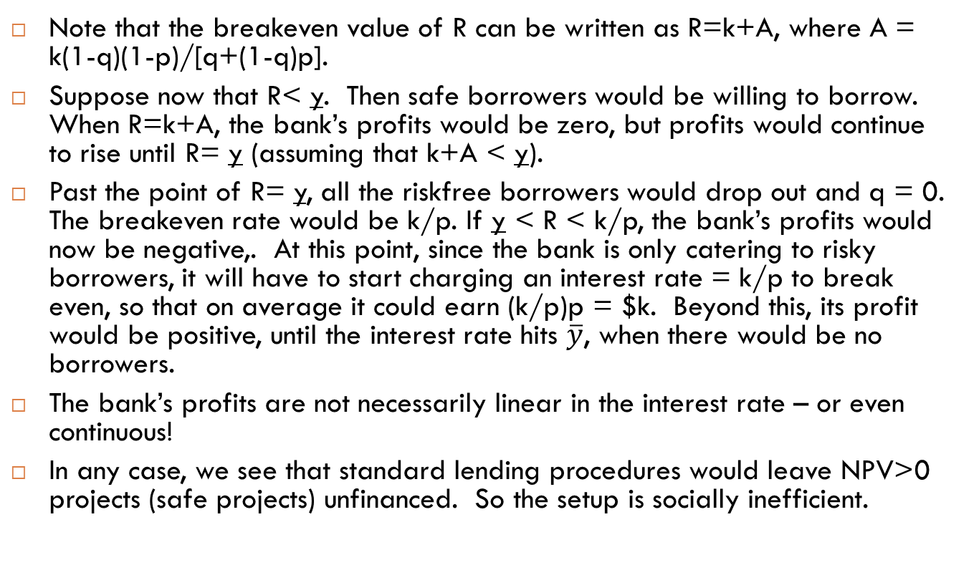
The Problem of Adverse Selection
Note that the breakeven value of R can be written as R=k+A, where A = k(1-q)(1-p)/[q+(1-q)p].
Suppose now that R< y. Then safe borrowers would be willing to borrow. When R=k+A, the bank’s profits would be zero, but profits would continue to rise until R= y (assuming that k+A < y).
Past the point of R= y, all the riskfree borrowers would drop out and q = 0. The breakeven rate would be k/p. If y < R < k/p, the bank’s profits would now be negative,. At this point, since the bank is only catering to risky borrowers, it will have to start charging an interest rate = k/p to break even, so that on average it could earn (k/p)p = $k. Beyond this, its profit would be positive, until the interest rate hits $\overline{y}$, when there would be no borrowers.
The bank’s profits are not necessarily linear in the interest rate – or even continuous!
In any case, we see that standard lending procedures would leave NPV>0 projects (safe projects) unfinanced. So the setup is socially inefficient.

Slide 4
Adverse Selection Example
k+A and k/p are both zero-profit interest rates for the borrower. For interest rates below y, there are safe and risky borrowers, above that, there are only risky borrowers.
Expected Profit
0
k
k+A
y
k/p
$$\overline{y}$$
Interest Rate

Slide 5
Another Adverse Selection Example
There are no safe borrowers at any rate unless the lender is willing to lose money. The risky types are riskier than in the previous example. The bank must raise rates to k/p to break even, at which rate, there are only risky borrowers.
We see that the bank can be profitable, inefficient and inequitable!
Expected Profit
0
k
y
k+A
k/p
$$\overline{y}$$
Interest Rate

Slide 6
Example on page 45 (section 2.3.3)
Suppose there are risky projects and safe projects. The safe projects yield $200 for every $100 invested. The risky projects yield $222, with a prob of 0.9 (zero otherwise).
The bank’s cost of funds is 40%.
The opportunity cost for lenders is $45.
The break-even interest rate is 47.36% and both types choose to borrow and invest.
However, if the risky project yields $267 (with a prob of 0.75), in equilibrium, the interest rate is 86.67% and safe investors are shut out.
Because the bank cannot distinguish between safe and risky borrowers, it has to charge a single interest rate and the safe borrowers have to subsidize the risky borrowers. In the second case, this subsidy is so high that the safe borrowers are forced out of the market.

Slide 7
Group Lending & Adverse Selection
How does microfinance resolve this problem?
The bank would like to charge differential rates for risky and risk-free borrowers, but it does not have this information. Suppose borrowers, as a group, do have this information. Microfinance tries to have borrowers reveal this information through the use of group lending.
Suppose, as before, borrowers are either risky or safe and borrowers know each other’s types.
Assume that loans are only made to groups of two. Borrowers are required to form their own groups.
Each partner in each group is responsible not only for his/her loan repayment but also for his partner’s loan repayment.
Of course, in this case, safe borrowers will want to partner with another safe borrower. Risky borrowers will have to partner with another risky borrower. This is called assortative matching.

Slide 8
Group Lending & Adverse Selection
So now we have groups that are safe and groups that are risky.
But how does this help the bank, since it still doesn’t know which borrowers are safe and which are risky?
The problem in the case of individual lending was that safe lenders had to subsidize risky borrowers who paid an effectively lower rate because they sometimes defaulted. This caused the interest for them to be higher and sometimes so high that all safe borrowers dropped out of the borrowing market.
With group lending, the bank still doesn’t have this information, but we will see that, even though the formal interest rate is the same for all borrowers, still risky borrowers, on average, pay a higher rate and therefore the subsidy to them from the safe borrowers is lower.
As a result, the interest rate will be lower in the group lending case. Here’s how it works.

Slide 9
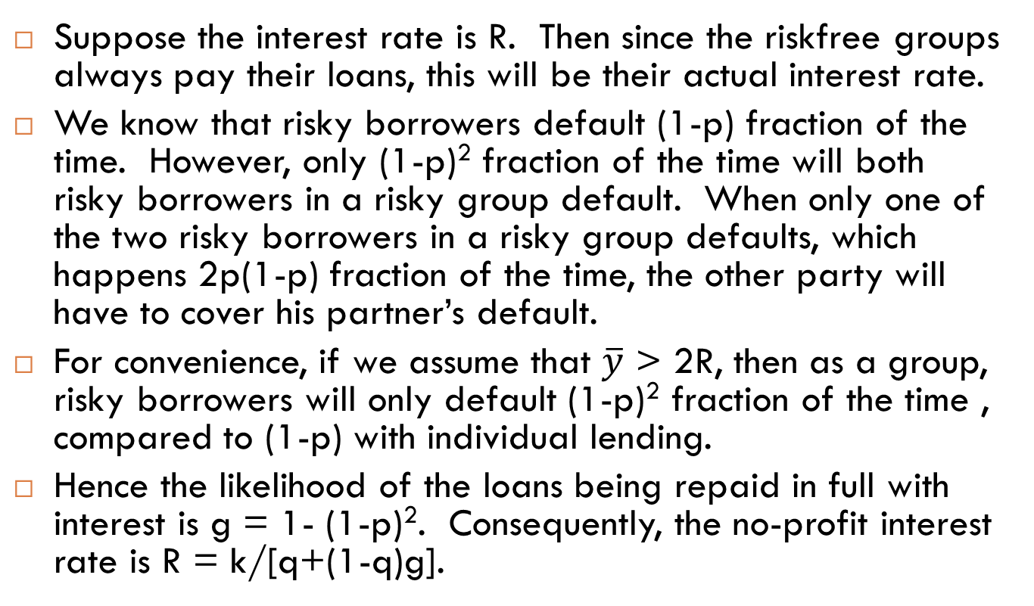
Group Lending & Adverse Selection
Suppose the interest rate is R. Then since the riskfree groups always pay their loans, this will be their actual interest rate.
We know that risky borrowers default (1-p) fraction of the time. However, only (1-p)² fraction of the time will both risky borrowers in a risky group default. When only one of the two risky borrowers in a risky group defaults, which happens 2p(1-p) fraction of the time, the other party will have to cover his partner’s default.
For convenience, if we assume that $\overline{y}$ > 2R, then as a group, risky borrowers will only default (1-p)² fraction of the time , compared to (1-p) with individual lending.
Hence the likelihood of the loans being repaid in full with interest is g = 1- (1-p)². Consequently, the no-profit interest rate is R = k/[q+(1-q)g].

Slide 10
Group Lending and Adverse Selection
We saw earlier that with individual loans, R = k/[q+(1-q)p].
Since g<p, the interest rate will be lower and positive NPV safe borrowers will be denied loans less frequently.
All borrowers face the same contract, but, because of assortative matching, risky types pay more on average.
The bank thus effectively discriminates, even though it doesn’t know who’s safe and who is risky.
Numerical example from page 104 (section 4.3.1)

Slide 11
Group Lending and Adverse Selection
What about group lending in a situation like the US where borrowers might not know each other well enough to figure out who’s risky and who’s not.
In this case, as well, it turns out that the bank can charge a lower interest rate with group lending, than with individual lending.
As a result, there are situations where individual lending would have shut out safe borrowers, but with group lending, both safe and risky borrowers will be funded.

