Slide 1
Capital Budgeting and Valuation with Leverage
P.V. Viswanath

Slide 2
Learning Objectives
The WACC, APV and FTE methods of valuation.
Computation of the unlevered and equity costs of capital, and their relationship.
Estimation of the cost of capital for a project, even if its risk is different from that of the firm as a whole.
Estimation of the cost of capital for a project, given the project’s debt-to-value ratio, assuming the firm maintains a target leverage ratio.
Calculation of the levered value of a project if (1) the firm has a constant interest coverage policy, or (2) the firm keeps debt at a constant level.
The effect of issuance costs, personal taxes and financial distress costs on the assessment of the project’s value.

Slide 3
WACC Method with constant D/E ratio
When the market risk of the project is the same as the average risk of the firm’s investments, the WACC can be used to value the project.
That is, its cost of capital is simply the cost of capital for a portfolio of all the firm’s securities.
We assume, in addition that the firm’s debt-equity ratio is constant and that corporate taxes and personal taxes are the only imperfections.
Since interest payments are tax-deductible, the effective cost of debt is r_{D}(1-τ_{c}). This allows us to write the WACC as:

Slide 4
WACC Method with constant D/E ratio
Personal taxes do not need to be taken into account separately since the cost of debt will adjust automatically in the marketplace to take personal taxes into account. Thus, if interest income is taxed at a higher rate than equity income, firms must pay a higher risk-adjusted cost to obtain debt capital, as compared to equity capital. In the WACC method, we use the actual market cost of debt and equity – so this “penalty” for debt capital is already taken into account.
We compute the value of the project by computing the cashflows to the firm if it were unlevered (EBIT(1-τ_{c}) adjusted for non-cash items in EBIT) and discounting them at the WACC.
The tax benefits of debt are taken into account in the discount rate as opposed to incorporating them in the cashflows directly.
This allows us to undertake a division of labor – the cashflow computation is not impacted by the firm’s leverage policy and can be calculated by employees who are only involved in the operations side of the firm.

Slide 5
Using the WACC: An example
Suppose Avco is considering introducing a new line of packaging, the RFX Series.
Avco expects the technology used in these products to become obsolete after four years. However, the marketing group expects annual sales of $60 million per year over the next four years for this product line.
Manufacturing costs and operating expenses are expected to be $25 million and $9 million, respectively, per year.
Developing the product will require upfront R&D and marketing expenses of $6.67 million, together with a $24 million investment in equipment.
The equipment will be obsolete in four years and will be depreciated via the straight-line method over that period.
Avco expects no net working capital requirements for the project.
Avco pays a corporate tax rate of 40%.

Slide 6
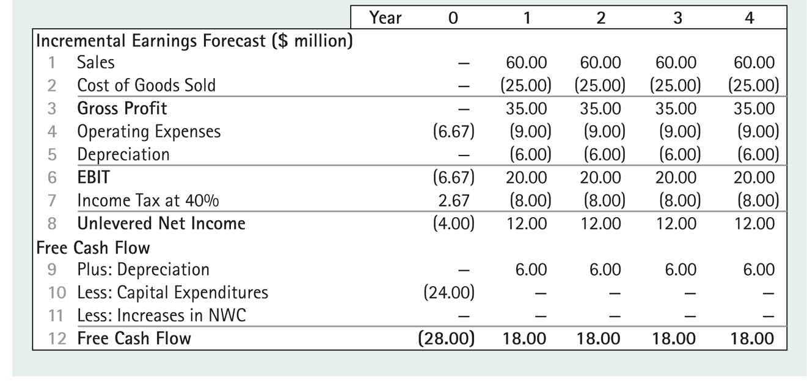
Expected Free Cashflow from Avco

Slide 7
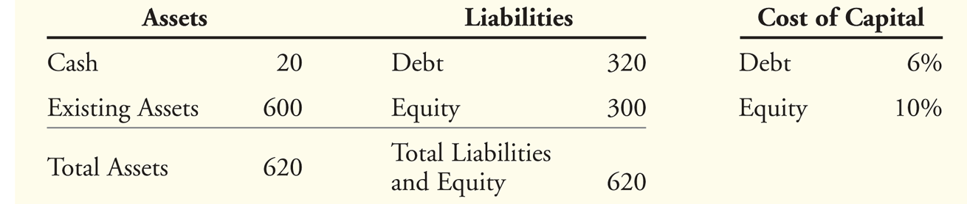
Using the WACC: An Example
Avco has $20 of cash and $320 of debt; since the cash could be used to pay off an equivalent amount of debt, we reduce debt by the amount of cash to get the net amount of debt. Hence Avco’s debt-value ratio is 300/600.
Avco’s WACC can, therefore be computed as

Slide 8
Using the WACC: An Example
The value of the project, including the tax shield from debt, is calculated as the present value of its future free cash flows.
The NPV of the project is $33.25 million
$61.25 million – $28 million = $33.25 million

Slide 9
Implementing a Constant Debt-Equity Ratio
The WACC method assumed that Avco would keep its debt-equity ratio constant.
This requires Avco to change the amount of its debt as its market value changes, as it will if it accepts the Avco project.
How can we compute the additional debt to be issued each year?
To begin with, we note that Avco has a debt-value ratio of 0.5
After Avco takes on the new project, its value will go up by the amount of the value of the new assets added due to the project, viz. $61.25m.
Hence Avco will have to issue 61.125/2 = 30.625 in net new debt.
We assume that Avco will do that by spending its $20m cash and issuing $10.625 in new debt.
Since the firm only needs $28m for the RFX project, the additional $2.625m will be paid out as a dividend.
Its balance sheet will now appears as follows:

Slide 10
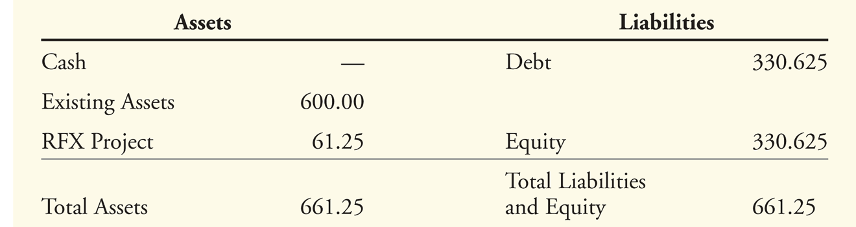
Implementing a Constant Debt-Equity Ratio
The firm’s debt capacity is defined as the total amount of debt required to maintain the firm’s target debt-value ratio. This equals D = dV^{L} , where d is the firm’s debt-value target ratio.
We can now compute the increased debt capacity due to the project at the different dates in the future by working backwards:

Slide 11
Implementing a Constant Debt-Equity Ratio
This is computed as follows. The value at the end of year 3 of the free cashflow of $18m in year 4 is 18/(1.068) = $16.854.
Hence the debt capacity at that point is 16.854/2 = $8.427m
The value of this project at the end of year 2 is (18+16.854)/1.068 = $32.635.
Hence the debt-capacity is 32.635/2 = 16.317m.
Using the same procedure, we compute the debt capacity at previous dates.
In order for the WACC answer to be correct, we must assume that AVCO decreases its debt according to the schedule provided here.
Thus, one year later, it must decrease debt by 30.62 – 23.71 or 6.91

Slide 12
WACC Method with Changing Debt Levels
Suppose we don’t want to modify debt levels each year to keep a constant D/E ratio. How do we apply the WACC method?
Clearly if the D/E ratio is changing, the WACC will be changing because the WACC depends on the D/E.
However, we cannot compute the D/E ratio for each year without knowing the value of the project because the equity value depends on the project value (assuming that we’re accepting the project).
Hence a trial-and-error method must be used to establish the WACC for each period.
On the other hand, unless we expect conditions to change constantly in a predictable fashion, we probably would want to optimize the amount of debt at a specific debt-equity ratio.
Hence the assumption of a fixed D/E ratio is reasonable.

Slide 13
The APV Method
In the APV method, we first value the investment as if it had no leverage, add the value of the interest tax shield and then deduct any costs that arise from other market imperfections.
We assume that personal taxes are the same on equity income as on debt income; if this were not so, the relative costs of debt and equity would be affected and hence we could not compute the unlevered cost of equity by working backwards from the observed levered cost of equity.
In practice, this theoretical point is often ignored, but as a result, the estimated values could be grossly in error and could lead to a wrong decision.
We now see how to implement the APV method.

Slide 14
APV: An Example
Let us look again at the Avco example. Since the RFX project has risk similar to that of the firm’s other projects, the discount rate to be used in valuing the RFX project is the required rate of return on the firm’s assets.
This can be computed by taking a weighted average of the cost of the firm’s securities.
We do not take into account the tax shield from debt because we are initially valuing the project as if there were no debt at all. That is, we use the pretax WACC:
We assume that effective personal taxes on debt income and equity income are the same; else the pre-tax WACC could not be computed by using the r_{D} that is observed when there is debt.
Thus, if interest income were taxed at a higher rate than equity income, then the actual r_{D} would contain a penalty due to the tax disadvantage of debt income for the investor. Hence in the absence of debt, the unlevered cost of capital would be lower than the pre-tax WACC.

Slide 15
APV: An example
The unlevered cost of equity works out to (0.5)(10) + (0.5)(6) = 8%
We first compute the project’s value without leverage:
Next we find the present value of the firm’s additional tax shields due to the project.
Since we have already computed the firm’s debt capacity previously, we can compute the tax shields each period as debt capacity times the interest rate of 6% times the tax rate of 40%:

Slide 16
APV: An example
In order to obtain the present value of the tax shields, we need to know the required rate of return on the firm’s tax shields.
In our case, we are assuming that the firm maintains a constant debt-to-value ratio.
This means that the tax shield at any point equals (Firm Value) x (target debt ratio) x (int rate) x τ_{c}
We see from this that the risk of the firm’s tax shield is the same as the risk of the firm itself and hence the appropriate discount rate to value the tax shields is r_{U}.

Slide 17
APV: An Example
The tax shields, discounted at r_{U} = 8% are worth $1.63m.
The unlevered project value is $59.62m for a total of $61.25m.
The present value is $61.25m - $28m = $33.25m as before.

Slide 18
Flow-to-Equity Method
In the WACC method, we compute the value of the firm and then subtract the value of debt, in order to obtain the value of equity.
When valuing a project, the WACC method implicitly assumes that if firm value goes up, so does equity value. This is true in most cases, but not in all cases.
The FTE method values equity directly by computing the free cash flows to equity holders (FCFE) and discounting them at the cost of equity.
We now use Avco’s RFX project to show that we get the same values with the FTE method as with the other methods.

Slide 19
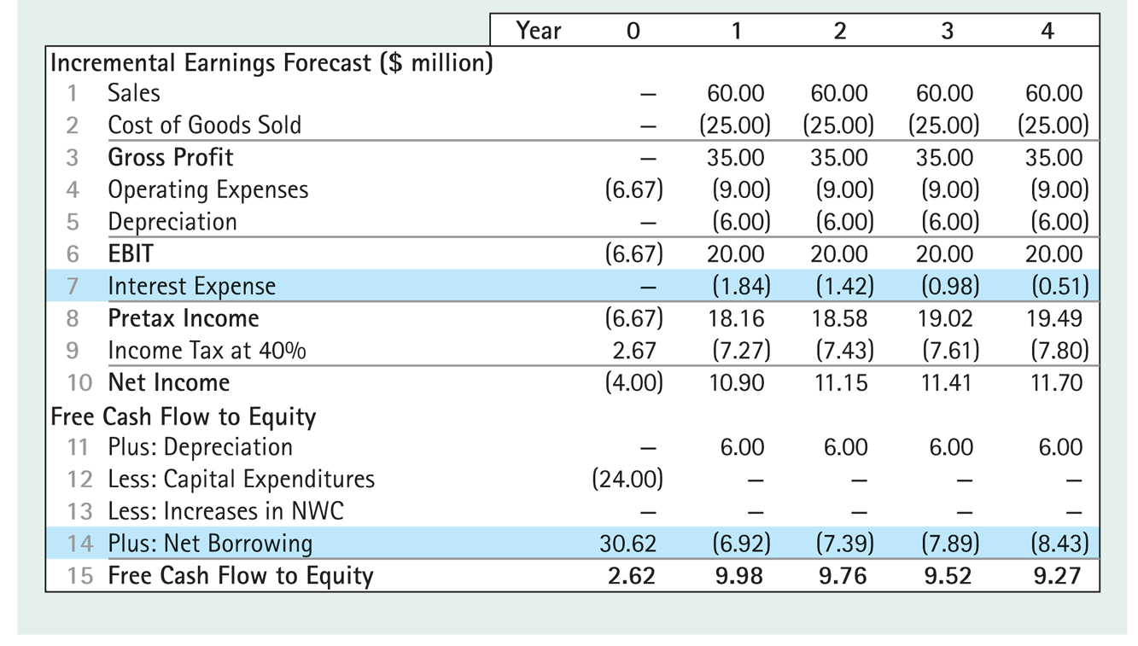
FTE: An Example

Slide 20
FTE: An Example
In computing the FCFE, we note that interest payments have to be deducted.
Furthermore, we have to adjust cashflows by the change in debt.
This is because if money is required to be paid out to debt-holders, it is not available to be paid out to equity-holders.
Similarly, if additional debt is issued, that can be used for payouts to equity-holders.
In our example, debt capacity dropped from $30.625 in year 0 to $23.71m in year 1. Hence Net Borrowing is 23.71-30.625 = -$6.915, i.e. a net payment to debt-holders of $6.915m.
Discounting FCFE at 10%, we get an NPV of $33.25 as before:
Notes:
The cost of equity capital is 10% for the RFX project, as assumed previously.

Slide 21
Project-Based Cost of Capital
If the new project has the same riskiness as the average projects undertaken by the firm, then the appropriate discount rate for valuing the project is simply the WACC of the firm, as discussed above.
What if the new project has a different risk?
In this case, we would need to find other firms whose riskiness is similar to the riskiness of the new project.
We could then take the average WACC for those firms to estimate the discount rate for our project.
However, those firms may have leverage ratios different from those that we propose to have for our project.
In this case, we can still use their unlevered cost of capital, r^{U}.
Consider the following example where Avco wishes to invest in a plastics project.

Slide 22
Project-Based Cost of Capital
Assume two firms are comparable to the plastics division and have the following characteristics:
Assuming that both firms maintain a target leverage ratio, the unlevered cost of capital for each competitor can be estimated by calculating their pretax WACC.
We then take the average of the two, which in our case works out to 9.5%.

Slide 23
Project Leverage and the Equity Cost of Capital
Suppose the firm desires to fund the project according to a specific target leverage ratio, since different firms could have different leverage ratios. In that case, we can compute r_{E} for our project using the same pre-tax WACC formula, but with our own target debt leverage ratio:
Thus if we have a target debt/equity ratio of 1, the cost of equity capital would be 9.5 +1(9.5-6) = 13%, assuming that the firm can continue to obtain debt financing at 6%.
We can now compute the WACC as:

Slide 24
Project-based Cost of Capital
An alternative method for calculating the division’s WACC is:
To determine the correct cost of capital for a project, we need to know the amount of debt to associate with the project.
This is equal to the incremental financing that results if the firm takes on the project, i.e. the change in the firm’s total debt (net of cash) with the project versus without the project.
The target debt ratio and hence the incremental debt capacity will depend upon the financial asymmetry costs and financial distress costs for the project.
However, financial distress costs and information asymmetry costs depend usually on the characteristics of the whole firm. Hence the optimal leverage for a firm will depend on the characteristics of both the project and the firm.

Slide 25
APV with Constant Interest Coverage Ratio
Up to this point, it has been assumed the firm wishes to maintain a constant debt-equity ratio. Two alternative leverage policies will now be examined.
Constant interest coverage
Predetermined debt levels
Constant Interest Coverage Ratio
When a firm keeps its interest payments equal to a target fraction, k, of its free cash flows, then the interest paid in year t = k(FCF_{t}) and the tax shield in that year is k(FCF_{t})τ_{c}.
The present value of the tax shield, then, is τ_{c}kV^{U}.
Hence the value of the entire project is (1+τ_{c}k)V^{U}.
That is, we compute the V^{U} as before and then adjust it by multiplying by (1+τ_{c}k).
Notes:
I need to explain how this allows us to use the WACC and FTE approaches.

Slide 26
APV with pre-determined debt levels
If a firm has pre-determined debt levels that will not vary according to the cashflows of the firm, then the riskiness of the tax shields are approximately the same as the riskiness of the interest payments themselves.
Hence the present value of the tax shield is simply Dτ_{c}, where D is the value of the debt, assuming that the debt is perpetual.
It must be kept in mind that in this case, there is no target debt ratio!
The value of the levered project is given by

Slide 27
Pros and Cons of the three methods
The FTE method offers some advantages.
It may be simpler to use when calculating the value of equity for the entire firm, if the firm’s capital structure is complex and the market values of other securities in the firm’s capital structure are not known.
It may be viewed as a more transparent method for discussing a project’s benefit to shareholders by emphasizing a project’s implication for equity.
The FTE method has a disadvantage.
One must compute the project’s debt capacity to determine the interest and net borrowing before capital budgeting decisions can be made.
The WACC method is easiest to use if the firm uses a target debt ratio.
The APV method is easier when using other leverage policies. However, if personal taxes need to be taken into account explicitly because of differences between tax rates on equity and bond income, the procedure is difficult in practice.

Slide 28
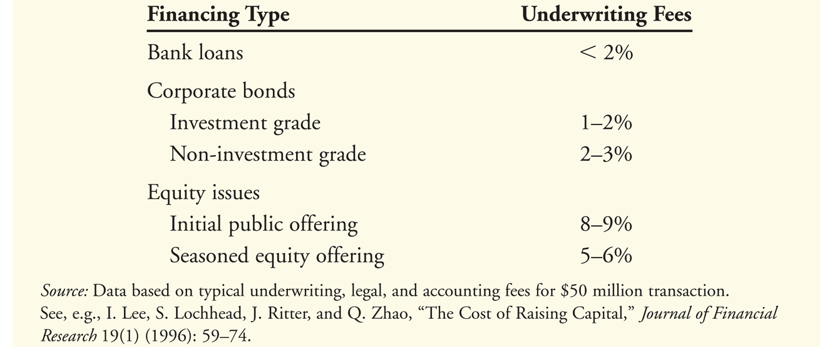
Issuance and Other Financing Costs
When a firm raises capital by issuing securities, the banks that provide the loan or underwrite the sale of the securities charge fees.
These fees should be included as part of the project’s required investment, reducing the NPV of the project.

Slide 29
Financial Distress Costs
Financial distress and agency costs also impact the cost of capital.
For example, financial distress costs tend to increase the sensitivity of the firm’s value to market risk, raising the unlevered cost of capital for highly levered firms.
The free cash flow estimates for a project should be adjusted to include expected financial distress and agency costs.
In addition, because these costs also affect the systematic risk of the cash flows, the unlevered cost of capital will no longer be independent of the firm’s leverage.
The following example shows how a firm could choose its optimal leverage ratio taking into consideration that both cashflows and r_{U} can change with leverage ratio.

Slide 30
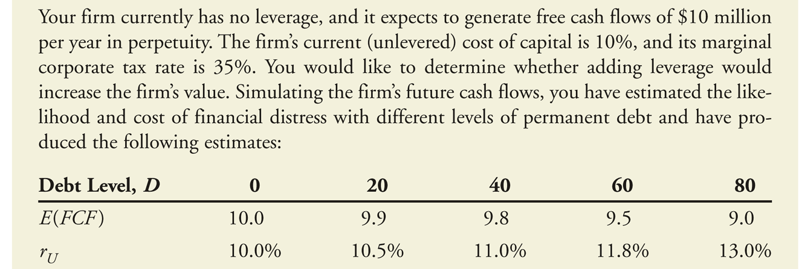
Financial Distress Costs
Notes:
Need to explain this better

Slide 31
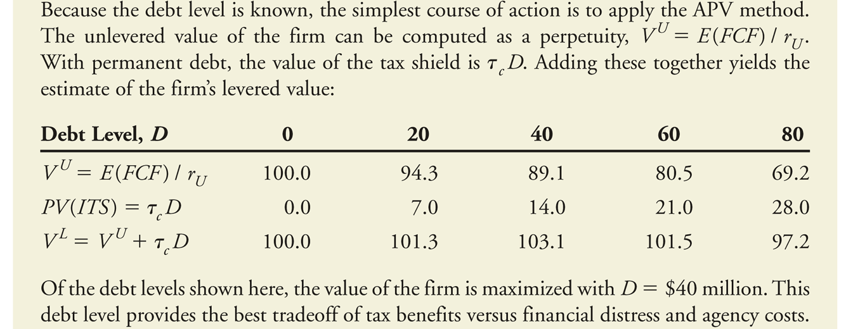
APV with financial distress costs

Slide 32
Estimating Financial Distress Costs
Financial distress occurs when the firm is in default or close to default. Hence the default premium, i.e. the difference between the value of the debt if the firm were default-free and the value of the debt with a non-zero likelihood of default is related to financial distress costs.
If we can assume that the ratio of financial distress costs to the default premium is constant, we can estimate the financial distress costs by looking at the market value of debt, as in the example below.
However, this method cannot provide estimates of financial distress costs at other debt levels different from what the firm actually has, currently.

Slide 33
Valuing Financial Distress Costs

