Slide 1
Functions of the Financial System
P.V. Viswanath
For a First Course in Finance

Slide 2
Financial System Functions
In this sections, we will look at:
The different functions of the financial system
Financial entities that accomplish these functions
Some economic and financial concepts that are relevant to the understanding of these functions

Slide 3
The Financial System: Its Functions
To transfer economic resources across time, borders and among industries
To provide ways of managing risk
To provide ways of clearing and settling payments to facilitate trade
To provide a mechanism for the pooling of resources and for the subdividing of ownership in various enterprises

Slide 4
The Financial System: Its Functions
To provide price information to help coordinate decentralized decision making in various sectors of the economy
To provide ways of dealing with the incentive problems created when one party to a transaction has information that the other party does not or when one party acts as an agent for another
As we discuss these functions, it is useful to keep in mind the flow of funds chart which is reproduced in the next slide.

Slide 5
Financial System: Flow of Funds

Slide 6
F1: Transferring Economic Resources
Intertemporal
Borrowing and lending are ways of transferring resources across time
Across space (or cyberspace)
If you have money in your checking account and you can access this via your Debit Card at your local store, this is transferring resources across space
If investment banks collect financial resources in the US and invest it in developing countries like China or India, this is also a transfer of resources across space

Slide 7
F2: Managing Risk
Issuing shares in their firms is a way for entrepreneurs to share the risk of the enterprise with others.
Futures contracts represent a way of offsetting risk
It is possible to buy insurance to lay off risk
CDOs (Collateralized Debt Obligations) represent complex ways of distributing risk
Credit swaps are another example of transferring firm-specific default risk.

Slide 8
F3: Clearing and Settling Payments
Every time you write a check or use a credit card or use an app like Venmo, you use the payment facilitation function of the financial system.
When you buy shares through your broker, this is done through the Stock Exchange which brings buyers and sellers together. However, there is a clearing house, which actually facilitates the exchange of money for the shares.
Most electronic funds transfers involving international transactions take place through the Clearing House Interbank Payments System (CHIPS), a computerized network developed by the New York Clearing House Association. Most large US banks and US branches of foreign banks are members of CHIPS.

Slide 9
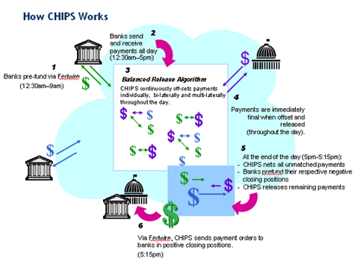
CHIPS: Interbank Clearing System
https://www.theclearinghouse.org/payment-systems/-/media/4143b0e4c558457491e053ae652fcbc9.svg

Slide 10
Credit Cards
Credit Cards are still widely used as a means of making payments.
The way in which credit cards work is quite complicated – and expensive – which is why there have been recent innovations in payment systems, e.g. distributed ledger systems, which are used by many cryptocurrencies.
We now look at the different parties involved in a credit card transaction.
Keep in mind that what’s happening is the instant provision of credit to the merchant by the card issuing bank.

Slide 11
Credit Cards
Merchant Processor: Performs credit check on merchant, sells or leases a terminal, establishes a connection between merchant and the Credit Card processor
Credit Card Association: Establishes rules and guidelines for card issuance and acceptance, markets brand name and various products. North American Credit Card Association is one such association. Visa, MasterCard, Discover, China UnionPay and American Express are also credit card associations that set transaction terms for merchants, card-issuing banks, and acquiring banks.
Acquiring Bank: A bank or financial institution that processes credit or debt card payments on behalf of a merchant.

Slide 12
Credit Cards
Card Issuer: Establishes criteria to approve or deny applicants and sets credit limits, interests rates, and fees. Ultimate risk taker. These are the actual issuers, e.g. Discover, Capital One, Barclays, Chase and many other banks issue credit cards.
Credit Card Processor: Receives and processes credit card applications, maintains cardholder data. Visa, MasterCard, Discover and American Express process payments. Discover and American Express issue credit cards as well.
Clearing House: ACH is a computer-based clearing and settlement facility established to process the exchange of electronic transactions between participating depository institutions. Settlement for a credit card transaction is triggered when the acquiring bank deposits the funds into the merchant’s account.

Slide 13
Credit Cards
Credit Card Transaction Example:
$100 purchase by consumer using Visa or MasterCard
$2 discount fee charged to merchant by acquirer/processor
$2 fee includes:
$1.50 interchange fee paid to card issuer
$0.10 assessment fee paid to card association (Visa/MasterCard)
$0.40 merchant processor fee
$98 credited to merchant for the transaction

Slide 14
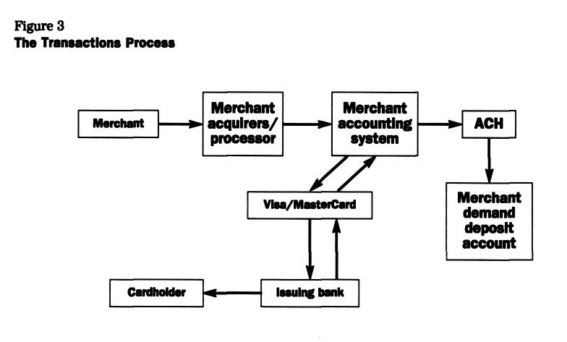
Credit Card Transaction Process
Automated Clearing House
From: Ramon P DeGennaro. “Merchant Acquirers and Payment Card Processors: A Look inside the Black Box,” Economic Review - Federal Reserve Bank of Atlanta. Atlanta: First Quarter 2006. Vol. 91, Iss. 1; pp. 27-43.

Slide 15
F4: Pooling Resources/Subdividing Shares
Mutual Funds provide a way for investors to come together and buy larger amounts of securities in an efficient manner
The corporate form of organization allows individuals to own parts of enterprises
Limited Partnerships allow individuals to participate in business enterprises and reap tax and other benefits
ETFs are a way of trading baskets of securities simultaneously.

Slide 16
Funds and Movie Investing
Barbarian Film Investment Fund, a $150 million structured fund
A mitigated-risk portfolio of non-correlated assets
Invests only in independent films that have greater than 80% of their budgets secured by foreign pre-sales.
Invests only in relatively low-budget films costing less than $10 million
Investment opportunities will be vetted by international sales agents who will make foreign sales estimates based on such factors as the film's genre, cast and creative team.
The first film backed by the fund, "Powder Blue," starring Forrest Whitaker, Jessica Biel and Jared Leto, began shooting in August 2007; it has a budget of $5 million with foreign sales estimated at $4.15 million.

Slide 17
Film Funds: S&R Films
Movie finance is at the core of S&R’s business. S&R Films controls a film fund of private equity and has been investing in feature length motion pictures since 2011. In order for a film to be considered for equity film financing, the movie or production must exhibit inherent mitigated risk by having secured assets that outweigh the total budget based on current marketplace trends. Such qualifying assets include ‘bankable’ name talent, ‘bankable’ name directors, and presales or minimum guarantees on limited territories where such presale values indicate a robust potential profit margin on remaining territories for the film’s equity tranche. http://snrfilms.com/film-financing/

Slide 18
F5: Information and Finance
Prices of financial assets are very important in sending the right signals to economic agents making real investment decisions.
We now talk about information-related issues:
The role of the financial sector in providing information
Circumstances when this role might be inefficiently performed
Adverse Selection
Moral Hazard
Principal-Agent problems

Slide 19
Providing Information
Asset prices and interest rates provide critical signals to firm managers in their selection of investment projects.
If a manager notes that stock prices are up in a certain sector, that is indicative of higher profits in that sector. It is, therefore, worthwhile investing there.
Should a firm finance its projects in dollars or in euros?
It can look at the forward euro rate, as well as euro-denominated interest rates to figure out the cost of borrowing in euros.
It can look at borrowing rates domestically
If the implied euro borrowing rate is lower, this means that there are more investors with euro resources and its better to finance in euros.
Individuals can also use interest rates as a guide to decide how much they want to save and how much to consume today.

Slide 20
Information and Action
It is worthwhile mentioning that, while higher stock prices in a given industry could be taken to imply the need for more real investment in that industry, it does not mean further investment in traded financial securities in that industry is warranted.
Financial securities markets are fairly liquid and informationally efficient; hence prices adjust pretty rapidly to information. Good news about a stock or industry will cause that information to cause the stock price to rise pretty quickly (perhaps within seconds), and beyond that window, will not imply abnormal returns for any investor. Furthermore, the supply of financial securities is pretty fixed and cannot be easily increased in the short run.

Slide 21
Information and Action: 2
On the other hand, if the reason for the increase in stock prices is due to an excess of demand over supply in that industry, real investment devoted to increasing supply of the underlying product will result in gains for the real sector investor.
The reason is that real investment cannot occur instantaneously and there is a larger window within which such investment can be profitably made. Furthermore, not everybody has the resources/knowhow to undertake real investment in a given sector .
It is, of course, still true that if a potential real investor waits too long, such delayed investment will not be profitable.

Slide 22
Markets and Information
In 1987, the stock market crashed. Many people think this was because investors had synthesized put options to allow themselves to pull out of the stock market if prices dropped.
A put option is a security that allows the holder to sell an underlying asset at a pre-specified price – this provides the holder with a floor value for the asset. Synthetic put options work by sending electronic signals to trading programs to sell automatically if prices drop.
A synthetic put option only works if the sell is executed.
In 1987, investors thought that they had price floor because of these synthetic put options. However, since these put options were not traded, investors did not know how many investors were planning on executing the same “sell” strategy.

Slide 23
Markets and Information
When stock prices dropped, all these programs tried to sell simultaneously. However, there were many more sellers than buyers and most sellers were not able to sell at the prices that they had planned to.
Prices plummeted, triggering fresh “program” selling. Ultimately, the floor that investors thought they had, didn’t exist because they didn’t have the information they needed to evaluate the feasibility of the synthetic put strategy.
The introduction of index options allowed investors to obtain information on the supply and demand for such options, as well as a more straightforward way of buying put “insurance.”

Slide 24
Other Providers of Information
We have seen that markets act as aggregators of individual pieces of private information and incorporate them in prices, so that resource allocation decisions can be taken.
In addition, individual firms collect information already available (but not necessarily easily), either about prices or about other aspects of firms so that individuals can make decisions.
For example, Bloomberg, Factset, Compustat and other such organizations provide firm and market information through their own databases.
Some firms might create “new” information by taking existing information, analyzing them and then presenting them in more useful ways for investors to make decision.
Credit Rating Agencies like Fitch and Moody’s would fall in this category.
So would equity research shops like JP Morgan, Goldman Sachs etc.

Slide 25
Adverse Selection
Adverse selection: One of the parties to a transaction lacks information while negotiating.
An example of adverse selection is when people who are high risk are more likely to buy insurance, because the insurance company cannot effectively discriminate against them, usually due to lack of information about the particular individual's risk but also sometimes by force of law or other constraints.

Slide 26
Adverse Selection
Suppose you announce that you are in the market for a used car and your budget is around $20,000
Suppose you can only tell imprecisely the true value of a car that is offered to you.
What proportion of cars offered to you will have an (unobservable to you) true worth of more than $20,000?
More than half
Less than half
Exactly half

Slide 27
Adverse Selection
Because of asymmetry between insider firm managers and outsider investors in financial markets, stock prices are likely to be sometimes too high and sometimes too low.
Just like in the used car market, overvalued firms are more likely to issue stock to take advantage of the overvaluation.
Hence, ceteris paribus, an announcement by a firm that it is selling stock can be a revelation to the market that it is overvalued.
Empirical evidence shows that stock prices, on average, drop on the announcement date.

Slide 28
Moral Hazard
Moral hazard: The ignorant party lacks information about performance of the agreed-upon transaction or lacks the ability to retaliate for a breach of the agreement.
People are more likely to behave recklessly if insured, either because the insurer cannot observe this behavior or cannot effectively retaliate against it, for example by failing to renew the insurance. This is an example of moral hazard.
Both issues are incentive problems and both have to do with lack of information; adverse selection manifests itself prior to the contract and moral hazard subsequent to the contract.

Slide 29
Moral Hazard
Suppose 50% of drivers are good drivers and 50% of drivers are bad drivers.
Also, suppose an insurance company cannot tell good drivers from bad drivers.
The insurance company offers an automobile insurance policy.
What proportion of its policy holders will turn out to be good drivers?
Half
More than half
Less than half

Slide 30
Moral Hazard
What moral hazard problem is induced by the Federal Reserve bailing out banks?
Is there a moral hazard problem when the Federal Government helps people affected by Hurricane Maria or Hurricane Katrina?
Is there a moral hazard problem when the government helps people who can’t make their mortgage payments because they have lost their jobs?
How would you deal with these situations?

Slide 31
Principal-Agent Problems
Principal-Agent problem: A special case of the moral hazard problem is when one party (the agent) undertakes to act on behalf of the other (principal). However, if the agent cannot be costlessly monitored, s/he might act in his own interests and to the detriment of the principal.
An example is when managers might act too conservatively because they don’t want to lose their jobs if the business fails – and they turn down risky, but profitable investment opportunities

Slide 32
Moral hazard between managers and bondholders
Bondholders lend money to a firm and rely upon the firm’s managers to make good investment decisions so as to be able to repay bonds when they come due.
However because bond payments are capped, firm managers have an incentive to take excess risk.
If the result of the risky investment is good, the returns above the cap go to the firm.
If the result of the risky investment is bad, the bond holders don’t get paid; since stock holders are not first claimants, the impact on them is less.

Slide 33
F6: Financial System Solutions
Adverse Selection
Banks cultivate long-term relationships with their clients making it less risky for clients to share sensitive information with the banks and allowing banks to price risk in a more informed fashion. There is evidence that the bond prices of firms that take loans from reputable banks go up!
Firms can signal using mechanisms such as dividends and capital structure to reduce the adverse selection problem in the sale of securities.
Firms can signal quality through the offering of guarantees; this reduces the adverse selection problem in the sale of products/services.

Slide 34
Financial System Solutions
Moral Hazard
Managers could be given shares of stock or stock options to give them incentives to act like stockholders.
Collateralization of loans reduces the incentive for borrowers to act in a risky fashion since they would lose their collateral.
The existence of liquid markets for collateral then allows lenders to dispose of the collateral. Markets for collateralized assets also allow them to keep track of the value of the collateral.

