Slide 1
Finance and Racism
Access to finance
Prof. P.V. Viswanath
Finance and Society

Slide 2
The data
Alicia Robb, “Access to Capital among Young Firms, Minority-owned Firms, Women-owned Firms, and High-tech Firms,” Small Business Administration Office of Advocacy, April 2013.
The data are from the Kauffman Firm Survey, a nationally representative cohort of businesses that began operations in 2004, which are followed over the 2004 to 2010 period.
The sampling frame for the KFS was the Dun & Bradstreet (D&B) database and restricted to businesses (or enterprises) reported by D&B as having started in 2004.
This database is a compilation of data from various sources, including credit bureaus and state offices that register new firms, as well as companies (e.g., credit card and shipping companies) that are likely to be used by all businesses.
In the following tables, we look at new capital injections in the start-up year and in following years.

Slide 3
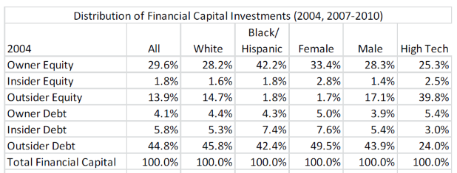
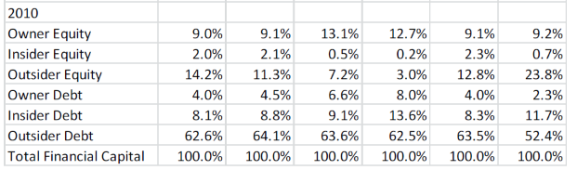
Patterns of financing

Slide 4
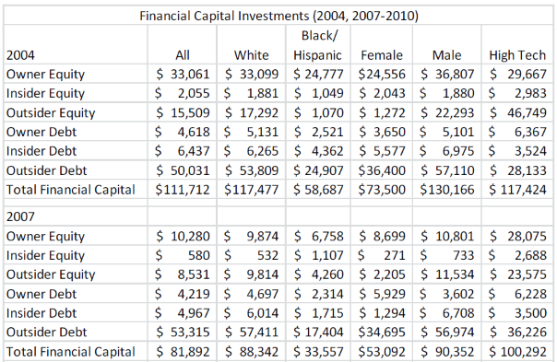
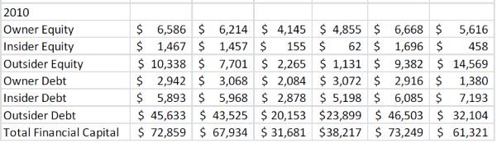
startup capital
Levels

Slide 5
Patterns of financing
Black firms have proportionately
  more owner equity
  More insider debt
  Less outsider debt
  The proportion of insider/owner debt to outsider debt is higher (11.7/42.4 or 28% for blacks/hispanic versus 8.7/45.8 or 19% for whites; for 2004)
  Lower levels of fresh capital injections at inception and after 6 years
  Female-owned firms have proportionately
  More owner equity
  More insider debt
  More outsider debt
  The proportion of insider/owner debt to outsider debt is higher (12.6/49.5 or 25.5% for females versus 9.3/43.9 or 21.2% for males; for 2004)
  Lower levels of total capital at inception and after 6 years

Slide 6
The importance of outside capital
Banks have historically provided new firms with crucial growth capital, and have played a substantial role in new firm formation and business expansion both in the United States and internationally.
Banks provide signals to other lenders regarding creditworthiness. They provide a monitoring function. Hence bank capital is important because it facilitates access to other sources of capital.
In times of financial distress, however, bank lending may be curtailed, with decreased lending potentially reflecting a “flight to quality.” Minorities may find it particularly difficult to access capital at such times.

Slide 7
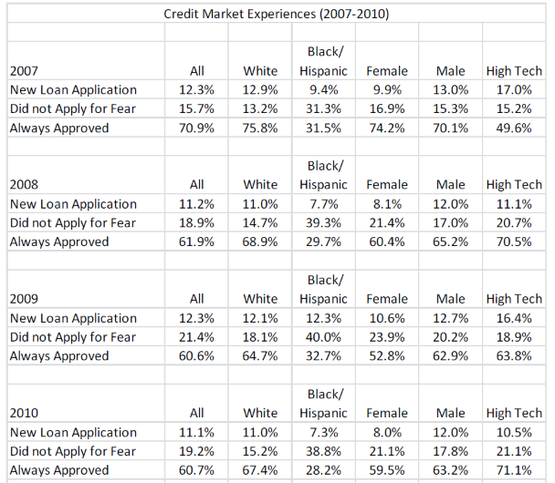
Credit market experiences

Slide 8
Loan applications: Fear of rejection
Among new and young firms, women were no more or less likely to apply for new loans than men.
Minorities were less likely than their White counterparts to apply for new loans when their firms were in the early years of operation.
Minority owners who did not apply for new loans were significantly more likely than their White counterparts to avoid applying for loans when needed because they were afraid that their loan applications would be declined by lenders. This is even after controlling for credit quality and a host of owner and firm characteristics.
Women were also more likely than similar men not to apply for credit when it was needed for fear of having their loan application denied during the years of the economic crisis.

Slide 9
Loan approvals: experience
Women and minority business owners’ fears of being declined for a loan were not necessarily unwarranted.
Even after controlling for such factors as industry, credit score, legal form, and human capital, minority owners of young firms were significantly less likely to have their loan applications approved than were similar White business owners.
In 2008, but not in 2007, 2009 or 2010, women owners of new businesses were significantly less likely than men with similar credit profiles and legal forms of organization to be approved for loans. This result may be related to the financial crisis.
We now look at the composition of financial capital used by the startups. But first we note some special costs of debt, particularly for startups.

Slide 10
Costs of using debt
Firms with more debt are likely to face higher probabilities of bankruptcy. Bankruptcy triggers both direct and indirect costs, which reduce the value of the firm.
  Direct Costs (Legal costs, costs due to illiquidity of assets in case of need to liquidate company).
  Indirect Costs
    Customers avoid firms selling products that might require future servicing and replacement if they are highly-leveraged because they are afraid the firm might go bankrupt.
    Customers avoid highly leveraged firms that provide goods or services whose quality cannot be determined easily in the short run.
Firms using debt capital also incur agency costs, due to inherent conflicts of interest between bondholders and stockholders.
  Hence firms with high levels of leverage tend to have higher overall costs of capital.
To protect themselves, lenders either
    incur costs of monitoring directly (which increases the cost of debt capital) or
    demand debt covenants, which reduce managerial flexibility.

Slide 11
Sources and amount of capital
In terms of the levels of financial capital, the evidence suggests that, although there are significant divergences between Blacks/Hispanics and whites and between women and men,
  after controlling for credit quality, industry, and other owner and firm characteristics, racial differences were generally not statistically significant, while in two of the years of observation, women used lower levels of financial capital.
Blacks and Hispanics relied less than Whites on formal financing channels such as bank financing (outsider debt), even after controlling for creditworthiness and wealth levels. Bank debt, in particular, provides an important signal for other investors.
However, women-owned startups were not significantly different from those owned by men in terms of the share of their financing that came from outside debt financing.

Slide 12
Minority access to finance: summary
Firms owned by African Americans and Latinos utilize a different mix of equity and debt capital, relative to firms owned by non-minorities.
They rely disproportionately upon owner equity investments and employ relatively less debt from outside sources (primarily banks), the average firm in these minority business subgroups operates with substantially less capital overall – both at startup and in subsequent years.
Women-owned businesses exhibit some similar disparities in capital structure. They have much less capital and have a different debt-equity mix. Their reliance upon outside equity capital is particularly low.
The initial disparities in the levels of startup capital by business owner race, ethnicity, and gender do not disappear in the subsequent years following startup.
The information asymmetry inherent with new and young firms is exacerbated in high technology industries due to the lack of tangible assets and their reliance on knowledge assets, as well as technical and market uncertainty. The information asymmetries associated with new firms in general, and high tech firms specifically, make traditional bank lenders less likely to lend to these firms. While the study does not look at how this affected minority businesses, it is reasonable to infer that minorities are less likely to go into such businesses.

