Slide 1
Financialization
Prof. P.V. Viswanath
Finance and Society

Slide 2
Financialization
It is useful to divide the economy into two sectors – real and financial, which contain real and financial assets respectively.
Real assets are used to produce goods and services directly, i.e. real assets are used in real activity. The real assets in the economy are objects such as land, buildings, machines and knowledge.
Financial assets are primarily claims to the results of the productive activity of the real sector, e.g. stocks. However, they also include derivatives of other financial assets, for example stock options.
Financial assets are traded in financial markets with the participation of financial institutions and create wealth for financial elites.
Financialization is a process whereby ﬁnancial elites gain greater inﬂuence over economic policy and economic outcomes through the operation of ﬁnancial markets and ﬁnancial institutions. The result is to transform the functioning of the economic system at both the macro and micro levels (Palley, 2013).

Slide 3
Financialization
The principal impacts are to
  elevate the signiﬁcance of the ﬁnancial sector relative to the real sector
  transfer income from the real sector to the ﬁnancial sector
  increase income inequality and contribute to wage stagnation.
Financialization operates through three different conduits: changes in the structure and operation of ﬁnancial markets; changes in the behavior of non-ﬁnancial corporations, and changes in economic policy.
We see some evidence now about the increased size of the finance sector and examine whether this growth has or has not contributed to welfare.

Slide 4
The story
The outlines of the financialization story are as follows.
The financial sector grows faster than the real sector. The financial subsectors farthest from the real economy, viz. the credit intermediation and securities subsectors grow faster (compared to the insurance subsector). These two subsectors are related, as explained below.
Credit intermediation is primarily the origination of loans taken by households, primarily secured by real estate.
This is followed by creation of asset backed securities (based on household mortgages) and the underwriting of these securities. Subsequently, derivatives of these securities are created ostensibly to manage the risk of these mortgage securities, but in the process encouraging speculation and trading.
The proliferation of all these securities leads to growth in the asset management sector, which in turn encourages trading in fixed-income securities and their derivatives.
Financialization sucks away resources from more productive sectors and draws human capital away from the real sector.
The size of the finance industry creates a political lobby which then influences public policy measures such as deregulation.
When the bubble bursts, there are real effects, which affect people in the real economy.
We can describe each part of this story.

Slide 5
The growth of the financial sector
At its peak in 2006, the financial services sector contributed 8.3 percent to US GDP, compared to 4.9 percent in 1980 and 2.8 percent in 1950.
The financial sector share of GDP increased at a faster rate since 1980 (13 basis points of GDP per annum) than it did in the prior 30 years (7 basis points of GDP per annum).
The securities and credit intermediation subsectors of finance are responsible for the acceleration of financial sector growth since 1980; insurance, by contrast, has grown at a steady pace since the 1940s. Insurance in contrast with the former two subsectors is tied to real activity, and hence provides a useful baseline to evaluate the growth of the financial sector
The growth of the financial sector is also evident in the growth of financial claims and contracts, including stocks, bonds, derivatives, and mutual fund shares.

Slide 6
The growth of the financial sector
Using data from the Flow of Funds Accounts published by the Federal Reserve, the value of total financial assets was approximately five times US GDP in 1980; by 2007, this ratio had doubled. Over the same period, the ratio of financial assets to tangible assets (like plant and equipment, land, and residential structures) increased as well.
This growth was not simply the continuation of a trend that started in the 1950s; rather, something appears to have changed in the early 1980s.
Workers in the financial sector have shared impressively in this growth: in 1980, the typical financial services employee earned about the same wages as his counterpart in other industries; by 2006, employees in financial services earned an average of 70% more.

Slide 7
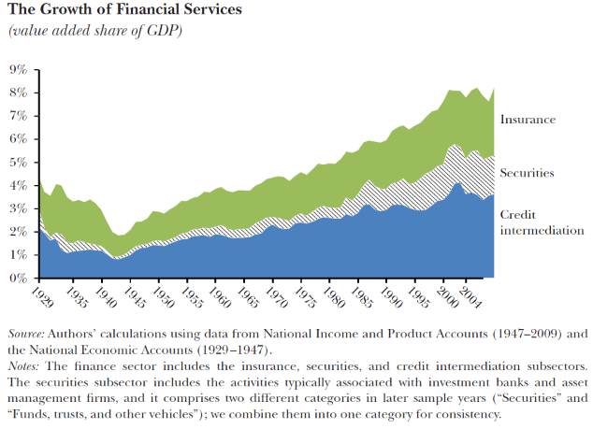
The growth of financial services
The growth rate of insurance is relatively constant; the growth rate of the other sectors is the main reason for financial service GDP growth.
Figure 1 from Greenwood, Robin and David Scharfstein, “The Growth of Finance,” Journal of Economic Perspectives—Volume 27, Number 2—Spring 2013—Pages 3–28

Slide 8
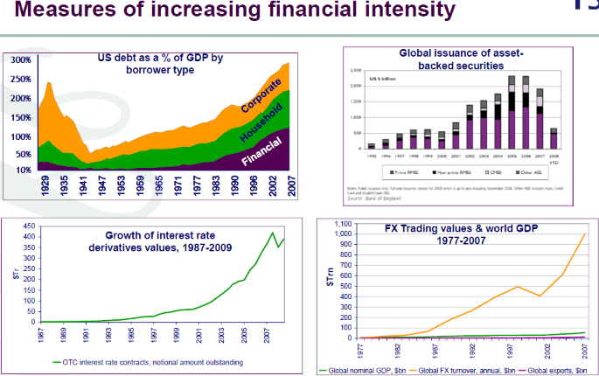
The growth of financial services
Figure 5 from Turner, Adair. 2010. “What Do Banks Do? Why do Credit Booms and Busts Occur and What Can Public Policy Do about It?” Chap. 1 in The Future of Finance, edited by Adair Turner et al. London School of Economics.

Slide 9
financial sector growth sources: summary
Much of the growth of finance is associated with asset management and the provision of household credit.
The value of financial assets under professional management and the total fees charged to manage these assets grew dramatically. A large part of this growth came from the increase in the value of financial assets, due to the increase in stock market valuations.
There was also enormous growth in household credit, from 48 percent of GDP in 1980 to 99 percent in 2007. Much of this growth was in consumer debt (auto, credit card, and student loans), but most of the growth was in residential mortgages. A significant fraction of mortgage debt took the form of home equity lines used to fund consumption.
The increase in household credit contributed to the growth of the financial sector mainly through fees on loan origination, underwriting of asset-backed securities, trading and management of fixed income products, and derivatives trading.

Slide 10
The securities subsector: investment banking
The securities subsector includes activities typically associated with investment banks (such as Goldman Sachs) and asset management firms (such as Fidelity). These activities include securities trading and market making, securities underwriting, and asset management for individual and institutional investors.
The three revenue sources traditionally associated with investment banking—trading fees and commissions, trading gains, and securities underwriting fees—fell as a percentage of GDP between 1997 and 2007, in spite of a fourfold increase in stock-market trading.
However, brokering and dealing in debt products had revenues in 2007 of $36 billion, and profits from derivatives trading were $45 billion. Most of the profits from derivatives trading came from fixed income products, a by-product of the growth of credit intermediation.

Slide 11
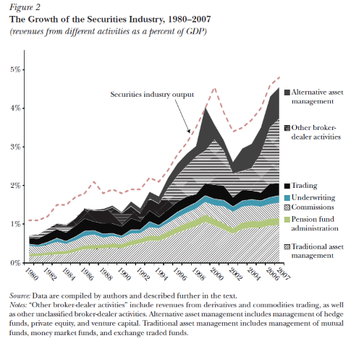
The growth of the securities industry
Much of the much of the growth in the securities subsector is associated with asset management and trading in derivatives (included in other broker-dealer activities).
Figure 2 from Greenwood, Robin and David Scharfstein, “The Growth of Finance,” Journal of Economic Perspectives—Volume 27, Number 2—Spring 2013—Pages 3–28

Slide 12
The securities subsector: asset management
There was enormous growth in fees from traditional asset management between 1980 and 2007.
The fees collected by alternative asset managers —hedge funds, private equity funds, and venture capital funds —also rose substantially over this period, due to “carried interest,” a percentage fee on realized gains.
Hedge fund fees peaked at $69 billion in 2007. Fees for private equity and venture capital spiked in 1999 at $66 billion; in 2007, private equity fees were $26 billion and venture capital fees were $14 billion. Together, fees for these alternative investments are comparable to the $91 billion that was collected by mutual fund managers, who managed more than five times as many assets.
During the period 1980 –2007, total asset management fees grew by 2.2 percentage points of GDP, which is over one-third of the growth in financial sector output.

Slide 13
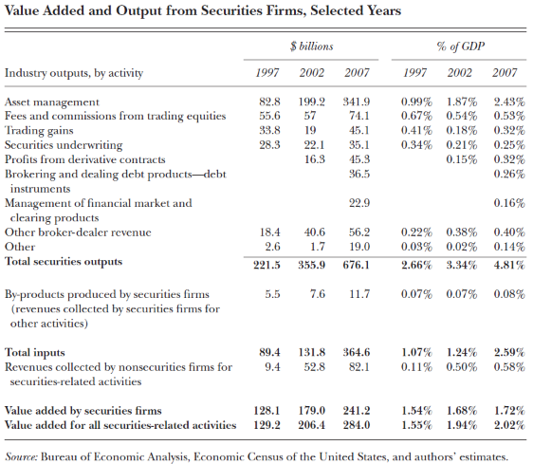
Value added and output: securities firms
Table 1 from Greenwood, Robin and David Scharfstein, “The Growth of Finance,” Journal of Economic Perspectives—Volume 27, Number 2—Spring 2013—Pages 3–28

Slide 14
growth in Asset management fees
Asset management fees as a percentage of assets did not fluctuate by much. The growth in these fees relative to GDP was driven by two factors: increases in the total outstanding amount of financial assets, and increases in the share of these assets that were professionally managed.
The value of traded equity and fixed income securities increased from 107 percent of GDP in 1980 to 323 percent of GDP by 2007.
  In fixed income, much of the growth came from securitization, whereby assets that were once held as illiquid loans on bank balance sheets were pooled into securities that could be traded and managed by professional investors. Fixed income securities grew from 57 percent of GDP in 1980 to 182 percent of GDP in 2007; approximately 58 percentage points of this growth came from securitization.
  In equities, much of the growth came from an increase in valuation ratios. Market capitalization of equities nearly tripled as a share of GDP between 1980 and 2007, growing from 50 percent to 141 percent of GDP. At the same time, the market-to-book ratio of the S&P 500 grew from 1.04 to 2.77
At the same time, the share of these assets under professional management has also increased.

Slide 15
professional asset management: Benefits
The growth of professional asset management was indirectly responsible for the large increase in stock market valuation ratios between 1980 and 2007. This, in turn, may have led to a decline in the cost of capital to corporations.
The greatest beneficiaries would have been young entrepreneurial firms —those most dependent on equity financing and whose values depend more on the cost of capital because of their more distant cash flows. Consistent with this interpretation, Fama and French (2004) show that young firms list their equity on the stock market at an increasing pace after 1979.
The enhanced ability of young firms to go public could also help explain the growth of venture-capital backed entrepreneurship after 1980.

Slide 16
professional asset management: Benefits
Mutual funds enable individuals to buy a basket of securities in one transaction rather than construct a portfolio of securities through multiple transactions. Employer-based retirement plans also make it easier to participate and diversify.
Professional asset management facilitates participation to the extent that excessively risk-averse individuals trust professional asset managers (rightly or wrongly) to invest their money wisely. Participation and diversification bring significant direct benefits to households. Participating in financial markets enables individuals to save and to earn a premium from holding risky assets —a premium that has historically been very high.
Diversifying enables individuals to more efficiently bear financial risk.

Slide 17
Professional asset management: benefits
There is evidence that professional asset management has indeed increased household participation. During the 1980–2007 period of growth in asset management, the share of household financial assets held in marketable securities or mutual funds grew from 45 percent to 66 percent.
According to the Survey of Consumer Finances, the percentage of households that owned stock increased from 32 percent in 1989 to 51 percent in 2007. There is also evidence that households increasingly diversified their portfolios. For example, holdings of foreign equities rose from 2 percent of US residents’ portfolios in 1980 to 27.2 percent in 2007.

Slide 18
Professional asset management: cons
Much of professional asset management, however, is not explicitly directed at participation and diversification but rather at beating the market—that is, earning excess risk-adjusted returns or “alpha.”
The evidence on mutual fund performance strongly indicates that such active management is not directly beneficial to investors on average. Most studies document that active investment managers underperform, especially after taking into account fees.
Of course, in the aggregate, there can be no outperformance of the market on average, since one investor’s positive alpha must be another’s negative alpha. Thus, beating the market cannot be a direct social benefit of professional management.
However, if chasing higher alpha leads to prices that reflect information better and lead to channeling of social resources into desirable investments, active asset management would be socially worthwhile. Such channeling is particularly valuable with startups, where uncertainty and information asymmetry is large; hedge funds are involved in such activity.
It is not clear that such value creation occurs. There is some evidence that evidence suggesting that securities prices have not become more informative since the 1960s.

Slide 19
Professional Asset management: Cons
It is not clear why investors put money into actively managed funds that do not earn excess returns. One possibility is that these investors are uninformed. But an undesirable consequence of the money that hedge funds make – in spite of the lack of social value added – is that they attract talent that could be used for social valuable ends.
In a recent study of MIT undergraduates, Shu (2013) shows that finance attracts the best students, as measured by their characteristics at the time of admission.

Slide 20
Credit intermediation subsector
The credit intermediation industry performs the activities typically associated with traditional banking—lending to consumers and corporations, deposit-taking, and processing financial transactions.
The credit intermediation subsector grew on a value-added basis from 2.6 percent of GDP in 1980 to 3.4 percent in 2007, having peaked at 4.1 percent of GDP in 2003.
This can be divided into two parts: traditional banking (lending and deposit-taking) and transactional services related to credit card accounts, deposit accounts, ATM usage, and loan origination.
The output from traditional banking as a percentage of GDP was roughly the same in 2007 as it was in 1997. However, substantial growth occurred in transactional services, which in turn were largely reflected in fees associated with deposits, residential loan origination, and the catchall category of “other products supporting financial services.”

Slide 21
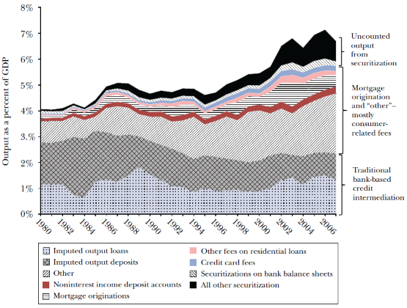
Credit intermediation output 1980-2007
Mortgage origination and consumer-related fees account for most of the growth in credit intermediation output.
Figure 4 from Greenwood, Robin and David Scharfstein, “The Growth of Finance,” Journal of Economic Perspectives—Volume 27, Number 2—Spring 2013—Pages 3–28

Slide 22
Credit Intermediation: securitization
Corporate and household credit rose as a share of GDP from 1980 –2007. Overall corporate credit grew from 31 percent of GDP in 1980 to 50 percent in 2007, while corporate loans on bank balance sheets fell slightly, from 14 percent of GDP in 1980 to 11 percent in 2007.
Household credit, mainly mortgage debt, grew more dramatically from 48 percent of GDP in 1980 to 99 percent, with the steepest rise occurring during the housing boom of 2000 –2006.
Despite this growth, banks held roughly the same amount of household credit as a share of GDP—approximately 40 percent—at the beginning and end of the period. All of the incremental growth in household credit as a share of GDP was securitized.
That is, banks holding the additional mortgages and consumer loans directly on their balance sheets, these loans were packaged into asset-backed securities. Indeed, as early as 1995, more than half of all outstanding single-family mortgages and a sizeable share of commercial mortgages and consumer credit were securitized.

Slide 23
Credit intermediation: securitization
It is difficult to know whether securitization was driven by an increased demand for credit by households and firms, or by an increase in supply stemming from changes in technology that allowed for easier administration of large pools of securities or lax regulation.
However, securitization went hand-in-hand with the growth of “shadow banking,” in which key functions of traditional banking are provided by a host of nonbank financial entities.
Shadow banks are “financial intermediaries that conduct maturity, credit, and liquidity transformation without explicit access to central bank liquidity or public sector credit guarantees.”
Like banks, they issue short-term, liquid claims and hold longer-term, riskier, and less-liquid assets. But unlike banks, they cannot issue insured deposits and do not have guaranteed access to the Federal Reserve’s lender-of-last-resort credit facilities.
Examples of shadow banks include mutual funds and structured investment vehicles that hold loans and asset-backed securities while being funded with short-term asset-backed commercial paper.

Slide 24
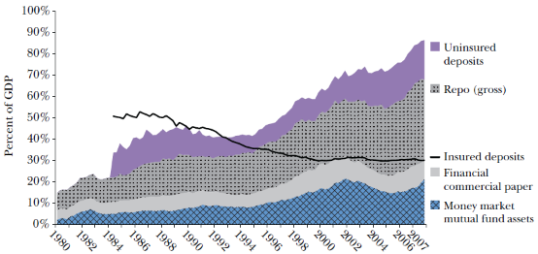
the financial sector: Short term funding
Short-term funding of the financial sector changed from insured deposits to most uninsured deposits, increasing instability.
Figure 5 from Greenwood, Robin and David Scharfstein, “The Growth of Finance,” Journal of Economic Perspectives—Volume 27, Number 2—Spring 2013—Pages 3–28

Slide 25
Shadow banks and fragility
Shadow banking institutions do not operate in isolation, but rather are connected to each other in the credit intermediation process. For example, money market funds hold asset-backed commercial paper, which itself holds asset-backed securities comprised of loans that are sometimes guaranteed by other entities.
Shadow banking has increased the number of interconnected steps in the credit intermediation process. Combined with short-term leverage, this new approach to banking may have increased financial system fragility.

Slide 26
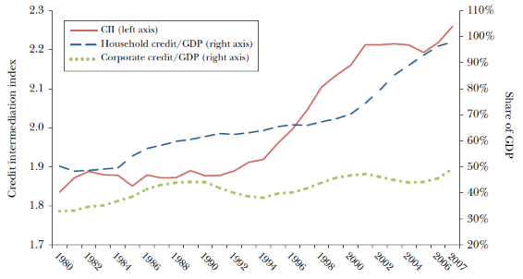
Credit intermediation index
The Credit Intermediation Index, measuring the number of steps between source of funds and use of funds has increased with household credit.
Figure 6 from Greenwood, Robin and David Scharfstein, “The Growth of Finance,” Journal of Economic Perspectives—Volume 27, Number 2—Spring 2013—Pages 3–28

Slide 27
Increase in credit: Cons
While credit can play an important role in enabling households to smooth consumption and fund investments, it can also lead to excessive consumption.
Laibson (1997) shows that when individuals have self-control problems —which he models with a hyperbolic discount rate — then financial innovation that increases the availability of credit can make these individuals worse off. The steep increase in indebtedness of many low- and moderate-income households above sustainable levels arguably made many of these households worse off. Many houses financed during the 2000–2007 housing boom now sit empty, and many households that increased their credit card borrowing during the credit boom have defaulted.
An increase in household indebtedness may have adverse consequences for macroeconomic stability. For example, Lamont and Stein (1999) show that household leverage increases house price volatility. Mian and Sufi (2012) show that greater availability of mortgage credit led to large increases in durables consumption, followed by large decreases in consumption when house prices fell during the financial crisis.

Slide 28
Did Finance contribute? Summary
Given that the growth in the financial sector comes primarily from asset management and the provision of household credit and the fees paid for such activity, the question of whether the recent growth in financial activity contributes to society is equivalent to an evaluation of professional asset management and the increase in household credit.
The main benefit was that it facilitated an increase in financial market participation and diversification, which likely lowered the cost of capital to corporations.
Young firms benefited in particular, both because they are more reliant on external financing and because their value depends more on the cost of capital.
While greater access to credit has arguably improved the ability of households to smooth consumption, it has also made it easier for many households to overinvest in housing and consume in excess of sustainable levels. Moreover, the shadow banking system that facilitated the credit expansion made the financial system more fragile.

Slide 29
Rent-seeking
How can we explain the growth in the financial sector that, most likely, did not help the overall population? One answer is rent-seeking.
Rent-seeking occurs when an individual or an entity seeks to increase their own wealth without creating any benefits or wealth to society through the manipulation of the distribution of economic resources. The practice reduces economic efficiency through the inefficient allocation of resources and leads to a rise in income inequality, lost government revenues, and a decrease in competition.

Slide 30
Rent seeking in finance
Competition in the financial sector is most likely to lead to socially desirable growth. However, excesses in the financial industry often leads to public resentment, which leads to a backlash against the entire finance industry.
Now, businesses can attract financial resources in two ways – one by competition with other firms, which requires on a legal system that one can trust for the prompt and unbiased enforcement of financial contracts. The other way is by creating monopolies with the help of regulation or some other element that raises the cost of entry to potential competitors. Such barriers to entry can potentially be created by a special relationship with the government, i.e. lobbying.
When there is public resentment, the prompt and unbiased enforcement of contracts, which are a necessary condition for competitive arm's length financing, is affected. Lacking public support, financiers need political protection to operate, but only those financiers who enjoy rents can afford to pay for heavy lobbying. Thus, in the face of public resentment only the noncompetitive and clubbish type of finance can survive (Zingales, 2015).
This is what happens particularly after financial crises, as explained below.

Slide 31
Rent seeking by finance industries
From a social point of view, competitive finance is preferable. However, there is no incentive for individuals to ensure that the political process works to such an end; on the other hand, there are incentives for businesses to try and lobby government for special treatment in obtaining finance. This is why public support is crucial to ensure that competitive financing is enabled.
Examples of lobbying that results in special treatment are bank bailouts, bank deregulation in the 1980s, and the implicit bailout options to Fannie Mae and Freddie Mac (their ability to borrow with a government guarantee) after the 2007 crisis. Many financial regulators, such as the SEC are sometimes captured by the finance industry.

Slide 32
Does finance benefit society?
There is evidence that on average a bigger banking sector (often measured as the ratio of private credit to GDP) is correlated with higher growth, both cross-sectionally and over time.
However, Arcand, Berkes and Panizza (2012) find that there is a non-monotonic relationship between the ratio of credit to GDP and growth, with a tipping point when credit to the private sector reaches around 80% to 100% of GDP. At this level, the marginal effect of financial depth on output growth becomes negative. In 2007, the ratio of private sector debt to GDP was around 225% and in 2020, it was 235%.

Slide 33
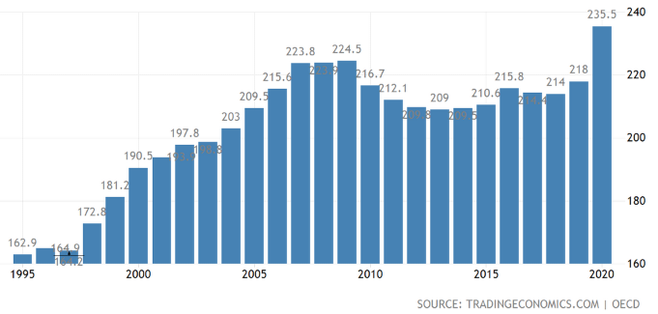
Private sector debt to GDP
Private sector debt to GDP measures the indebtedness of both sectors, non-financial corporations and households and non-profit institutions serving households, as a percentage of GDP.

Slide 34
Financial complexity: cons
Since the 1980s, debt securities have become more and more complex.
There is evidence that consumers do not understand them. For example, in Illinois, Agrawal et al. (2014) show that an overwhelming majority of borrowers who were receiving adjustable rate loans did not understand that their mortgage payment was not fixed over the life of the loan.
Other financial products, such as credit cards are structured such that the basic product is cheap, but with overpriced add-ons. Unsophisticated purchasers, not understanding this, buy the add-ons (Gabaix and Laibson, 2006).
Financial innovation is devoted to increasing profits, understandably, rather than helping clients. Thus, payday loans would help borrowers gradually adjust their day-to-day expenses in response to negative shocks or when they overestimate their resources, if repayments needed to be made in instalments (as shown by an experiment in Colorado); instead they are payable in full at maturity, which often leads to refinancing since clients are unable to make such large payments at a single time. Thus, although payday loans could be used to help people deal with natural disasters and other shocks, their structure leads people to use them unwisely.
Outright frauds also seem to be pervasive in the finance industry, judging from the amount of fines collected from companies.

Slide 35
What we need to do?
Countering ﬁnancialization calls for a multi-faceted agenda that (1) restores policy control over ﬁnancial markets, (2) challenges the neoliberal economic policy paradigm, (3) makes corporations responsive to interests of stakeholders other than just ﬁnancial markets, and (4) reforms the political process so as to diminish the inﬂuence of corporations and ﬁnancial elites.
Palley, T.. Financialization : The Economics of Finance Capital Domination, Palgrave Macmillan UK, 2013.
Greenwood, Robin and David Scharfstein, “The Growth of Finance,” Journal of Economic Perspectives—Volume 27, Number 2—Spring 2013—Pages 3–28
Zingales, Luigi. “Does Finance Benefit Society,” The Journal of Finance, August 2015, Vol. 70, No. 4, pp. 1327- 1363

