Slide 1
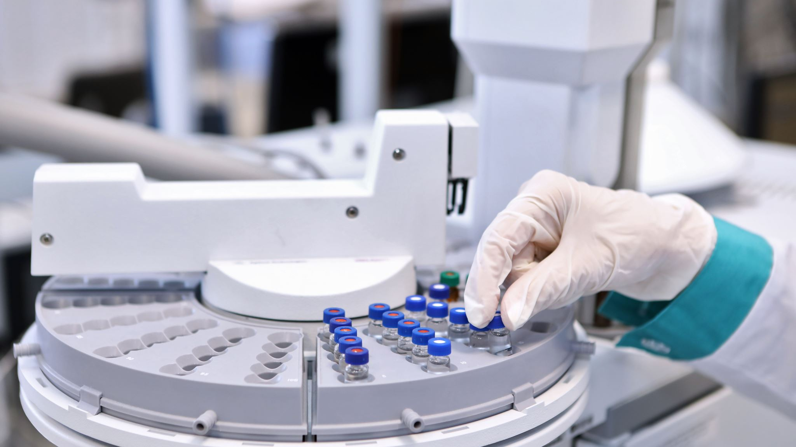
Porter Model: Pharmaceutical industry in 1990s
FIN 663: Financial Strategy and Business Decisions

Slide 2
Porter Model Applied: Pharmaceutical Industry 1990s
Barriers to Entry – Very Attractive
Steep R&D experience curve effects
Large economies-of-scale barriers in R&D
Critical Mass in R&D and marketing required global scale
Significant R&D and marketing costs
High Risk inherent in the drug development process
Increasing threat of new entries from biotechnology companies

Slide 3
Porter Model Applied: Pharmaceutical Industry 1990s
Bargaining Power of Suppliers
Mostly commodities
Individual scientists may have some personal leverage

Slide 4
Porter Model Applied: Pharmaceutical Industry 1990s
Bargaining Power of Buyers: Mildly Unattractive
Buying Process is price sensitive – the consumer did not pay and the buyer did not pay
Large power of buyers – plan sponsors with an incentive to contain costs
Mail-order pharmacies obtain large discounts on volume drugs
Large aggregated buyers – hospital suppliers, large distributors, government institutions

Slide 5
Porter Model Applied: Pharmaceutical Industry 1990s
Threat of Substitutes: Mildly Unattractive
Generic drugs weakening branded drugs
More than half the patent life spent on product development and approval process
Technological development is making imitation easier – reverse engineering
Consumer aversion to chemical substances erodes the appeal for pharmaceutical drugs

Slide 6
Porter Model Applied: Pharmaceutical Industry 1990s
Intensity of Rivalry: Attractive
Global Competition Concentrated Amongst fifteen large companies
Most companies focus on certain types of disease therapy
Competition amongst incumbents limited by patent protection
Competition based on price and product differentiation
Government intervention increases rivalry
Strategic alliances establish collaborative agreements among industry players
Very profitable industry, but declining margins

