Slide 1
Risk Management Introduction and Tools
P.V. Viswanath
Financial Theory
and
Strategic Decision-Making

Slide 2
Outline
Risk and Uncertainty
Risk Management
Risk Management using Vertical Integration and Storage
Risk Management using Long-term contracts
Hedging with Forwards
Hedging with Futures
Hedging with Options

Slide 3
Risk and Uncertainty
There is a distinction between risk and uncertainty.
Uncertainty exists whenever we do not know for sure what will occur in the future.
Risk is uncertainty that matters because it affects people’s welfare.
Thus if a supplier has scheduled a delivery for some time in the morning, there is uncertainty.
But there may be no risk if the supplies are only to be used in the future and employees are available to accept the delivery any time that it is made.
Bodie, Merton and Cleeton, Financial Economics

Slide 4
Risk and Risk Management
The riskiness of an asset or a transaction cannot be assessed in isolation; one has to look at the other activities/assets of the person/entity in question.
There is a trade-off between the benefit of eliminating the risk and the cost of that risk reduction. The process of formulating the benefit-cost trade-offs of risk reduction and deciding on the course of action to take (including the decision to take no action at all) is called risk management.
The appropriateness of a risk management decision should be made in light of the information available at that time. Thus, if the event feared does not come to pass, e.g. if the forecasted hurricane is not as severe as expected, the risk management action does not, ex post, become a bad one (or a good one).
Bodie, Merton, Cleeton, Financial Economics

Slide 5
Risks facing Firms
There are several kinds of risk that face firms. Some of them are:
Production risk – the risk that machines will break down, that deliveries of raw materials will not arrive on time, that workers will not show up for work, or that a new technology will make the firm’s existing equipment obsolete.
Price risk of outputs
Price risk of inputs
Other risks, such as risk of nonpayment by customers, reputation risk etc.
Bodie, Merton, Cleeton, Financial Economics

Slide 6
The Risk management process
The risk management process consists of several steps:
Risk identification – figuring out the most important risk exposures. It is important to take a holistic approach. Thus, a firm that sells products and buys inputs abroad in prices that are fixed in foreign currencies has to look at the net effect of exchange rate uncertainty on its revenues less its costs. The firm’s net exposure to exchange rate uncertainty might be positive or even zero.
Risk assessment – a quantification of the costs associated with the risks that have been identified in the step of risk identification.
Selection of risk-management techniques
Implementation
Review – feedback.
Bodie, Merton, Cleeton, Financial Economics

Slide 7
Basic Risk Management Techniques
Risk avoidance
a firm may decide not to produce in a politically sensitive country, so as not to be subject to political risk.
Loss prevention and control
actions taken to reduce the likelihood and severity of loss; the firm might decide to choose a small scale of operations or a particular geographical location or it might decide to go into a joint undertaking with the government (if nationalization is feared).
Risk retention
a decision to absorb the risk and covering losses out of the firm’s own resources.
Risk transfer
transferring the risk to others, e.g. by selling an asset to somebody else, or by buying insurance.
Example with an impending hurricane..
Bodie, Merton, Cleeton, Financial Economics

Slide 8
Dimensions of Risk Transfer
Hedging
reducing one’s exposure to loss – and also to gain.
Insuring
Paying a premium to avoid solely the loss.
Q: Can you insure using a financial security?
Diversifying
holding similar amounts of many risk assets instead of concentrating on only one. Similarly, investing in many similar projects, but where the loss/gain in one project is unrelated with the loss/gain in another.
Q: What would be an example of diversifying in supply chain management?
Bodie, Merton, Cleeton, Financial Economics

Slide 9
Vertical Integration and Storage
Firms can make real investments in assets with offsetting risk. Two of these are vertical integration and storage.
Vertical integration refers to the merger of a firm and its supplier or a firm and its customer. Because an increase in the price of the commodity raises the firm’s costs and the supplier’s revenues, these firms can offset their risks by merging.
Long-term storage of inventory is another strategy for offsetting commodity price risk. For example, an airline concerned about rising fuel costs could purchase a large quantity of fuel today and store the fuel until it is needed. By doing so, the firm locks in its cost for fuel at today’s price plus storage costs.
Berk and DeMarzo, Corporate Finance

Slide 10
Long-term Contracts
Long-term contracts can also transfer risk to other parties. This can be considered a form of hedging.
In early 2000, when oil prices were close to $20 per barrel, the CFO of Southwest Airlines developed a hedging strategy to protect the airline from a surge in oil prices. By the time oil prices soared above $30 per barrel later that year Southwest had signed contracts guaranteeing a price for its fuel equivalent to $23 per barrel.
However, had oil prices fallen below $23 per barrel in the fall of 2000, Southwest’s hedging policy would have obligated it to pay $23 per barrel for its oil.
Southwest accomplished it’s objective by locking in its cost of oil at $23 per barrel, regardless of what the price of oil did on the open market.
Why would you call this hedging? How is it or is it not similar to insuring?
Berk and DeMarzo, Corporate Finance

Slide 11
Hedging w/ Long-term Contracts: Example
How do you decide which is the better solution of the two?
Berk and DeMarzo, Corporate Finance

Slide 12
Long-term Contracts: Disadvantages
They expose each party to the risk that the other party may default and fail to live up to the terms of the contract. Thus, while they insulate the firms from commodity price risk, they expose them to credit risk.
Long-term supply contracts cannot be entered into anonymously; the buyer and seller know each other’s identity. This lack of anonymity may have strategic disadvantages.
The market value of the contract at any point in time may not be easy to determine, making it difficult to track gains and losses, and it may be difficult or even impossible to cancel the contract if necessary.
Q: Where does this show up in the balance-sheet?
Berk and DeMarzo, Corporate Finance

Slide 13
Hedging with Futures Contracts
An agreement to trade an asset on some future date, at a price that is locked in today
Futures contracts are traded anonymously on an exchange at a publicly observed market price and are generally very liquid.
Both the buyer and the seller can get out of the contract at any time by selling it to a third party at the current market price.
Futures contracts eliminate credit risk.
Futures prices are not prices that are paid today.
Rather, they are prices agreed to today, to be paid in the future.
The futures prices are based on the supply and demand for each delivery date.
Berk and DeMarzo, Corporate Finance

Slide 14
Futures Contracts and Credit Risk
Futures exchanges use two mechanisms to prevent buyers or sellers from defaulting.
Traders are required to post collateral when buying or selling commodities using futures contracts.
This collateral, which is called margin, serves as a guarantee that traders will meet their obligations.
Marking to Market
Futures contracts are zero-sum contracts. Gains and losses are computed each day based on the change in the market price of the futures contract. These gains are paid by the losing party in the futures contract to the gaining party.
Berk and DeMarzo, Corporate Finance

Slide 15
Marking-to-Market: An Example
Suppose a buyer who enters into the contract has committed to pay the futures price of $81 per barrel for oil.
Q: At this point, how much money changes hands?
If the next day the futures price is only $79 per barrel, the buyer has a loss of $2 per barrel on her position. This loss is settled immediately by deducting $2 from the buyer’s margin account.
Q: Who gets the $2?
If the price rises to $80 per barrel on the following day, the gain of $1 is added to the buyer’s margin account.
The buyer’s cumulative loss is the sum of these daily amounts and always equals the difference between the original contract price of $81 per barrel and the current contract price.
Fun activity: See the movie “Arbitrage” and “Margin Call.” The first movie has something to do with margin calls, but the second doesn’t seem to..
Berk and DeMarzo, Corporate Finance

Slide 16
Marking-to-Market: An Example
If the price of oil is ultimately $59 per barrel, the buyer will have lost $22 per barrel in her margin account.
Thus her total cost is $59 + $22 = $81 per barrel, the price for oil she originally committed to.
Through this daily marking to market, buyers and sellers pay for any losses as they occur, rather than waiting until the final delivery date. In this way, the firm avoids the risk of default.
However, even though futures hedging can reduce ultimate price risk, it does introduce uncertain demands for cash because of marking-to-market.
Berk and DeMarzo, Corporate Finance

Slide 17
Hedging with Forwards
A forward contract is similar to a futures contract, except that there is no marking-to-market.
Counterparty risk is, therefore, very important. As a result, forward trading is usually done only between parties that have long-term business relationships, such as banks and their customers.
For example, by entering into a currency forward contract, a firm can lock in an exchange rate in advance and reduce or eliminate its exposure to fluctuations in a currency’s value.
A currency forward contract specifies
The forward exchange rate
An amount of currency to exchange
A delivery date on which the exchange will take place
Q: Is there a similarity between a forward contract and a long-term business contract?
Berk and DeMarzo, Corporate Finance

Slide 18
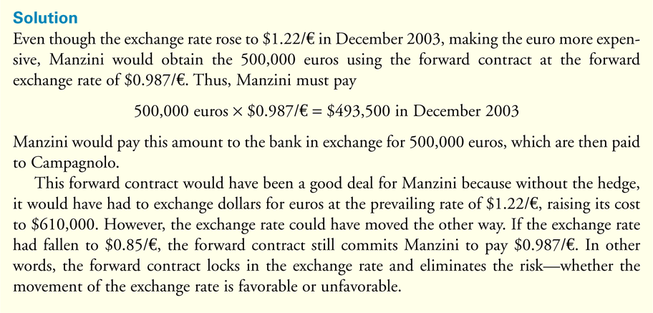
Hedging with Forwards: An example
Berk and DeMarzo, Corporate Finance

Slide 19
Hedging with Options
Currency options are another method to manage exchange rate risk.
Assume that in December 2005, the one-year forward exchange rate was $1.20 per euro.
A firm that will need euros in one year can buy a call option on the euro, giving it the right to buy euros at a maximum price.
Suppose a one-year European call option on the euro with a strike price of $1.20 per euro trades for $0.05 per euro.
Berk and DeMarzo, Corporate Finance

Slide 20
Hedging with Options
If the spot exchange rate is less than the $1.20 per euro strike price of the option, then the firm will not exercise the option and will convert dollars to euros at the spot exchange rate.
If the spot exchange rate is more than $1.20 per euro, the firm will exercise the option and convert dollars to euros at the rate of $1.20 per euro. Adding in the initial cost of the option gives the total dollar cost per euro paid by the firm.
Berk and DeMarzo, Corporate Finance

Slide 21
Forward Contract, Option, or No Hedge
If the firm does not hedge at all, its cost for euros is simply the spot exchange rate.
If the firm hedges with a forward contract, it locks in the cost of euros at the forward exchange rate and the firm’s cost is fixed.
If the firm hedges with options, it puts a cap on its potential cost, but will benefit if the euro depreciates in value.
If the firm sells an option or trades forward, there will usually be margin payments and, there could be short-term liquidity problems.
Berk and DeMarzo, Corporate Finance

Slide 22
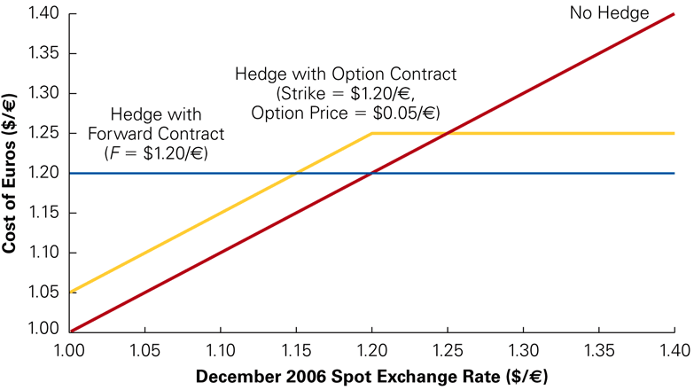
Forward Contract, Option, or No Hedge
Berk and DeMarzo, Corporate Finance

