Slide 1
Introduction to Chinese history
The Chinese financial system, spring 2014
PV Viswanath
Lubin school of business

Slide 2
Location
14,500 km coastline along the East China Sea, the Korean Bay, the Yellow Sea and the South China Sea.
Bordered by North Korea, Russia and Mongolia in the northeast and north
Kazakhstan, Kirghizstan, Tajikistan, Afghanistan and Pakistan in the west
India and Nepal in the southwest
Myanmar, Laos and Vietnam in the South
The Yellow river originates at the foot of the Kunlun mountains in the west and flows over 5000 kilometers eastward to the Pacific Ocean.
Present day Chinese seem themselves as the descendants of the Hua, who settled in the middle reaches of the Yellow river valley and the Xia people, who established themselves near the Han river (a tributary, which meets the Yangtse near Wuhan).
These areas are in the central southern region 0f Shaanxi province, whose capital is the well-known city of Xi’an (famous for its terracotta warriors, from the reign of Shi Huangdi of the Qin dynasty (247 BCE – 210 BCE).

Slide 3
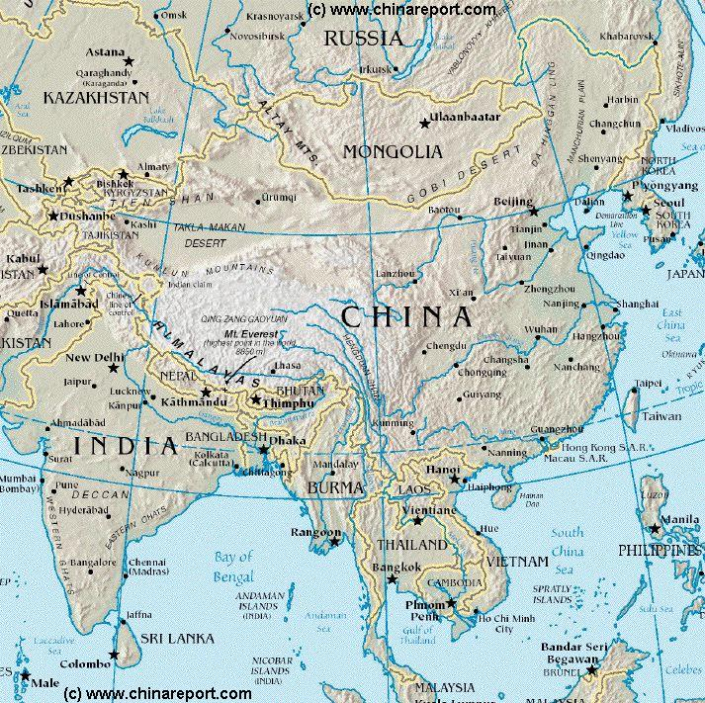
China: Location and neighbors

Slide 4
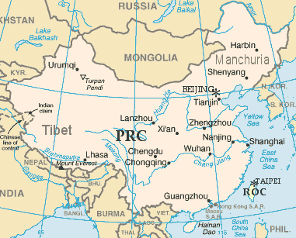
China: Rivers
Huang He: Yellow River
Chang Jiang: Yangtse River (Long River)

Slide 5
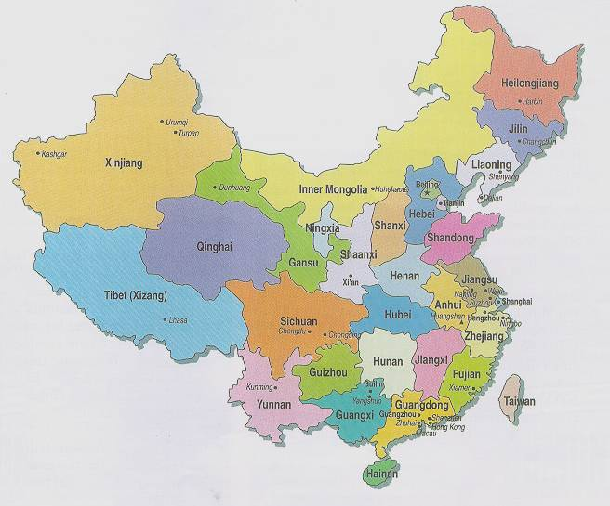
China: provinces

Slide 6
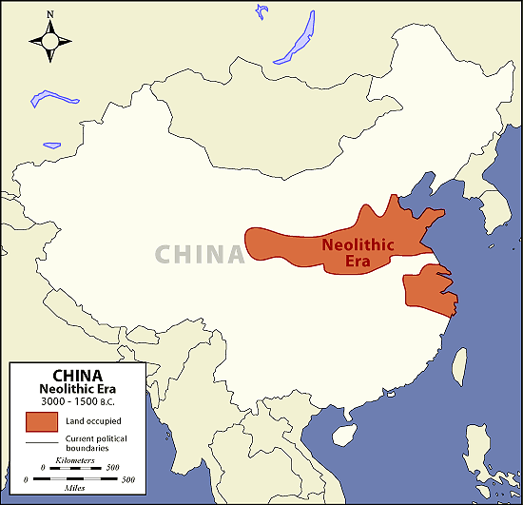
Chinia: 3000-1500 BCE

Slide 7
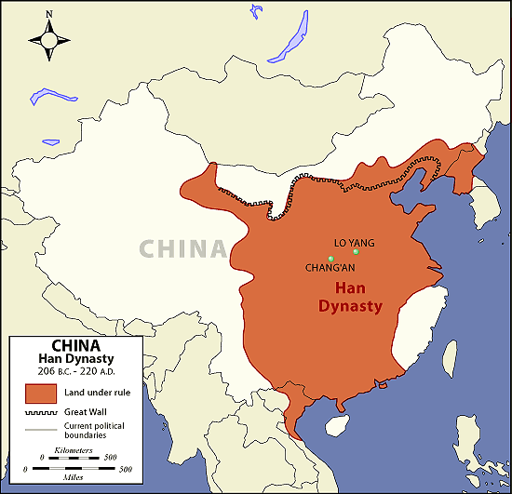
China: han dynasty, 206-220 CE

Slide 8
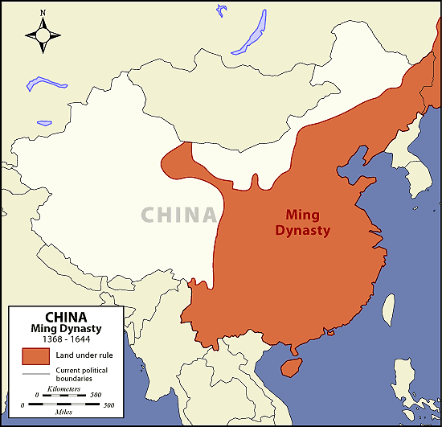
China: ming Dynasty, 1368-1644 CE

Slide 9
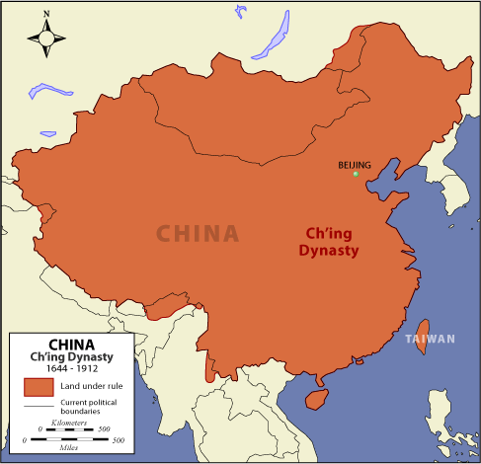
China: Qing dynasty, 1644-1912 CE

Slide 10
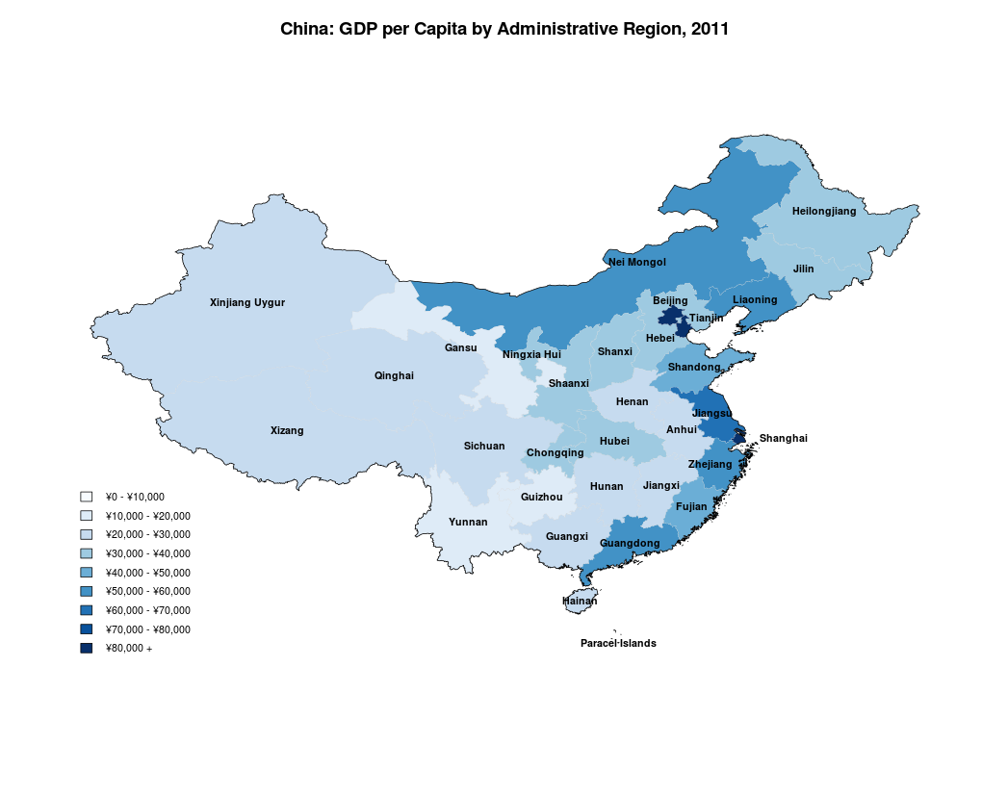
China: GDP by provinces

Slide 11
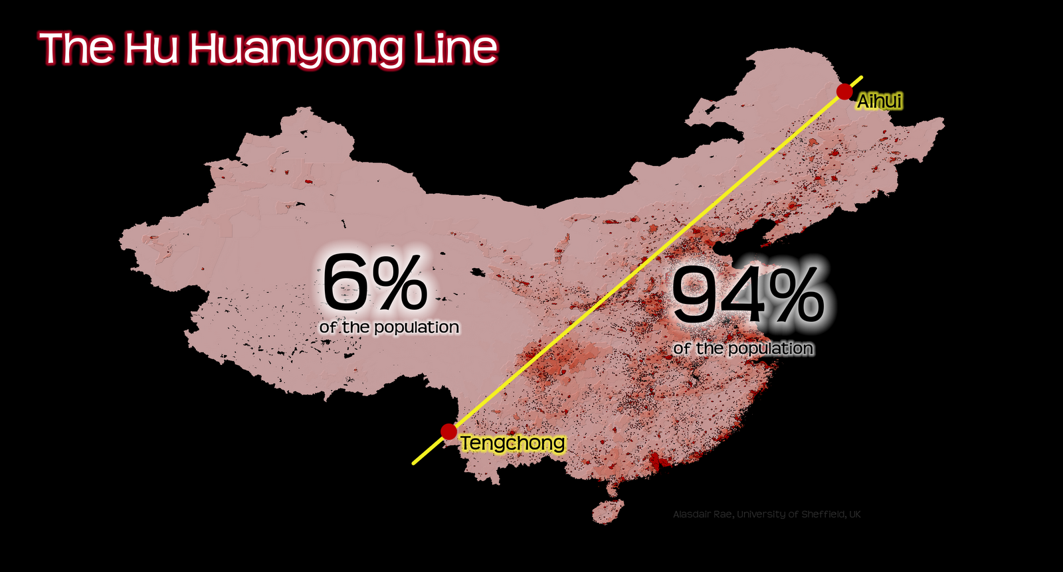
The aihui-tengchong line
From Alasdair Rae’s page, http://undertheraedar.blogspot.com/2012/06/population-of-china.html
Figures for 2010

Slide 12
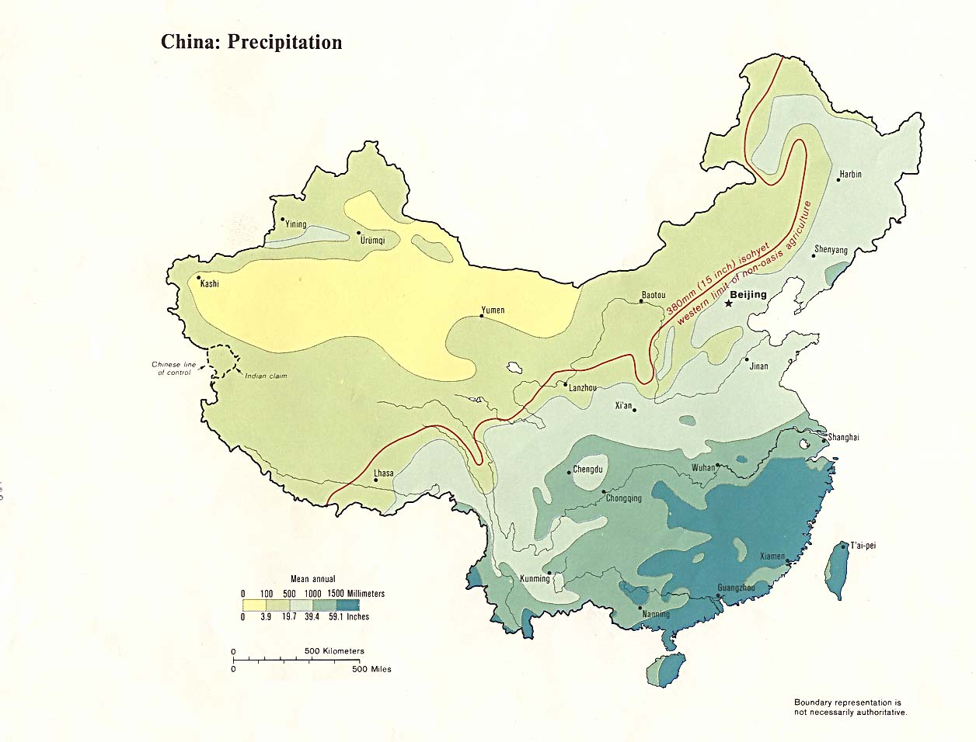
China: precipitation
From http://lib.utexas.edu/maps/china.html, 1983 data

Slide 13
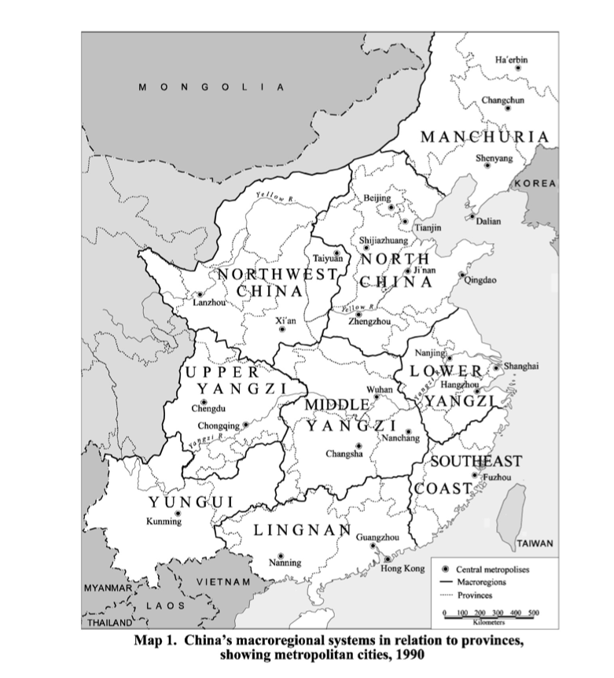
China: Macro regions
Macro Region | Characteristic | Cities
North China | Most important | Beijing
Lower Yangzi | Most developed | Shanghai
Northeast (Manchuria) | Abundant natural resources, center of heavy industry | Shenyang
Middle Yangzi | Grain producing | Wuhan
Upper Yangzi | Fertile and densely populated | Chongqing, Chengdu
Southeast Coast | Maritime China, home of Overseas Chinese | Fuzhou, Xiamen
Far South (Lingnan) |  | Guangzhou
Southwest China (Yungui) | Dense population, low income | Kunming
Northwest China | Plateau, arid land, few fertile river valleys | Xi’an, Taiyuan
Most developed: Lower Yangzi

Slide 14
China: history
Time | Dynasty | Remarks
Ca. 2700 BCE/2300 BCE | Emperor Yan, Emperor Huangdi | Legendary kings
21st century BCE to 1766 BCE | Xia | Neolithic culture
1766 BCE to 1046 BCE | Shang dynasty | Based on agriculture, development of oracle bone writing, use of bronze
1046 BCE to 3rd century BCE | Zhou dynasty | Feudal system, first use of Zhongguo (middle kingdom), Laozi, Confucius, Mencius, Mozi, Hanfei, Xunzi
221 BCE to 206 BCE | Qin (Emperor Shi Huangdi) | Legalism – strict system of rewards and punishments; construction of the Great Wall
206 BCE to 220 CE | Han | Expansion to Xinjiang and Central Asia, Confucianism official doctrine; social chaos towards the end of the period

Slide 15
China: history
Time | Dynasty | Remarks
220 CE to 265 CE | Three kingdoms period: Wei, Shu and Wu
265 CE to 420 CE | Jin | Non-Han enemies in the north forced capital to move to Nanjing; economic center moves to southeast; Buddhism popular
420 CE to 589 CE | Southern and Northern dynasties | Fragmentation
589 CE to 618 CE | Sui | Construction of the Grand Canal
618 CE to 907 CE | Tang | Golden age of literature and art; system of civil service exams; Arab victory at Talas in 751 CE began period of decline
907 CE to 960 CE | Five dynasties | Fragmented China
960 CE to 1279 | Song | Centralized bureaucracy, capital at Kaifeng; non-Han Liao capture Kaifeng; non-Han Jin capture northern China; Song capital move Innovations: Compass, gunpowder, movable type printing

Slide 16
China: history
Period | Dynasty | Remarks
1279 CE to 1367 CE | Yuan | Mongol rule under the leadership of Genghis Khan, cultural exchange with Europe and West Asia; conversion to Islam of many Chinese in Northwest and Southwest; Nestorian and Catholicism, Tibetan Buddhism flourish Innovations: printing techniques, porcelain production, playing cards
1368 CE to 1644 | Ming | Han dynasty established in Nanjing, moved in 1421 to Beijing. Northern Vietnam conquered. Chinese navy sails the China seas, the Indian Ocean and Africa.
1644 CE to 1911 | Qing | Manchu, non-Han dynasty, but assimilated to Han Chinese culture; conquered outer Mongolia, Taiwan incorporated into kingdom. In the 1840s, Britain starts First Opium War for right to import Indian opium in exchange for Chinese tea. USA, Britain and other European powers seize concessions.
1911 to 1949 | Republic of China | Dr. Sun- Yatsen, first President

