Slide 1
Venture capital and private Equity in china
The Chinese financial system, spring 2014
PV Viswanath
Lubin school of business

Slide 2
Learning objectives
What is private capital?
What do private equity firms do? What is the difference between private equity and venture capital?
How do PE/VC firms exit from their investments?
How did venture capital begin in China in the early days of reform? What were the early problems?
What was the role of the government in promoting innovation?
When did foreign money enter the Chinese VC market? What was the nature of this early investment and what were the problems?
What were some of the problems that foreign investors encountered in exiting their investment?
What is the status of the VC market today?

Slide 3
What is Private equity?
Private Equity firms are financial intermediaries that collect funds from investors who want high returns and are willing to take high risks with low liquidity.
They then turn around and invest it in unlisted companies, help develop them and then take them public or sell them to other, larger firms.
Most private equity firms work with small and medium-sized enterprises (SMEs). Some also invest in entrepreneurial start-ups that have just the germ of a business idea or innovation and don’t require large amounts of capital; these are usually called angel investing firms. Venture capital firms invest in firms that are somewhat larger, have a product and are ready to commercialize their innovative idea.
Although the three investor groups are quite different, and the risk profile is different, we will discuss all three simultaneously.
In the context of China, we are mainly talking about venture capital firms and PE firms investing in SMEs.

Slide 4
What is private equity?
PE firms are the talent scouts of company investment. They spend a lot of time assessing the potential of companies, to understand their risks and how to mitigate them. (The Little Book of Private Equity, EVCA).
The idea is to invest in a company and make it more valuable, over a number of years, before finally selling it to a buyer who appreciates that lasting value has been created.
These buyers might be large conglomerates and corporations, larger financial investors or stock market investors (through an IPO).
In listed companies, managers and owners are separated, and there is often a misalignment of interests. Managers don’t always act to maximize owners’ wealth.
In private equity, companies are owned by a small number of professional investors, through a chain of command that directly links value with reward, from company managers through to private equity fund managers.

Slide 5
What is private equity?
VC/PE fills the void between sources of funds for innovation (e.g. corporations, government bodies, entrepreneur’s friends and family) and traditional lower-cost sources of capital such as the stock market, bond market and banks that are available to ongoing concerns.
VC/PE firms invest for a period of time from 5 to 10 years and expect to make a return of 25% to 35% p.a. However, 40% of the firms that VC/PE firms invest in may turn out to be unsuccessful, about 40% may do quite well and only 20% may do very well. Hence the risk profile of a VC/PE firm is quite high.
PE firms might start out with a 20% to 40% preferred equity ownership which offers downside protection, since they will be paid off before other equity investors. In addition, the PE investor might be protected against equity dilution if subsequent rounds of financing take place at lower valuations, in the form of anti-dilution clauses called ratchets. If a company does well, on the other hand, PE investors will have the right to put additional money into the venture at a predetermined price.
For example, Airbnb – a company created in 2008 to help people find spare rooms and couches to sleep on -- has a list of VC investors, such as TPG Growth, Sequoia Capital, the only outside investor in WhatsApp; Andreessen Horowitz, an early backer of Facebook; Founders Fund; and the actor Ashton Kutcher. Its 2012 fund-raising round valued the company at $2.5 billion. It’s 2014 round is raising $400 million in new capital, which is likely to value it at more than $10 billion. Sequoia Capital invested $600K in the second round of financing in 2009 and continued to invest in 2010 and 2011.

Slide 6
VC In the beginning
In the mid-1980s, the central government decided to sponsor local venture capital funds as part of the overall reforms in China’s science and technology sector. These initiatives were in the areas of basic research, high technology R&D, technology innovation and commercialization, construction of scientific research infrastructure, and development of human resources in science and technology. These programs were driven by the Ministry of Science and Technology (MOST), the National Natural Science Foundation and the Ministry of Finance.
These initiatives led to the creation of many government-funded VC firms.
However these companies were staffed with government officials and SOE managers without previous VC/invest experience; in addition, there was a lot of bureaucracy and a government agenda.
This was a mechanism for the government to try to drive macroeconomic growth y encouraging technology innovation and commercialization.
As a result, most of these funds failed, notably the China New Technology Venture Investment Company, which was founded in 1985 and which went bankrupt in 1997.

Slide 7
MOST programs to support innovation
However, many of these initial programs survived and went on to be the seeds for innovation. For example, the Torch program from MOST is a very successful entrepreneurial program. Its objective is to support high-tech industrialization, focusing on promoting indigenous innovation.
In the last decade, the Torch program has managed to break free of the government bureaucracy and is being run like a startup. Torch has four major parts – innovation clusters, Technology Business Incubators, Seed Funding (Innofund) and Venture Guiding Fund.
Industries have a competitive advantage when companies are clustered in a single geographical location, where firms can learn from each other, such as in Silicon Valley for technology, Hollywood for movies, Milan for fashion and New York for finance. The Torch program intentionally creates innovation clusters in the form of Science and Technology Industrial Parks, Software Parks and Productivity Promotion Centers. A prominent example is Zhongguancun Science Park in Beijing, which has become China’s Silicon Valley.
Inside these clusters are located incubators which provide startups with office space, access to university technology transfer, etc.
Innofund offers grants, loan interest subsidies and equity investment for early stage technology companies that have innovative technology, but are too early for commercial funding from banks or VCs (angel funding).
The Venture Guiding Fund, set up by MOST invests directly in VC funds and also co-invests with other VC funds; in other cases it provides downside insurance for VC funds to enable them to take risks.
Steven Blank, http://steveblank.com/2013/04/10/china-the-sleeper-awakens/

Slide 8
Commercially driven PE/VC in the 1990s
Once the government realized that the government couldn’t successfully operate VC funds, Chinese banks stepped in, with local governments often acting as guarantors. The Technology Industrial Parks and incubators made it easier for banks to fund such ventures.
International Data Group (IDG) formed the first foreign venture fund to operate in China. 95% of the funds were foreign funds.
The reasons for this timing are manifold.
The Shanghai Stock Exchange opened in December 1990
The Shenzhen Stock Exchange opened in April 1991.
In 1992, Deng Xiao Peng went on his southern tour, declaring “black or white cat, it is a good cat as long as it catches the mouse.” Capitalism with Chinese characteristics.
Greater SOE autonomy, price reforms and the opening of the Chinese economy to the world.
The Chinese economy grew at a rate of 11% from 1991 to 1994.
Chinese firms had begun to list on overseas stock exchanges; in October 1992, Brilliance Automotive (an SOE) listed on the NYSE, followed by nine IPOs the following year on the HKSE.
These reasons can be summarized in two broad ways: one, the Chinese economy was opening up, and two, exit options were increasing.

Slide 9
Failure of early Vc/PE funds
Asian Strategic Investment Management Company (ASIMCO), a VC firm founded by Jack Perkowski, in 1994, was one of the first foreign ventures into China. This was an automotive parts company that planned to consolidate the numerous small firms in the industry. Although ASIMCO is very successful today, it did not make much headway for quite some time.
Other VC firms were even less successful mainly due to the fact that these fund managers did not realize the difficulties of investing in the Chinese business environment of that time.
One of the big issues that VC firms faced was because they chose to create joint ventures with SOEs as a way to resolve the problem of creating deal flow, i.e. finding new companies to invest in.
In developed capital markets, PE and VC investors rely on their reputation, on proprietary deal sourcing networks and on market intermediaries such as investment banks, accounting firms and law firms.
In China, this infrastructure did not really exist and foreign investors had no existing deal flow structure to rely upon to source transactions. Hence PE/VC firms sought to speed up the process by leveraging SOE relationships. Furthermore, they also sought these connections as insurance against state expropriation.

Slide 10
Failure of early Vc/PE funds
The problem was that the SOEs had weak corporate governance and SOE managers had no incentive to pursue enterprise growth because they got no benefit from any increase in firm value. SOE managers were more interested in satisfying their political bosses, since their careers depended on how they were perceived by their superiors in the SOE firm as well as in the Communist party, since the party controls higher-level SOE appointments.
The VC firms’ problems were threefold:
The VC firms’ interests were not aligned with the SOEs, both in terms of setting up investment funds, as well as in executing a “turnaround strategy.”
The SOE partners did not have the same interest in creating an exit in the domestic capital markets due to “legal person share” illiquidity issues.
The VC firms could not properly judge the quality of Chinese business managers or evaluate the sustainability of business models in the face of the rapid changes occurring in the Chinese economy.

Slide 11
Failure of early vc/pe funds
One way that the VC firms could have more control of the process would be to have majority ownership of the portfolio companies; however, this was politically difficult to obtain in China.
Furthermore, early investors depended heavily upon legal contracts to gain “control.” However without a robust and functioning legal system, the standard investing strategies (i.e. contract-based) that were effective in developed capital markets failed to produce successful results in China.
SOE firms, especially in the early years, exhibited a corporate culture that had a planned economy mentality. SOE managers were difficult to motivate to generate shareholder value rather than other entrenched goals, such as employment, size and political objectives.

Slide 12
Exit problems
China’s early security regulations limited the trading of shares on the public markets to newly issued shares. The government did not want shares owned by SOEs and other government institutions to be traded, since this would cause the government to lose control of those state owned enterprises.
To a certain extent, the government was using SOEs to provide employment, particularly to the urban population and losing control of SOEs would preclude this strategy. Furthermore, the government wanted to keep the value of the newly issued shares high and make them more attractive; if existing shares could be traded, the supply of shares could depress prices.
Hence shares held by existing shareholders prior to an IPO were treated as “legal person” shares. These shares were prohibited from being traded on any public market, even if the firm’s shares were traded on an external stock exchange such as the Hong King Stock Exchange or the NYSE.
This meant that since VC investors would normally be holding legal person shares in the SOEs that they had invested in, they were not able to used the public markets to exit their investments even if they successfully engineered an IPO on a foreign market.

Slide 13
Solutions to Exit problems
Some investors expected rules regarding legal person shares to be changed soon, so they simply invested directly into China-based companies as a joint-venture partner. This process was initiated in April 2005 and was well under way by mid-year 2006. However, non-tradable shareholders were required to compensate tradable shareholders for the dilution in share prices that this trading reform caused. This process is complete, in that all legal person shares are now tradable. However, large block of shares are still in government hands.
Others tried to finesse the issue by structuring their investment through an offshore holding company, which would own majority control of the domestic China-based operating company. In this structure, the offshore holding company would become the listed vehicle, in which the foreign investors would hold shares, while the Chinese investors would hold shares in the onshore operating company. However, this structure provided no incentive for the Chinese management teams to profitably manage their companies.
Another structure that was tried was co-investing with multinational companies (MNCs) with the expectation that the financial investor’s stake could be sold to the MNC. This structure solved the exit problem, but the financial investor was not adding much value as if they had invested in a Chinese company directly.

Slide 14
Private company deals: the start
Another problem was that there were few skilled and trained Chinese investors active in the market in this early period. Skills such as analyzing business models, performing in-depth due diligence, and judging the quality of management teams did not exist. Hence foreign investors were not able to accurately research and evaluate investment opportunities.
Over time, the value-added to the Chinese economy by private companies became quite evident and trained equity analysts began to be available. VC/PE deals involving private companies became more common.
In 1997, China International Capital Corporation structured and lead a $40m. investment Eagle Brand Holdings, one of the largest ceramic tile and sanitary ware manufacturers in China at that time. The investors structured the deal so that the Chinese management team held ownership in an offshore holding company alongside the financial investors, effectively aligning the interests of all shareholders toward building shareholder value. This solved the exit problem and the alignment of interests problem simultaneously, as it would work in a developed market.
The founding shareholders of CICC were China Jianyin Investment Limited, Morgan Stanley, China National Investment and Guaranty Co., Ltd. (CNIGC), Government of Singapore Investment Corporation (GIC), and the Mingly Corporation.
According to its website, CICC offers comprehensive financial services including investment banking, capital markets, institutional and individual securities sales and trading, fixed income, asset management, private equity, individual wealth management and research.

Slide 15
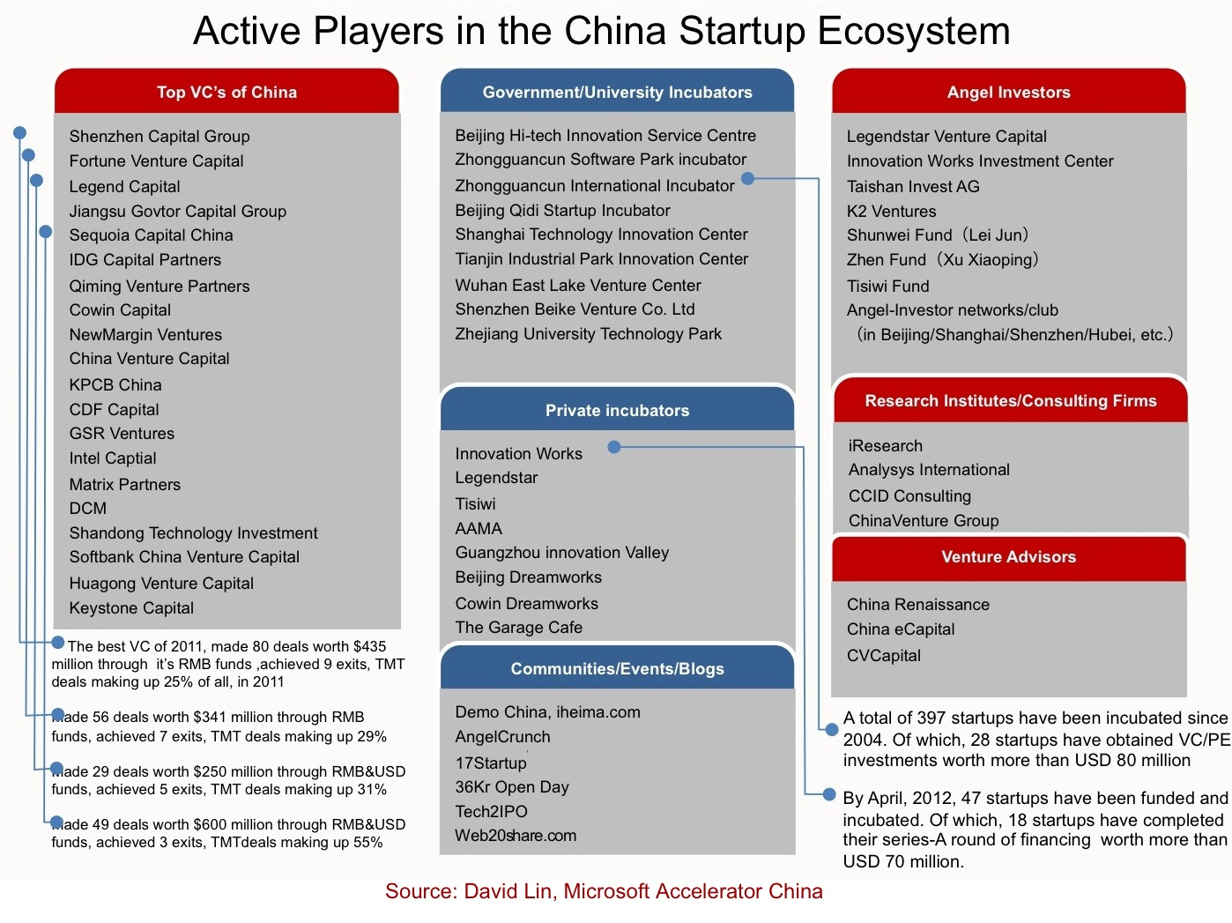
http://steveblank.files.wordpress.com/2013/04/active-player-in-china-vc.jpg

Slide 16
RMB funds vs dollar funds
Another change in the legal environment is that most of the early deals were done by offshore venture funds which had to be registered in countries outside China and had to invest dollars. Exits had to be accomplished through complicated offshore structures using offshore listings, as explained above.
At present, it is possible for foreign investors to set up Renminbi (人民币) funds; these have fewer restrictions on what industries the fund can invest in, less regulatory oversight and access to listing a portfolio company in China. (Portfolio companies are the companies that the VC/PE fund invests in, not the fund itself.)
There are two kinds of RMB funds – domestic funds are fully owned by Chinese investors, while foreign-invested RMB funds may be partially or fully owned by non-Chinese investors. Both types of funds are organized under Chinese law.
Also, in 2009, China created ChiNext, China’s equivalent of the NASDAQ stock exchange for start-ups. As with other exchanges for start-ups, it is easier to list on these exchanges than on the regular Shenzhen or the Shanghai stock exchanges, and provides a quicker exit opportunity for VC investors. ChiNext is a wholly-owned but independent arm of the Shenzhen Stock Exchange (SZSE). It is a dealer market where dealers are assigned to buy and sell securities from their own inventory. This is likely to assure liquidity even if there are independent buyers and sellers for a stock because these dealers are required to show minimum size bids and offers and are obligated to fill a certain quantity of orders as well.
http://www.chinabusinessreview.com/a-new-welcome-for-venture-capital/, July 2009

Slide 17
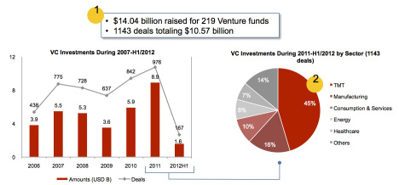
China’s vc industry today
As can be seen, most of the deals today are in the Technology, Media and Telecom sector. Internet investments make up over half of the deals in the TMT sector since 2011, while almost half of the investment deals in Internet are in the e-Commerce sector. Investments in Mobile Internet make up roughly 11% of the deals in TMT and have been increasing, of late.
Since those early days, China’s VC industry has grown tremendously. Here is a picture of the deals done from 2007 to 2012.

Slide 18
Problems in the Chinese VC ecosystem
The Chinese government has closed its search, media and social network software market to foreign companies, who wouldn’t play by the government’s censorship rules. As a result, Google was replaced by Baidu, Facebook by Renren, Twitter by Sina Weibo, Amazon/Ebay by Taobao or 360buy.com.
One result of this is that companies seek to copy global models rather than being truly innovative.
There is a lack of knowledge sharing (“pay it forward” isn’t part of the culture,) limited mentoring (few experienced mentors,) and a lack of open source education, and no AngelList model (a matchmaking platform for founders and investors to make early stage fundraising more efficient). In the U.S. it’s easy to share and browse ideas and deals, but in China there’s a long legacy of guarding knowledge as power, and the justifiable paranoia of someone copying your idea prevents sharing.
Large players like Alibaba, Baidu and Tencent are more likely to simply copy a startup’s features than to hire their talent. Big companies rarely acquire startups. Liquidity for most Internet startups happens via IPO’s. 70% of exits in China are via IPO compared to the 90% of exits in US via mergers or acquisitions. As a result, there is a funding gap for seed stage investments, since the money cannot be easily recouped by selling to larger players.
There is a lack of creativity and a freedom to dissent. In the final analysis, this may be more important the availability of financing.

Slide 19
Themes
The Chinese government, early on, realized the importance of nurturing investment and providing funding.
However, bureaucracy has often stifled the development of VC funds.
Although the government is willing to invite foreign funds, foreign companies – particularly in the all-important technology, media and telecommunications field – have been shut out.
This has dovetailed with the tendency of Chinese firms to copy rather than to innovate.
A lack of appreciation of the rule of law and the importance of intellectual property rights have also stymied the market for innovation. This may be much more important in the long run than access to funding.
In the past, it was possible to achieve above-average returns by investing in construction materials, machinery, or export-oriented industries, but this is not as easy now. Even though TMT sectors are going to be important, it may still be possible to invest profitably in service sectors like insurance and financial services, which will benefit from a more wealthy aging population. But there are regulation issues that still have to be overcome. Companies that just relied on low labor costs, low energy costs, and low pollution-control costs in the past will not be successful.

