Slide 1
Value Creation
P.V. Viswanath
For a First Course in Valuation

Slide 2
Learning Objectives
Decomposing the firm into its operating and financing components
How to use ROIC in Value Creation
Using the Concept of Economic Value Added
The difference between Financial Markets vs Real Markets
What is the relationship between Growth and Market Value
Relating EVA to FCF
Developing the Zen Formula for Valuation

Slide 3
Traditional Decomposition of Profitability
The traditional Measure of Profitability of a Firm is ROE
ROE = Net Income/Shareholder Equity
But to forecast Net Income, we need to know the drivers of ROE
Traditional Approach to Decomposing Profitability
ROE = ROA x Financial Leverage = NI/Assets x Assets/Shareholder Equity
ROA = NI/Sales x Sales/Assets

Slide 4
The Du Pont Identity
ROA = NI/ TA
ROA = (NI/ Sales)*(Sales / TA)
ROA = (Net Profit Margin)*(Asset Turnover)
ROE = NI / TE
ROE = (NI/Sales)*(Sales/TA)*(TA/TE)
= Net Profit Margin*Asset Turnover*Equity Multiplier
Net Profit margin is a measure of the firm’s operating efficiency – how well it controls costs
Total asset turnover is a measure of the firm’s asset use efficiency – how well it manages its assets
Equity multiplier is a measure of the firm’s financial leverage

Slide 5
Alternative Approach to Decomposing Profitability
The problem is that Net Income has operating as well as financing elements
Hence we define an alternative measure called NOPLAT that only includes operating items.
NOPLAT = Net Income + (Int exp – Int Inc)(1-τ) = NI+ Net Interest Expense After tax (NIAT)
Correspondingly, we also define a version of Capital that only includes operating items.
We first divide total liabilities into operating current liabilities + Debt + Debt equivalents (e.g. unfunded retirement liabilities, restructuring reserves) + Equity and Equity Equivalents (deferred tax assets and income-smoothing provisions).
Total Assets are divided into Current Operating Assets + Net PPE + Intangible Assets + Goodwill + Non-operating Assets (e.g. Excess Cash, Longterm Investments)

Slide 6
Alternative Approach to Decomposing Profitability
Operating CA excludes excess cash and marketable securities.
Operating CL excludes interest bearing current liabilities. Interest bearing CL are not operational.
Operating WC = Operating CA – Operating CL
Invested Capital = Net Operating Assets = Operating WC + Net PPE + Intangible Assets + Other Operating Assets. (This is equal to Operating Assets – Operating Liabilities.)
By subtracting out operating CL from the assets side instead of leaving it on the liabilities side, we are able to keep all operating elements on the assets side.
On the liabilities side, all we have are the sources of capital (i.e. net debt plus net equity).
Net Debt (NE) = Debt + Debt Equivalents; Net Equity (NE) = Equity + Equity Equivalents.
Total Funds Invested = Invested Capital Less Non-operating Assets.
If other (unspecified) long-term assets and liabilities are small, we can assume that they are operating.
If the other long-term assets account is large, it may include non-operating items such as deferred tax assets, prepaid pension assets, intangible assets related to pensions, nonconsolidated subsidiaries and other equity investments.
Non-operating items should not be included in invested capital.
We see how this computation can be done in the case of Pepsico Inc.
Notes:
Page 170 ff.

Slide 7
Pepsico Inc. Balance Sheet (in mil. $)

Slide 8
Non-operating assets/liabilities
On the liabilities side, the current portion of long-term debt is non-operating.
Of the elements on the assets side, cash may or may not be necessary for the operations of the business. Often, it is estimated that cash equal to about 2% of revenues is sufficient for business purposes – the rest is excess cash.
Revenue for the years ending 12/02 and 12/01 were $25112m. And $26935m. respectively. Then, 2% of this amount or $502.24 and $538.7 are required cash. Consequently, $1135.76m (1638-502.24) and $144.3m (683-538.7) is excess cash. We will assume, here, as some analysts do, that all cash is non-operating.
Marketable securities is probably also not an operating asset.
The same might be said for long-term investments.
The sum of these three items comes to $4456 and $4520 respectively for 2002 and 2001.
All of these are deducted from Invested Capital to get Net Funds Invested.
Let’s see what the balance sheet looks like with these modifications.

Slide 9
Redesigned Balance Sheet
Assets | 28-Dec-02 | 29-Dec-01 | Liabilities | 28-Dec-02 | 29-Dec-01
Net Receivables | 2,531 | 2,142 | Short/Current Long Term Debt | 562 | 354
Inventory | 1,342 | 1,310 | Long Term Debt | 2,187 | 2,651
Other Current Assets | 695 | 752 | Other long-term liabilities | 5,937 | 5,398
Total Operating Current Assets | 6,413 | 5,853 | Total Liabilities | 8,686 | 8,403
Accounts Payable | 5,490 | 3,484 | Common Stock & Other Paid-up Capital | 30 | 43
Other Current Liabilities |  | 1,160 | Retained Earnings | 9,268 | 8,605
Total Operating Current Liabs | 5,490 | 4,644 | Total Stockholders' Equity | 9,298 | 8,648
Net Operating Working Capital | 923 | 1,209 | Tot Liabs & Shareholder Eq | 17,984 | 17,051
Property Plant and Equipment | 7,390 | 6,876
Goodwill | 3,631 | 3,374
Intangible Assets | 1,588 | 1,467
Other Assets | 1,841 | 1,254
Invested Capital | 13,528 | 12,531
Less: Non-operating Assets | 4,456 | 4,520
Total Funds Invested | 17,984 | 17,051

Slide 10
Alternative Approach to Decomposing Profitability
ROE = NOPLAT/Equity – (NIAT)/Equity = (NOPLAT/ IC)x(IC/NE) – (NIAT/ND)x(ND/NE) = (NOPLAT/IC)+(1+ND/NE)] – (NIAT/ND)x(ND/NE) = NOPLAT/IC + (NOPLAT/IC – NIAT/ND)x(ND/NE) = ROIC+ (Spread) x NetFinLev, where
The terms are defined as follows:
Net Fin Lev = Net Debt/Equity
ROIC = NOPLAT/IC
Effective Int Rate after tax = NIAT/ND
Spread = (ROIC– Effective Int Rate after tax)
Alternatively, ROIC = ROE – Spread x NetFinLev
ROIC = NOPLAT/Sales x Sales/IC = (1-Cash tax rate) x EBITA/Sales x Sales/IC
Using this, ROE can be decomposed as Operating Margin (NOPLAT/Sales) times Operating Efficiency (Sales/IC) less Leverage Advantage (Spread x NetFinLev)

Slide 11
Profit Margin and Asset Utilization for CAKE
The correlation between the two series is -0.25

Slide 12
ROIC vs Cost of Capital
To what should we compare ROIC?
Investors have a choice between investing in a given firm and investing in other traded assets elsewhere of comparable risk.
In order for it to be worth the investor’s while to invest in this stock, s/he should obtain a return at least as large as the return available elsewhere.
This alternative return is called the cost of capital.
In competitive markets, this is what investors will demand as compensation for investing in a given firm.
Thus, if ROIC > Cost of Capital, the manager is adding value.

Slide 13
Don’t Maximize ROIC
That is, the cost of capital should be the hurdle rate for the manager and all investments should be undertaken, as long as ROIC > the cost of capital.
But does it make sense to compare ROIC to cost of capital?
Wouldn’t ROIC increase by closing down the least profitable stores even if they do earn more than the cost of capital?
Consider the following example:
 | ROIC | WACC | Spread | Invested Capital | Economic Profit
Without low return store | 19% | 10% | 9% | 8000 | 720
Low return store | 14% | 10% | 4% | 2000 | 80
Entire Company | 18% | 10% | 8% | 10000 | 800

Slide 14
Don’t Maximize ROIC
Even though ROIC is greater if we drop the low return store, Economic Profit actually drops by $80.
Hence we see that ROIC should not automatically be sought to be maximized; maximizing ROIC can decrease economic profit.
Economic Profit is the return on invested capital above and beyond what can be obtained by investing in traded securities.
If we seek to maximize investor wealth, we should maximize Economic Profit.

Slide 15
Investing now; recouping later
What if increasing investment now will lead to higher economic profit later on?
How do we compare lower present economic profit against future economic profit?
We already know that the right investment decision is to invest as long as NPV or the discounted present value of future cashflows less the initial investment is positive.
It turns out that the way to evaluate economic profit over time is also to discount it to the present. In fact, discounted economic profit is exactly equal to NPV.

Slide 16
Economic Value Added (EVA)
Economic Profit or EVA measures annual value added by the manager over and above the cost of tying up resources.
EVA_{n} = EBIT(1-t) – Dollar Cost of capital = C_{n} – Depreciation – r*I_{n-1} in period n, where
C_{n} = cashflow in period n
r = cost of capital for project
I_{n-1} = amt of capital allocated to the project at date n-1
A variant of EVA can be defined as NOPLAT – Dollar Cost of Capital = (IC*ROIC) – (IC*WACC) = IC*(ROIC-WACC).
This formulation points out that value is added only if ROIC>WACC.
The NPV of the cashflows C_{n} is equal to the present value of EVA_{n}.
The NPV of the project is independent of the depreciation schedule; however, the EVA_{n} for period n will be correct only if I_{n-1} and depreciation are measured correctly.
If the cashflow and EVA approaches both give the same answer, why do we need to use EVA?
If the rights to projects can be sold immediately, the firm can recover the NPV of the project immediately; however, usually they are not. In this case, we might want to compensate the manager over the life of the project in proportion to the economic value added each period.
Notes:
Implicit assumption that the NPV reflects market value

Slide 17
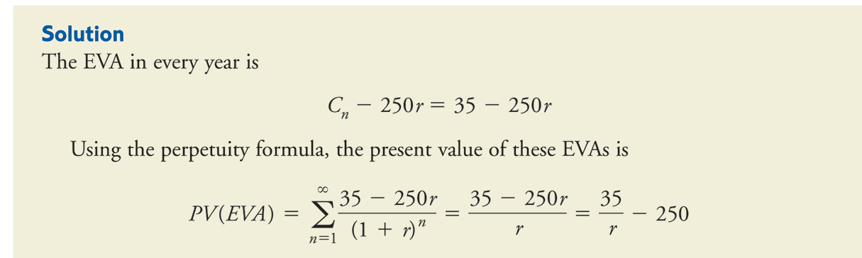
EVA vs NPV: Example
An investment requires an upfront investment of $250m. and generates a net income of $35m. each year. Depreciation is zero. If the cost of capital is 10%, should the investment be made?
The PV of the EVA is 35/0.10 – 250 = $100m. which means that the investment is profitable.
The NPV works out to -250 + 35/.10 = $100 and once again, we come to the same conclusion.

Slide 18
EVA vs NPV: Second example

Slide 19
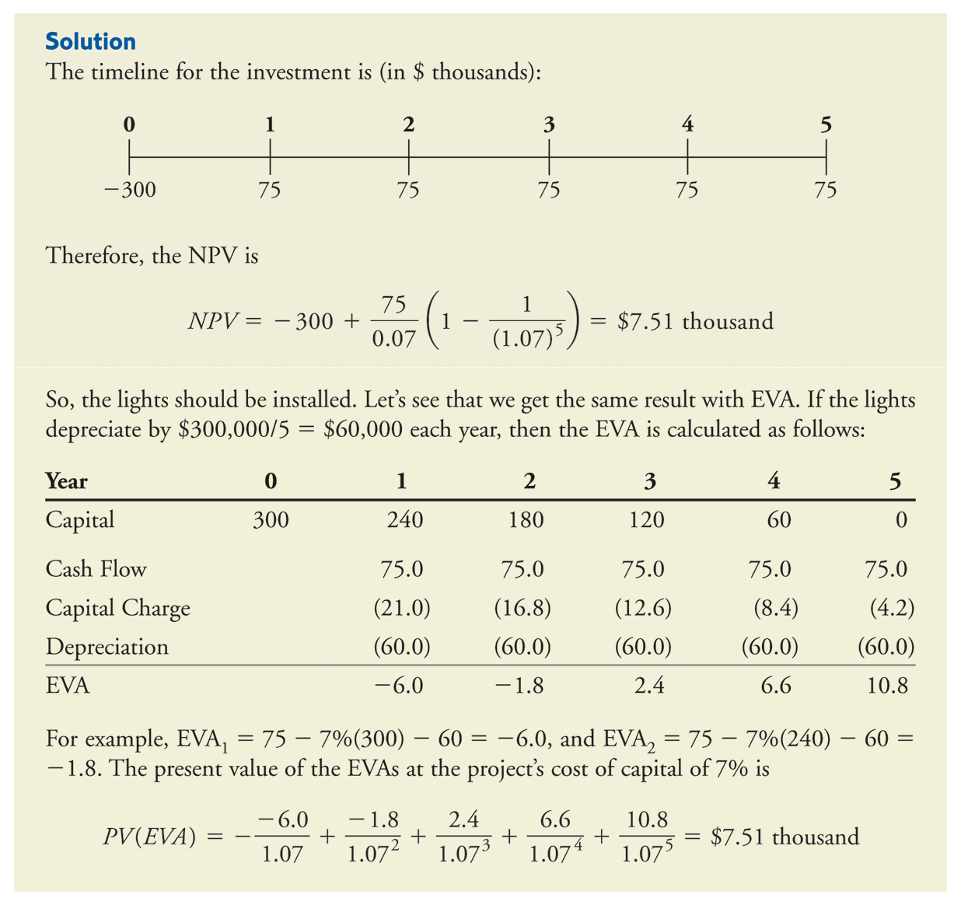
Second Example: EVA and NPV

Slide 20
Financial Markets and Real Markets
In the real market, the decision rule is simple:
Choose strategies or make operational decisions that maximize the present value of future cash flow or future economic profit.
The more you can invest at returns above the cost of capital, the more value you create (growth creates more value as long as the return on capital exceeds the cost of capital).
You should select strategies that maximize the present value of expected cash flows or economic profit – the answer is always the same.
How is a manager to use the information in financial markets?
Will share prices always go up as long as s/he makes investments that generate positive economic profit?

Slide 21
Return in Financial Markets
The answer is, surprisingly – not necessarily!
The value of a company’s shares in the stock market is based on the market’s expectations of future performance (which can deviate from intrinsic value if the market is less than fully informed about the company’s true prospects).
After an initial price is set, the actual returns that shareholders earn depend more on the changes in expectations about the company’s future performance than the actual performance of the company..
For example, if a company is expected to earn 25% on its investment, but only ends up earning 20%, its stock price will drop, even though the company is earning more than its cost of capital.
The rule for the manager is still the same – invest as long as ROIC > Cost of Capital.
However, he can use stock price movements as indications of the market’s evaluation of his actions.
Although he has more information about the firm, the market price is the aggregation of information and opinions of lots of traders – hence he should pay attention to the stock price, as well.

Slide 22
Earnings/NOPLAT and Value
Earnings/Yr | 1 | 2 | 3 | 4 | 5
Value | 100 | 105 | 110.3 | 115.8 | 121.6
Volume | 100 | 105 | 110.3 | 115.8 | 121.6
Here are two firms with the same Net Income each year.
Would they sell for the same amount?
Depends! Let’s look at their cashflow.
Value Inc | 1 | 2 | 3 | 4 | 5
Earnings | 100 | 105 | 110.3 | 115.8 | 121.6
Net Investment | 25 | 26.25 | 27.575 | 28.95 | 30.4
Cashflow | 75 | 78.75 | 82.725 | 86.85 | 91.2
Volume Inc | 1 | 2 | 3 | 4 | 5
Earnings | 100 | 105 | 110.3 | 115.8 | 121.6
Net Investment | 50 | 52.5 | 55.15 | 57.9 | 60.8
Cashflow | 50 | 52.5 | 55.15 | 57.9 | 60.8

Slide 23
Earnings/NOPLAT isn’t everything!
Value Inc. reinvests 25% of its cashflow each period, whereas Volume Inc. reinvests 50% of its cashflow.
Assuming that the companies have identical risk, we can discount their cashflows at the same discount rate, say 10%.
The formula is PV = CF_{t=1}/(CoC-g) = 75/(.1-.05) = $1500, since the cashflows are growing at 5%.
The formula for the second firm is 50 /(.1-.05) = $1000, since the growth rate, once again, is 5%.
Hence even though the two firms have identical earnings, Value is worth more, since the earnings can be generated with less reinvestment.
Clearly, they have different multiples, as well.
The difference in the multiples is because of the difference in their reinvestment rate.
Using the same multiple for both firms would overstate the value of Volume Inc. and understate the value of Value Inc.!
Let’s look more closely at the underlying drivers of earnings.

Slide 24
Fundamental Determinants of Growth Rate ?
What are the determinants of growth in a firm’s earnings?
Earnings/NOPLAT in any period depends on the investment base, as well as the rate of return that the firm earns on that investment base:
NOPLAT_{t+1} = (IC_{t})ROIC
= (IC_{t-1} + ΔΝIC_{t})(ROIC), where ΔIC_{t} is the increment in invested capital in period t over and above that in period t-1.
= (IC_{t-1})ROIC + (ΔIC_{t})(ROIC)
= NOPLAT_{t} + (ΔIC_{t})(ROIC);
Hence NOPLAT_{t+1} - NOPLAT_{t} = (ΔIC_{t})(ROIC)
Dividing both sides by NOPLAT_{t} , we get g_{t} = (Reinvestment Rate)(ROIC), assuming that the additional investment is made possible by retaining part of the firm’s earnings.
Hence the growth rate depends on the ROIC as well as on the reinvestment rate.

Slide 25
Growth and Market Value
Now going back to our example, we can see that if the Value firm and the Volume firm both had growth rates of earnings of 5%, but with reinvestment rates of 25% and 50% respectively, their ROICs must have been 20% (0.05 = 0.25x0.2) and 10% (0.05 = 0.25x0.1) respectively.
Since Earnings for year 1 is $100 for both firms, the IC for Value Inc must have been $500 (100/.2) and that for Volume Inc. must have been $1000 (100/0.1).
The increased market value of Value Inc. due to its reinvestment program is because of the excess of ROIC over the CoC.
EVA for this firm is $50 in the first year (Earnings – IC*CoC) and goes up by 5% each year leading to an increase in market value of 50/(.1-0.05) or $1000 for a total market value of 1000+500 = 1500.
Volume, Inc. on the other hand has ROIC = CoC and hence its reinvest program leads to no increase in market value.
EVA for this firm is $0 in the first year and continues to be zero in each succeeding year. Its market value, therefore is simply the original IC of $1000.

Slide 26
NOPLAT and Free Cashflow
NOPLAT = Net Income + (Int exp – Int Inc)(1-τ) It is the profits generated from the company’s core operations after subtracting the income taxes related to the core operations.
Invested Capital (IC) represents the cumulative amount the business has invested in its core operations – primarily PP&E and working capital.
Net Investment is the change in IC from one year to another.
Free Cash Flow (FCF) is the cash flow generated by the core operations of a business after deducting investments in new capital: FCF = NOPLAT – Net Investment It is, thus, the cash that can be withdrawn from the business without affecting its operations. The value of the core business is, consequently, the sum of the present values of the Free Cash Flow.

Slide 27
Some Definitions
ROIC (NOPLAT/IC) is the return the company earns on each dollar invested in the business
RONIC is the return the company earns on each new dollar invested in the business (as opposed to existing IC).
Investment Rate (IR) is the portion of NOPLAT invested back in the business = Net Investment/NOPLAT
CoC is the cost of capital.
Since capital can be obtained as debt capital or equity capital, it can also be computed as the weighted average of the cost of debt capital and the cost of equity capital.
In this guise, it is known as WACC or Weighted Average Cost of Capital.
g is the rate at which the company’s NOPLAT and cash flow grows each year.

Slide 28
The Zen Formula for Value
Assuming the FCF grows at a constant rate of g%, we can use the perpetuity formula to write: Value_{t} = FCF_{t+1}/(WACC-g)
Using the definition of FCF = NOPLAT – Net Investment and that of IR, we find Value_{t} = NOPLAT_{t+1}(1-IR)/(WACC-g)
Using the relationship g = ROIC*IR, we get: Value_{t} = NOPLAT_{t+1}(1-g/ROIC)/(WACC-g)
From here, we see how ROIC, g and WACC affect the value of the core business.

