Slide 1
Capital Structure and Perverse Stockholder Incentives
P.V. Viswanath
Financial Theory
and
Strategic Decision-Making

Slide 2
Leverage and Excessive Risk-Taking

Slide 3
Debt and Incentives
We will see in this set of slides, how the existence of debt in a firm’s capital structure causes its managers to act differently from how they would behave without debt.
We will look at three different perverse outcomes of leverage:
The tendency of leveraged firms to take excessive risk.
The tendency to underinvest
The tendency to be more myopic

Slide 4
Leverage and excessive risk-taking: I
We first look at a solvent firm faced with two different projects: one less valuable on its face but riskier and the second more valuable and less risky.
We will see that our leveraged firm will chose the worse alternative.
Example: Consider these two projects faced by a firm with a promised payment of $500,000 to debtholders.
There are only two possible states of the world, both equally likely.

Slide 5
Leverage and excessive risk-taking: II
Payoffs to the two projects
 | Prob. | Proj. 1 | Proj. 2
State 1 | 0.5 | $600,000 | $1,000,000
State 2 | 0.5 | $600,000 | $0
Expected Value |  | $600,000 | $500,000
Proj. 1 is better for the entire firm

Slide 6
Leverage and excessive risk-taking: III
Payoffs to the bondholders
 | Prob. | Proj. 1 | Proj. 2
State 1 | 0.5 | $500,000 | $500,000
State 2 | 0.5 | $500,000 | $0
Expected Value |  | $500,000 | $250,000
Proj. 1 is better for bondholders

Slide 7
Leverage and excessive risk-taking: IV
Payoffs to the equityholders
 | Prob. | Proj. 1 | Proj. 2
State 1 | 0.5 | $100,000 | $500,000
State 2 | 0.5 | $100,000 | $0
Expected Value |  | $100,000 | $250,000
Proj. 2 is better for equityholders, which they choose.
The reason for the bad choice is that bondholders do not share in the upside but share fully in the downside. Equivalently, equityholders share the downside with bondholders, but capture the upside fully.
This predilection for excessive risk only occurs when there is a likelihood of bankruptcy, as will be clear from the next example.

Slide 8
Bankruptcy and Risky Investments
In this example, we have a leveraged firm, Baxter, Inc. facing financial distress.
Baxter has a loan of $1 million due at the end of the year.
Without a change in its strategy, the market value of its assets will be only $900,000 at that time, and Baxter will default on its debt.
Baxter is considering a new strategy
The new strategy requires no upfront investment, but it has only a 50% chance of success.
If the new strategy succeeds, it will increase the value of the firm’s assets to $1.3 million.
If the new strategy fails, the value of the firm’s assets will fall to $300,000.
The expected value of the firm’s assets under the new strategy is $800,000, a decline of $100,000 from the old strategy.
50% × $1.3 million + 50% × $300,000 = $800,000

Slide 9
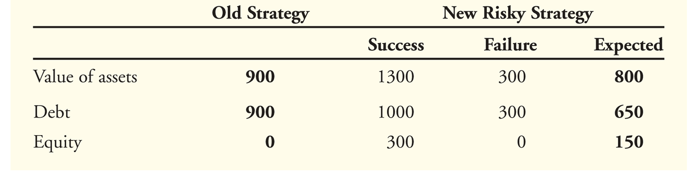
Bankruptcy and Risky Investments
If Baxter does nothing, it will ultimately default and equity holders will get nothing with certainty.
Equity holders have nothing to lose if Baxter tries the risky strategy.
If the strategy succeeds, equity holders will receive $300,000 after paying off the debt.
Given a 50% chance of success, the equity holders’ expected payoff is $150,000.
The perverse incentives for Baxter’s shareholders to undertake the new strategy can be seen in the following table.

Slide 10
Value loss: is it inevitable?
What we see in the Baxter example is that debtholders lose $250 in expected value, but equity holders gain only $150 in expected value.
Hence there is an overall loss to the firm of $100. Is it not possible for debtholders to make a deal with stock holders?
In the next example of Unistar, we see another case of value loss. We can then go on to see why such value loss is often unavoidable.

Slide 11
Leverage and excessive risk-taking
Exhibit 16.3: Unistar’s Alternative Payoffs on a project requiring $70m investment, no debt
Exhibit 16.4: Unistar’s Payoffs to Equity Holders When the Debt Obligation Is $40 Million
We see that when Unistar has debt, it chooses the second process, which on its own has lower value (assume discount rate = 0%). Let’s see why this happens.
Notes:
Create the balance sheet in these two cases

Slide 12
Leverage and Excessive risk-taking
Exhibit 16.4b: Unistar’s Payoffs to Bondholders When the Debt Obligation Is $40 Million
CASH FLOW IF THE STATE OF THE ECONOMY IS
 | Unfavorable (p=0.50) | Favorable (p=0.50) | Expected Value
Process 1 | $40 million | $40 million | 0.50x40 + 0.50x40 = $40
Process 2 | $25 million | $40 million | 0.50x25 + 0.50x40 = $32.50
When the firm undertakes process 2, it is able to extract $7.5m from bondholders, compared to process 1. This trumps the $5 higher overall value of process 1 ($75m versus $70m), which is why equity holders end up preferring the lower-valued process 2.
Notes:
Process 1 yields $25 in the unfavorable state, all of which goes to Bondholders for a loss of $15 (B put in $40, get $25 back)

Slide 13
Leverage and excessive risk-taking
All of this is after-the-fact, assuming the debt already exists. What if the capital for the firm has not yet been raised? Assume the equilibrium expected return is 0%.
First of all, because of this perverse incentive, the firm cannot get the $40m. debt in the first place, if equityholders can pick either project.
However, if equityholders can commit to taking process 1, debtholders would be willing to invest $40m for a promised payoff of $40m, because then they would be repaid with certainty. Equityholders would put up $30m. and obtain a $5m. profit.
However, this will involve covenants and monitoring, which may not be feasible.
If so, debtholders would only put up $32.5m for a promised payment of $40m. Then, they would get (40+25)/2 = $32.5m (stated interest rate of 23.078%).
But then equityholders would have to put up the remaining $37.5m for a payoff of only $35m under project 1 and $37.5m under project 2. They would take project 2 and lose the NPV from project 1.
So even though they could get debt financing, the efficiency losses from choosing proj 1 are lost.

Slide 14
Leverage, excessive risk-taking and under-investment
However, if the firm had $45m. in cash, it would only have to raise $25, which it could at an interest rate of 0% and then equityholders would choose project 1 and obtain the higher value from project 1.
In this case, we see that not having sufficient internal resources can be costly!
If we have to look for outside financing, that can exacerbate the problem!
However, in the Baxter case (above), there was no need for outside financing and there were still perverse investment incentives.
Hence the basic underlying problem is the inability to credibly and cheaply contract with other stakeholders.
Lack of internal funding only exacerbates this basic problem.
What we see is that perverse incentives result in under-investment.

Slide 15
Cashing Out
When a firm faces financial distress, we can also see the converse of the underinvestment problem.
Stockholders have an incentive to take money out of the firm – to cash out by paying themselves high dividends.
Furthermore, if it is likely the company will default, the firm may sell assets below market value and use the funds to pay an immediate cash dividend to the shareholders.
In the next example, we see how leverage can lead to myopia or short-sightedness.

Slide 16
Credit Rationing
We have seen that when a firm’s debt obligations increase, it has a greater tendency to choose risky projects.
Could this tendency to take risk be offset by higher interest rates, perhaps?
The answer in this case is, no! In fact, as interest rates increase, the problem is further exacerbated because the likelihood of bankruptcy also goes up with higher promised interest rate payments: firms thus tend to choose ever-riskier projects.
Higher interest rates may not be able to compensate for the firm’s ever-increasing tendency to choose risky projects.
When there is no interest rate at which loans are available, it is called a situation of credit rationing. It is called rationing because price cannot be used to allocate resources.
As a result, lenders may choose not to lend to certain firms regardless of the rate of interest the firms are willing to pay.
We see this in the following example of Multi-Universal.

Slide 17
Credit Rationing
Exhibit 16.5: Multi-Universal’s Project Payoffs on a $100m investment
We assume that investors are risk neutral and that the risk-free
rate of interest is zero. The amount borrowed is $100m.
The present value of project A is 130(.8) + 50(.2) = 114.
The present value of project B is 150(.2) + 50(.8) = 70, i.e. an NPV < 0 at any positive interest rate.
We will see that stockholder’s choice of project changes when the rate of interest changes.

Slide 18
Credit Rationing
The equilibrium expected rate of return is 0%; investors are risk-neutral.
Project A | Payoff to project | Payoff to bondholders | Payoff to equityholders
Good State (p=0.8) | 130 | 112.5 | 17.5
Bad State (p=0.2) | 50 | 50 | 0
Expected Payoff | 114 | 100 | 14
Project B | Payoff to project | Payoff to bondholders | Payoff to equityholders
Good State (p=0.2) | 150 | 112.5 | 37.5
Bad State (p=0.8) | 50 | 50 | 0
Expected Payoff | 70 | 62.5 | 7.5
The stated interest rate has to be 12.5% in order for the expected rate of return to be zero. Equityholders choose project A.
Notes:
The stated interest rate has to be 12.5%, in order for the expected rate of return to be zero. Nash equilibrium with an interest rate of 12.5%

Slide 19
Credit Rationing
Assume now, the equilibrium expected rate of return is 12%; again investors are risk-neutral.
If investors believe project A will be chosen, the promised interest rate has to be 27.5%. But then equity holders will choose project B.
Project A | Payoff to project | Payoff to bondholders | Payoff to equityholders
Good State | 130 | 127.5 | 2.5
Bad State | 50 | 50 | 0
Exp. Payoff | 114 | 112 | 2
Project B | Payoff to project | Payoff to bondholders | Payoff to equityholders
Good State | 150 | 127.5 | 22.5
Bad State | 50 | 50 | 0
Exp. Payoff | 70 | 65.5 | 4.5

Slide 20
Credit Rationing
As a result, the lenders will have to demand an interest rate of 260%.
But this would not be affordable/credible, since project B has a negative NPV to begin with!
Hence lenders will not be willing to lend at any interest rate!
Project B | Payoff to project | Reqd payoff to bondholders | Payoff to equityholders
Good State | 150 | 360 | -210
Bad State | 50 | 50 | 0
Exp Payoff | 70 | 112 | -42
The firm may not be able to commit to taking Project A, again because of monitoring costs. This phenomenon of project switching is sometimes called diversion.
In this case, we see that the need for outside financing leads to a positive NPV project being rejected and no investment being undertaken.
The issuance of equity would solve the problems in principle, but agency problems of inside equity may make this also impossible.

Slide 21
Leverage and Myopia

Slide 22
Short-sighted investment problem
The existence of debt can lead shareholder value maximizing managers to take a short-sighted approach to investment.
If the cashflows from a project are higher in the short-run, it might be preferred by shareholders if debt comes due in the short-run.
Given information asymmetry, it may not be easy for the debt to be rolled over. The higher-NPV long-term project may not be liquid or tradable in the short-run.
Opting for the long-term project may then lead to bankruptcy and loss of shareholder value.

Slide 23
Short-sighted investment problem
Exhibit 16.2: Applied Textronics Cash Flows
The short-term project has all of its payoffs in year 1; the long-term project has most of its payoff in year 2. But its value exceeds that of the short-term project. (Assume the expected equilibrium rate of return is zero.)
But:
If the firm selects the short-term project, it will have enough funds to meet the debt payment due in year 1. It will default in the unfavorable state in year 2.
Equityholders will get $20 in the favorable state and zero in the unfavorable state (expected value of $10).

Slide 24
Short-sighted investment problem
Exhibit 16.2: Applied Textronics Cash Flows
If the firm selects the long-term project, it will not have enough funds and will have to refinance $30m. However, if the new debt is junior to the existing debt, the firm will have to promise $50m (since it will only be able to pay $10m in the unfavorable state).
The payoffs to equityholders will be zero in the unfavorable state and $10m in the favorable state, if it takes the long-term project (expected value of $5).
Hence equityholders will choose the short-term project.
The problem, in this case, is the need to go to the external capital markets to raise funds.

Slide 25
Leverage and Underinvestment

Slide 26
Leverage and Underinvestment
We saw, briefly, earlier that the existence of leverage could lead to an unwillingness to invest even when such investment could lead to higher firm value.
Let’s look at some more examples of this phenomenon.

Slide 27
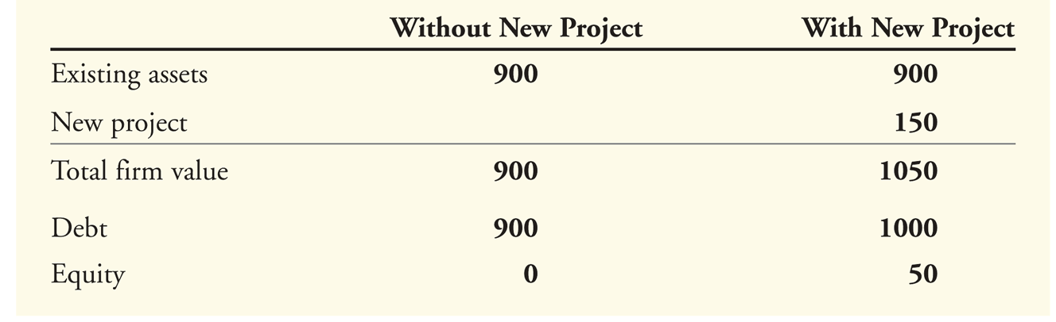
The Underinvestment Problem
Consider a firm that currently has debt with face value of $1000 that will come due in one year and assets that are projected to be worth $900 in one year.
Suppose the firm has the opportunity to invest in a new project requiring an immediate investment of $100 and offering a return of 50% in one year. Assuming the required rate of return for this project is less than 50%, it’s a NPV>0 project.

Slide 28
The Underinvestment Problem
Suppose the only way to get the $100 for the initial investment is for the existing equity holders to contribute it.
With the new project, equity-holders will get $50 in one year for a current investment of $100 – clearly equity-holders would not make the investment even though the project has an NPV > 0. This is the Underinvestment Problem.
This problem is also known as the debt overhang problem because the existence of debt in a firm that’s close to financial distress inhibits additional investment.
Let’s look at another version of the same problem, but now the underinvestment problem is in the future and impacts the interest rate that the firm has to pay on current borrowings.
Notes:
What if the firm had $100 cash, in addition, and had the option of either investing this in the firm or paying it out as dividends? What would they do?

Slide 29
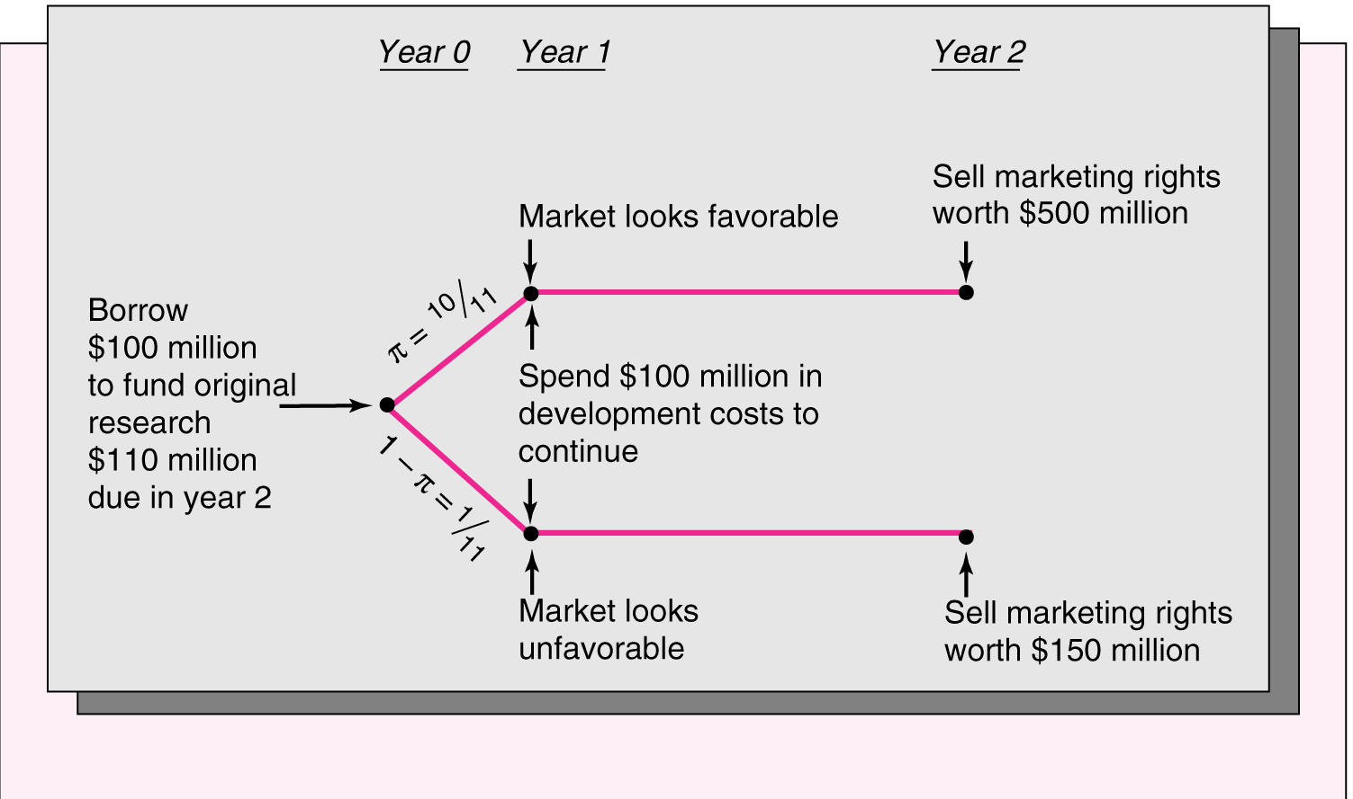
Debt Overhang I: Lily Pharmaceuticals Research

Slide 30
Debt Overhang I: Lily Pharmaceuticals Research
Assume risk-neutral investors and a 0% required rate of return.
At year 1, if the market is unfavorable, and the firm invests an additional $100m, the marketing rights can be sold for $150 at year 2. If not, the project will become worthless.
However, given the existing debt, it will not be possible to raise the $100m if the market is unfavorable, since the new debtholders will not be paid in full.
The phenomenon of not being able to obtain debt for a positive NPV project because of existing debt is called debt overhang, as we see in this example.
As a result, the firm has to promise a 10% interest rate (2yr rate). If the firm could obtain senior debt in year 1, it would only have to promise a 5% interest rate on the initial debt (over the 2-year period), because then there would be an extra $50 available in the unfavorable state.
The availability of senior debt resolves the year 2 underinvestment problem.
Notes:
Show…
The debt overhang also raises the period 1 interest rate

Slide 31
Debt Overhang II
We see, thus, that the availability of financing alternatives other than simple straight junior debt has the potential to resolve the firm’s year 2 underinvestment problem and improve the borrowing situation for the firm in year 1 .
Let’s investigate this possibility further.

Slide 32
Debt Overhang II
Assume an economy where the equilibrium expected rate of return is 16.197% and that all agents are risk-neutral.
Now consider a firm that has sold debt with $4000 of pre-existing principal and interest payments due at the end of the year, for a price of $2581.822 (a promised return of 54.96% and an expected return is 16.197%). If there is a recession, it will be pulled into bankruptcy because its cash flows will be only $2000. Else, it will have cash flows of $5000.
Soon after this, the firm finds that it has access to a new project that would allow it to avoid bankruptcy in a recession. The project costs $1000 and brings in $1400 in either state and has an NPV > 0.
Recession and Boom states are equally likely.
Will it do the right thing and raise new funds?
Let’s try equity financing first and then junior and senior debt financing.

Slide 33
Equity financing is not a solution
 | Firm Without Proj |  | Firm With Proj
 | Boom | Recession | Boom | Recession
Firm Cashflows | 5000 | 2000 | 6400 | 3400
Bondholders’ payoff | 4000 | 2000 | 4000 | 3400
Stockholders’ claim | 1000 | 0 | 2400 | 0
The new project will not be undertaken. Stockholders have on av. $500 without the project, and $200 with the project [(2400)/2 – 1000].

Slide 34
Neither may junior debt work
 | Firm W/o Proj |  | Firm W/ Proj
 | Boom | Recession | Boom | Recesn
Firm Cashflows | 5000 | 2000 | 6400 | 3400
Original bondholders’ payoff | 4000 | 2000 | 4000 | 3400
New bondholders’ payoff | NA | NA | 2323.94 (1000x2.32394) | 0
Stockholders’ claim | 1000 | 0 | 60.6 | 0
Suppose new debt is issued on a par with existing debt. In this case, they have to be offered a promised rate of 132.394%, so that on average, they will earn the required rate of 16.197% (2323.94+0)/2. Under these circumstances, equityholders will still not want to borrow.

Slide 35
Neither may debt w/equal parity work
 | Firm W/o Proj |  | Firm W/ Proj
 | Boom | Recession | Boom | Recesn
Firm Cashflows | 5000 | 2000 | 6400 | 3400
Original bondholders’ payoff | 4000 | 2000 | 4000 | 2505.07
New bondholders’ payoff | NA | NA | 1429 (1000x1.429) | 894.93 (1429/5429)x3400
Stockholders’ claim | 1000 | 0 | 971 | 0
Suppose new debt is issued on a par with existing debt. In this case, they have to be offered a promised rate of 42.9%, so that on average, they will earn the required rate of 16.197% (1429+894.93)/2. Under these circumstances, equityholders will still not want to borrow.
Of course, the original debtholders will lose out in this case, but let’s assume that the new project was not foreseen and so they were willing to take the original promised interest rate.

Slide 36
Senior Debt/Project Financing
 | Firm W/o Proj |  | Firm With Project
 | Boom | Recesn | Boom | Recesn
Firm Cashflows | 5000 | 2000 | 6400 | 3400
Sr Bondholdr | 0 | 0 | 1161.97 | 1161.97
Jr Bondholdr | 4000 | 2400 | 4000 | 2238.03
Stockholdr | 1000 | 0 | 1238.03 | 0
If the new project could be financed separately, say, under debtor-in-possession financing, or a new issue that would be senior to the previous issue, then stockholders would undertake the new project.

Slide 37
Debt Overhang: Loan Commitments
Two stage financing structured as loan commitment; fee = $500 plus 128.51% of draw-down (equivalent to 28.51% interest). Tot bondholder ret (w/proj) = 0.5(5103.908/3581.822)+0.5(3400/3581.822)=118.697%
Tot bondholder ret (w/o proj)=0.5(3688.808/3581.822)+(0.5)(2000/3581.822)=93.304%
Assuming a probability of the project being available of .90155, the expected returns for the bondholders on the two-stage commitment is the required 16.197%
 | Firm W/o Proj |  | Firm W/ Proj
 | Boom | Recess’n | Boom | Recess’n
Firm Cashflows | 5000 | 2000 | 6400 | 3400
Bondholders’ claim | 3817.90 (2581.822x1.2851+500) | 2000 | 5103 (3581.822x1.2851+500) | 3400
Stockholders’ claim | 1311.19 | 0 | 1476.09 | 0
The new project prob. is 0.90155, so that the expected return on the two-stage financing deal is 16.197%. Thus, the bondholders who originally provided the loan for the first tranche of $2581.822 at a promised rate of return of 54.96%, so as to be sure of getting an expected return of 16.197%, are also willing to provide a two-stage financing commitment for $500 plus 128.51% of draw-down.
Notes:
Question: What should be the stated interest rate for the bondholders to get 10% on average?

Slide 38
Loan Commitments
This works because part of the payoff is independent of the amount borrowed. This allows the “interest” rate to be smaller.
As a result, the disincentive to borrow isn’t as large, when a good project turns up.
The existing bondholders commit, ahead of time, to help resolve the underinvestment problem for an up-front fee.

Slide 39
Capital Structure and Liquidation
Here’s another perspective on the perverse incentives of stockholders to take risk…
Equity holders are residual claimants and are paid after bondholders get paid. Hence they can be thought of as having a call option on the assets of the firm, where the exercise price is the face value of debt.
Just as the value of an option is increasing in the volatility of the returns on the underlying asset, so too the value of equity is increasing in the volatility of returns on the assets of the firm.
Compared to the payoff from continuing to operate, liquidation provides a relatively safe payoff. Hence equityholders prefer to keep the firm going, compared to liquidating it.
Managers as representatives of equityholders also have this preference. Furthermore, the human capital of managers is often tied up with the continued existence of the firm.
For all of these reasons, leveraged firms are less likely to liquidate.

Slide 40
Debt and Perverse Incentives
We’ve seen how debt can cause the firm to act differently and sometimes perversely.
In the next set of slides, we’ll see how this can sometimes be used to the advantage of the leveraged firm.

Slide 41
Outside Financing: Information Issues
We saw that the existence of debt could cause debt overhang and consequent underinvestment.
In this case, we saw that inside equityholders may not be willing to invest even in NPV > 0 projects because they have to share the benefits with existing debtholders.
However, even in the absence of debt, the need to obtain outside equity could lead to the rejection of profitable projects because of information asymmetry.

Slide 42
Outside Equity: An Example
Consider the following problem. Suppose outside investors are unsure whether a firm’s assets are worth $100 or $200. They believe either possibility is equally likely.
Insiders, however, know exactly what the value of the firm is. The market value of the firm will be $150 ((100+200/2).
Suppose this firm also has a project that it can invest in, which requires an investment of $40 and has a PV of $50 (i.e. an NPV of $10). Now the firm is worth $160 (150+10)

Slide 43
Outside Equity: An Example
Let’s assume the firm has no debt and wants to issue new equity to raise the $40 for the project.
Together with the new funds to be raised, outside investors will expect the firm to be worth $200 (160+40). In order to get shares worth $40 in return for the $40 they are investing, they will ask for 25% (40/200) of the new firm.
Inside investors know the real value of the firm. If the firm is undervalued in the market (the true value is $210, while the market value is $160), by giving up 25% of the firm, they will actually be giving up 0.25(250) or $62.50 and will be left with 250-62.5 or $187.5.
If they did not issue equity and did not invest in the project, they would have a firm worth $200.
Since 200 > 187.5, they would forego the project. The result, again, is underinvestment as before under the debt overhang situation, but now for a different reason: information asymmetry.

