Slide 1
Capital Budgeting and
Valuation with Leverage
P.V. Viswanath

Slide 2
Learning Objectives
The WACC, APV and FTE methods of valuation.
Computation of the unlevered and equity costs of capital, and their relationship.
Estimation of the cost of capital for a project, even if its risk is different from that of the firm as a whole.
Estimation of the cost of capital for a project, given the project’s debt-to-value ratio, assuming the firm maintains a target leverage ratio.
Calculation of the levered value of a project if (1) the firm has a constant interest coverage policy, or (2) the firm keeps debt at a constant level.
The effect of issuance costs, personal taxes and financial distress costs on the assessment of the project’s value.

Slide 3
WACC method
When the market risk of the project is the same as the average risk of the firm’s investments, the WACC can be used to value the project.
That is, its cost of capital is simply the cost of capital for a portfolio of all the firm’s securities.
We assume, in addition that the firm’s debt-equity ratio is constant and that corporate taxes and personal taxes are the only imperfections.
Since interest payments are tax-deductible, the effective cost of debt is r_{D}(1-τ_{c}). This allows us to write the WACC as:

Slide 4
WACC method
Personal taxes do not need to be taken into account separately since the cost of debt will adjust automatically in the marketplace to take personal taxes into account. Thus, the larger the level of personal taxes, the greater the rate that firms must pay to get debt financing. Since all investors are free to invest in all firms, we don’t need to take the personal taxes of this particular firm’s debt-holders.
We compute the value of the project by computing the cashflows to the firm if it were unlevered (EBIT(1-τ_{c}) adjusted for non-cash items in EBIT) and discounting them at the WACC.
The tax benefits of debt are taken into account in the discount rate as opposed to incorporating them in the cashflows directly.
This allows us to undertake a division of labor – the cashflow computation is not impacted by the firm’s leverage policy and can be calculated by employees who are only involved in the operations side of the firm.

Slide 5
Using the WACC: An example
Suppose Avco is considering introducing a new line of packaging, the RFX Series.
Avco expects the technology used in these products to become obsolete after four years. However, the marketing group expects annual sales of $60 million per year over the next four years for this product line.
Manufacturing costs and operating expenses are expected to be $25 million and $9 million, respectively, per year.
Developing the product will require upfront R&D and marketing expenses of $6.67 million, together with a $24 million investment in equipment.
  The equipment will be obsolete in four years and will be depreciated via the straight-line method over that period.
Avco expects no net working capital requirements for the project.
Avco pays a corporate tax rate of 40%.

Slide 6
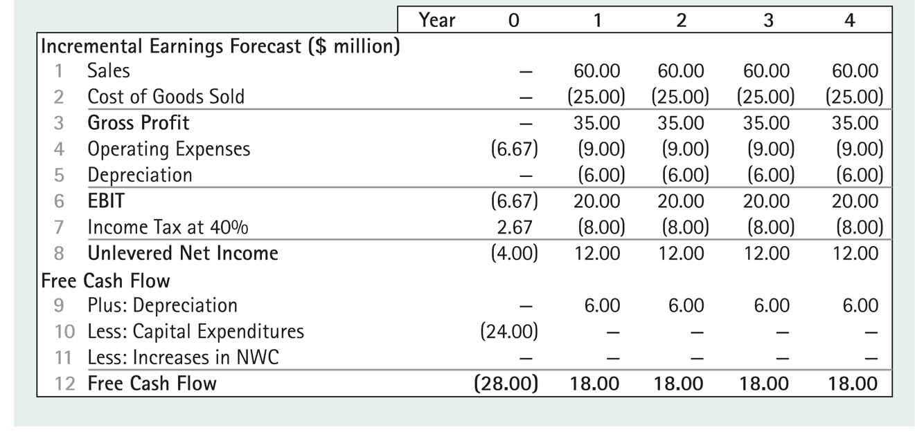
Expected Free Cashflow from Avco

Slide 7
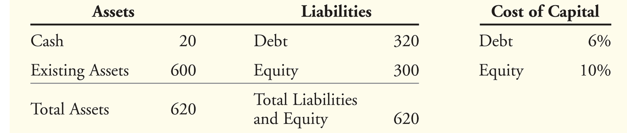
Using the WACC: An Example
Avco has $20 of cash and $320 of debt; since the cash could be used to pay off an equivalent amount of debt, we reduce debt by the amount of cash to get the net amount of debt. Hence Avco’s debt-value ratio is 300/600.
Avco’s WACC can, therefore be computed as

Slide 8
Using the WACC: An Example
The value of the project, including the tax shield from debt, is calculated as the present value of its future free cash flows.
    The NPV of the project is $33.25 million
      $61.25 million – $28 million = $33.25 million

Slide 9
Implementing a Constant Debt-Equity Ratio
The WACC method assumed that Avco would keep its debt-equity ratio constant.
This requires Avco to change the amount of its debt as its market value changes, as it will if it accepts the Avco project.
How can we compute the additional debt to be issued each year?
To begin with, we note that Avco has a debt-value ratio of 0.5
After Avco takes on the new project, its value will go up by the amount of the value of the new assets added due to the project, viz. $61.25m.
Hence Avco will have to issue 61.125/2 = 30.625 in net new debt.
We assume that Avco will do that by spending its $20m cash and issuing $10.625 in new debt.
Since the firm only needs $28m for the RFX project, the additional $2.625m will be paid out as a dividend.
Its balance sheet will now appears as follows:

Slide 10
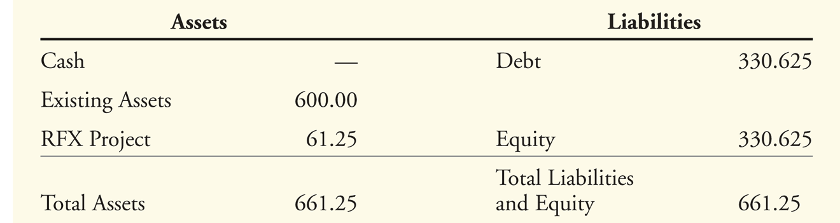
Implementing a Constant Debt-Equity Ratio
The firm’s debt capacity is defined as the total amount of debt required to maintain the firm’s target debt-value ratio. This equals D = dV^{L} , where d is the firm’s debt-value target ratio.
We can now compute the increased debt capacity due to the project at the different dates in the future by working backwards:

Slide 11
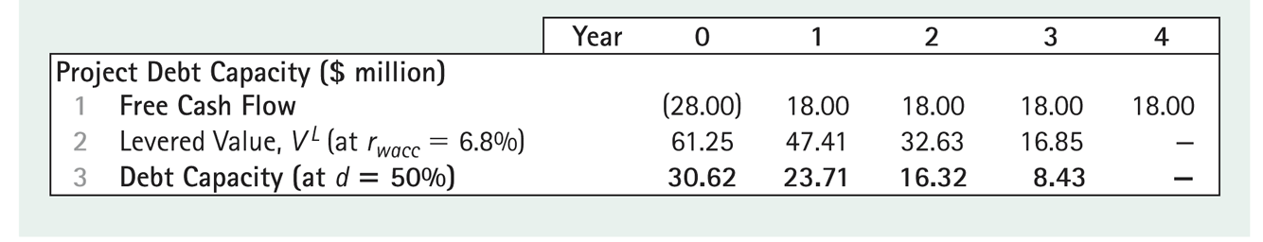
Implementing a Constant Debt-Equity Ratio
This is computed as follows. The value at the end of year 3 of the free cashflow of $18m in year 4 is 18/(1.068) = $16.854.
Hence the debt capacity at that point is 16.854/2 = $8.427m
The value of this project at the end of year 2 is (18+16.854)/1.068 = $32.635.
Hence the debt-capacity is 32.635/2 = 16.317m.
Using the same procedure, we compute the debt capacity at previous dates.
In order for the WACC answer to be correct, we must assume that AVCO decreases its debt according to the schedule provided here.
Thus, one year later, it must decrease debt by 30.62 – 23.71 or 6.91

Slide 12
The APV Method
In the APV method, we first value the investment as if it had no leverage, add the value of the interest tax shield and then deduct any costs that arise from other market imperfections.
We assume that there are no personal taxes; this is because if there were personal taxes, the cost of debt would be affected and so would the cost of unlevered equity.
In practice, this theoretical point is often ignored, but as a result, the estimated values could be grossly in error and could lead to a wrong decision.

Slide 13
APV: An Example
Let us look again at the Avco example.
Since the RFX project has risk similar to that of the firm’s other projects, the discount rate to be used in valuing the RFX project is the required rate of return on the firm’s assets.
If the firm adjusts its debt to maintain a constant leverage ratio, then this can be computed by taking a weighted average of the cost of the firm’s securities.
We do not take into account the tax shield from debt because we are initially valuing the project as if there were no debt at all. That is, we use the pretax WACC:
For Avco, this works out to (0.5)(10) + (0.5)(6) = 8%
We assume that effective personal taxes on debt income and equity income are the same, so that there is no need to make any adjustment to obtain the unlevered cost of capital

Slide 14
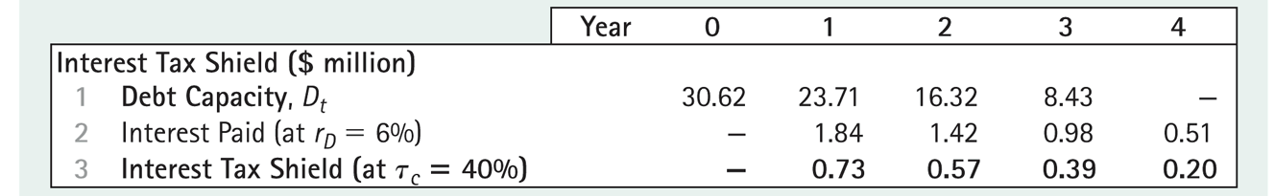
APV: An example
We first compute the project’s value without leverage:
Next we find the present value of the firm’s additional tax shields due to the project.
Since we have already computed the firm’s debt capacity previously, we can compute the tax shields each period as debt capacity times the interest rate of 6% times the tax rate of 40%:

Slide 15
APV: An example
In order to obtain the present value of the tax shields, we need to know the required rate of return on the firm’s tax shields.
In our case, we are assuming that the firm maintains a constant debt-to-value ratio.
This means that the tax shield at any point equals
(Firm Value) x (target debt ratio) x (int rate) x τ_{c}
We see from this that the risk of the firm’s tax shield is the same as the risk of the firm itself and hence the appropriate discount rate to value the tax shields is r_{U}.

Slide 16
APV: An Example
The tax shields, discounted at r_{U} = 8% are worth $1.63m.
The unlevered project value is $59.62m for a total of $61.25m.
The present value is $61.25m - $28m = $33.25m as before.

Slide 17
The APV Method with Personal Taxes
17
The APV approach requires modification in the presence of investor taxes because it requires the computation of the unlevered cost of capital.
This is because in the APV method, we have to compute the cost of capital that would obtain if there were no debt at all.
If the tax rate on equity capital is different from the tax rate on debt, then the cost of debt is going to be different from the cost of equity; the cost of debt has to be adjusted for the tax difference between debt and equity before combining them to come up with the unlevered cost of capital for the firm.
The tax rate on interest income is, in general, higher than the personal tax on equity income. Hence r_{D}, the cost of debt will be higher in the presence of personal taxes than the cost of equity. If we don’t make an adjustment for this, the pre-tax WACC computed using the market value of r_{D} will be too high because it uses this grossed up value of r_{D}. Consequently, the imputed cost of capital of the unlevered firm, i.e. the cost of capital pertaining to the assets alone, will be too high.

Slide 18
The APV Method with Personal Taxes
18
We adjust for this by multiplying r_{D} by the after-tax return proportion obtained by the investor (after paying taxes on interest) and dividing by the after-tax return obtained by the investor if he were to obtain the income as equity income. In other words, we have to adjust r_{D} only by the net effect of personal taxes on the market cost of debt.
The modified cost of debt is computed as:
We then proceed to compute the pre-tax WACC as before, but now using the modified cost of debt.
This computation, however, assumes that the firm uses a target leverage ratio. This will not be true if there are some predetermined tax shields. If some of the debt is predetermined, then the tax shields implied by this debt is also pre-determined and relatively risk-free. Hence we have to adjust the amount of debt by the amount of these relatively risk-free tax shields, just as we previously reduced the amount of debt by the amount of cash.

Slide 19
The APV Method with Personal Taxes
19
If T^{s} is the present value of the interest tax shields from predetermined debt, the risk of a firm’s equity will depend on its debt net of the predetermined tax shields:
The unlevered cost of capital becomes:
The effective tax rate is computed as :
This corresponds to τ_{c}, but adjusted for the asymmetric tax effects of debt and equity.

Slide 20
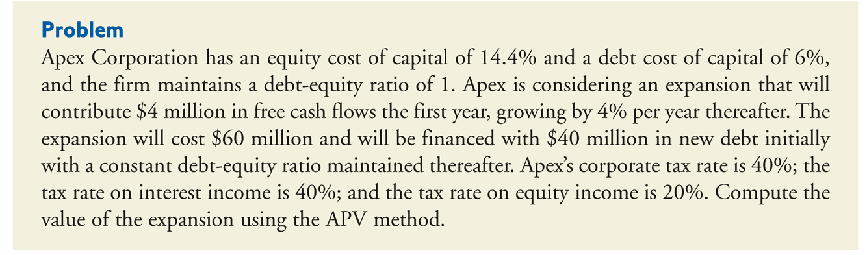
Example of APV with Personal Taxes
20
We then proceed as before to compute the value of the unlevered firm using the unlevered cost of capital and then add back the present value of the tax shields calculated above plus the amount of the predetermined tax shields.

Slide 21
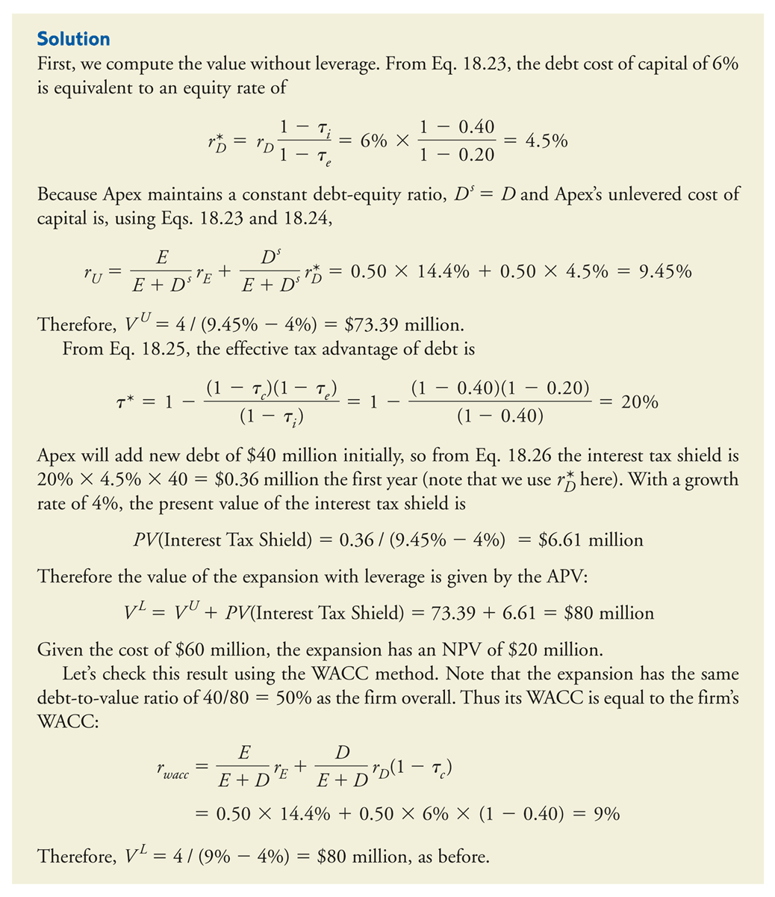
APV with Personal Taxes
21
First, we compute the value without leverage. The cost of debt of 6% is equivalent to 6%(1-0.4)/(1-0.2) or 4.5% after factoring in personal taxes.
Since there is no predetermined debt and Apex maintains a target debt ratio, D^{s}=D and the unlevered cost of capital is (0.5)(14.4)+(0.5)(4.5) = 9.45%.
Therefore, V_{U} = 4/(0.0945-0.04) = $73.39m.
The effective tax advantage of debt is:

Slide 22
APV with Personal Taxes

Slide 23
Flow-to-Equity Method
In the WACC method, we compute the value of the firm and then subtracted the value of debt, in order to obtain the value of equity.
When valuing a project, the WACC method implicitly assumes that if firm value goes up, so does equity value. This is true in most cases, but not in all cases.
The FTE method values equity directly by computing the free cash flows to equity holders (FCFE) and discounting them at the cost of equity.
We now use Avco’s RFX project to show that we get the same values with the FTE method as with the other methods.

Slide 24
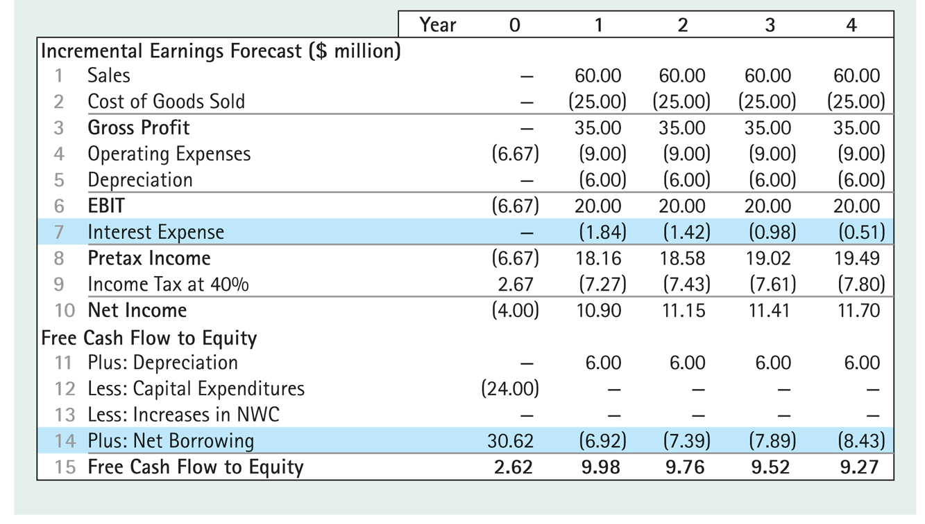
FTE: An Example

Slide 25
FTE: An Example
In computing the FCFE, we note that interest payments have to be deducted.
Furthermore, we have to adjust cashflows by the change in debt.
This is because if money is required to be paid out to debt-holders, it is not available to be paid out to equity-holders.
Similarly, if additional debt is issued, that can be used for payouts to equity-holders.
In our example, debt capacity dropped from $30.625 in year 0 to $23.71m in year 1. Hence Net Borrowing is 23.71-30.625 = -$6.915, i.e. a net payment to debt-holders of $6.915m.
Discounting FCFE at 10%, we get an NPV of $33.25 as before:
Notes:
The cost of equity capital is 10% for the RFX project, as assumed previously.

Slide 26
Project-Based Cost of Capital
If the new project has the same riskiness as the average projects undertaken by the firm, then the appropriate discount rate for valuing the project is simply the WACC of the firm, as discussed above.
What if the new project has a different risk?
In this case, we would need to find other firms whose riskiness is similar to the riskiness of the new project.
We could then take the average WACC for those firms to estimate the discount rate for our project.
However, those firms may have leverage ratios different from those that we propose to have for our project.
In this case, we can still use their unlevered cost of capital, r^{U}.
Consider the following example where Avco wishes to invest in a plastics project.

Slide 27
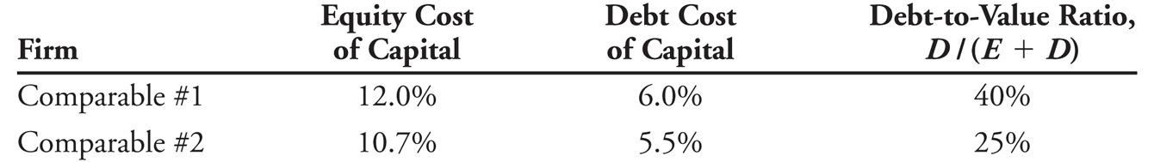
Project-Based Cost of Capital
Assume two firms are comparable to the plastics division and have the following characteristics:
Assuming that both firms maintain a target leverage ratio, the unlevered cost of capital for each competitor can be estimated by calculating their pretax WACC.
We then take the average of the two, which in our case works out to 9.5%.

Slide 28
Project Leverage and the Equity Cost of Capital
Suppose the firm desires to fund the project according to a specific target leverage ratio, since different firms could have different leverage ratios. In that case, we can compute r_{E} for our project using the same pre-tax WACC formula, but with our own target debt leverage ratio:
Thus if we have a target debt/equity ratio of 1, the cost of equity capital would be 9.5 +1(9.5-6) = 13%, assuming that the firm can continue to obtain debt financing at 6%.
We can now compute the WACC as:

Slide 29
Project-based Cost of Capital
An alternative method for calculating the division’s WACC is:
To determine the correct cost of capital for a project, we need to know the amount of debt to associate with the project.
This is equal to the incremental financing that results if the firm takes on the project, i.e. the change in the firm’s total debt (net of cash) with the project versus without the project.
Financial distress costs and information asymmetry costs depend usually on the characteristics of the whole firm. Hence the optimal leverage for a firm will depend on the characteristics of both the project and the firm.

Slide 30
Other Leverage Policies
Up to this point, it has been assumed the firm wishes to maintain a constant debt-equity ratio. Two alternative leverage policies will now be examined.
  Constant interest coverage
  Predetermined debt levels
Constant Interest Coverage Ratio
  When a firm keeps its interest payments equal to a target fraction, k, of its free cash flows, then the interest paid in year t = k(FCF_{t}) and the tax shield in that year is k(FCF_{t})τ_{c}.
  The present value of the tax shield, then, is τ_{c}kV^{U}.
  Hence the value of the entire project is (1+τ_{c}k)V^{U}.
Notes:
I need to explain how this allows us to use the WACC and FTE approaches.

Slide 31
APV with pre-determined debt levels
If a firm has pre-determined debt levels that will not vary according to the cashflows of the firm, then the riskiness of the tax shields are approximately the same as the riskiness of the interest payments themselves.
Hence the present value of the tax shield is simply Dτ_{c}, where D is the value of the debt, assuming that the debt is perpetual.
It must be kept in mind that in this case, there is no target debt ratio!
The value of the levered project is given by

Slide 32
WACC and FTE with Changing Leverage
The WACC and FTE methods are difficult to use when a firm does not maintain a constant debt-equity ratio. This is because when the proportion of debt financing changes, the project’s equity cost of capital and WACC will not remain constant over time.
  However, these methods can still be used with
  some adjustments.

Slide 33
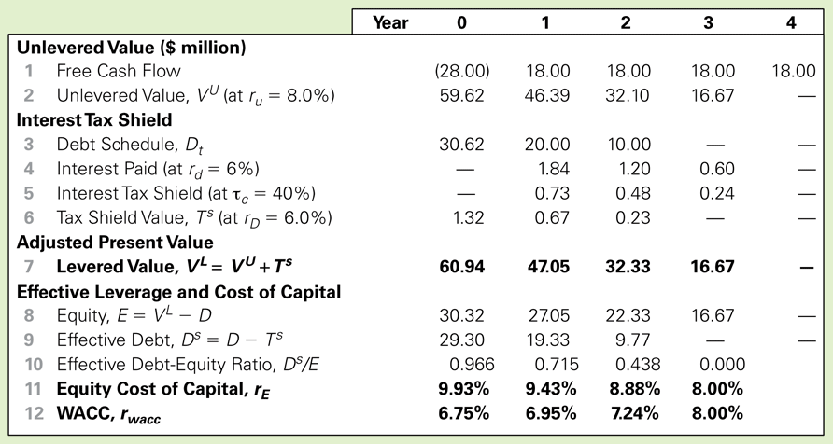
Table 18.10 Spreadsheet Adjusted Present Value and Cost of Capital for Avco’s RFX Project with a Fixed Debt Schedule

Slide 34
WACC and FTE with Changing Leverage
For example, at the beginning of the project, the WACC is calculated as:
The levered value each year is computed as:

Slide 35
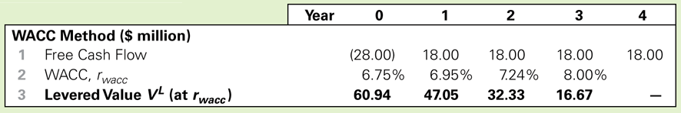
Table 18.11 Spreadsheet WACC Method for Avco’s RFX Project with a Fixed Debt Schedule

Slide 36
Pros and Cons of the three methods
The FTE method offers some advantages.
  It may be simpler to use when calculating the value of equity for the entire firm, if the firm’s capital structure is complex and the market values of other securities in the firm’s capital structure are not known.
  It may be viewed as a more transparent method for discussing a project’s benefit to shareholders by emphasizing a project’s implication for equity.
The FTE method has a disadvantage.
  One must compute the project’s debt capacity to determine the interest and net borrowing before capital budgeting decisions can be made.
The WACC method is easiest to use if the firm uses a target debt ratio.
The APV method is easier when using other leverage policies.

Slide 37
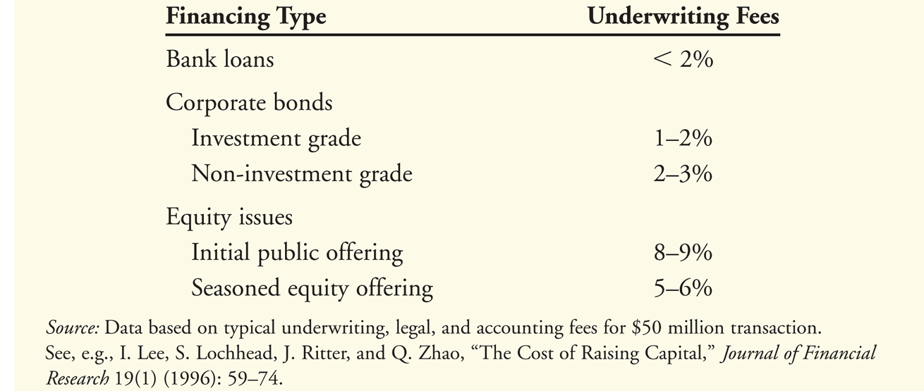
Issuance and Other Financing Costs
When a firm raises capital by issuing securities, the banks that provide the loan or underwrite the sale of the securities charge fees.
These fees should be included as part of the project’s required investment, reducing the NPV of the project.

Slide 38
Financial Distress Costs
Financial distress and agency costs also impact the cost of capital.
  For example, financial distress costs tend to increase the sensitivity of the firm’s value to market risk, raising the unlevered cost of capital for highly levered firms.
The free cash flow estimates for a project should be adjusted to include expected financial distress and agency costs.
In addition, because these costs also affect the systematic risk of the cash flows, the unlevered cost of capital will no longer be independent of the firm’s leverage.
The following example shows how a firm could choose its optimal leverage ratio taking into consideration that both cashflows and r_{U} can change with leverage ratio.

Slide 39
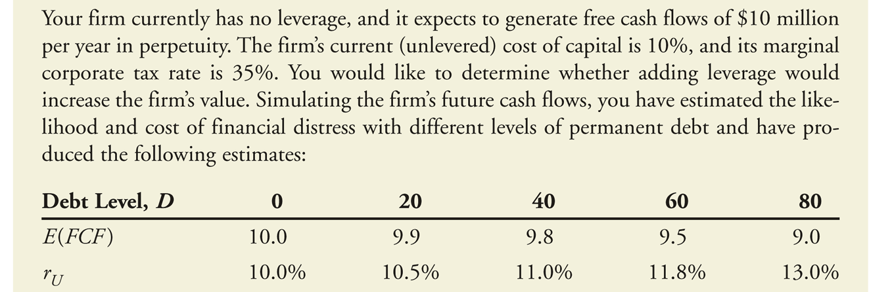
Financial Distress Costs
Notes:
Need to explain this better

Slide 40
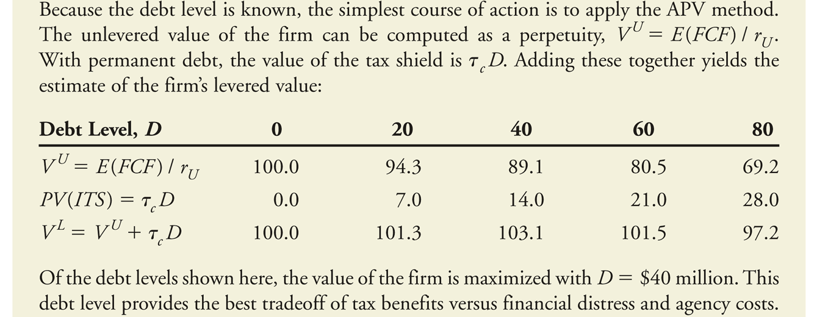
APV with financial distress costs

