Slide 1
Debt and Taxes
P.V. Viswanath
For a First Course in Finance

Slide 2
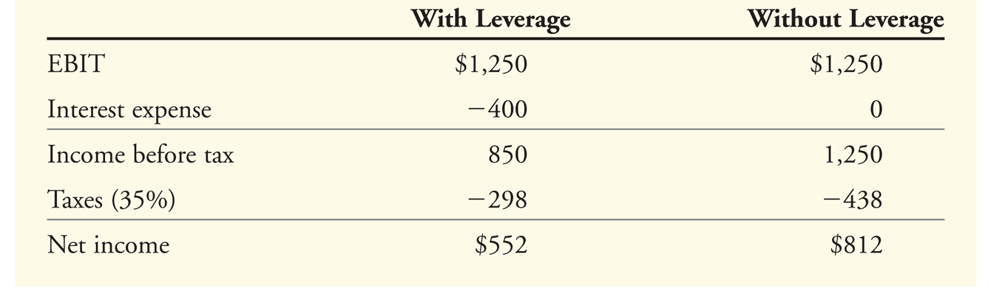
The Interest Tax Deduction
Corporations pay taxes on their profits after interest payments are deducted. Thus, interest expense reduces the amount of corporate taxes. This creates an incentive to use debt.
Consider Safeway, Inc. which had earnings before interest and taxes of approximately $1.25 billion in 2005, and interest expenses of about $400 million. Safeway’s marginal corporate tax rate was 35%.
Safeway’s net income in 2005 was lower with leverage than it would have been without leverage.

Slide 3
Tax Benefits of Debt
Safeway’s debt obligations reduced the value of its equity. But the total amount available to all investors was higher with leverage.
This additional amount equal to (952-812) = $140 is equal to a corresponding decrease of $140 in taxes paid from $438 to $298, i.e. $400(35%).
The increased payments to investors increases the value of the firm by the present value of the decrease in taxes.

Slide 4
Tax Benefits of Debt
If the debt has a maturity of ten years, then the PV of the tax shield is simply the present value of an annuity of $140, i.e. PV(Interest payment x tax rate) = Tax rate x PV(Interest payments for ten years)
If the debt is in perpetuity, then we use the formula for valuing a perpetuity. What discount rate should we use? Most of the time, if the interest is paid by the company, it will be able to obtain the tax benefits, as well. Consequently, the present value of the of the tax shield equals the tax rate times the present value of all the interest payments) = τ_{c}D, where D is the value of the debt.
With tax-deductible interest, the levered firm clearly has an advantage. This advantage could be thought of as a reduction in the cost of capital because the IRS is implicitly subsidizing debt. Alternatively, we could think of the advantage as an increase in the total cashflows available to the firm’s investors.
It is customary, though, to make the adjustment to the cost of capital. Hence the WACC is written as:

Slide 5
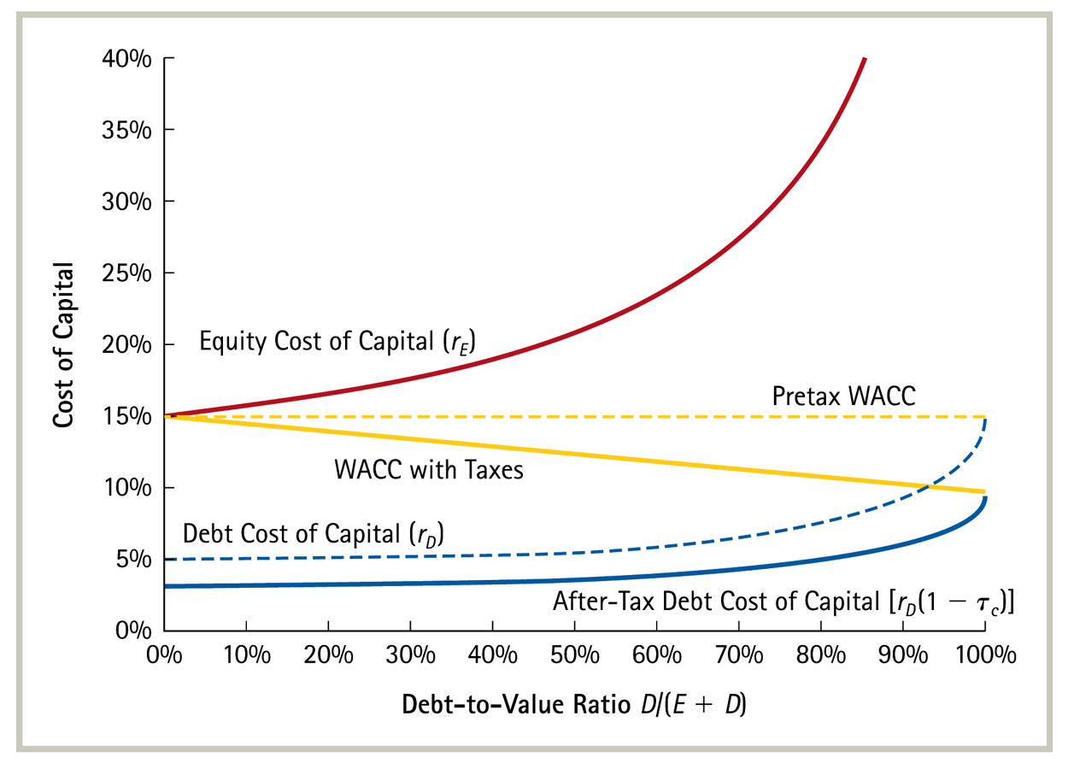
WACC and Corporate Taxes

Slide 6
Capital Structure and Personal Taxes
If only corporate taxes were relevant, there would be no costs to taking on additional debt and all firms should have a lot of debt.
However, this is obviously not true.
The reason is that cash flows to investors are typically taxed twice. Once at the corporate level and then investors are taxed again when they receive their interest or dividend payment.
Hence there is a cost to paying interest to corporate investors. This cost is borne not directly by the corporation, but indirectly through an additional burden on investors; i.e. they have to pay personal taxes on interest income.
However, investors have to pay personal taxes on dividend income and on stock capital gains as well. Hence, if tax rates on dividends were the same as tax rates on interest income, there would still be a net benefit to issuing debt and we should see firms issuing tremendous amounts of debt to take advantage of the tax subsidy provided by the IRS to raising debt capital.
In fact, though, effective tax rates on equity income have mostly been lower than effective tax rates on interest income.
This mitigates somewhat the incentive for firms to use debt capital.

Slide 7
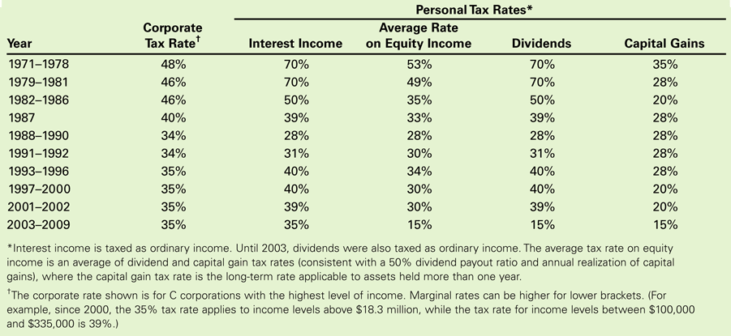
Top Federal Taxes in the US: 1971-2009
Notes:
Note that capital gains rates have been lower. And, now, dividend rates are lower as well. Hence debt has is disadvantageous, from the point of view of the investor (the supplier of capital).

Slide 8
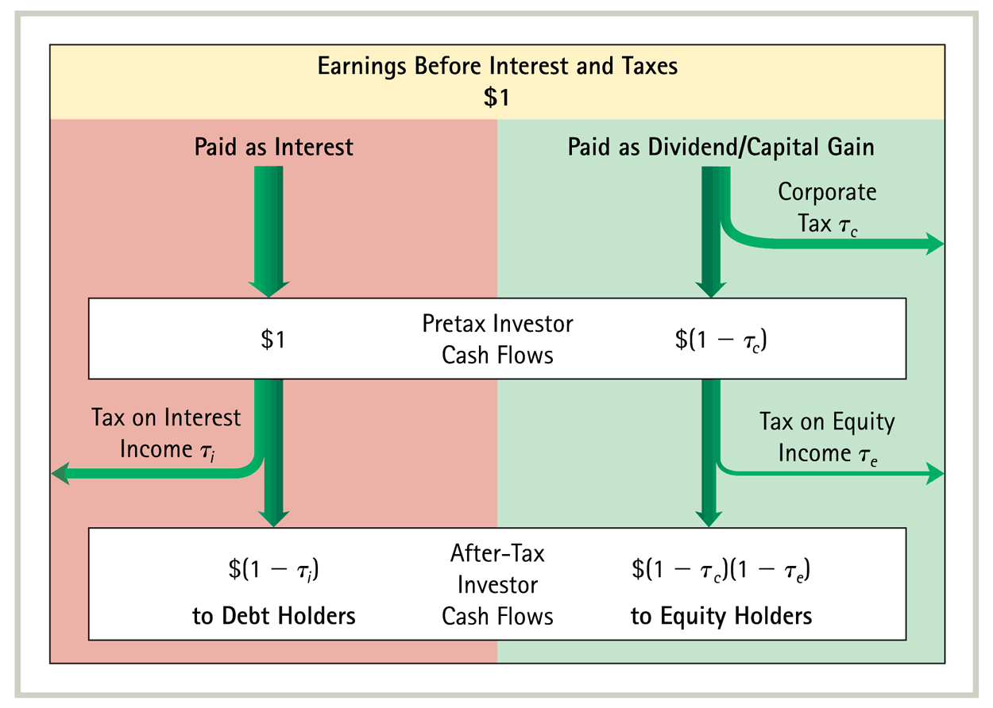
After-Tax Investor Cash Flows from $1 in EBIT
There is a net corporate tax advantage to debt only if (1-τ_{i}) > (1-τ_{c})(1-τ_{e}).

Slide 9
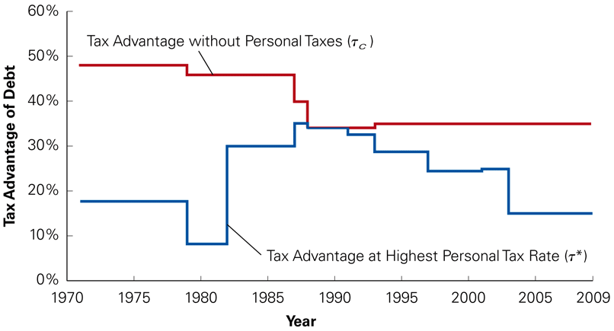
Effective Tax Advantage of Debt over time
The effective tax advantage from perpetual debt is not Dτ_{c}, but rather Dτ*, where
If τ_{i}>τ_{e}, there may be no tax advantage at all; in fact, debt could be disadvantageous.

Slide 10
Debt versus Equity for Firms
We should keep in mind several factors in determining τ* for any particular firm.
The firm’s investors might pay taxes at lower rates than the maximum tax rate. Many investors face no personal taxes. For example, investments held in retirement savings accounts or pension funds that are not subject to taxes.
For investors who are securities dealers, equity income and interest income are taxed at the same rate. Hence the effective tax advantage of debt is the full τ_{c}.
Individual investors may also be able to postpone realization of capital gains leading to lower effective tax rates on equity income, since the present value of the tax payments would be lower.
Still, taking into account all of these factors, it has been estimated that the tax advantage of debt is about 34%. As long as there is any tax advantage, the proportion of debt to EBIT should be close to unity.
So how much do firms rely on debt capital?

Slide 11
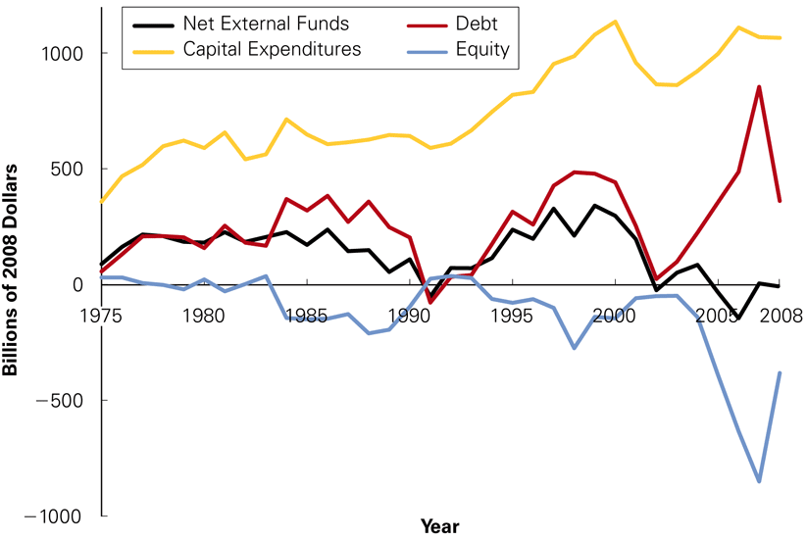
How do firms finance investments?
When firms raise new capital, they do so primarily by issuing debt, as can be seen below:
Copyright © 2007 Pearson Addison-Wesley. All rights reserved.

Slide 12
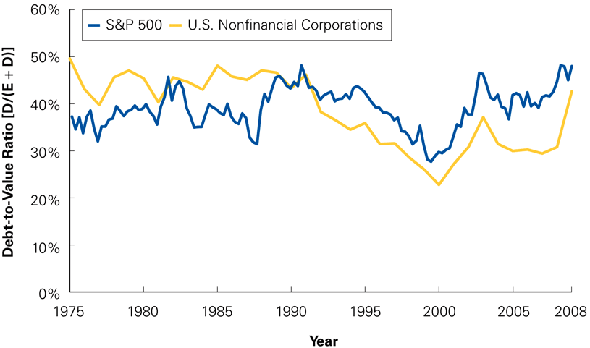
How do firms finance investments?
Still, external capital accounts only for a small proportion of capital invested.
A large proportion of capital needs are met from retained earnings. Even though most external capital raised is debt, the proportion of debt remains relatively constant over time.
Copyright © 2007 Pearson Addison-Wesley. All rights reserved.

Slide 13
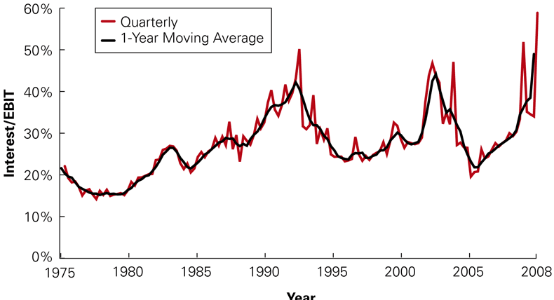
Interest Payments as a Percentage of EBIT for S&P 500 Firms over time
The amount of interest paid as a proportion of EBIT is never close to 100% and rarely goes above 50%.
Copyright © 2007 Pearson Addison-Wesley. All rights reserved.

Slide 14
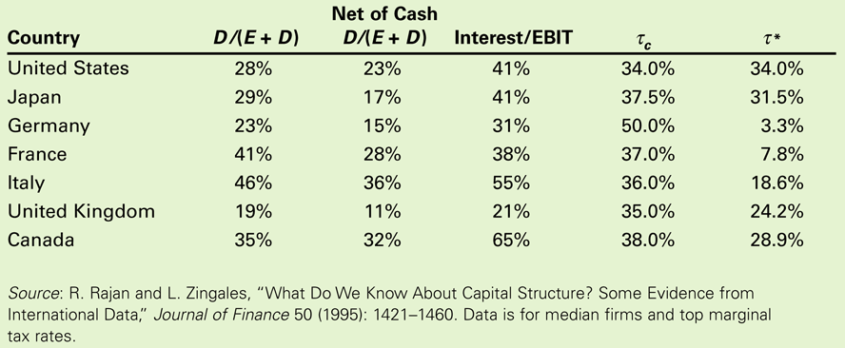
The Low Leverage Puzzle
Firms worldwide have similar low proportions of debt financing.
Although the corporate tax codes are similar across all countries in terms of the tax advantage of debt, personal tax rates vary more significantly, leading to greater variation in τ*.

Slide 15
Table 15.5 International Leverage and Tax Rates (1990)

Slide 16
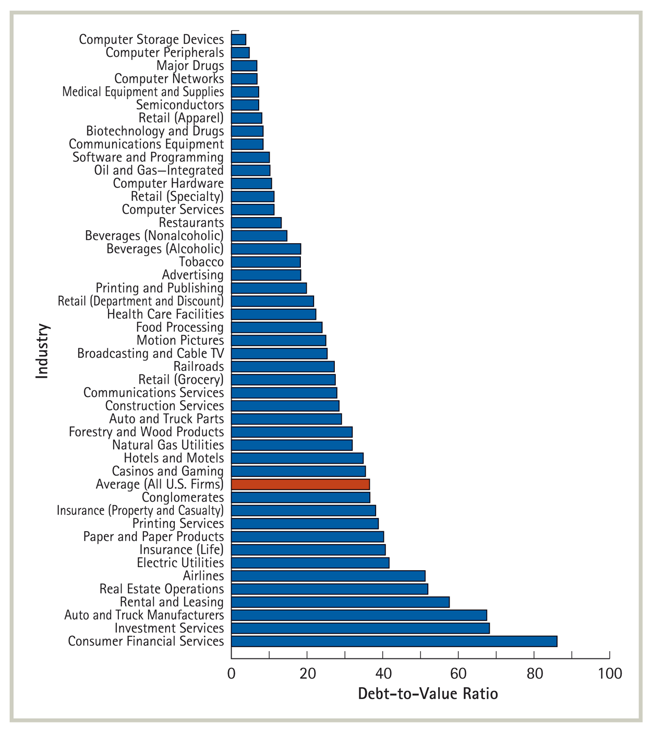
How firms finance investments
This is partly due to the unpredictability of EBIT. Still this cannot account for such a low Interest/EBIT ratio.
Furthermore, the debt-assets ratio also varies a lot across industries

