Slide 1
Financial Distress, Managerial Incentives and Information
P.V. Viswanath

Slide 2
Learning Objectives
Describe the effect of bankruptcy in a world of perfect capital markets.
List and define two types of bankruptcy protection offered in the 1978 Bankruptcy Reform Act.
Discuss several direct and indirect costs of bankruptcy.
Illustrate why, when securities are fairly priced, the original shareholders of a firm pay the present value of bankruptcy and financial distress costs.
Calculate the value of a levered firm in the presence of financial distress costs.

Slide 3
Learning Objectives (cont'd)
Define agency costs, and describe agency costs of financial distress and agency benefits of leverage.
Calculate the value of the firm, including financial distress costs and agency costs.
Explain the impact of asymmetric information on the optimal level of leverage.
Describe the implications of adverse selection and the lemons principle for equity issuance; describe the empirical implications.

Slide 4
Bankruptcy and Firm Value
It is clear that there are other factors determining capital structure, besides taxes.
The main additional factor is bankruptcy.
However, the mere possibility of bankruptcy would not make debt less attractive.
Keep in mind that the firm is an operation that attracts resources from investors, uses them and returns profits to investors according to certain rules.
Bankruptcy is simply a recognition that the promised payments to debt-holders are greater than the value of all the assets. Since equity-holders are residual claimants, at this point, their claims are worth zero. Hence control of the assets passes to the erstwhile debt-holders, who now become the new equity-holders.
The fact of bankruptcy does not change the value of the firm. An instant before bankruptcy, the value of equity-holders claims was very, very small. If the prospects of the firm continue to deteriorate, equity-holders claims drop to zero. It is not bankruptcy that hurts equity-holders, but rather the declining fortunes of the firm!

Slide 5
Bankruptcy in a Perfect Market
Armin is considering a new project.
While the new product represents a significant advance over Armin’s competitors’ products, the product’s success is uncertain.
If it is a hit, revenues and profits will grow, and Armin will be worth $150 million at the end of the year.
If it fails, Armin will be worth only $80 million.
Armin may employ one of two alternative capital structures.
It can use all-equity financing.
It can use debt that matures at the end of the year with a total of $100 million due.

Slide 6
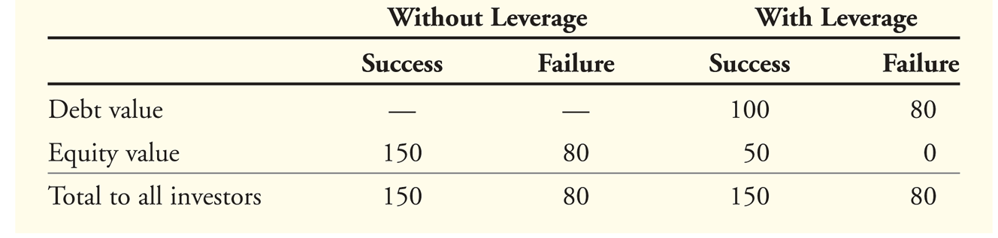
Bankruptcy in a Perfect Market
Both debt and equity holders are worse off if the product fails rather than succeeds.
Without leverage, if the product fails equity holders lose $70 million.
$150 million − $80 million = $70 million.
With leverage, equity holders lose $50 million, and debt holders lose $20 million, but the total loss is the same, $70 million.

Slide 7
Direct Bankruptcy Costs
The problem with bankruptcy is that its mere occurrence entails additional costs.
There are two kinds of bankruptcy – Chapter 7 involves liquidation of the firm and repayment of debt-holders and Chapter 11,which is more common involves financial reorganization of the firm.
In chapter 7, a trustee is appointed to oversee the liquidation of the firm’s assets through an auction. The proceeds from the liquidation are used to pay the firm’s creditors, and the firm ceases to exist.
With Chapter 11, all pending collection attempts are automatically suspended, and the firm’s existing management is given the opportunity to propose a reorganization plan.
While developing the plan, management continues to operate the business.
The reorganization plan specifies the treatment of each creditor of the firm.
Creditors may receive cash payments and/or new debt or equity securities of the firm.
The value of the cash and securities is typically less than the amount each creditor is owed, but more than the creditors would receive if the firm were shut down immediately and liquidated.
The creditors must vote to accept the plan, and it must be approved by the bankruptcy court.
If an acceptable plan is not put forth, the court may ultimately force a Chapter 7 liquidation.

Slide 8
Direct Bankruptcy Costs
In order to ensure that all debt-holders (and equity-holders) are satisfied, it is necessary to value the firm at the time of bankruptcy, as well as the different securities that are being offered to the different security-holders as part of the reorganization.
Considering that the assets of most firms are illiquid, this is an expensive process, requiring payments to experts and lawyers, as well as one that involves a lot of gaming between security-holders.
Creditors also incur costs during the bankruptcy process.
They may wait several years to receive payment.
They may hire their own experts for legal and professional advice.
Finally, the smooth operation of the business is held up while all this is happening.
The bankruptcy process is complex, time-consuming, and costly.

Slide 9
Direct Costs of Bankruptcy
Given the direct costs of bankruptcy, firms may avoid filing for bankruptcy by first negotiating directly with creditors.
Workout
A method for avoiding bankruptcy in which a firm in financial distress negotiates directly with its creditors to reorganize
The direct costs of bankruptcy should not substantially exceed the cost of a workout.
Prepackaged Bankruptcy (Prepack)
A method for avoiding many of the legal and other direct costs of bankruptcy in which a firm first develops a reorganization plan with the agreement of its main creditors and then files Chapter 11 to implement the plan
With a prepackaged bankruptcy, the firm emerges from bankruptcy quickly and with minimal direct costs.

Slide 10
Direct Bankruptcy Costs
Financial reorganization essentially involves reassigning rights to firm cashflows. For example, the maturity of debt might be lengthened or the interest rate increased in return for a postponement of interest payments.
Alternatively, debt-holders might be given equity in the firm.
Furthermore, there are different classes of debt-holders with different payment priorities. Secured debt-holders have a right to be paid first out of the assets that are subordinated to those claims. Then there is senior debt that is supposed to be paid in full before junior debt.
All of this makes for a lot of complications and is expensive.
These out-of-pocket expenses and attendant opportunity costs are termed the direct costs of bankruptcy.
It is estimated that the direct costs of bankruptcy reduce the value of the assets that the firm’s investors will ultimately receive.
The average direct costs of bankruptcy are approximately 3% to 4% of the pre-bankruptcy market value of total assets.

Slide 11
Indirect Costs of Bankruptcy
Loss of Customers: bankruptcy allows firms to walk away from commitments to their customers – hence customers may be unwilling to purchase products that involve future services. This may be in the form of warranties, or future upgrades (of software) or frequent flier mileage (for airlines) or availability of maintenance and parts for durable goods.
Loss of suppliers: suppliers may be unwilling to provide a firm with inventory if they think they might not be paid. (Corporate Finance, London: Feb 2002, issue 207, p. 8) Many Kmart shoppers have suffered the embarrassment of being strapped for cash at the checkout, but this time the shoe is on the other foot. Discount retailer Kmart did not have enough money to pay Fleming Companies, its food supplier, and filed for bankruptcy in January. Fleming is owed $77 million, and joined the tough suppliers who suspended shipments to the struggling retailer - the final blow for Kmart, who promotes itself as the home of low prices.

Slide 12
Indirect Bankruptcy Costs
Loss of employees: Firms that are more likely to enter into bankruptcy provide less job security for employees – hence top workers might be discouraged from working for such firms.
Loss of Receivables: Firms in bankruptcy might be distracted and be less able to collect from trade debtors. Ordinarily, customers would pay in order to continue being able to do business with the firm – if a firm is in bankruptcy, this is less of an incentive.
Fire sales of assets: assets might need to be sold at a lower price than they are worth if the firm needs the resources right away.
Creditors who have to wait for payment may themselves be pushed into bankruptcy.
It has been estimated that indirect costs of bankruptcy are about 10% to 20% of a firm’s pre-bankruptcy value.
A firm with more debt has a greater chance of bankruptcy and its attendant direct and indirect costs of bankruptcy. Hence these costs must be taken into account by the firm in deciding how much debt to have in its capital structure.
When securities are fairly priced, the original shareholders of a firm pay the present value of the costs associated with financial distress and bankruptcy.

Slide 13
The Tradeoff Theory
The tradeoff theory says that a firm weighs the benefits of debt that result from shielding cashflows from taxes against the costs of financial distress associated with leverage.
The total value of a levered firm equals the value of the firm without leverage plus the present value of the tax savings from debt less the present value of financial distress costs.

Slide 14
Implications of Bankruptcy Costs
Financial distress costs vary from industry to industry. This leads to different capital structures for firms in different industries.
Firms in some industries will strategically choose less debt because of the fear of high financial distress costs:
Firms that sell durable products with long lives that require replacement parts and service.
Firms that provide goods or services for which quality is an important attribute but where quality difficult to determine in advance – if the firm goes bankrupt by the time that the quality is determined to be low, customers cannot go to the firm for compensation.
Firms producing products whose value to customers depends on the services and complementary products supplied by independent companies:
Firms that sell products requiring continuous service and support from the manufacturer
Notes:
Indirect bankruptcy costs are likely to be higher for these types of firms and they should therefore be much more cautious about borrowing money in the first place.

Slide 15
Agency Costs of Debt
In addition to financial distress costs, there are additional implications of debt that derive from the incentive effects of debt.
Some of these are due to agency costs. Debt-holders entrust money to the firm, which is run by stockholders or by the direct representatives of stockholders (Board of Directors, officers of the firm).
The stockholders are, essentially, the agents of the debt-holders who can be thought of as principals.
And since the agents put their own interests first, they will often take actions that are against the interests of bondholders. These, on the other hand, will impose restrictions on stockholders to prevent being dispossessed and will, in addition, expend resources in monitoring stockholders.
These restrictions are costly because stockholders sometimes will be forced to take second-best actions to satisfy the restrictions. Other times they will take second-best actions that are value-destroying in order to dispossess bondholders.
The sum of monitoring costs, the opportunity costs of restrictions and the costs of second-best actions taken to dispossess bondholders is termed the agency costs of debt.

Slide 16
Investing in Risky Assets
Consider Baxter, Inc., which is facing financial distress.
Baxter has a loan of $1 million due at the end of the year.
Without a change in its strategy, the market value of its assets will be only $900,000 at that time, and Baxter will default on its debt.
Baxter is considering a new strategy
The new strategy requires no upfront investment, but it has only a 50% chance of success.
If the new strategy succeeds, it will increase the value of the firm’s assets to $1.3 million.
If the new strategy fails, the value of the firm’s assets will fall to $300,000.
The expected value of the firm’s assets under the new strategy is $800,000, a decline of $100,000 from the old strategy.
50% × $1.3 million + 50% × $300,000 = $800,000

Slide 17
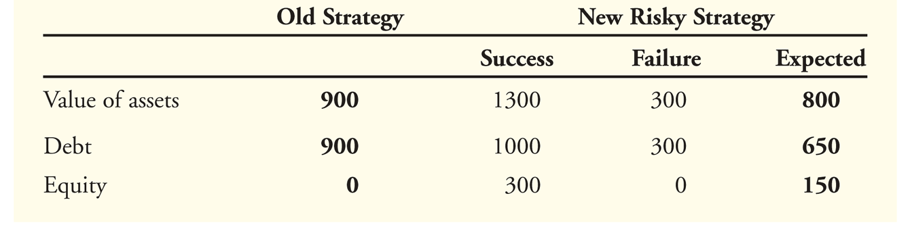
Investing in Risky Assets
If Baxter does nothing, it will ultimately default and equity holders will get nothing with certainty.
Equity holders have nothing to lose if Baxter tries the risky strategy.
If the strategy succeeds, equity holders will receive $300,000 after paying off the debt.
Given a 50% chance of success, the equity holders’ expected payoff is $150,000.
The perverse incentives for Baxter’s shareholders to undertake the new strategy can be seen in the following table.

Slide 18
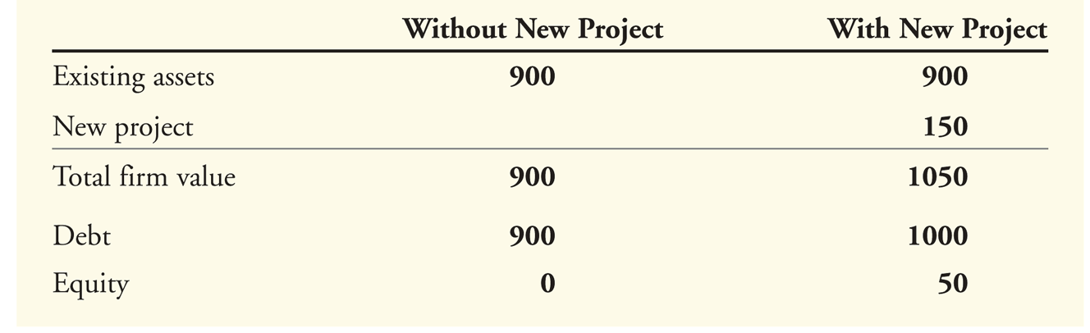
The Underinvestment Problem
Consider a firm that currently has debt with face value of $1000 that will come due in one year and assets that are projected to be worth $900 in one year.
Suppose the firm has the opportunity to invest in a new project requiring an immediate investment of $100 and offering a return of 50% in one year. Assuming the required rate of return for this project is less than 50%, it’s a NPV>0 project.
Suppose the only way to get the $100 for the initial investment is for the existing equity holders to contribute it.
With the new project, equity-holders will get $50 in one year for a current investment of $100 – clearly equity-holders would not make the investment even though the project has an NPV > 0. This is the Underinvestment Problem.

Slide 19
Cashing Out
When a firm faces financial distress, we can also see the converse of the underinvestment problem.
Stockholders have an incentive to take money out of the firm – to cash out by paying themselves high dividends.
Furthermore, if it is likely the company will default, the firm may sell assets below market value and use the funds to pay an immediate cash dividend to the shareholders.

Slide 20
Discipline Characteristics of Debt
Managerial incentives are better aligned with other shareholders, the greater the proportion of equity owned by the managers.
With more debt and fewer shares outstanding, less of an investment is required for managers to hold a given proportion of shares. This reduces the cost to managers of having to hold an undiversified portfolio to maintain incentives.
Consider the following example. Assume Ross is the owner of a firm and he plans to expand. He can either borrow the funds needed for expansion or raise the money by selling shares. If he issues equity, he will need to sell 40% of the firm to raise the necessary funds.
Suppose the value of the firm depends largely on Ross’s personal effort.
By financing the expansion with borrowed funds, Ross retains 100% ownership in the firm. Therefore, Ross is likely to work harder, and the firm will be worth more since he will receive 100% of the increase in firm value.
However, if Ross sells new shares, he will only retain 60% ownership and only receive 60% of the increase in firm value.

Slide 21
Discipline Characteristics of Debt
With leverage, Ross retains 100% ownership and will bear the full cost of any “perks,” like country club memberships or private jets.
By selling equity, Ross bears only 60% of the cost; the other 40% will be paid for by the new equity holders.
Thus, with equity financing, it is more likely that Ross will overspend on these luxuries.
By issuing new equity, the firm incurs the agency costs of reduced effort and excessive spending on perks.
As shown before, if securities are fairly priced, the original owners of the firm will pay these costs.
Using leverage can benefit the firm by preserving ownership concentration and avoiding these agency costs.

Slide 22
Discipline Characteristics of Debt
Higher debt means that bad managerial decisions are more likely to result in bankruptcy, which among other things is likely to result in the manager’s losing his/her job. This gives an incentive for managers to do a good job.
Wasteful investment is less likely in highly levered firms.
Leverage may also tie managers’ hands and commit them to pursue strategies with greater vigor than they would without the threat of financial distress. For example, when American Airlines was in labor negotiations with its unions in April 2003, it was able to win wage concessions by dangling the fear of bankruptcy if higher wages were paid.
A firm with greater leverage may also become a fiercer competitor and act more aggressively in protecting its markets because it cannot risk the possibility of bankruptcy.

Slide 23
Free Cashflow Hypothesis
A concern for large corporations is that managers may make large, unprofitable investments.
Managers may engage in empire building.
Managers of large firms tend to earn higher salaries, and they may also have more prestige and garner greater publicity than managers of small firms.
Thus, managers may expand unprofitable divisions, pay too much for acquisitions, make unnecessary capital expenditures, or hire unnecessary employees
Managers may over-invest because they are overconfident.
Even when managers attempt to act in shareholders’ interests, they may make mistakes; managers tend to be bullish on the firm’s prospects and may believe that new opportunities are better than they actually are.
When cash is tight, managers will be motivated to run the firm as efficiently as possible.
According to the free cash flow hypothesis, leverage increases firm value because it commits the firm to making future interest payments, thereby reducing excess cash flows and wasteful investment by managers.

Slide 24
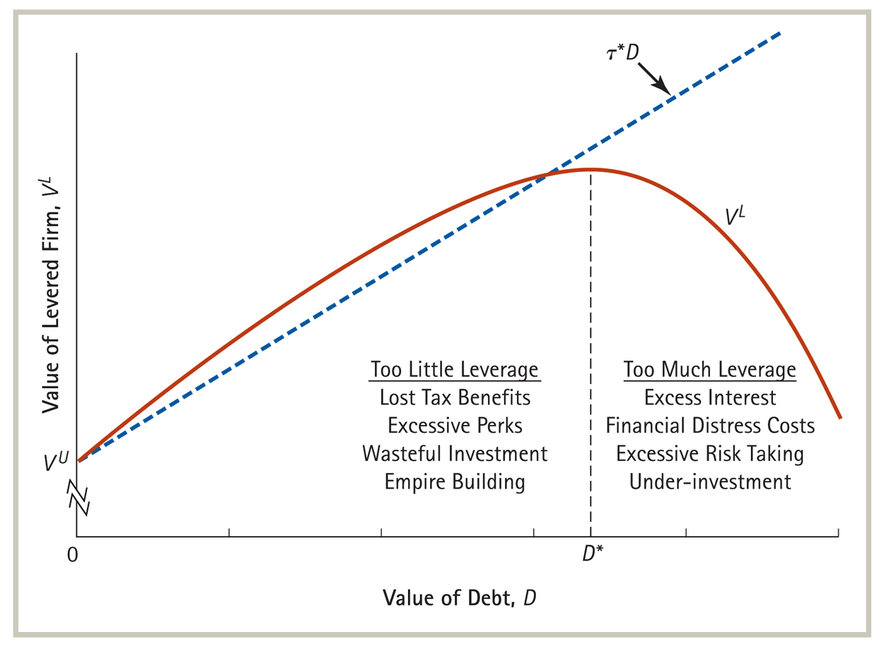
The Optimal Amount of Debt

Slide 25
Information Asymmetry
We now look at how managers may be led to change capital structure because of the fact that managers and investors have different information sets and managers cannot credibly and costlessly provide information to investors in capital markets.
Two examples:
Managers use debt as a signal that the firm is in a strong position.
Managers avoid using equity because markets may view the decision to issue equity as proof of the overvaluation of the stock.

Slide 26
Debt Signaling
Assume a firm has a large new profitable project, but cannot discuss the project due to competitive reasons.
One way to credibly communicate this positive information is to commit the firm to large future debt payments.
If the information is true, the firm will have no trouble making the debt payments.
If the information is false, the firm will have trouble paying its creditors and will experience financial distress. This distress will be costly for the firm.
The choice of the firm to issue debt will be viewed by the market as evidence of the existence of the profitable project since otherwise the decision to issue debt would be suboptimal from the shareholders’ point of view.

Slide 27
Debt Signals Strength

Slide 28
Adverse Selection and Equity Issuance
Adverse Selection
When buyers and sellers have different information, the average quality of assets in the market will differ from the average quality overall
A classic example of adverse selection is the used car market.
If the seller has private information about the quality of the car, then his desire to sell reveals the car is probably of low quality.
Lemons Principle
When a seller has private information about the value of a good, buyers will discount the price they are willing to pay due to adverse selection.
Buyers are therefore reluctant to buy used cars except at heavily discounted prices.
Managers prefer not to use equity financing because investors infer from the manager’s desire to sell stock that the shares are overpriced.

Slide 29
Adverse Selection and Equity Issuance
The lemons principle directly implies that:
The stock price declines on the announcement of an equity issue.
The stock price tends to rise prior to the announcement of an equity issue.
Firms tend to issue equity when information asymmetries are minimized, such as immediately after earnings announcements.
Managers who perceive the firm’s equity is underpriced will have a preference to fund investment using retained earnings, or debt, rather than equity.
Managers who perceive the firm’s equity to be overpriced will prefer to issue equity, as opposed to issuing debt or using retained earnings, to fund investment.
Pecking Order Hypothesis: managers will prefer to fund investments by first using retained earnings, then debt and equity only as a last resort

Slide 30
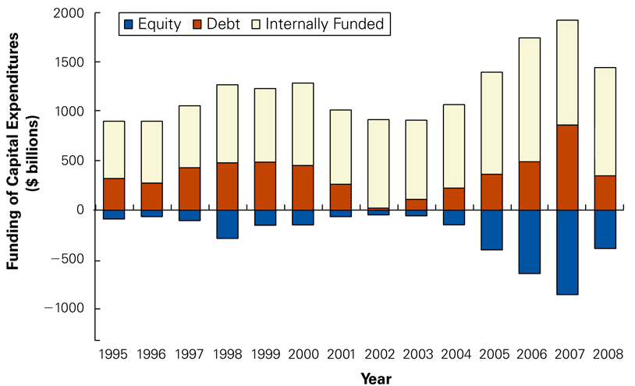
Sources of Funding for U.S. Corporations

Slide 31
Capital Structure and Managerial Entrenchment
The optimal capital structure depends on market imperfections, such as taxes, financial distress costs, agency costs, and asymmetric information.
Even though in principle firms should trade off the tax advantages of debt against financial distress costs and the incentive effects of debt, in practice, managers may not behave in this fashion.
The management entrenchment theory suggests that managers choose a capital structure to avoid the discipline of debt and maintain their own job security.
Managers seek to minimize leverage to prevent the job loss that would accompany financial distress, but are constrained from using too little debt (to keep shareholders happy).
Shareholders should be active in voting against policies that protect managers unduly from the negative effects of their actions.

