Slide 1
Payout Policy
P.V. Viswanath

Slide 2
Learning Objectives
How is cash returned? The Mechanics
How do we choose between dividends and Share Repurchases?
Why Dividends and Share Repurchases are irrelevant in Perfect Markets
Why dividends might be paid because of Tax Clienteles
The choice between payout and retention of Cash
Signaling reasons for Payout Policy

Slide 3
Dividend Mechanics
Declaration date: The board of directors declares a payment Record date: The declared dividends are distributable to shareholders of record on this date. Payment date: The dividend checks are mailed to shareholders of record.
Ex-dividend date: A share of stock becomes ex-dividend on the date the seller is entitled to keep the dividend. At this point, the stock is said to be trading ex-dividend.

Slide 4
Types of dividends
There are different kinds of dividends:
Ordinary dividend: the firm pays a certain amount per share on a regular basis – usually this amount is increased over time.
Special dividends: more than a regular dividend, but not paid all the time. For example, Microsoft paid a $3 special dividend in 2004.
Stock dividend or stock split: this is not really a dividend at all; the stockholder gets a certain number of additional shares per share that s/he owns. If the number of additional shares is large such as 2 or 2.5, it’s called a stock split.
Dividend reduce the firm’s retained earnings. In some cases, dividends are attributed to other accounting sources, such as paid-in capital or the liquidation of assets. In this case, the dividend is known as a return of capital or a liquidating dividend. A return of capital is treated as a capital gain rather than as a dividend for the investor.
Another way that the firm can return cash to shareholders is by buying back shares.

Slide 5
Share repurchases
Open Market Repurchase: A firm announces it intention to buy its own shares in the open market and then proceeds to do so over time like any other investors; the firm is not supposed to buy back the shares in such a way as to manipulate the price. Share repurchases represent 95% of all repurchase transactions.
Tender offer: a firm offers to buy shares at a pre-specified price during a short time period – generally within 20 days. The price is usually set at a substantial premium to the current market price. If shareholders do not tender enough shares, the firm may cancel the offer and no buyback occurs.
Targeted repurchase: the firm buys directly from a specific shareholder. This may occur if the shareholder wants to sell his shares but is afraid of moving the market price – in this case, the shareholder may be willing to sell at the market price; if the firm is afraid of the shareholder’s intentions, it may buy back the shares at a premium to the market price. This may occur if management feels threatened by a shareholder who intends to takeover the firm. Such a buyback is called greenmail.

Slide 6
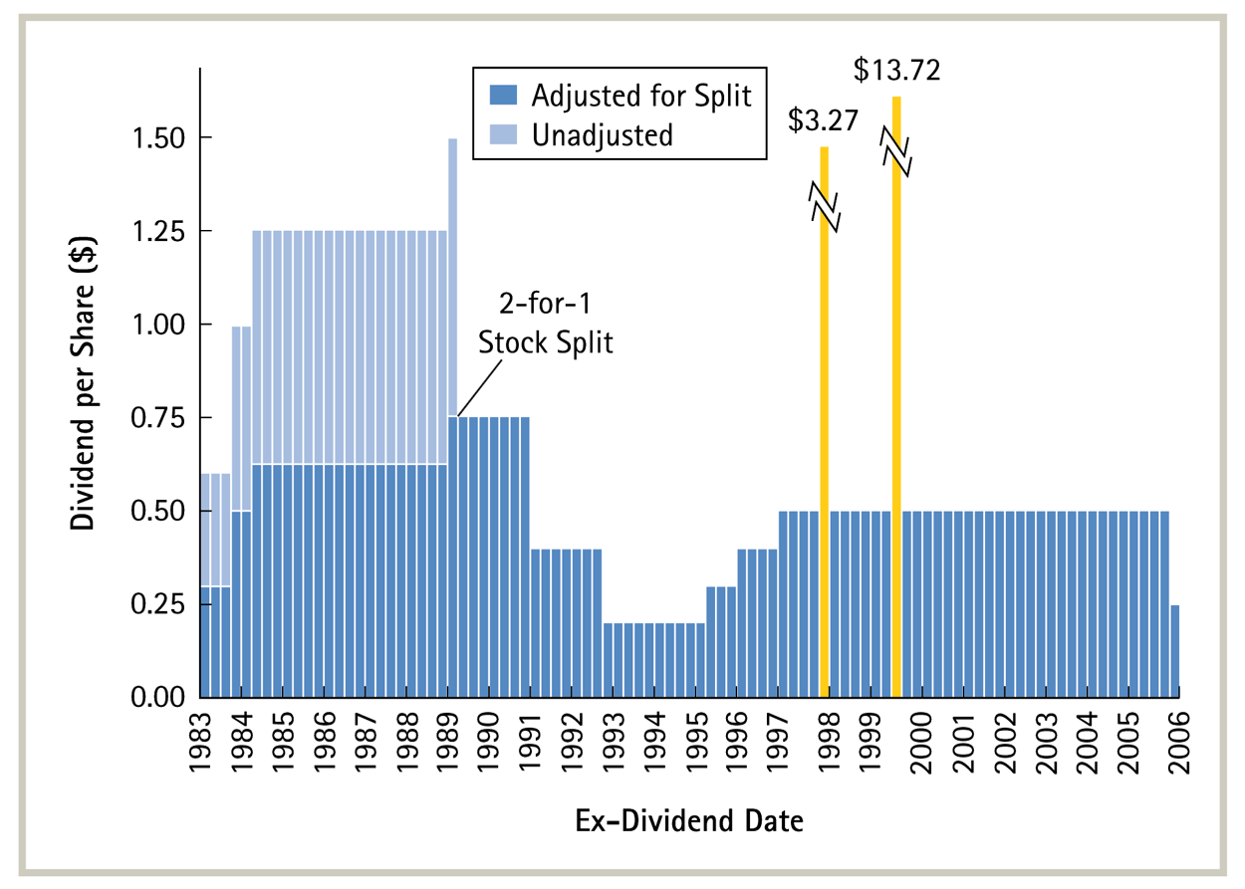
Dividend History for GM Stock, 1983–2006

Slide 7
Dividends vs Share Repurchases
In properly functioning capital markets, the method of redistributing cash to stockholders should not matter – whether through dividends or through share repurchase.
In both cases, the firm has less equity and less cash.
Since the amount of funds left invested in the firm does not change, the present value of future dividends should not change. Consequently, the present value of shareholder wealth should be the same, as well.

Slide 8
Irrelevance of share repurchases
Buttle Wilson and Co. has $50 m. available for distribution. Buttle has 10 m. shares outstanding. It expects to earn $2.50 a share, and the current market value per share is $25. The firm has unused cash that could be used to pay a cash dividend of $5 per share, implying an ex-dividend value of $20 per share.
Alternatively, the firm could use the $50 m. to repurchase 2 m. shares ($50,000,000/$25). Following the share repurchase, each share would be worth (10*25-50)/(10-2) = $25.
As long as the firm repurchases the shares at the market price of $25, a shareholder who does not sell will have the same wealth as a shareholder who does sell--$25. The difference is that the former has it in stock, the latter in cash.
If Buttle paid the $5 dividend, every shareholder would have their wealth in the same form--$5 in cash plus $20 in stock.

Slide 9
Impact of repurchases on EPS
Following the distribution of the $50 m. whether through a stock repurchase or through a dividend payment, the firm's shares will trade at a P/E ratio of 8 (= $20/$2.50).
Neither the firm's capital structure nor its capital investment policies are affected by the method of cash distribution; hence the risk-return tradeoff is the same.
Under the dividend alternative, the EPS is unchanged at $2.50, because the $50 m. paid out were unused, and the number of shares is unchanged. Each shareholder gets (EPS x P/E = $2.50 x 8 =) $20 + $5 = $25 in total value.
Under the share repurchase alternative, the projected EPS is higher at (2.5*10)/8 = $3.125.
However, shareholder value is (EPS x P/E =) $3.125 x 8 = $25, once again. The higher EPS is exactly offset by the drop in the P/E ratio from ($25/2.5 =) 10 before the stock repurchase to 8 afterwards.
The confusion over the impact of share repurchases results from the mistaken view that share repurchase will not alter the P/E ratio. But paying out cash results in a riskier firm and hence the P/E ratio must drop (the required rate of return must rise).

Slide 10
Reasons for Share Repurchase
If markets are imperfect, there may be reasons to repurchase shares. Some reasons are value-increasing; others value-decreasing.
The following four reasons are value-increasing.
Tax considerations:
Gains to individual shareholders from share repurchases are taxed at the capital gains rate, which is usually smaller than the tax rate on cash dividends. However, a regular policy of repurchasing shares could be disallowed by the IRS for favorable capital gains treatment.
Eliminate Small Shareholdings:
The cost of servicing a small shareholder account is roughly the same as that of servicing a large shareholder account. Hence repurchasing shares of small stockholders could reduce overall stockholder service costs.
Increase Leverage:
If the firm wishes to increase debt in its capital structure, it could borrow funds and use the proceeds to repurchases shares or offer its shareholders the opportunity to exchange their shares for a new debt issue.

Slide 11
Reasons for Share Repurchases
Exploit Perceived Undervaluation:
If a firm's stock is perceived by the management to be undervalued, repurchasing shares at a favorable price could increase the wealth of the firm's remaining shareholders. However, if investors believe that the share repurchase is being undertaken for this purpose, share prices will jump to reflect market belief in a higher share value. If so, the true wealth of the firm's remaining shareholders would not increase; however, the market value of their shareholdings will increase, which can be valuable for shareholders who desire liquidity.
The following two reasons are value-decreasing.
Consolidation of Insider Control:
Firms sometimes purchase stock from contentious minority stockholders, sometimes at a premium (greenmail). At other times, they may do so to reduce public float--to reduce the percentage of stock held by persons not affiliated with the insider group.
Protection against Takeovers
Stock repurchases may also be designed to reduce the attractiveness of the company as an acquisition candidate, thus enhancing management's security.
These objectives may not be consistent with firm value maximization.

Slide 12
Example of Dividend Irrelevance
Stellar, Inc. has decided to invest $10 m. in a new project with a NPV of $20 m., but it has not made an announcement.
The company has $10 m. in cash to finance the new project.
Stellar has 10 m. shares of stock outstanding, selling for $24 each, and no debt.
Hence, its aggregate value is $240 m. prior to the announcement ($24 per share).

Slide 13
Example of Dividend Irrelevance
Two alternatives:
For both alternatives, we will see that the investor ends up in the same situation, thus proving dividend irrelevance.
One, pay no dividend and finance the project with cash. The value of each share rises to $26 following the announcement. Each shareholder can sell 0.0385 (= 1/26) shares to obtain a $1 dividend, leaving him with .9615 shares value at $25 (26 x 0.9615). Hence the shareholder has one share worth $26, or one share worth $25 plus $1 in cash.

Slide 14
Example of Dividend Irrelevance
Two, pay a dividend of $1 per share, sell $10m. worth of new shares to finance the project.
After the company announces the new project and pays the $1 dividend, each share will be worth $25.
To raise the $10 m. needed for the project, the company must sell 400,000 (=10,000,000/25) shares. Immediately following the share issue, Stellar will have 10,400,000 shares trading for $25 each, giving the company an aggregate value of 25 x 10,400,000 = $260m.
If a shareholder does not want the $1 dividend, he can buy 0.04 shares (1/25).
Hence, the shareholder has one share worth $25 and $1 in dividends, or 1.04 shares worth $26 in total.

Slide 15
Dividend Policy Irrelevance
Modigliani–Miller Theorem on Dividend Irrelevance
In perfect capital markets, holding fixed the investment policy of a firm, the firm’s choice of dividend policy is irrelevant and does not affect the initial share price.
A firm’s free cash flow determines the level of payouts that it can make to its investors.
In a perfect capital market, the type of payout is irrelevant.
In reality, capital markets are not perfect and it is these imperfections that should determine the firm’s payout policy.

Slide 16
Tax Disadvantage of Dividends
Shareholders must pay taxes on the dividends they receive and they must also pay capital gains taxes when they sell their shares.
Dividends are typically taxed at a higher rate than capital gains. In fact, long-term investors can defer the capital gains tax forever by not selling.
The higher tax rate on dividends makes it undesirable for a firm to raise funds to pay a dividend.
When dividends are taxed at a higher rate than capital gains, if a firm raises money by issuing shares and then gives that money back to shareholders as a dividend, shareholders are hurt because they will receive less than their initial investment
The optimal dividend policy when the dividend tax rate exceeds the capital gain tax rate is to pay no dividends at all.
The payment of dividends has declined on average over the last 30 years while the use of repurchases has increased.
The surprising fact, though, is that firms continue to pay dividends!

Slide 17
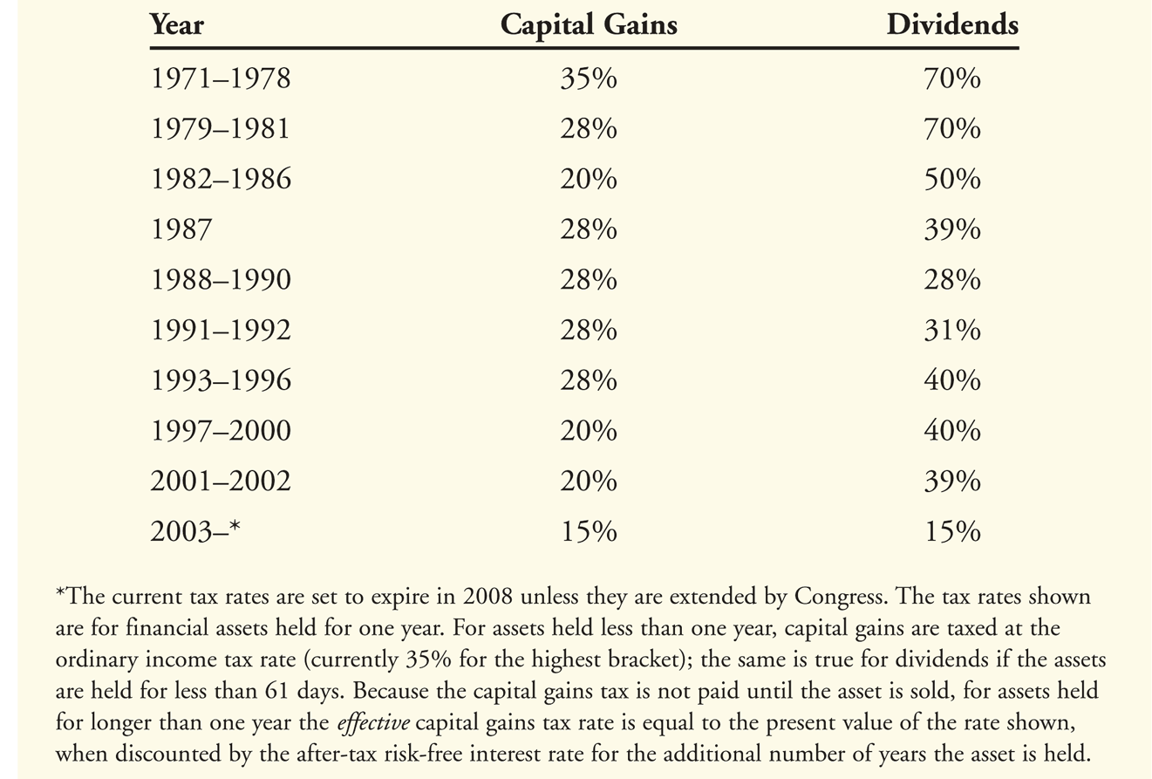
US Capital Gains vs Dividend Tax Rates

Slide 18
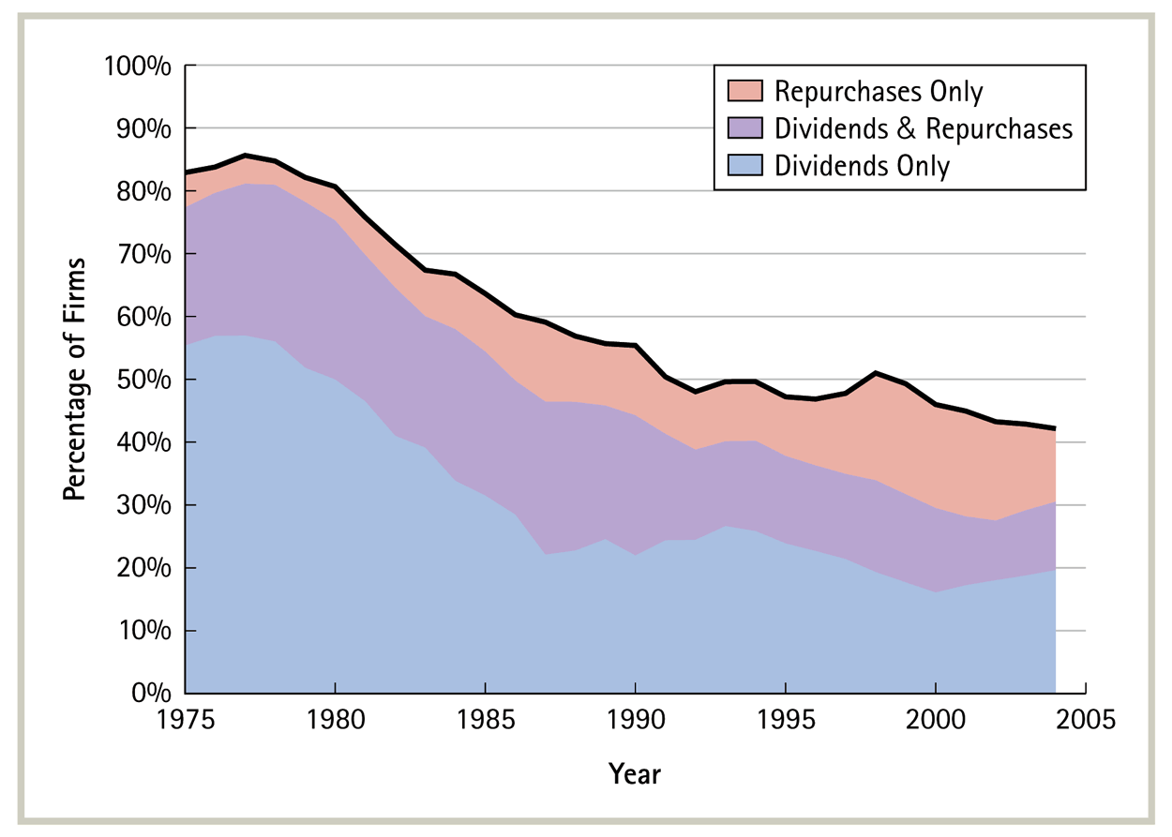
The Declining Use of Dividends

Slide 19
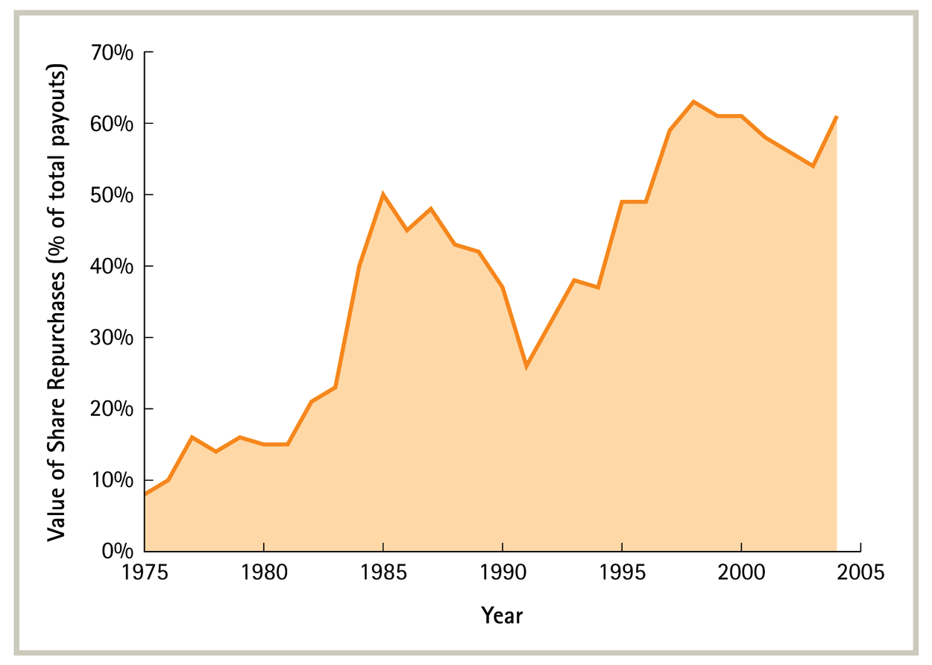
Changing Composition of Shareholder Payouts

Slide 20
Impact of Taxes on the value of dividends
Question: Suppose
A firm raises $25 million from shareholders and uses this cash to pay them $25 million in dividends.
Dividends are taxed at a 39% tax rate and capital gains are taxed at a 20% tax rate.
How much will shareholders receive after taxes?
On dividends, shareholders will owe:
39% × $25 million = $9.75 million in dividend taxes.
Shareholders will lower their capital gains taxes by:
20% × $25 million = $5 million; the value of the firm will fall when the dividend is paid lowering the shareholders’ capital gains.
Shareholders will pay a total of $4.75 million in taxes.
$9.75 − $5.00 = $4.75 million
Shareholders will receive back only $20.25 million of their $25 million investment.
$25 − $4.75 = $20.25 million

Slide 21
Tax Clienteles
Many investors have a tax preference for share repurchases over dividends. But this is not true of all shareholders!
To look at shareholder preferences, we need to quantify the combined effects of dividend and capital gains taxes.
Consider an investor who buys a stock today just before it goes ex-dividend and sells the stock just after. If the stock pays a dividend of Div, the after-tax cashflow is from the dividend is Div(1-τ_{d}).
In addition, because the stock price just before the stock goes ex-dividend P_{cum} is less than the price just after, P_{ex}, the investor will experience a tax loss and obtain a capital loss providing an after-tax loss of P_{cum}-P_{ex}(1-τ_{g}).
Hence the investor obtains a gain by this procedure if Div(1-τ_{d}) > P_{cum}-P_{ex}(1-τ_{g}). To prevent arbitrage, therefore, the two quantities should be equal. This can be rewritten as:

Slide 22
Clientele Effects
The effective dividend tax rate τ_{d}* measures the additional tax paid by the investor per dollar of after-tax capital gains income that is instead received as a dividend.
The effective dividend tax rate for an investor depends on many factors:
Income level – higher income investors fall into higher tax brackets.
Investment horizon – capital gains on stocks held less than a year are taxed at higher ordinary income tax rates. Investors who bequeath the stock to their heirs avoid capital gains taxes altogether.
Type of investor – investment in retirement accounts or by nonprofit endowment funds are not subject to taxes. Corporations that hold stocks exclude 70% of dividends from corporate taxes, but not capital gains. Thus for a corporation, τ_{d}* = -38% today, assuming τ_{d} = 15%.
Tax jurisdiction – investors are subject to state taxes that vary across states; e.g. New Hampshire imposes no tax on capital gains, but does impose a 5% tax on dividends.

Slide 23
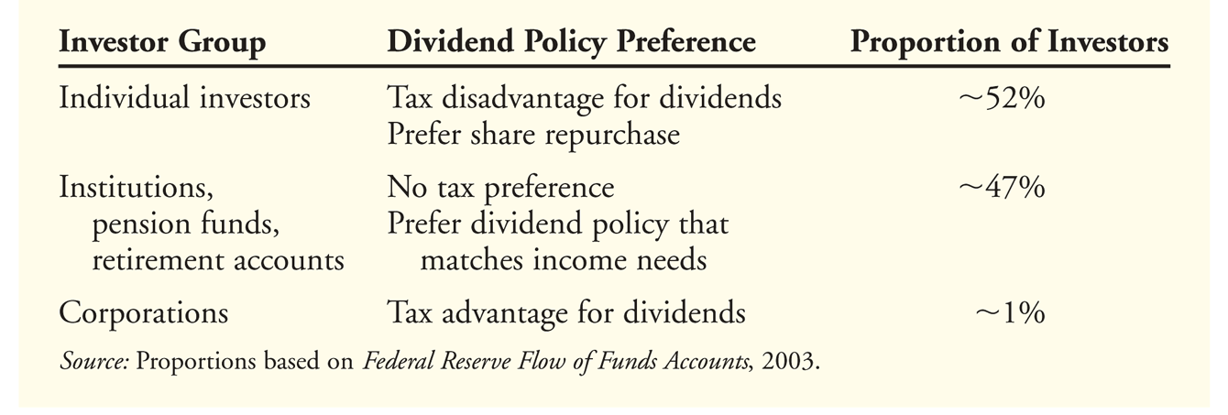
Dividend Preferences Across Groups

Slide 24
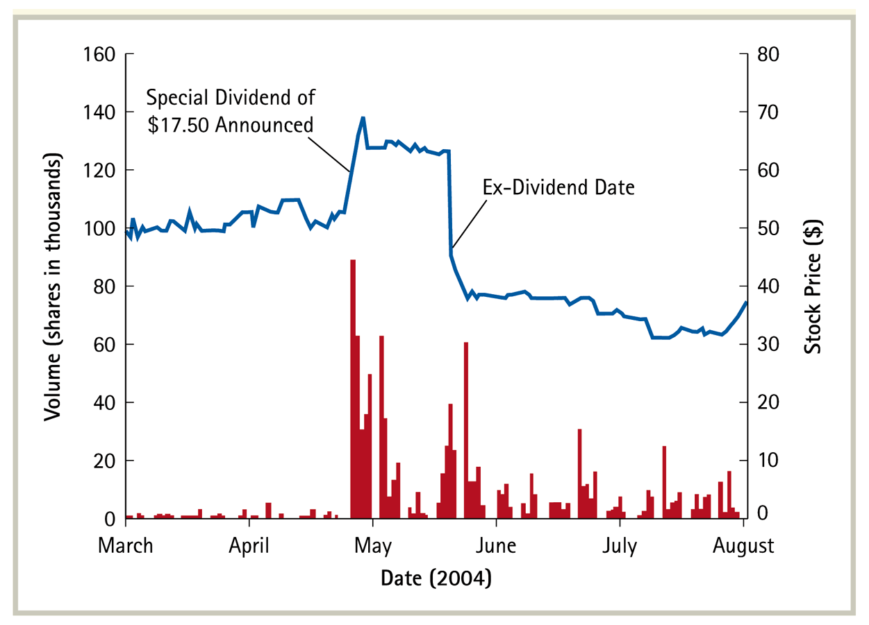
Dividend-Capture Theory
This theory says that absent transaction costs, investors can trade shares at the time of the dividend so that non-taxed investors receive the dividend
An implication of this theory is that we should see large trading volume in a stock around the ex-dividend day, as high-tax investors sell and low-tax investors buy the stock in anticipation of the dividend, and then reverse those trades just after the ex-dividend date.

Slide 25
Example of Dividend Capture
On Aug 2, 2005, CorpCo declares a dividend payable on October 3, 2005. CorpCo announces that shareholders of record on or before Sept 30, 2005 are entitled to the dividend. The stock goes ex-dividend Sept 28, 2005, two days before the record date.
Anyone who bought the stock before September 28, 2005 or after would get the dividend.
The stock price will fall after the dividend payment, but usually less than the div amount. If the trader is tax-neutral, selling right after the stock goes ex-dividend, i.e. on Sept 28, can net the trader a profit.

Slide 26
Payout vs Retention of Cash
Modigliani-Miller Payout Irrelevance Proposition: In perfect capital markets, if a firm invests excess cash flows in financial securities, the firm’s choice of payout versus retention is irrelevant and does not affect the value of the firm.
If there are positive NPV projects, clearly the firm should invest in them.
After making such value-increasing investments, if the firm pays out excess cash to shareholders, the value of the firm will not decrease.
Alternatively, if the firm retains the excess cash and invests it in financial securities that are properly priced, there should be no impact on firm value, since these securities are presumably zero NPV investments.

Slide 27
Funds Retention and Taxes
Suppose Barston must pay corporate taxes at 35% on the interest it will earn from the Treasury bills. In this case, Barston shareholders who pay taxes at a rate lower than 35% would prefer that Barston distribute the money in cash as opposed to retaining it and investing it in taxable securities.

Slide 28
Funds Retention and Taxes
Suppose Barston must pay corporate taxes at 35% on the interest it will earn from the Treasury bills. In this case, Barston shareholders who are pensioners and pay taxes at a much rate lower than 35% would prefer that Barston distribute the money in cash as opposed to retaining it and investing it in taxable securities.
Even shareholders who do pay taxes at higher rates would prefer that Barston not hold on to the cash. This is because Barston has to pay corporate taxes on the interest income. In contrast, if Barston pays out the cash, the shareholders only pay tax at the rate levied on interest income, which is usually around the level of the corporate tax rate or less. Furthermore, the price of Barston stock would drop giving shareholders a valuable tax loss.
We don’t worry about the tax that would be paid on dividends by shareholders if Barston paid out the cash as dividends because this is a tax that has to be paid by shareholders either now or in the future when Barston pays out the interest on the cash as a perpetuity.
The effective tax disadvantage on retaining the cash can be computed as:

Slide 29
Issuance and Distress Costs
If there is a tax disadvantage to holding cash, why do firms continue to hold cash?
One answer is that they do so to cover future potential cash shortfalls.
If there is a chance that the company may need money in the future to fund positive-NPV investment opportunities, the firm may prefer to put money aside today for that eventuality. The alternative of paying out the money today and raising funds in the future may not be attractive because of information asymmetry problems, which may require the firm to issue new securities at a time when the firm may be undervalued by investors.
In addition, the firm can save issuance costs of 1-3% for debt issuance and 3.5% to 7% for equity issuance.
On the other hand, the free cash flow hypothesis suggests that managers may engage in empire-building and in others investing free cash in NPV<0 projects.

Slide 30
Payout Policy and Signaling
Firms prefer to smooth dividends even though earnings themselves may be volatile. This may be because of investor preferences for smooth dividend payment streams to allow them to plan better.
As a result, managers tend to increase dividends only if they can maintain the increase and are loth to decrease them.
Given this, a decision by a manager to increase dividends could contain information regarding the manager’s belief that future cashflows will be high enough to allow the firm to continue paying dividends at that higher level.
This works similar to signaling with debt.

Slide 31
Share repurchases and signaling
Share repurchases differ from dividends in terms of their potential to be used as signals:
Managers are less committed to share repurchases than to dividends; when they announce share repurchases, they announce a maximum amount and buy back the shares over a period of time – sometimes they suspend or cancel the buyback.
Firms do not smooth their buyback activity – hence the information content in deviations is less.
On the other hand, the cost of a buyback depends on the price of the share – the lower the share price, the less the cost of the buyback. Hence a buyback decision could convey information directly that management believes shares to be underpriced.
Share price go up, on average, when a firm announces a buy-back.

Slide 32
Stock Dividends and Splits
A stock dividend does not involve any cash returned to shareholders and stock dividends are not taxed.
Firms pay stock dividends (or split their shares) to keep trading levels for their shares low.
If the price per share is too high, investors will have to invest a very high amount to be able to trade in a round lot of 100 shares; prices for odd-lots are higher.
Stock splits are often followed by dividend increases – hence announcements of stock splits are often greeted with higher stock prices by the market.
If the price of the share is too low, bid-ask spreads are higher, as well.
If the price falls too low, firms engage in reverse splits to increase the price per share.

Slide 33
Spin-offs
A firm can also distribute shares of a subsidiary in a transaction called a spin-off.
For example, after selling 15% of Monsanto Corporation in an IPO in October 2000, Pharmacia Corporation announced in July 2002 that it would spin off its remaining 85% holding in Monsanto.
This was done as a special dividend in which each Pharmacia shareholder got 0.170593 shares of Monsanto per Pharmacia share.
A shareholder who held 100 shares of Pharmacia would receive 17 shares of Monsanto plus (0.0593 x 16.21 =) $0.96 in cash, since Monsanto shares were trading at $16.21 per share.
The other alternative of selling the additional Monsanto shares and paying a cash dividend would be more expensive since Pharmacia shareholders would have to pay tax. With a spin-off they could decide when to sell the Monsanto shares and pay the lower capital gains tax.

Slide 34
Dividends and Firm Life-Cycle
Stage 1 Introduction
Funding Needs
Limited by size and other infrastructure limits
Cash flows generated
Negative as investments are made
Dividend Policy
No dividends New Stock Issues

Slide 35
Dividends and Firm Life-Cycle
Stage 2 Rapid expansion
Funding Needs
High relative to firm value
Cash flows generated
Cash flow low relative to firm value
Dividend Policy
No or very low dividends

Slide 36
Dividends and Firm Life-Cycle
Stage 3 Mature growth
Funding Needs
Moderate relative to firm value
Cash flows generated
Cash flow increases as percentage of firm value
Dividend Policy
Increase dividends

Slide 37
Dividends and Firm Life-Cycle
Stage 4 Decline
Funding Needs
Low as projects dry up
Cash flows generated
Cash flow high relative to firm value
Dividend Policy
Special dividends Repurchase stock

Slide 38
Relevant factors in dividend policy
Investment Opportunities: A firm with more investment opportunities should pay a lower fraction of its earnings.
Stability of earnings: A firm with more volatile earnings should pay, on average, a lower proportion of its earnings, so that it will not have to cut dividends.
Alternative sources of capital: To the extent that a firm can raise alternative capital at low cost, it can afford to pay higher dividends. Hence, large firms tend to pay higher dividends.

Slide 39
Relevant Factors in Dividend Policy
Degree of financial leverage: If a firm has high leverage, it will probably also have covenants restricting the payment of dividends. Furthermore, to a certain extent, dividends and debt can be considered substitutes for the purpose of manager discipline.
Signaling incentives: To the extent that a firm can signal using other less costly means, for example debt, it should pay lower dividends.
Stockholder Characteristics: If a firm's stockholders want higher dividends, it should provide them.

Slide 40
Computing optimal payout: first step
Questions: How much cash is available to be paid out as dividends?
Answer: The funds available to be paid out as dividends are essentially equal to free cash flow to equity (FCFE) Keep in mind these quantities should be computed prospectively.

Slide 41
Three definitions of FCFE
Direct methods of computing the Free cash flow to equity:
FCFE = Net Income - (Capital Expenditures - Depreciation) - (Change in Noncash Working Capital) + (New Debt Issued - Debt Repayments) - Preferred Dividends
FCFE = Net Income - (Capital Expenditures - Depreciation)*(1- Debt Ratio) - Change in Non-cash Working Capital (1-Debt Ratio).
Using the Statement of Cashflows: this is only available for the past
Cash Flows from Operating Activities - (Capital expenditures) - (preferred dividends) - (New Debt Issued - Debt Repayments).

Slide 42
Computing optimal payout: second step
How good are the projects available to the firm?
If Dividends greatly exceed FCFE, dividends should be cut.
If the rate of return on equity is greater than the cost of equity, the released funds should be invested in new projects and if funds are inadequate, funding should be sought from elsewhere.
If projects are unprofitable, investment should be reduced.

Slide 43
Computing optimal payout: second step
If FCFE greatly exceed Dividends, the CFO must check to see how funds are being invested.
If the actual rate of return (accounting rate of return) on equity is greater than the required rate of return, then the excess funds should be invested in new projects. If necessary, the dividend payout ratio should also be decreased to release funds for new projects.
If the actual rate of return is low relative to the required rate of return, then dividends should be increased.

Slide 44
Computing Optimal Dividends: An example
You are analyzing the dividend policy of Conrail and have collected the following information from the last five years (in millions):
The average debt ratio during this period was 40% and the total noncash working capital at the end of 1990 was $10 million.
How much could Conrail have paid in dividends during this period?
If the average return on equity during the period was 13.5% and Conrail had a beta of 1.25, what conclusions would you draw about Conrail’s dividend policy? The average T-bond rate during the period was 7% and the average return on the market was 12.5%
Problem 8, Chap. 22 from Damodaran, “Corporate Finance: Theory and Practice”

Slide 45
Computing Optimal Dividends: An example
Conrail could have paid, on average, yearly dividends equal to its FCFE.
Conrail is earning an average accounting return on equity of 13.5%.
The required rate of return = 0.07 + 1.25(0.125-0.07) = 13.875.
Hence Conrail’s projects have done badly on average.
It’s average dividends have been much lower than the average FCFE.
Conrail should pay more in dividends.

