Slide 1
Capital Markets and the Pricing of Risk
P.V. Viswanath
For a First Course in Finance

Slide 2
Learning Objectives
Why do average returns vary across asset classes?
How do we measure the uncertainty of asset returns?
What part of the uncertainty of asset returns is relevant for asset pricing?
Why is the pricing of individual stocks different from the pricing of diversified portfolios of stocks?
How should average returns vary across individual stocks?
What is the CAPM?
What asset pricing models are used today that go beyond the CAPM?
How do firms measure the cost of capital to decide whether or not to invest in a project?

Slide 3
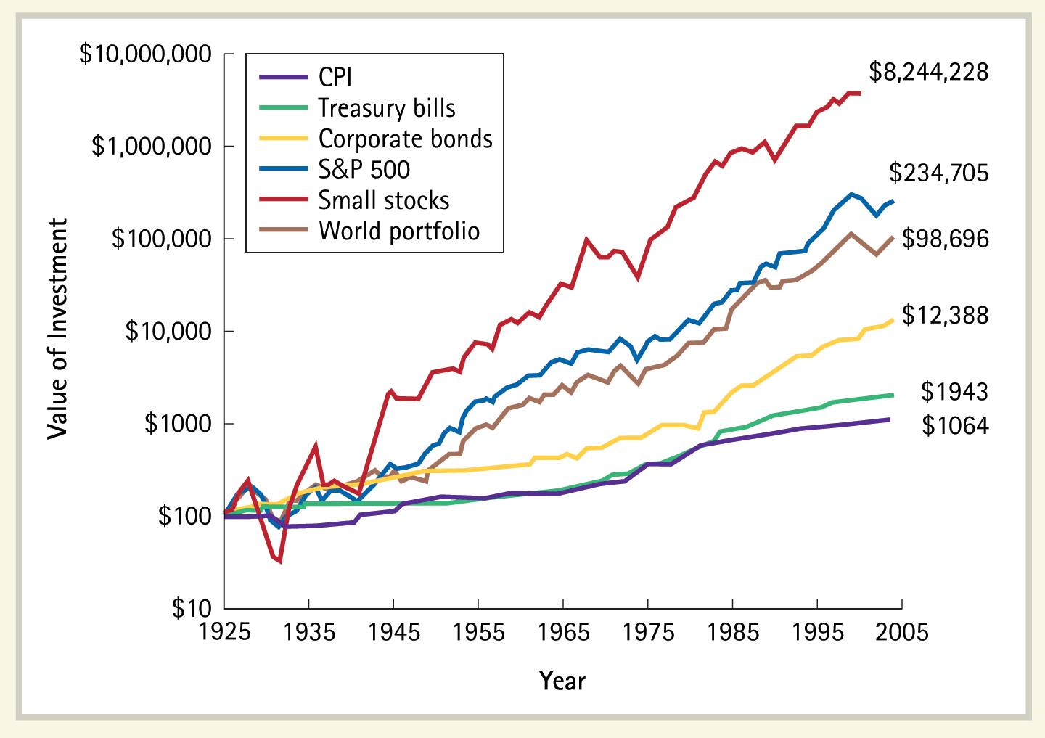
Rates of Return vary across Assets
Value of $100 Invested at the End of 1925 in U.S. Large Stocks (S&P 500), Small Stocks, World Stocks, Corporate Bonds, and Treasury Bills. These returns assume all dividends and interest are reinvested and exclude transactions costs. Also shown is the change in the consumer price index (CPI).
Source: Chicago Center for Research in Security Prices (CRSP) for U.S. stocks and CPI, Global Finance Data for the World Index, Treasury bills and corporate bonds.

Slide 4
Average Rates of Return
Average rates of return are not the same across asset classes.
Over the eighty years, the ranking of asset classes is:
Small Stocks
S&P 500
World Portfolio
Corporate Bonds
Treasury Bills
CPI
Is this ranking coincidental or is there a pattern? How can we explain this ranking?
The answer has to do with risk.
We begin our exploration of risk by describing probability distributions.

Slide 5
Poll: What is Risk?
What is risk with respect to a particular investment?
Risk is the possibility of losing money in that investment
Risk is the uncertainty of not knowing exactly what will be the return on that investment
Risk is the possibility of having your total wealth decreased (compared to present wealth) because of the outcome in a particular investment.
Risk is the uncertainty of not knowing what your future wealth will be because of the outcome on that investment

Slide 6
Returns and Return Uncertainty
If an investor buys an asset, a, at time 0 for $P₀, receives a cashflow at time 1 of $D₁ and sells it at time 1, for $P₁, the return on the asset is defined as R_{a,1} = (P₁ + D₁ – P₀)/P₀
At time 0, the actual value of R_{a,1} is unknown.
Suppose there are three different possible outcomes, corresponding to three different states: states 1, 2 and 3.
Thus R_{a,1} could be equal to 3%, 7% or 10% with probabilities of 0.3, 0.2 and 0.5 for the three different states.
The mean or expected value of R_{a,1} is computed as 0.3(3%) + 0.2(7%) + 0.5(10%) = 7.3%

Slide 7
Returns and Return Uncertainty
The expected value is a kind of average outcome, where the different possible outcomes are weighted by the probabilities.
E(R_{a}) is the way we represent the expected return on asset a.
Here is the general formula for expected return, where p_{R} is the probability of a return R.

Slide 8
Poll: Expected Return
An asset has three possible return outcomes over the next year: 30% (probability 0.1), 20% (probability 0.4), and 10% (probability 0.4). The expected return is:
15%
20%
You can’t compute the expected return
The expected return doesn’t depend on the possible outcomes. It is what each person wants to get from that investment.

Slide 9
Return Volatility
Consider another asset, b, which has returns of 1%, 7% and 11.2% in the three different states.
The expected return of asset b is 0.3(1%) + 0.2(7%) + 0.5(11.20%), which is also 7.3%.
However, asset b’s returns are said to be more volatile than those of asset a, meaning roughly that the range of possible outcomes is greater, or that more extreme outcomes – both positive and negative – are more likely.

Slide 10
Variance
The variance of returns is computed as the mean squared deviation from the expected return.
The squared deviation is a measure of how extreme a return is.
Taking the mean computes the average value of these deviations.
The square root of the variance is called the standard deviation or volatility.
Variance is measured in percent-squared.
Standard deviation is measured in the same units as returns, viz. percent.

Slide 11
Return volatilities of Assets a & b
Probabilities | Return (Asset a) | Deviation from Mean Return | Squared Deviation
0.3 | 3 | -4.3 | 18.49
0.2 | 7 | -0.3 | 0.09
0.5 | 10 | 2.7 | 7.29
We see that the variance of returns for asset a is 9.21, computed as 0.3(18.49) + 0.2(0.09) + 0.5(7.29) and the standard deviation is 3.035%

Slide 12
Return volatilities of Assets a & b
Probabilities | Return (Asset b) | Deviation from Mean Return | Squared Deviation
0.3 | 1 | -6.3 | 39.69
0.2 | 7 | -0.3 | 0.09
0.5 | 11.2 | 3.9 | 15.21
The variance of returns for asset b can be computed as 39.69 (0.3) + 0.09 (0.2) + 15.21 (0.5) = 19.53; the standard deviation is the square root of 19.53, i.e. 4.419%.
We see - as expected – that asset b, which has more extreme outcomes, also has a higher volatility.

Slide 13
Poll: Variance
Asset A has three equally likely returns over the next period: 5%, 10% and 15%. Asset B’s equally likely returns are 3%, 10% and 17%. Which of these statements is true? More than one can be true:
Asset A and asset B have the same expected return
Asset B has a higher variance than asset A.
Asset A has a higher standard deviation than asset B.
Asset A and asset B have the same variance.

Slide 14
Variance and Standard Deviations
σ_{a} is used to represent the standard deviation of returns on asset a, while Var(R_{a}) or σ_{a}² is used to represent the variance of returns on asset a.
The probability distributions that we have considered only have three possible outcomes; actual return distributions may have many, even an infinite number 0f outcomes.
One particular distribution with an infinite number of outcomes is called a normal distribution. If we order observations by value, group them into categories and plot a frequency distribution, the resulting plot looks like a bell curve as we make the categories smaller and smaller.

Slide 15
A Normal Probability Distribution
This probability distribution has a mean return of 10% and a standard deviation of returns of 5%

Slide 16
Some things to know about normal distributions
The probability curve is comparable to a figure you might draw for a discrete distribution with the values of the random variable on the X-axis and the probabilities on the Y-axis.
The height of the normal distribution probability curve at a specific X-point can be thought of roughly as proportional to the probability that the random variable will take a value in the neighborhood of that point.
For any range of values on the X-axis, the associated probability is found by drawing a vertical line corresponding to the two end-points of the range. The area under the curve between those two lines is the required probability.
The total area under the curve is, thus, one.

Slide 17
Probability Distributions and Historical Returns
Up to now, we started out with probability distributions and used them to compute expected returns and standard deviations.
Where do we get these probability distributions?
We might use them to represent our subjective evaluations of what we think will happen in the future.
This might work well for returns on new projects or assets without any price history.
However, if we have assets with a price history, we would like to use this price history to inform our assumptions regarding the probability distributions of their returns.
We now look at how to do this.

Slide 18
Computation of Returns
We already know how returns are computed:
If we have quarterly returns, we can combine them to get annual returns, as follows:
However, we can combine returns from periods of different lengths as well. We can see this in the following example.

Slide 19
Computation of Annual Returns
Suppose we start out with the following data:

Slide 20
Computation of Annual Returns
We can use the formulas to obtain returns for each of the periods. Thus the return for the period between 12/31/98 and 2/2/99, e.g., is computed as the sum of the dividend (0.5) and the end of period price (89.44) divided by the price at 12/31/98, $71.56:
The returns for the different periods are combined to get the total return for 1999 and 2004 as:

Slide 21
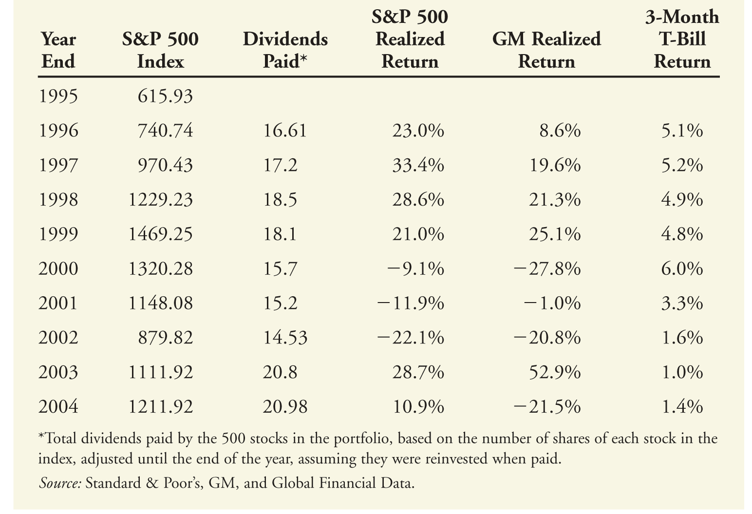
Return data for different asset classes
Here are some return data for different assets and asset classes:

Slide 22
Average Returns and Expected Returns
We can use this data to compute average returns using the following formula, where T is the number of years of data:
Using this formula, we can compute the average return over the nine years as 11.39% for the S&P 500 investment and 3.7% for the 3-month T-bill investment.
If we now wanted to use this information to come up with an estimate for the expected value of the underlying probability distribution of returns on the S&P 500 investment and the 3-month T-bills, we would use exactly these values as estimates.
Thus if I believe that the return over the next year on the S&P 500 came from the same probability distribution as over the nine years of my data, my best estimate of this return would be 11.39%.

Slide 23
Variance Estimation
How do we use this data to come up with an estimate of the variance and standard deviation of the underlying probability distribution of returns on my asset classes?
The formula for this variance estimate is given by:
The estimated standard deviation is simply the square root of this estimated variance.
For our data, we would then compute our estimate of the underlying variance and standard deviation as:

Slide 24
How certain are we of our estimates?
Again, if we believe that the underlying probability distribution that generated the returns in the years 1996-2004 is the same as the distribution from which returns will be generated in the future, we will have been able to establish information regarding future returns:
Our estimate of the expected value of future annual returns is 11.39% and the standard deviation is 20.6% p.a.
Even though the average annual return is estimated to be 11.39%, we also know that in any given year, the actual return could be quite different. Well, how different could it be?
The standard deviation turns out to be useful to answer this question.

Slide 25
How certain are we of our estimates?
We can answer this question by making two assumptions:
One, the different returns that we are using to compute our average are independent or unrelated – that is, there is no pattern across the observations. For example, it cannot be the case that high return years are followed by high (or low) return years.
Two, the plot of returns looks bell-shaped or normal.
If we can make these assumptions, then statistical theory allows us to say that future returns will be within a specific range (or confidence interval) approximately 95% of the time.

Slide 26
95% Confidence Intervals
This confidence interval is computed as the expected return estimate ± twice the standard deviation (s.d.).
For the S&P 500, the s.d. is 20.6% and our confidence interval is 11.39 ± 2(20.6), which works out to (-29.81, 52.59). Clearly, this is not very precise!
Fortunately, we can be much more certain regarding the average return over a number of years.
The confidence interval for the average return over T years is computed as the expected return estimate ± twice the s.d. of the average return, which is the s.d. of the individual returns divided by √T. The standard deviation of the average is also called the standard error (s.e.).

Slide 27
95% Confidence Intervals
For the S&P 500, if we hold it for say 20 years, the s.e. is 20.6/√20 = 4.61% and our confidence interval is 11.39 ± 2(4.61), which works out to (2.18,20.6).
The same computation can be done for our confidence regarding the underlying expected return over the sample period 1996-2004. The confidence interval for the expected return over that period is 11.39 ± 2(20.6/√9) or (-2.343,25.123).
As we have more data to estimate the expected return, our confidence increases. However, as we use longer periods of data, we are less confident that the future will be similar to the past!

Slide 28
Poll: Probability distributions
Suppose I use the historical returns on a stock to derive an expected return for the stock over the next year, say 14%. However, I think that the economy has changed and the company which is represented by the stock will behave differently. As a result, I believe the expected return is likely to be more like 10%. What should I do for investment purposes?
I should continue to use 14% to make decisions because numbers don’t lie.
I should continue to use 14% because my personal opinions don’t matter.
I should use 10%.
I should use a combination of 14% and 10% depending upon how confident I am about my beliefs.

Slide 29
Poll: Uncertainty
My confidence interval about the expected annual return over the next five years is larger than my confidence interval about the expected annual return over the next ten years.
True because it’s easier to predict averages of a large number of items than of a small number of items.
False, the confidence interval does not depend on the length of the period for which I am making the estimation.
False because the confidence interval will be increasing in the time period.

Slide 30
Poll: Uncertainty about estimates
My confidence interval about the expected annual return over the next year, estimated from data over the last ten years must be smaller than my confidence interval about the same expected annual return, estimated from data over the last five years.
True
False, because with more data, my confidence interval should be larger.
False, because the distant past is less relevant to make forecasts for the future than the more recent past.

Slide 31
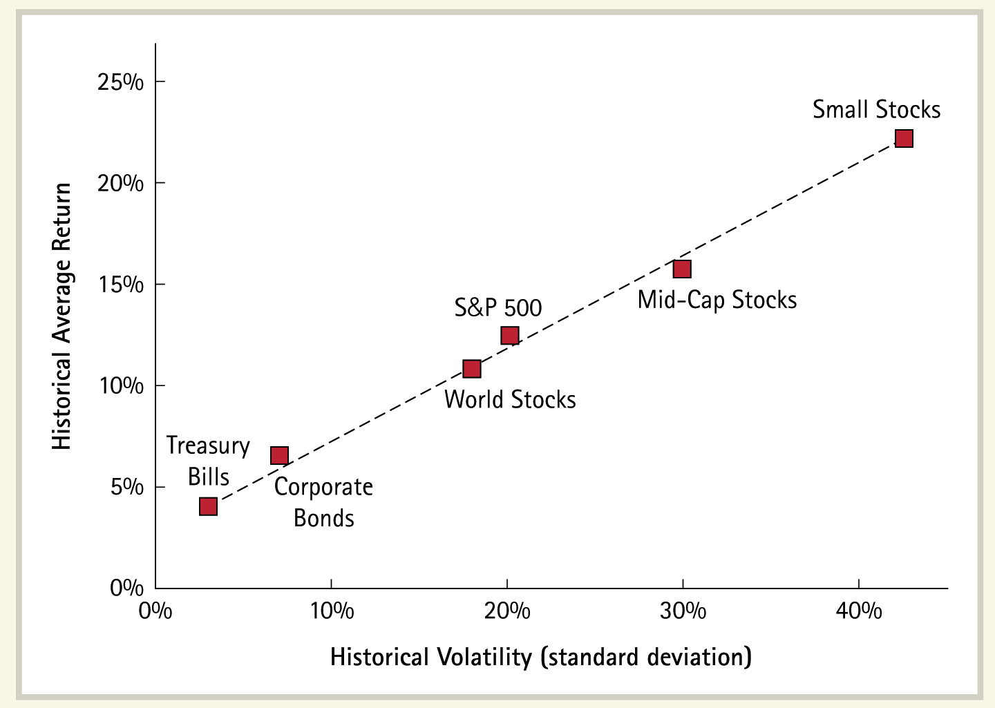
Back to Explaining Average Returns
Using historical data, if we compute average returns and volatility (standard deviation) of returns for asset classes over 1926-2004, we find a relationship:
This might lead us to believe that average returns are related to standard deviation.

Slide 32
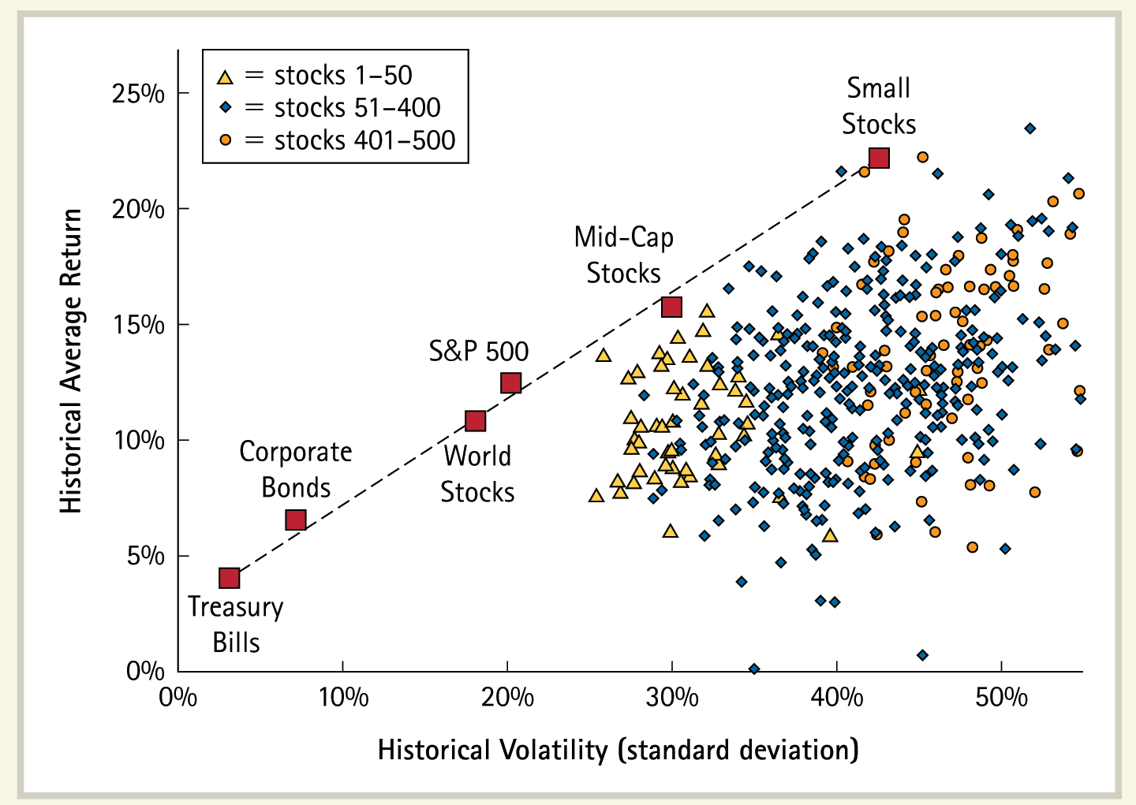
Average Return on Individual Stocks
However, before we conclude that the expected return for an asset (GM stock) or an asset class (S&P 500) is positively related to its return volatility, look at the picture below:
The figure includes data on 500 individual stocks ranked by size and updated quarterly over the same period (1926-2004)!

Slide 33
Portfolios and Single Assets
Why is there a difference between asset classes and single assets? Can we come up with a single theory to explain both?
To do this, we need to realize that the numbers defining portfolios are not simply the average of the numbers for the assets making up the portfolio.
In fact, when we put together single assets in a portfolio, the volatility of the portfolio diminishes, the greater is the number of assets in the portfolio.
The return on a portfolio of assets is indeed the average return on the different assets making up the portfolio.
Thus, if we have a portfolio invested equally over 3 assets earning 2%, 4% and 9% respectively, the return on the portfolio is (2+4+9)/3 = 5%

Slide 34
Portfolios and Single Assets
With respect to standard deviation, the answer is different.
We said earlier, that if the different observations used to compute an average are independent, then the standard deviation for the average, s.e. equals (s.d.)/√n, where n is the number of observations and s.d. is the standard deviation of the observations.
So if the return on a portfolio is an average, can we say that if a portfolio consists of 100 assets, the standard deviation of the returns on the portfolio is one-tenth of the standard deviation of the returns on an individual asset?
No, because while returns on an asset over different periods are mostly uncorrelated, the returns on the different assets in a portfolio are not unrelated.
In fact, we know that the prices of most assets in an economy move in the same direction as the overall market! How then can we say that they are unrelated? We can’t.

Slide 35
Portfolios and Single Assets
But let’s see if we can resuscitate our conclusion somewhat.
Consider the following “market” model for individual asset returns: That is, the asset return has two components – one component, a_{i} + b_{i}R_{m} related to the market return, R_{m}, and a second component e_{i}, that is zero on average, unrelated to the market return and uncorrelated across assets.
The market return is simply the return on a broad-based portfolio such as the S&P 500.
Then, if an investor spreads out his investment over a number of assets, his portfolio return will be equal to the average a_{i} of his portfolio plus R_{m} times the average b_{i} of his portfolio plus the average e_{i} of his portfolio.

Slide 36
Portfolios and Single Assets
If the e_{i} components are uncorrelated (which is approximately true) and the portfolio is spread out over a large number of assets, the average e_{i} will be almost exactly equal to the average value of zero. In other words, in a portfolio, there will be no uncertainty regarding the e component.
The return on such a portfolio, therefore, is simply
The volatility of the entire portfolio therefore will be the average of the b_{i} coefficients times the volatility of the return on the market.
What this means is that the volatility of returns on an individual stock that is due to its e_{i} component is completely irrelevant because it disappears when held as part of a portfolio. This is the power of diversification.

Slide 37
Portfolios and Single Assets
Since the market risk is pervasive and economy-wide and unavoidable, it makes sense that this is relevant risk; investors will want to be compensated for such risk.
All other uncertainty is irrelevant and anybody who exposes himself to such risk will not be compensated for such exposure.
And in fact, there is no need to expose oneself to such risk because by holding a diversified portfolio, all such non-market risk can, in fact, be avoided. (See http://webpage.pace.edu/pviswanath/class/data/insurance_principle.xlsx)

Slide 38
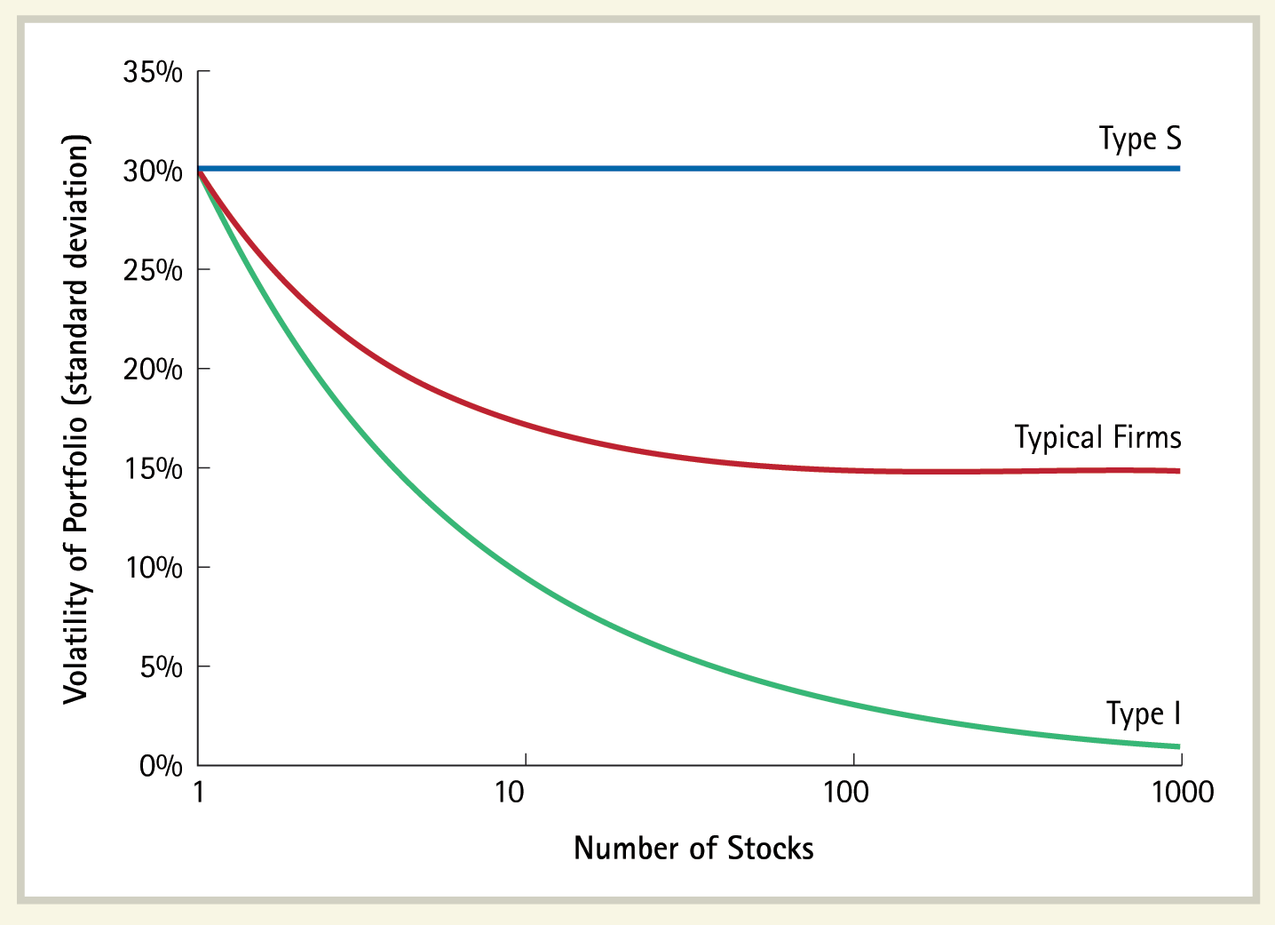
Volatility of Portfolios of Type S and I Stocks
38
The market model described above can be understood by thinking of a given “real” firm as a combination of two kinds of prototypical firms – Type S and Type I. Type I firms have returns similar to e_{i}, while type S have returns similar to the market portfolio. A specific firm is like a combination of 1 unit of Type I and b_{i} units of Type S. Type S firms have only systematic risk, hence the volatility of a portfolio consisting of only type S firms does not change as the number of firms in the portfolio increases.

Slide 39
Volatility of Portfolios of Type S and I Stocks
39
Type I firms have only idiosyncratic risk, which is diversified and eliminated as the number of firms in the portfolio increases. Typical stocks carry a mix of both types of risk, so that the risk of the portfolio declines as idiosyncratic risk is diversified away, but systematic risk still remains.
This can be seen more clearly by looking at the simulation in the file diversex.xls

Slide 40
Poll: Idiosyncratic Risk
The risk that the main factory of a company will be shut down due to a tornado.
Idiosyncratic Risk
Systematic Risk

Slide 41
Poll: Idiosyncratic Risk
The risk that expansion into the Chinese market next year will not materialize for a firm, whose stock you are holding.
Idiosyncratic Risk
Market Risk

Slide 42
Poll: Diversifiable Risk
The risk that the Chinese yuan will depreciate over the next year.
Diversifiable Risk
Non-diversifiable Risk

Slide 43
Average Return and Relevant Volatility
Consequently, investors will all hold portfolios that contain only market volatility; we can ignore the e_{i} component of a stock’s volatility.
Each asset contributes to the volatility of the portfolio return in proportion to its own b_{i} and this is the only part of the asset’s volatility that is relevant.
If we relate the average return on assets and asset classes to their relevant volatility, we find a reasonably good fit.
For asset classes which are already diversified, the relevant volatility is simply their own return volatility.

Slide 44
Average Return and Relevant Volatility
For individual assets, the relevant volatility is that part of their volatility that cannot be diversified, that is their b_{i} times the volatility of the market portfolio.
An asset’s b_{i} is called its beta (written β) and its average return in a market where assets are properly priced will be proportional to its beta risk.
If we plot the betas of single assets against their average returns, they should form a straight line
The model that describes this relationship is called the Capital Asset Pricing Model – the CAPM.

Slide 45
CAPM
The market model says that each asset mimics the market with a scaling or mimicking factor, b_{i}. We already established that the remaining uncertainty is irrelevant because of diversification. Hence the remaining portion is equivalent to a riskfree asset. Each asset, thus, can be thought of as a combination of a risk free asset and the market portfolio.
To the extent that it is a risk-free asset, it should earn r_{f}, the return on the risk-free asset. To the extent that it mimics the market portfolio, an asset should earn, on average, the average return on the market portfolio times the mimicking factor.

Slide 46
CAPM
The mimicking factor of an asset is its b_{i} (beta) (recall R_{i} = a_{i} + b_{i}R_{m} + e_{i}). Hence the average return on a stock is βE(R_{m}) + (1-β)r_{f}. This can be rewritten as r_{f} + β[E(R_{m})-r_{f}], where E(R_{m})-r_{f} is the market risk premium.
The required rate of return on a project, therefore is also related to its beta risk and equals r_{f} + β_{pr}[E(R_{m})-r_{f}], where β_{pr} is the beta of the project.

Slide 47
Asset Betas
We just noted that an asset’s beta is simply its market mimicking factor.
Hence we can estimate a stock’s beta as the slope coefficient in a regression of the stock return on the market portfolio return because the slope coefficient in a regression is the extent to which the LHS variable changes when the RHS variable changes.
Any uncertainty in an asset’s return that is market related is called non-diversifiable risk and all other uncertainty is called diversifiable risk and, as we have already seen, is irrelevant for pricing purposes.

Slide 48
Poll: Required Rates of Return
According to the CAPM, an asset with a beta of zero, but with a non-zero variance of returns will have
The same expected return as a risk-free asset
A higher expected return as a risk-free asset

Slide 49
Asset Betas
Thus, the risk that a founder CEO of a company might retire is diversifiable risk, while the risk that oil prices rise, increasing production risks is non-diversifiable market risk.
Similarly, the risk that a product design is faulty and that the product must be recalled is specific to the company and is diversifiable.
Let’s see how to estimate the beta of a specific stock, CISCO.

Slide 50
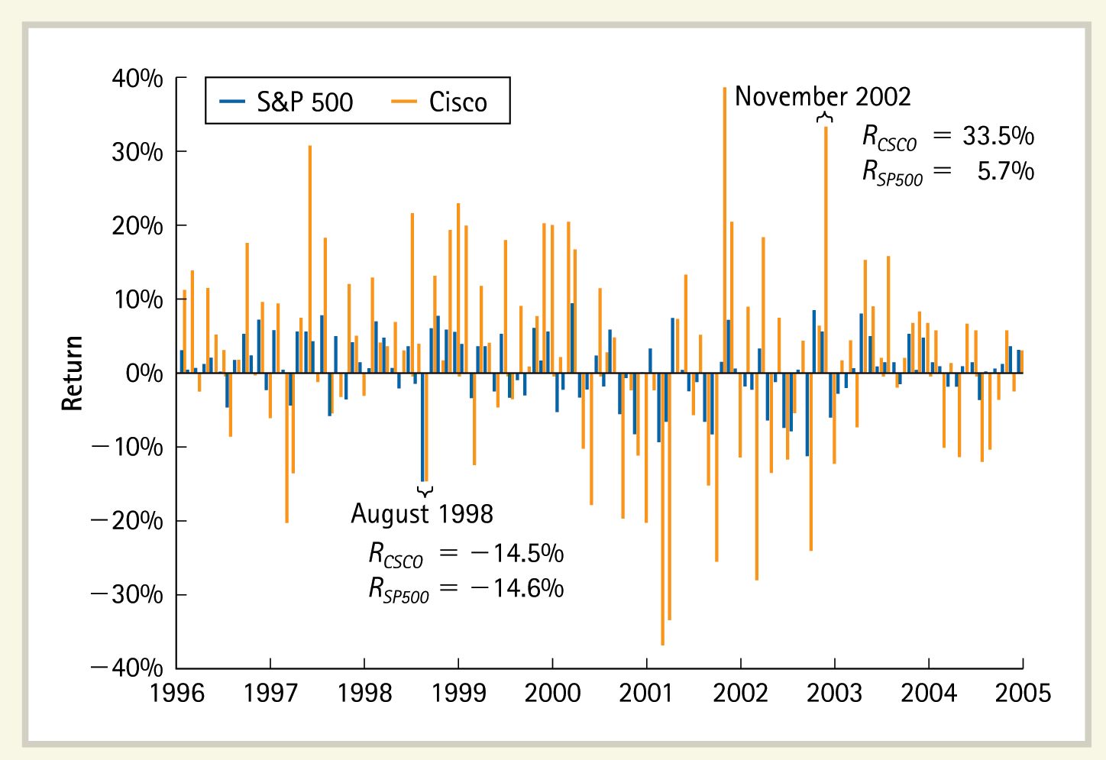
Monthly Returns for Cisco Stock and for the S&P 500, 1996–2005
Cisco’s returns tend to move in the same direction, but with greater amplitude, than those of the S&P 500.

Slide 51
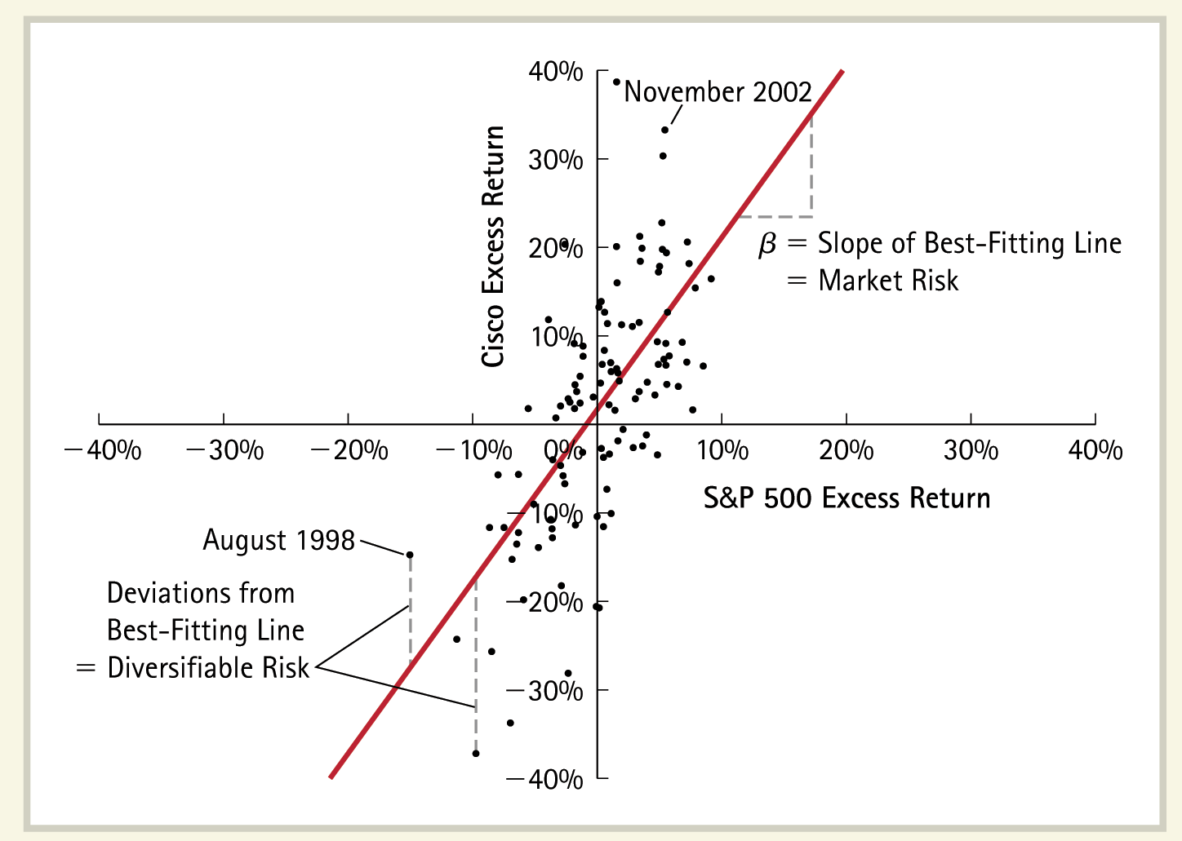
Scatter Plot of Monthly Excess Returns for Cisco Versus the S&P 500, 1996–2005
Beta corresponds to the slope of the best-fitting line. Beta measures the expected change in Cisco’s excess return per 1% change in the market’s excess return. Deviations from the best-fitting line correspond to diversifiable, non-market-related risk.

Slide 52
Betas
Betas can be estimated by regressing the historical return on the stock against the historical return on the market portfolio, which is often proxied by the S&P 500.
Further, if the beta of a firm measures the likelihood of a firm to move with the market, then betas must be similar for all firms that are similar, e.g. by being in a given industry.
This is what we see in the next table. The left-hand side column shows betas for industries, while the right-hand side shows betas for firms. Note that consumer goods firms like Anheuser-Busch, Heinz and Coca-Cola have similar betas – and they are all less than one.
Note, however, that these numbers are only estimates and have their own standard error or confidence intervals.

Slide 53
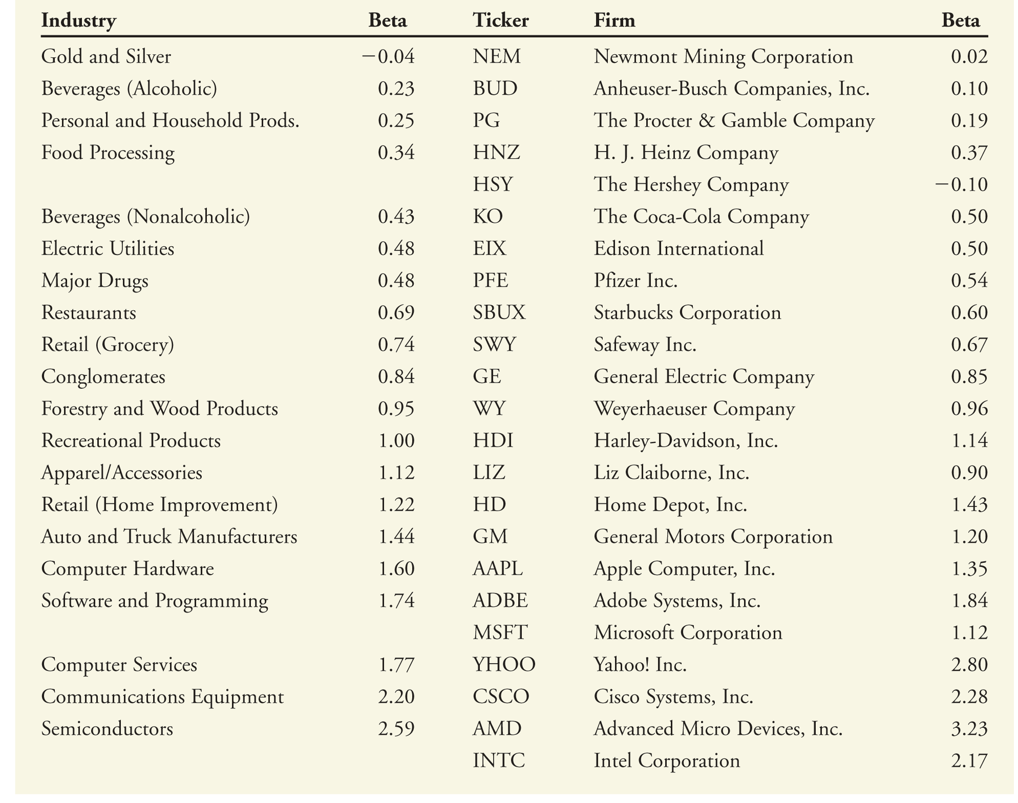
Betas With Respect to the S&P 500 for Individual Stocks and Average Betas for Stocks in Their Industries

Slide 54
Poll: Betas
According to the CAPM, a lottery ticket has a beta of
Zero because it’s return is unrelated to the market portfolio.
A beta greater than zero because it is risky.
A negative beta because you can use it to diversify.

Slide 55
Discount Rates for Risky Assets
Earlier, we spoke about pricing complex assets with reference to the implied discount rates in the pricing of primary assets.
But how do we get the discount rates to associate with and use to discount risky cashflows?
One practical way is to give up the notion of a primary asset and work directly with the actual complex financial assets that we want to price, such as a capital budgeting project or a private business.
We then come up with a loose measure of risk, such as a P/E ratio. We then find other traded securities that have similar P/E ratios. The average return on these comparable securities could then be used as the discount rate to price our asset of interest.

Slide 56
Discount Rates for Risky Assets
The second solution is to work with an explicit equilibrium model of capital asset pricing, such as the CAPM.
What we need to do first is to define cashflow risk in a precise sense. This is what we just did. In our context, risk is measured by beta.
Our “primary asset” now is an asset with beta risk = 1, which is the market portfolio.
Every asset, in equilibrium, will have to earn the sum of two kinds of compensation – compensation for delay consumption over time (which is the riskfree rate, r_{f} ) and compensation for risk.
To obtain the compensation for risk, we take the beta of an asset and multiply it by the risk compensation for the “primary risk asset,” the market portfolio, i.e. E(R_{m})-r_{f}
The required rate of return for an asset, then, is: r_{f} + β[E(R_{m})-r_{f}],

Slide 57
Going beyond the CAPM
The data are not entirely consistent with the CAPM.
Researchers constructed portfolios of stocks with beta=1 and ordered them by the size of the stocks they contained and checked to see if all such portfolios had average returns as predicted by the CAPM. They found that they did not – portfolios of small stocks tended, on average, to earn higher returns than portfolios of larger stocks.
Furthermore, portfolios consisting of stocks that had high book-to-market ratios (value stocks) had higher average returns than portfolios consisting of stocks with low book-to-market ratios (growth stocks).
Momentum strategies seemed to provide positive alphas (abnormal returns) when they are adjusted only for CAPM beta risk.
These CAPM violations could be because we do not have the true market portfolio or because the CAPM itself does not fully describe expected returns. However, since these findings are stable over time, it’s likely that these factors represent sources of risk in addition to the beta as measured by using popular market indices.
Using these empirical facts, researchers have constructed a four-factor asset-pricing model.

Slide 58
The Fama-French-Carhart model
The Fama-French-Carhart (FFC) model is an empirical model which specifies four factors, represented by returns on four different portfolios.
The market portfolio
A self-financing portfolio consisting of long positions in small stocks financed by short positions in large stocks – the SMB (small-minus-big) portfolio.
A self-financing portfolio consisting of long positions in stocks with high book-to-market ratios financed by short positions in stocks with low book-to-market ratios – the HML (high-minus-low) portfolio.
A self-financing portfolio consisting of long positions in the top 30% of stocks that did well the previous year financed by short positions the bottom 30% stocks – the PR1YR (prior 1-yr momentum) portfolio.
The resulting asset pricing equation is:

Slide 59
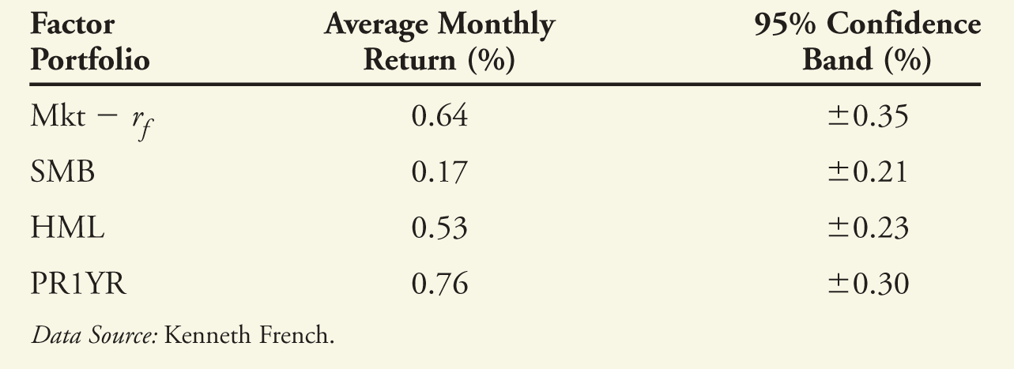
Using the FFC Model
We see above estimates of expected risk premiums for the four FFC factors.
Let us now consider how to use the FFC model in practice. Suppose you find yourself in the situation described below:

Slide 60
Using the FFC Model

Slide 61
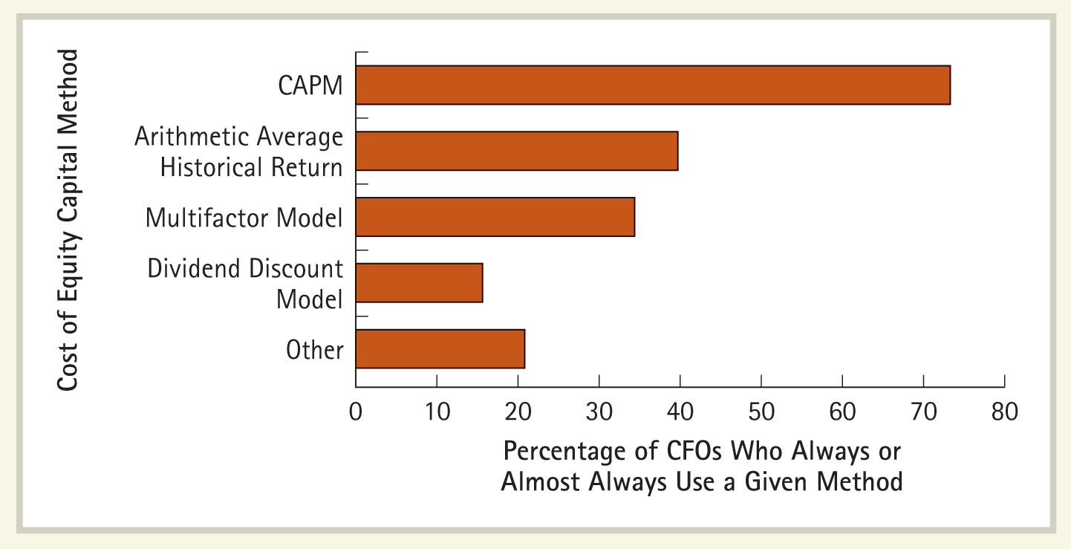
How Firms Calculate the Cost of Capital
61
The figure shows the percentage of firms that use the CAPM, multifactor models, the historical average return, and the dividend discount model.
Source: J. R. Graham and C. R. Harvey, “The Theory and Practice of Corporate Finance: Evidence from the Field,” Journal of Financial Economics 60 (2001): 187–243.

Slide 62
Conclusions
We measure the uncertainty of returns by the standard deviation of returns.
Average returns over a period of time and average returns on portfolios are more predictable than returns on an asset in a single period.
Assuming a market model for individual stock returns, we find that only part of the uncertainty of the return on individual stocks is relevant for asset pricing.
This is the part that is related to overall market uncertainty.
The remaining uncertainty can be diversified away and hence is irrelevant.
This leads us to the central conclusion of the CAPM: that asset beta is the right measure of risk for asset pricing.
Empirical data are not entirely consistent with the CAPM. The four-factor Fama-French-Carhart model is an empirical model of asset pricing that takes these inconsistencies into account.

