Slide 1
Optimal Portfolio Choice and the CAPM
P.V. Viswanath

Slide 2
A different perspective on the CAPM
We saw earlier why, intuitively, the CAPM should describe required returns.
We will see, in this chapter, the connection between the CAPM and individual investors’ construction of optimal portfolios.
We will define an optimal or efficient portfolio as one that has the highest Sharpe Ratio, i.e. the ratio of expected return to portfolio volatility.
We will find that if investors hold efficient portfolios, then the CAPM must hold.
Conversely, if investors do not hold efficient portfolios, then the CAPM need not hold.
This will be important in our later discussion of real-world implications for asset valuation.

Slide 3
Portfolios
We first define portfolio weights
  The fraction, x_{i} of the total investment in the portfolio held in investment ‘i’; the portfolio weights must add up to 1.00 or 100%.
Then the return on a portfolio, R_{p} , is the weighted average of the returns, R_{i}, on the investments in the portfolio, where the weights correspond to portfolio weights.

Slide 4
Expected Portfolio Return
The expected return of a portfolio is the weighted average of the expected returns of the investments within it.
The next step is to see how forming a portfolio affects the volatility of returns.

Slide 5
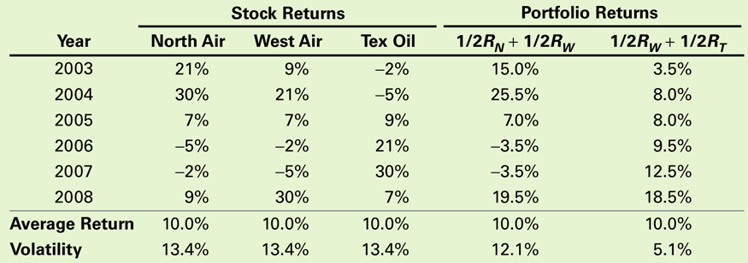
The Volatility of a Two-Stock Portfolio
The relationship between volatility and average return for pairs of stocks can be seen in the file diversex.xls
Combining Risks
Table 11.1 Returns for Three Stocks, and Portfolios of Pairs of Stocks

Slide 6
Combining Risks
  While the three stocks in the previous table have the same volatility and average return, the pattern of their returns differs.
    For example, when the airline stocks performed well, the oil stock tended to do poorly, and when the airlines did poorly, the oil stock tended to do well.
  By combining stocks into a portfolio, we reduce risk through diversification.
  The amount of risk that is eliminated in a portfolio depends on the degree to which the stocks face common risks and their prices move together.
  To find the risk of a portfolio, one must know the degree to which the stocks’ returns move together. This is measured by correlation or covariance.

Slide 7
Determining Covariance and Correlation
Covariance
  The expected product of the deviations of two returns from their means
  Covariance between Returns R_{i} and R_{j}
  Estimate of the Covariance from Historical Data
    If the covariance is positive, the two returns tend to move together.
    If the covariance is negative, the two returns tend to move in opposite directions.

Slide 8
Determining Covariance and Correlation
Correlation
  A measure of the common risk shared by stocks that does not depend on their volatility
  The correlation between two stocks will always be between –1 and +1.

Slide 9
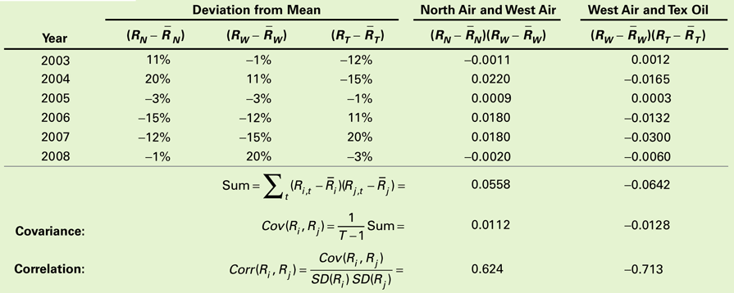
Computing the Covariance and Correlation Between Pairs of Stocks

Slide 10
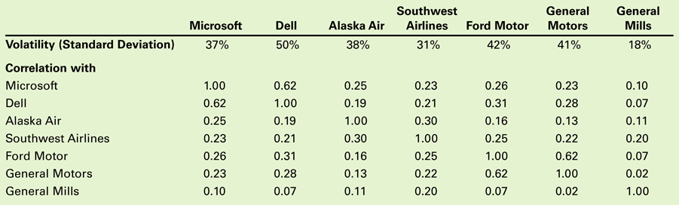
Historical Annual Volatilities and Correlations for Selected Stocks

Slide 11
Computing a Portfolio’s Variance and Volatility
For a two security portfolio:
  The Variance of a Two-Stock Portfolio

Slide 12
Diversification with an Equally Weighted Portfolio of Many Stocks
Equally Weighted Portfolio
  A portfolio in which the same amount is invested in each stock
Variance of an Equally Weighted Portfolio of n Stocks

Slide 13
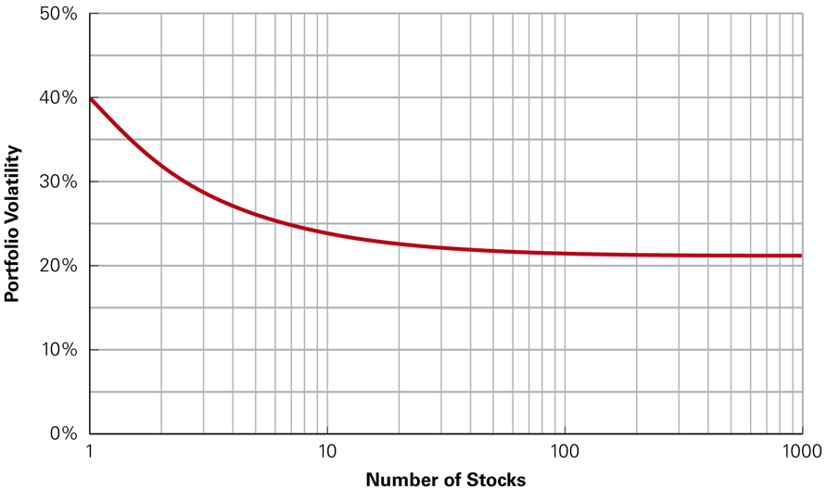
Volatility of an Equally Weighted Portfolio Versus the Number of Stocks

Slide 14
Diversification with General Portfolios
For a portfolio with arbitrary weights, the standard deviation is calculated as:
Unless all of the stocks in a portfolio have a perfect positive correlation of +1 with one another, the risk of the portfolio will be lower than the weighted average volatility of the individual stocks:

Slide 15
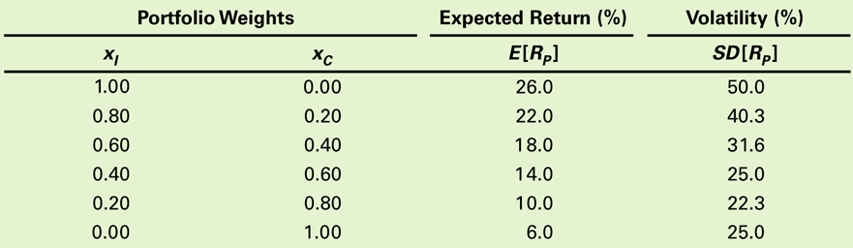
Risk Versus Return: Choosing an Efficient Portfolio
Table 11.4 Expected Returns and Volatility for Different
Portfolios of Two Stocks
Efficient Portfolios with Two Stocks
  Consider a portfolio of Intel and Coca-Cola

Slide 16
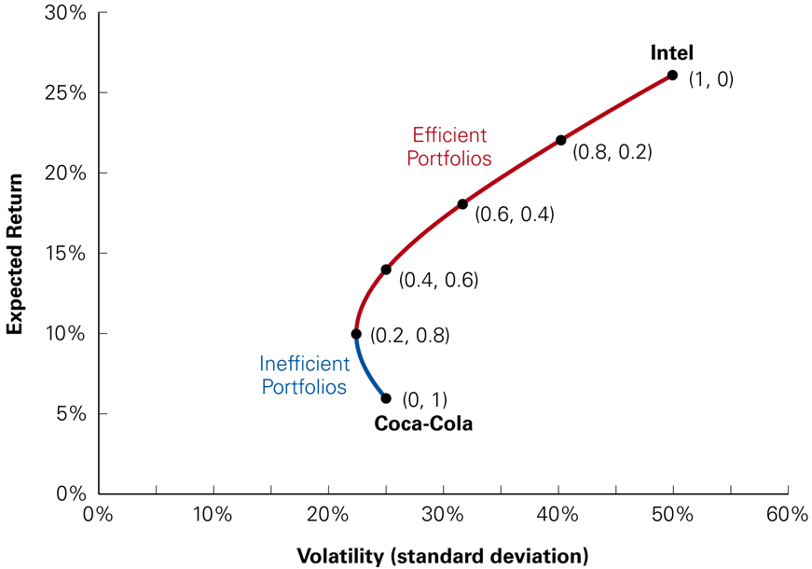
Figure 11.3 Volatility Versus Expected Return for Portfolios of Intel and Coca-Cola Stock

Slide 17
Risk Versus Return: Choosing an Efficient Portfolio
Efficient Portfolios with Two Stocks
  Consider investing 100% in Coca-Cola stock. As shown in on the previous slide, other portfolios—such as the portfolio with 20% in Intel stock and 80% in Coca-Cola stock—make the investor better off in two ways: It has a higher expected return, and it has lower volatility. As a result, investing solely in Coca-Cola stock is inefficient.

Slide 18
The Effect of Correlation
Correlation has no effect on the expected return of a portfolio. However, the volatility of the portfolio will differ depending on the correlation.
The lower the correlation, the lower the volatility we can obtain. As the correlation decreases, the volatility of the portfolio falls.
The curve showing the portfolios will bend to the left to a greater degree as shown on the next slide.

Slide 19
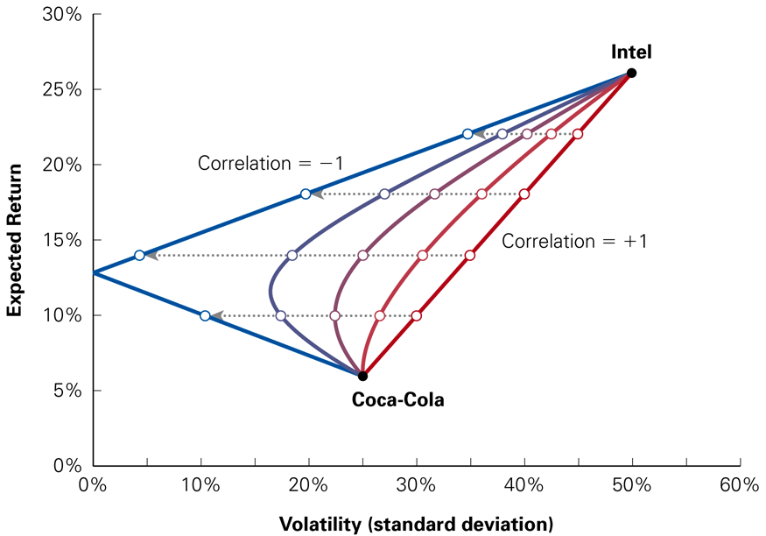
Figure 11.4 Effect on Volatility and Expected Return of Changing the Correlation between Intel and Coca-Cola Stock

Slide 20
Short Sales
We now see what happens if we allow short positions. What is a short position and a long position?
Long Position
  A positive investment in a security
Short Position
  A negative investment in a security
  In a short sale, you sell a stock that you do not own and then buy that stock back in the future.
  Short selling is an advantageous strategy if you expect a stock price to decline in the future.

Slide 21
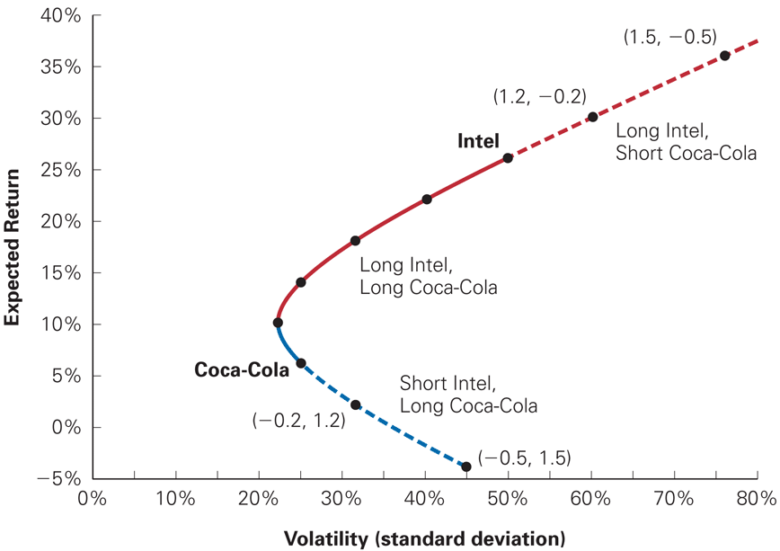
Portfolios of Intel and Coca-Cola Allowing for Short Sales

Slide 22
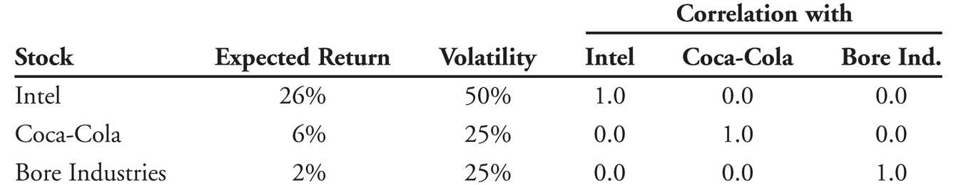
Efficient Portfolios with Many Stocks
Consider adding Bore Industries to the two stock portfolio:
Although Bore has a lower return and the same volatility as Coca-Cola, it still may be beneficial to add Bore to the portfolio for the diversification benefits.
We will see what happens if we invest in combinations of Bore and a 50-50 portfolio invested in Intel and Coke
And finally, we see what happens if can vary the proportions for all three stocks.

Slide 23
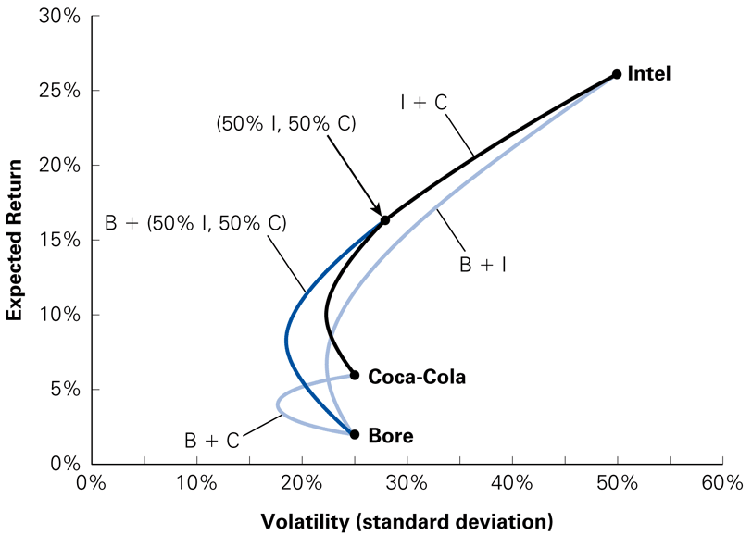
Expected Return and Volatility for Selected Portfolios of Intel, Coca-Cola, and Bore Industries Stocks

Slide 24
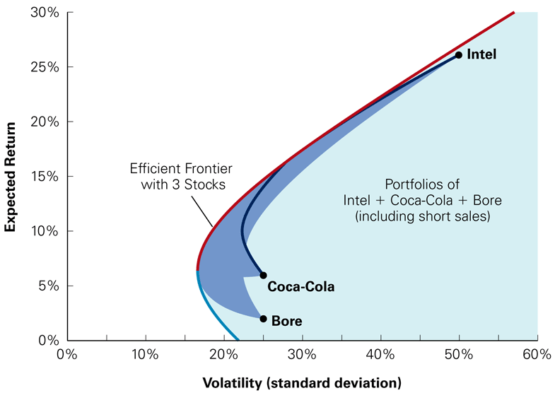
The Volatility and Expected Return for All Portfolios of Intel, Coca-Cola, and Bore Stock

Slide 25
Risk Versus Return: Many Stocks
The efficient portfolios, those offering the highest possible expected return for a given level of volatility, are those on the northwest edge of the shaded region, which is called the efficient frontier for these three stocks.
In this case none of the stocks, on its own, is on the efficient frontier, so it would not be efficient to put all our money in a single stock.

Slide 26
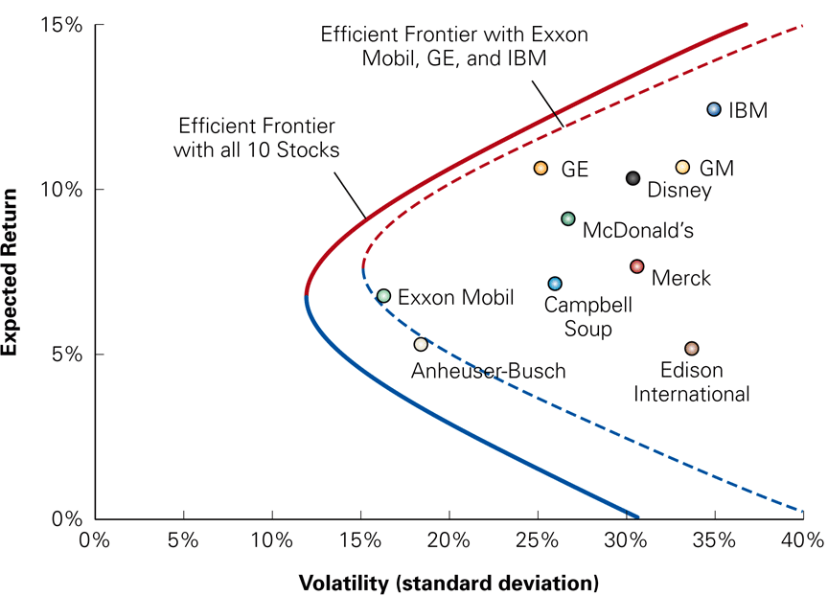
Efficient Frontier with Ten Stocks Versus Three Stocks

Slide 27
Risk-Free Saving and Borrowing
Risk can also be reduced by investing a portion of a portfolio in a risk-free investment, like T-Bills. However, doing so will likely reduce the expected return.
On the other hand, an aggressive investor who is seeking high expected returns might decide to borrow money to invest even more in the stock market.
Consider an arbitrary risky portfolio and the effect on risk and return of putting a fraction of the money in the portfolio, while leaving the remaining fraction in risk-free Treasury bills. The expected return would be:

Slide 28
Investing in Risk-Free Securities
0
The standard deviation of the portfolio would be calculated as:
  Note: The standard deviation is only a fraction of the volatility of the risky portfolio, based on the amount invested in the risky portfolio.

Slide 29
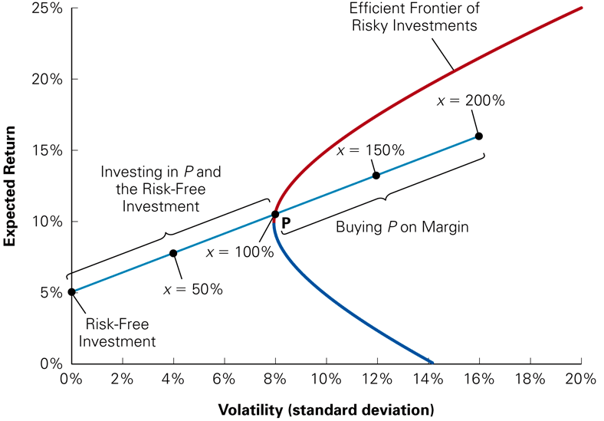
The Risk–Return Combinations from Combining a Risk-Free Investment and a Risky Portfolio

Slide 30
Borrowing and Buying Stocks on Margin
To go past point P, it is necessary to buy Stocks on Margin.
  What is buying on margin? It is borrowing money to invest in a stock. It is similar to short-selling; however, in this case, we’re not short-selling the stock. Rather, we’re short-selling a risk-free security.
  A portfolio that consists of a short position in the risk-free investment is known as a levered portfolio. Margin investing is a risky investment strategy.
Note, however, that portfolio P is not the best portfolio to use for our margin strategy.
To earn the highest possible expected return for any level of volatility we must find the portfolio that generates the steepest possible line when combined with the risk-free investment.

Slide 31
Identifying the Tangent Portfolio
In order to find this portfolio, we need to use the Sharpe Ratio.
The Sharpe Ratio measures the ratio of reward-to-volatility provided by a portfolio
The portfolio with the highest Sharpe ratio is the
portfolio where the line with the risk-free investment is tangent to the efficient frontier of risky investments. The portfolio that generates this tangent line is known as the tangent portfolio.

Slide 32
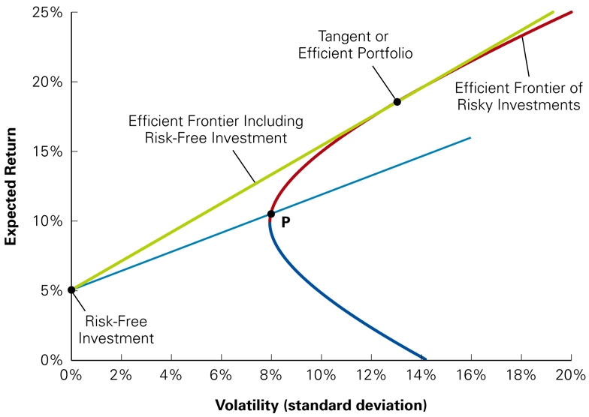
The Tangent or Efficient Portfolio

Slide 33
Identifying the Tangent Portfolio
Combinations of the risk-free asset and the tangent portfolio provide the best risk and return tradeoff available to an investor.
  This means that the tangent portfolio is efficient and that all efficient portfolios are combinations of the risk-free investment and the tangent portfolio. Every investor should invest in the tangent portfolio independent of his or her taste for risk.
An investor’s preferences will determine only how much to invest in the tangent portfolio versus the risk-free investment.
  Conservative investors will invest a small amount in the tangent portfolio.
  Aggressive investors will invest more in the tangent portfolio.
  Both types of investors will choose to hold the same portfolio of risky assets, the tangent portfolio, which is the efficient portfolio.

Slide 34
The Efficient Portfolio and Required Returns
Portfolio Improvement: Beta and the Required Return
  Assume there is a portfolio of risky securities, P. To determine whether P has the highest possible Sharpe ratio, consider whether its Sharpe ratio could be raised by adding more of some investment i to the portfolio.
  The contribution of investment i to the volatility of the portfolio depends on the risk that i has in common with the portfolio, which is measured by i’s volatility multiplied by its correlation with P.
  If you were to purchase more of investment i by borrowing, you would earn the expected return of i minus the risk-free return. Thus adding i to the portfolio P will improve our Sharpe ratio if:

Slide 35
The Efficient Portfolio and Required Returns
Beta of Portfolio i with Portfolio P
  Increasing the amount invested in i will increase the Sharpe ratio of portfolio P if its expected return E[R_{i}] exceeds the required return r_{i} .
The required return of i is the expected return that is necessary to compensate for the risk investment i will contribute to the portfolio.

Slide 36
Expected Returns and the Efficient Portfolio
  As long as E[R_{i}] > r for any security in the portfolio, the portfolio is not efficient because moving more funds into the security can increase the Sharpe Ratio.
  Hence a portfolio is efficient if and only if the expected return, E[R_{i}] of every available security equals its required return.

Slide 37
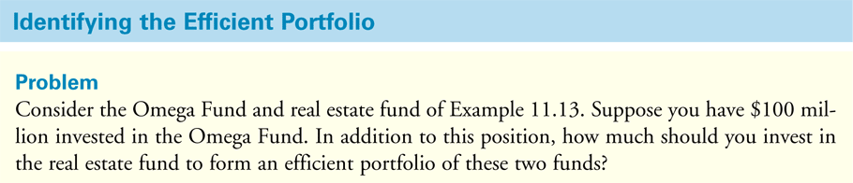
Textbook Example 11.14

Slide 38
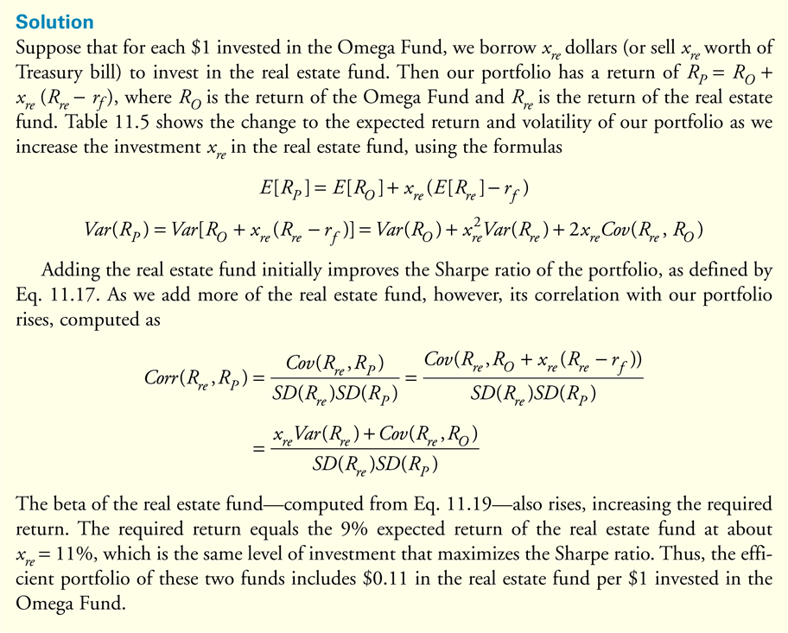
Textbook Example 11.14

Slide 39
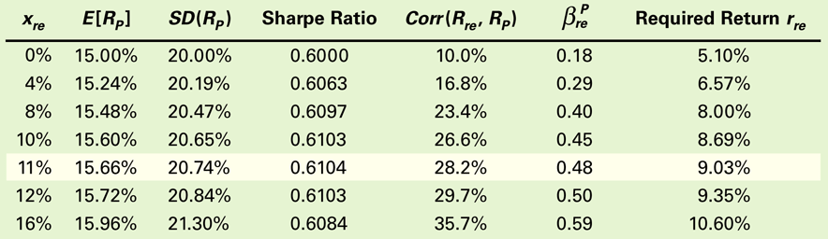
Table 11.5 Sharpe Ratio and Required Return for Different Investments in the Real Estate Fund

Slide 40
The Capital Asset Pricing Model
The Capital Asset Pricing Model (CAPM) allows us to identify the efficient portfolio of risky assets without having any knowledge of the expected return of each security.
Instead, the CAPM uses the optimal choices investors make to identify the efficient portfolio as the market portfolio, the portfolio of all stocks and securities in the market.

Slide 41
The CAPM Assumptions
Three Main Assumptions
  Assumption 1
    Investors can buy and sell all securities at competitive market prices (without incurring taxes or transactions costs) and can borrow and lend at the risk-free interest rate.
  Assumption 2
    Investors hold only efficient portfolios of traded securities—portfolios that yield the maximum expected return for a given level of volatility.
  Assumption 3
    Investors have homogeneous expectations regarding the volatilities, correlations, and expected returns of securities.
    Homogeneous Expectations means that:
      All investors have the same estimates concerning future investments and returns.

Slide 42
Supply, Demand, and the Efficiency of the Market Portfolio
Given homogeneous expectations, all investors will demand the same efficient portfolio of risky securities.
The combined portfolio of risky securities of all investors must equal the efficient portfolio.
Thus, if all investors demand the efficient portfolio, and the supply of securities is the market portfolio, the demand for market portfolio must equal the supply of the market portfolio.

Slide 43
Optimal Investing: The Capital Market Line
When the CAPM assumptions hold, an optimal portfolio is a combination of the risk-free investment and the market portfolio.
  When the tangent line goes through the market portfolio, it is called the capital market line (CML).
The expected return and volatility of a capital market line portfolio are:

Slide 44
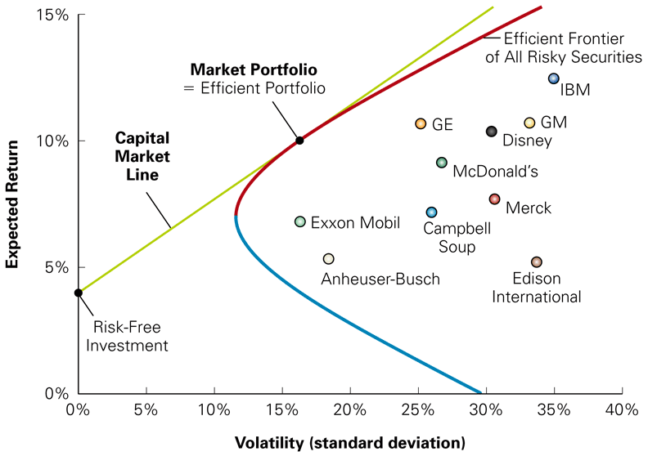
Figure 11.11 The Capital Market Line

Slide 45
Determining the Risk Premium
Market Risk and Beta
  Given an efficient market portfolio, the expected return of an investment is:
  The beta is defined as:

Slide 46
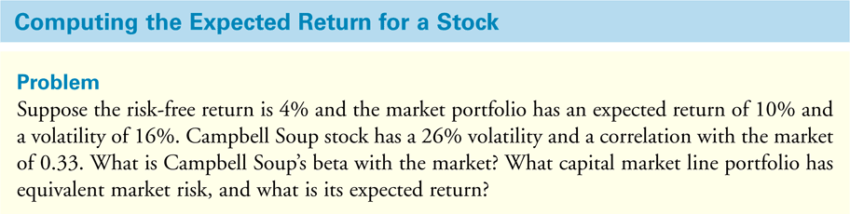
Textbook Example 11.16

Slide 47
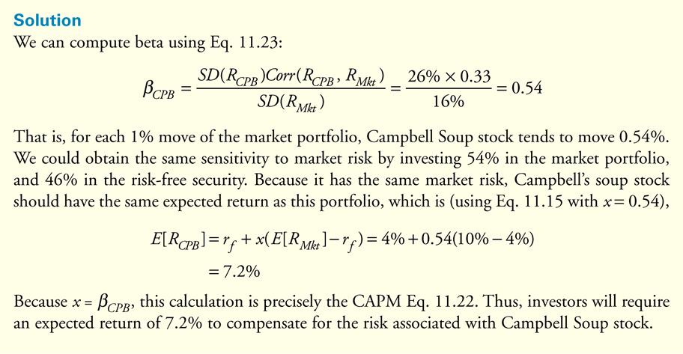
Textbook Example 11.16 (cont'd)

Slide 48
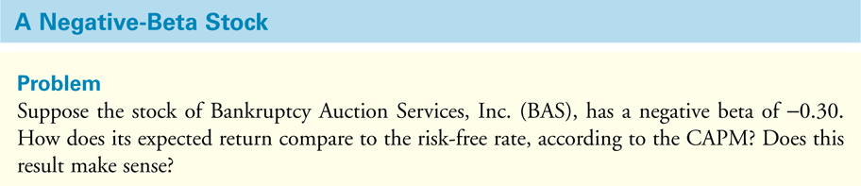
Textbook Example 11.17

Slide 49
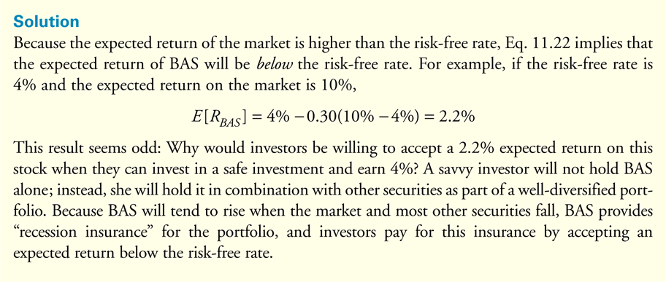
Textbook Example 11.17 (cont'd)

Slide 50
The Security Market Line
There is a linear relationship between a stock’s beta and its expected return (See figure on next slide). The security market line (SML) is graphed as the line through the risk-free investment and the market.
  According to the CAPM, if the expected return and beta for individual securities are plotted, they should all fall along the SML.

Slide 51
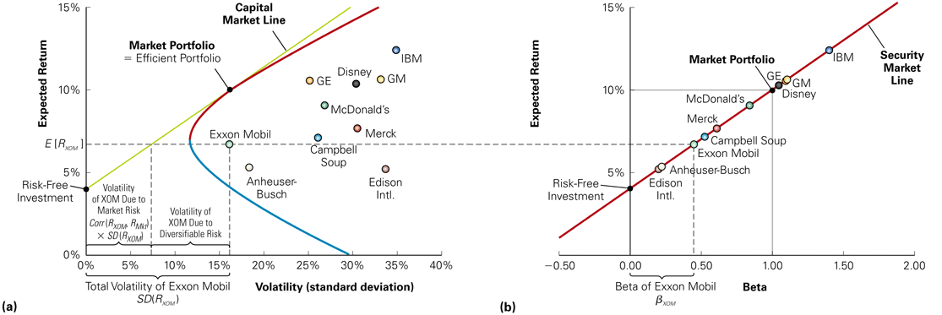
Figure 11.12 The Capital Market Line and the Security Market Line

Slide 52
Figure 11.12 The Capital Market Line and the Security Market Line, panel (a)
(a) The CML depicts portfolios combining the risk-free investment and the efficient portfolio, and shows the highest expected return that we can attain for each level of volatility. According to the CAPM, the market portfolio is on the CML and all other stocks and portfolios contain diversifiable risk and lie to the right of the CML, as illustrated for Exxon Mobil (XOM).

Slide 53
Figure 11.12 The Capital Market Line and the Security Market Line, panel (b)
(b) The SML shows the expected return for each security as a function of its beta with the market. According to the CAPM, the market portfolio is efficient, so all stocks and portfolios should lie on the SML.

Slide 54
The Security Market Line
Beta of a Portfolio
  The beta of a portfolio is the weighted average beta of the securities in the portfolio.

Slide 55
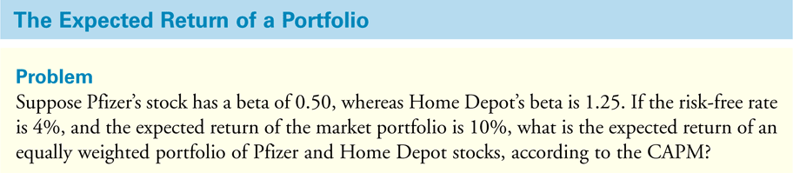
Textbook Example 11.18

Slide 56
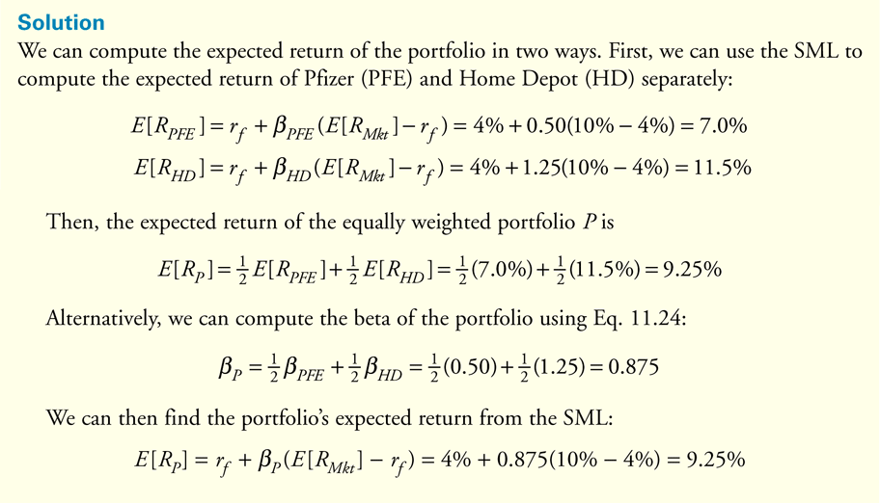
Textbook Example 11.18 (cont’d)

Slide 57
Summary of the Capital Asset
Pricing Model
The market portfolio is the efficient portfolio.
The risk premium for any security is proportional to its beta with the market.

Slide 58
CAPM Assumptions
We cannot measure returns on the actual market portfolio. Hence the usual way in which the CAPM is used is by assuming that some proxy for the market portfolio is efficient. Often this is taken to be simply the S&P 500.
But the S&P 500 is a tiny fraction of the assets that are available to be held in the economy, since individuals hold not only large stocks, but other stocks, bonds, alternative investments and – most importantly – human capital!
Still, the CAPM could hold if the S&P 500 mimics the true market portfolio well and happens to be an efficient portfolio.

Slide 59
Is the CAPM true?
One way to check this out is to look at whether the expected returns on assets are linearly related to their betas, i.e. does the CAPM hold?
Furthermore, if the CAPM holds for single assets, this relationship must hold for portfolios of assets as well.
Researchers (e.g. Banz) constructed portfolios of stocks and ordered them by the size of the stocks they contained and checked to see if all such portfolios lay on the Security Market Line.
They found that they did not – portfolios of small stocks tended, on average, to earn higher returns than portfolios of larger stocks.

Slide 60
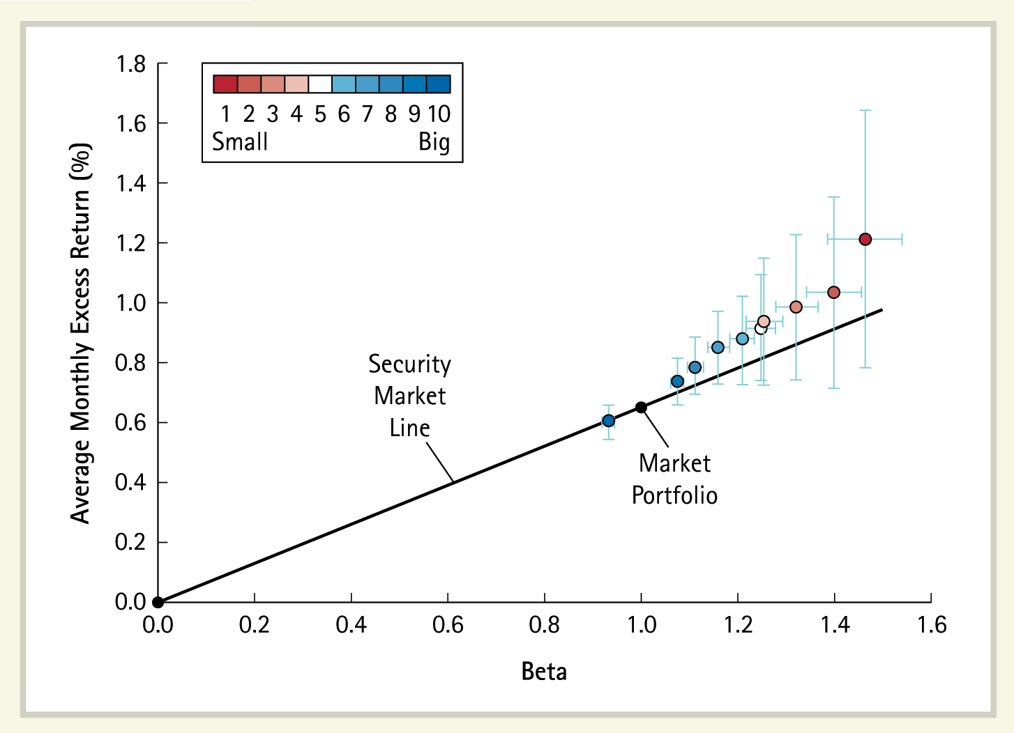
Excess Return of Size Portfolios, 1926–2005
60
The plot shows the average excess return (the return minus the three-month risk-free rate) for ten portfolios formed in each month over 80 years using the firms’ market capitalizations. The average excess return of each portfolio is plotted as a function of the portfolio’s beta (estimated over the same time period). The black line is the security market line. If the market portfolio is efficient and there is no measurement error, all portfolios would plot along this line. The error bars mark the 95% confidence bands of the beta and expected excess return estimates.

Slide 61
Size Anomalies
Why should there be such a pattern?
One answer is that it’s due to data-snooping – that is, given enough characteristics, it will always be possible ex-post to find some characteristic that by pure chance happens to be correlated with the estimation error of average returns.
Another answer is that if the market portfolio is inefficient, then some assets would be overpriced and some assets would be underpriced. The overpriced assets would tend to be larger since their market values are larger than what they should be according to the CAPM. Similarly, underpriced assets would tend to be smaller. Since underpriced (overpriced) assets would tend over time to realize higher (lower) returns, we would expect to see patterns like those of Banz.
In fact, it turned out that portfolios consisting of stocks that had high book-to-market ratios (i.e. underpriced stocks) had higher average returns than portfolios consisting of stocks with low book-to-market ratios.

Slide 62
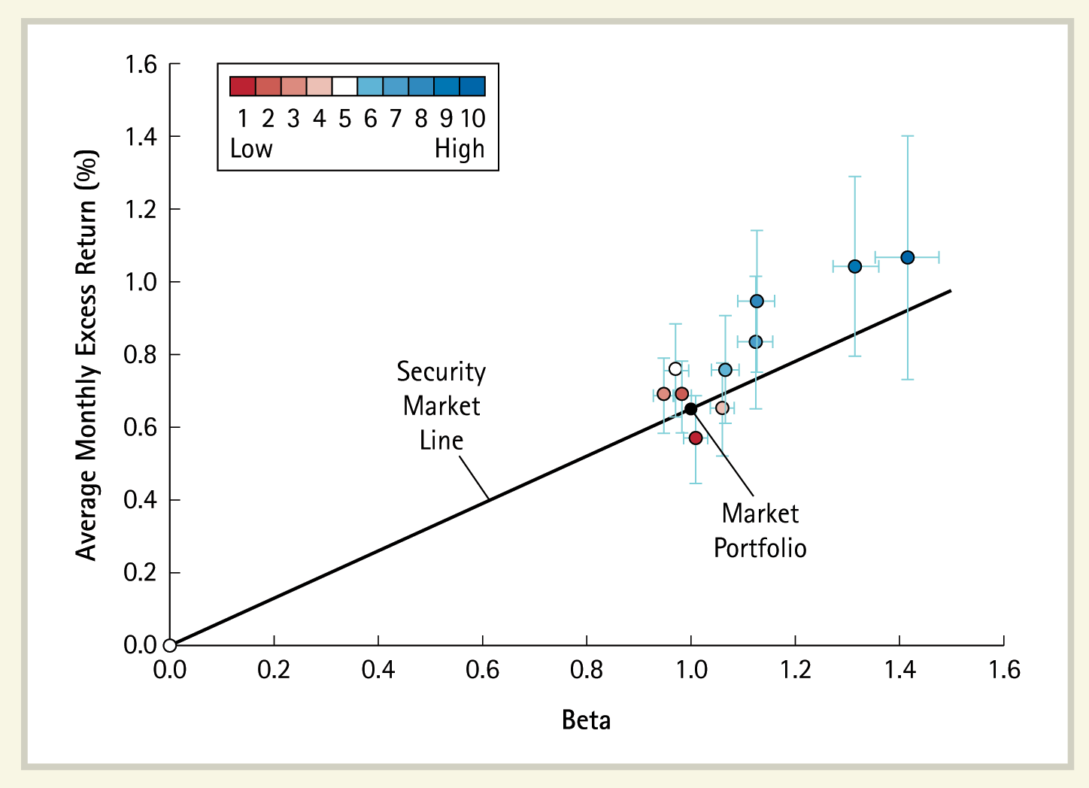
Excess Return of Book-to-Market Portfolios, 1926–2005
62
The plot shows the average excess return (the return minus the three-month risk-free rate) for ten portfolios formed in each month over 80 years using the stocks’ book-to-market ratios. The average excess return of each portfolio is plotted as a function of the portfolio’s beta (estimated over the same time period). The black line is the security market line. If the market portfolio is efficient and there is no measurement error, all portfolios would plot along this line. The error bars mark the 95% confidence bands of the beta and expected excess return estimates.

Slide 63
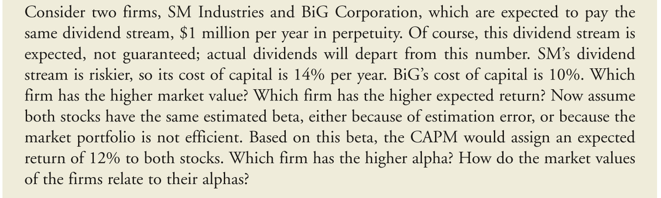
Risk and the Market Value of Equity
This can be seen by looking at the following example, where the true costs of capital of two firms differ, but we mistakenly believe them to be the same.
(Note that this does not explain why there should be deviations from the CAPM; just that if there are such deviations, then they are likely to be indicated by the book-to-market ratio.)

Slide 64
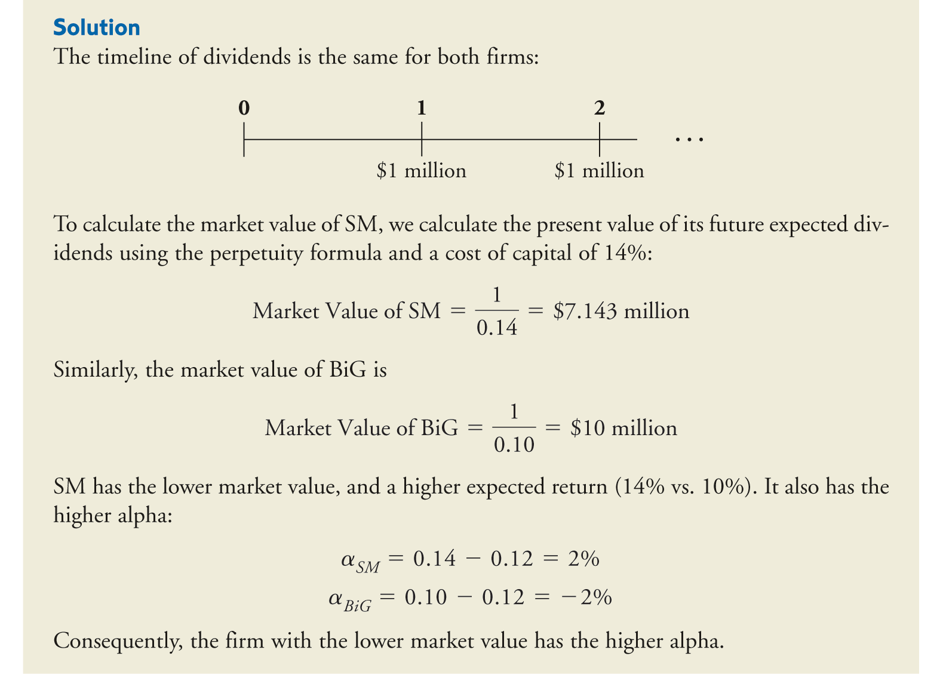
Risk and the Market Value of Equity

Slide 65
Momentum Anomalies
Jegadeesh and Titman showed, furthermore, that momentum strategies seemed to provide positive alphas (abnormal returns) when they are adjusted only for CAPM beta risk.
This can only happen if, either the proxy market portfolio is inefficient or if the CAPM does not hold.
Since momentum strategies are available to all investors, it is more likely that the CAPM does not hold and that the positive alphas are spurious.
In other words, we must conclude that the proxy market portfolio is indeed not efficient and there are risk measures other than the CAPM beta that the market takes into account, then we have to ask what those risk measures might be.

Slide 66
Why is the market inefficient?
There are two reasons why the proxy market portfolio may be inefficient (and market-risk adjusted betas may not reflect all risk that investors care about).
One, as we mentioned above, the proxy for the market portfolio that we use may not be the correct measure.
Two, even the true market portfolio may be inefficient and investors care about sources of risk, other than correlation with the market portfolio.

Slide 67
Proxy Error
We normally use a broad portfolio of stocks to measure the market.
However, in principle the market portfolio should consist of all available assets, including real estate, bonds, art, previous metals, etc. – not just stocks.
It’s difficult to get return data on all of these other assets since they don’t trade on liquid markets. Researchers use a broad-based equity index like the S&P 500, assuming that it’s highly correlated with the “true” market and should suffice as a proxy.
But what if this assumption is not true?
Then the estimated betas might be in error and the true alphas (computed with betas relative to the true market) might be zero even if the empirical versions show positive alphas.

Slide 68
Other risk sources: non-tradable wealth
Another possibility is that investors might care about characteristics other than the expected return and volatility of their portfolio – another assumption that we made implicitly in our arguments – they might care about the skewness of the distribution of returns as well.
Alternatively, they might have significant wealth invested in non-tradable assets. Such a person would try to hold a portfolio of all her assets that is efficient. But the tradable portion of her portfolio might not be efficient. If this is true for a lot of people, then the market portfolio of trade assets would not be efficient and the CAPM would not work.
An important example of non-tradable wealth is human capital.
Researchers have indeed discovered that the anomalies disappear or become less acute when human capital is taken into account.
Considering the evidence that the market portfolio is not efficient, researchers have developed multi-factor models of asset pricing.

Slide 69
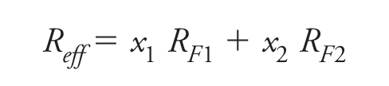
Multifactor Models of Risk
We saw previously that the expected return on any marketable security can be written as a function of the expected return on an efficient portfolio.
If the proxy market portfolio is not efficient and we believe that the CAPM holds with respect to some efficient portfolio, then we have to find a way to identify this alternative portfolio.
However, we can also use the above relationship if we find several portfolios that are themselves not efficient but that can then be combined to form efficient portfolios.
Suppose the efficient portfolio can be formed by combining two portfolios F1 and F2 called factor portfolios.

Slide 70
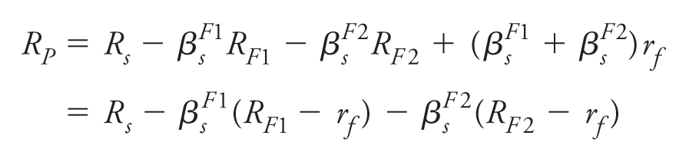
Multifactor Models of Risk
Now, let us regress the excess return (return in excess of the risk-free rate) on an arbitrary security s on the factor portfolios.
We will show next that α_{s} must be equal to zero.
To do this, consider a portfolio, P, where you first buy stock s sell a fraction β_{s}^{F1} in factor portfolio 1 and a fraction β_{s}^{F2} in factor portfolio 2 and invest the proceeds in the risk-free asset. The return on this portfolio would be

Slide 71
Multifactor Models of Risk
Using the regression equation, we can simplify this to
Now the uncertain part of this return, ε_{s}, must be uncorrelated with the factor portfolios F1 and F2 and hence with the efficient portfolio. Consequently, the uncertain part of the return, ε_{s}, needs no compensation and does not require a risk premium.
Hence the expected return on the portfolio P must simply be the risk-free rate and, therefore, α_{s} = 0.
Now if we go back to the regression equation and take the expected value of both sides, we see that

Slide 72
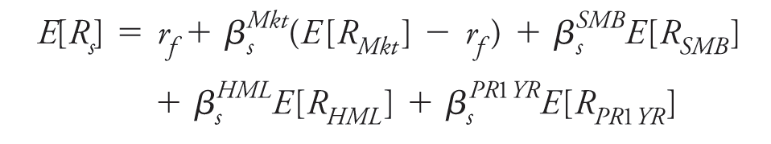
The Fama-French-Carhart model
The next question is – how do we select the factor portfolios?
The Fama-French-Carhart (FFC) model is an empirical model which specifies four different factor portfolios.
  The market portfolio
  A self-financing portfolio consisting of long positions in small stocks financed by short positions in large stocks – the SMB (small-minus-big) portfolio.
  A self-financing portfolio consisting of long positions in stocks with high book-to-market ratios financed by short positions in stocks with low book-to-market ratios – the HML (high-minus-low) portfolio.
  A self-financing portfolio consisting of long positions in the top 30% of stocks that did well the previous year financed by short positions the bottom 30% stocks – the PR1YR (prior 1-yr momentum) portfolio.
The resulting factor-pricing equation is:
Since the last three portfolios are self-financing, there is no investment and the risk-free return does not figure in the formula.

Slide 73
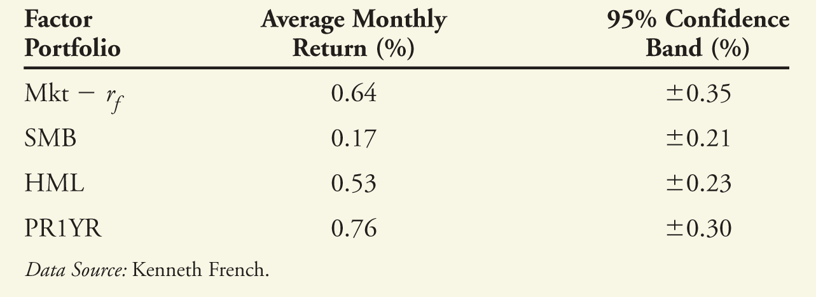
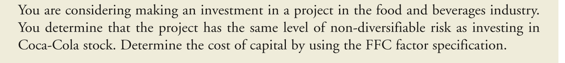
Using the FFC Model
We see above estimates of expected risk premiums for the four FFC factors.
Let us now consider how to use the FFC model in practice. Suppose you find yourself in the situation described below:

Slide 74
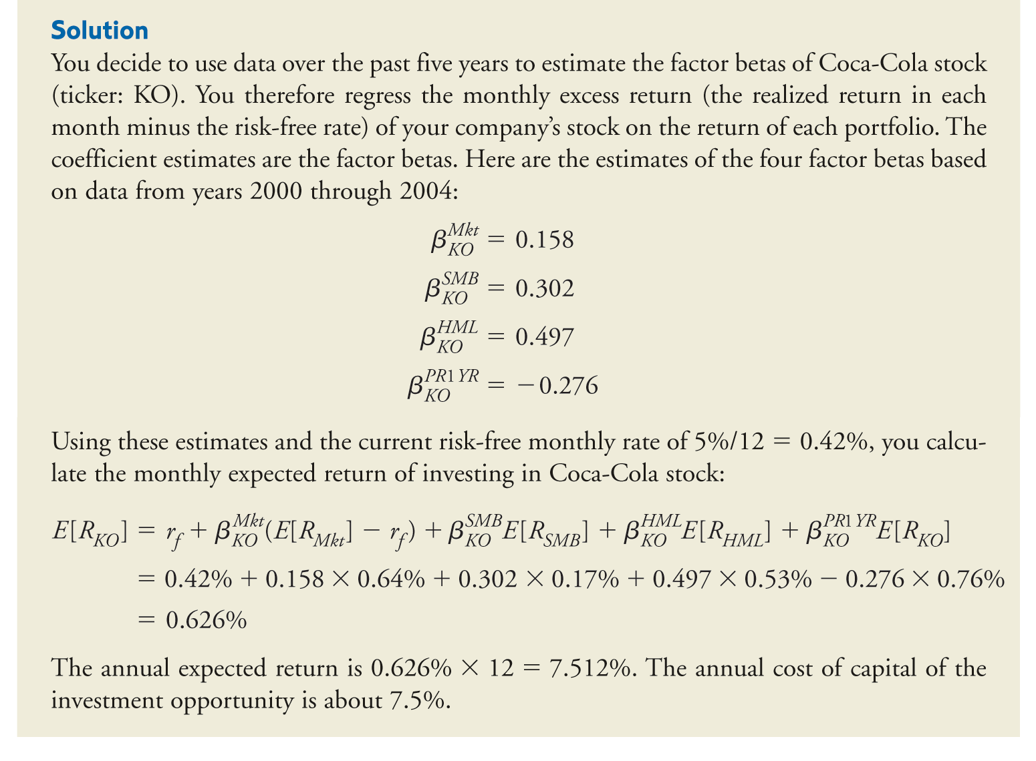
Using the FFC Model

Slide 75
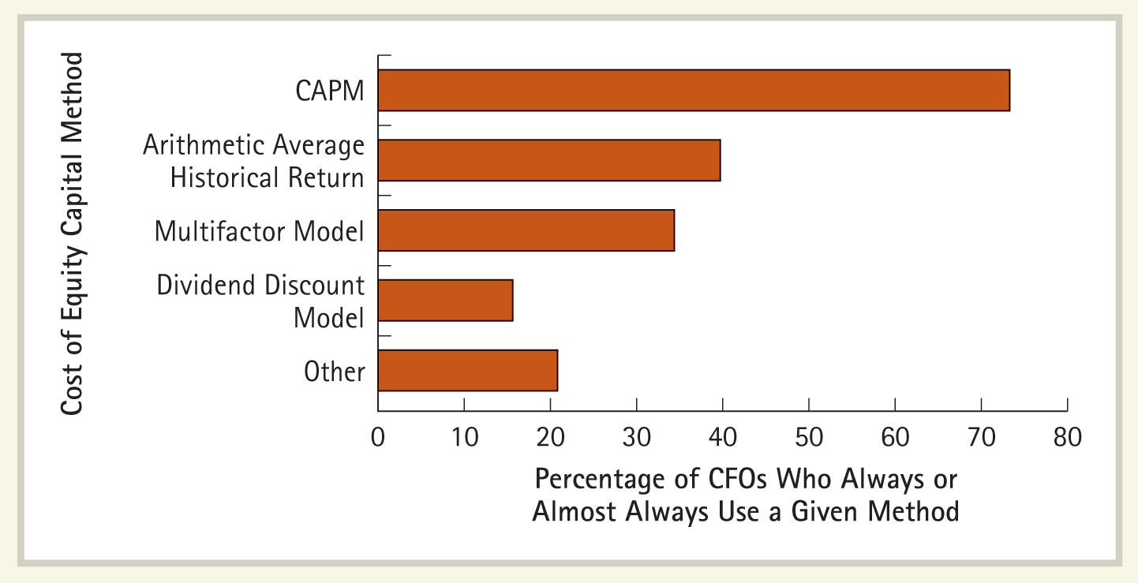
How Firms Calculate the Cost of Capital
75
The figure shows the percentage of firms that use the CAPM, multifactor models, the historical average return, and the dividend discount model. Because practitioners often refer to characteristic variable models as factor models, the multifactor model characterization includes characteristic variable models. The dividend discount model is presented in Chapter 9.
Source: J. R. Graham and C. R. Harvey, “The Theory and Practice of Corporate Finance: Evidence from the Field,” Journal of Financial Economics 60 (2001): 187–243.

